Slide 1
Aspect-Based Sentiment Analysis using BERT
Raja Vara Siddi Varma Nadimpalli
Roux Institute, Northeastern University
CS6120 - Project
April 2025

Slide 2
Abstract
Fine-tuned BERT for Aspect-Based Sentiment Analysis (ABSA).
Used Amazon Polarity dataset with simulated aspects.
Achieved ~80% accuracy and 0.78 F1-score.
Training visualized with wandb.ai.

Slide 3
Introduction
ABSA = Fine-grained sentiment analysis on specific features.
Useful for understanding user opinions at a detailed level.
BERT enables context-aware encoding of aspect-sentiment pairs.
Project goal: build a compact, effective ABSA model.

Slide 4
Dataset Overview
Source: Amazon Polarity dataset via Hugging Face.
3000 samples used(out of 10000), 5 simulated aspects.
Class Labels: Negative (0), Neutral (1), Positive (2).
Balanced class distribution: 40% pos, 40% neg, 20% neutral.
Avg. review length: 86 words, vocab size: ~23,500

Slide 5
Input Format & Preprocessing
Input format: '[aspect]: [review text]'.
Encourages BERT to focus on specified aspect.
Used bert-base-uncased tokenizer (max length = 128).
Tokenized, padded, and truncated uniformly.

Slide 6
Model Architecture
Encoder: bert-base-uncased (12-layer Transformer).
Decoder: Linear layer on [CLS] output + softmax.
Dropout (0.1) to prevent overfitting.
Optimizer: AdamW with learning rate 5e-5.
Loss: Cross-entropy.

Slide 7
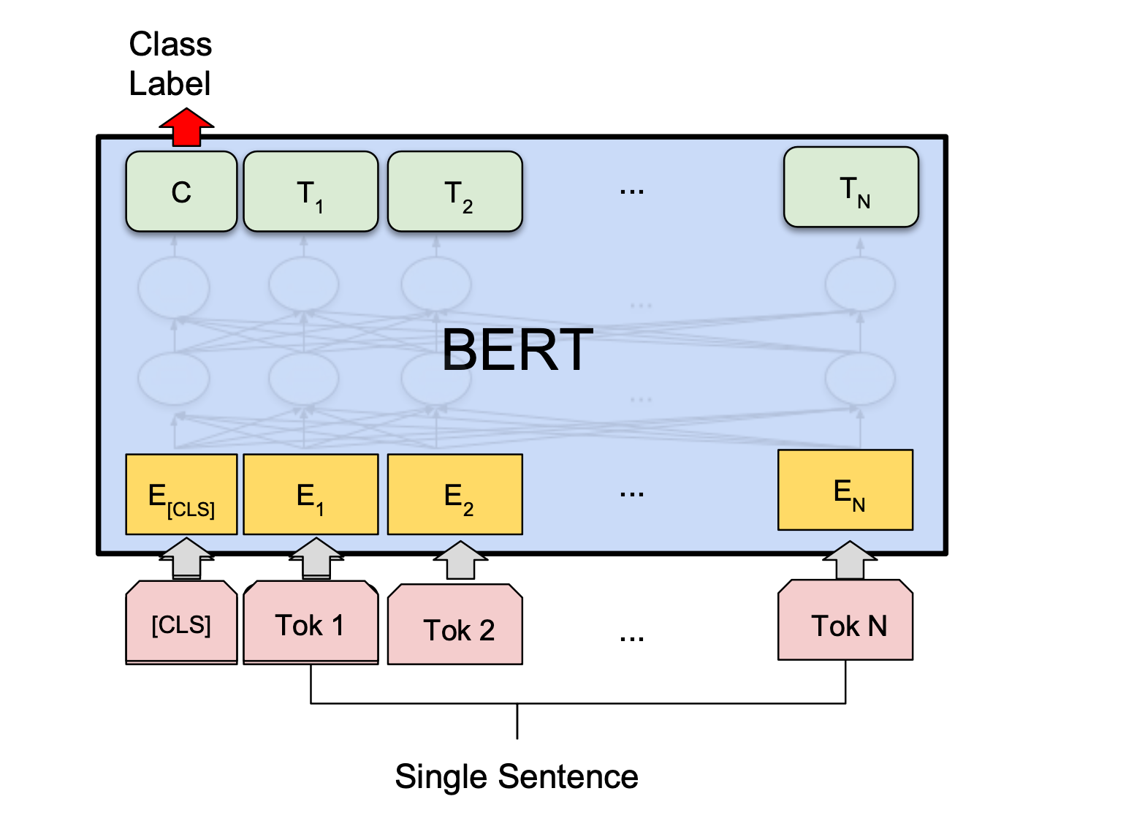
Source: https://api.wandb.ai/files/mukilan/images/projects/36846249/54b8fcd4.png

Slide 8
Training Setup
Batch Size: 8.
Validation split: 20%.
Metrics: Accuracy and Weighted F1.
Tracked via wandb.ai: loss, learning rate, gradients.

Slide 9
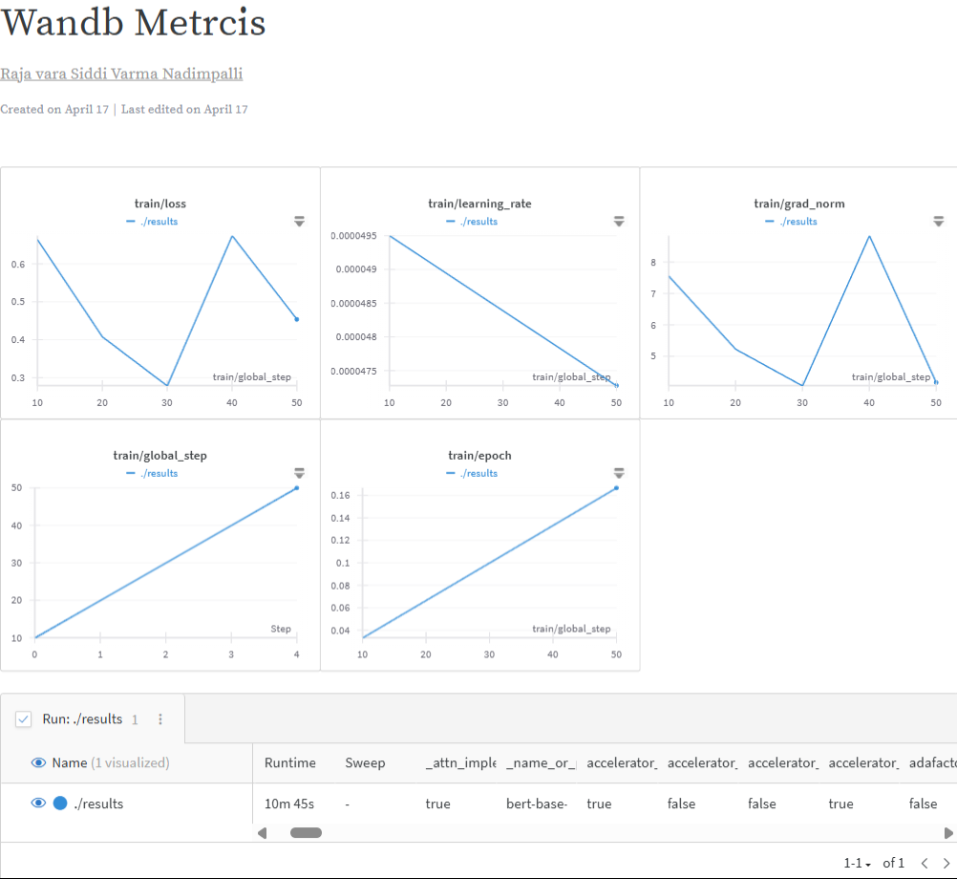
Training Metrics

Slide 10
Results
Validation Accuracy: ~80%
F1 Score: ~0.78
Eval loss: 0.44
Model generalized well across all aspects.

Slide 11
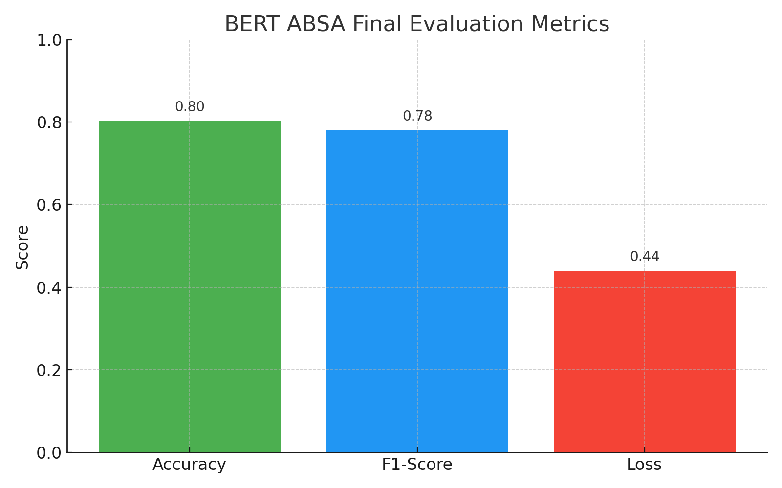

Slide 12
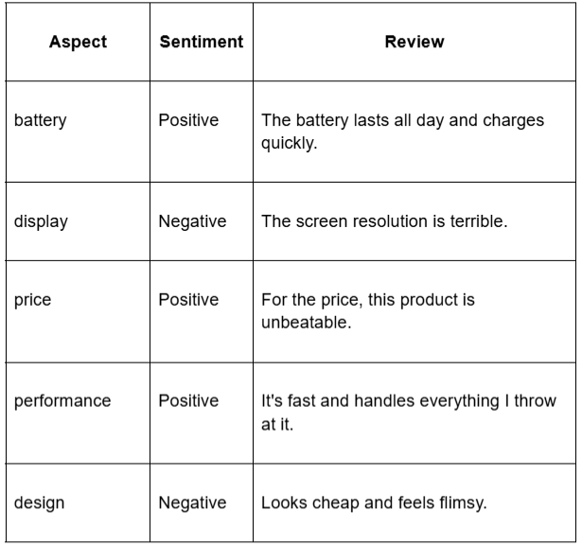
Example Predictions

Slide 13
Discussion
BERT captured aspect-sentiment relationships effectively.
Input formatting was key to model performance.
Converged quickly, minimal overfitting.
Limitations: synthetic aspects, simple decoder head.

Slide 14
Future Work
Use real-world aspect-labeled datasets (SemEval).
Explore joint aspect + sentiment extraction.
Multilingual expansion (e.g., XLM-R).
Model interpretability with attention visualizations.

Slide 15
Conclusion
Small-scale BERT ABSA system shows strong performance.
Effective for rapid prototyping and feedback analytics.
Flexible and extendable to richer tasks.

Slide 16
Tools & References
Hugging Face Transformers, Datasets
Weights & Biases for training logs
GitHub Repo: github.com/RajaNadimpoalli/bert-absa

