Slide 1
AI ENHANCED DEBUGGING AND CODE TRANSLATION
Project Presented By
Pranav VS 312321205121
Raja N 312321205128
Mentor:
Mrs. Shoba Rajendran (M.E)
ASSITANT PROFESSOR

Slide 2
Abstract
Software development workflows are being revolutionized by artificial intelligence (AI) through the "AI Enhanced Debugging and Code Translation" initiative. The project streamlines debugging procedures and improves code quality by automating error detection, diagnosis, and optimization operations through the integration of sophisticated AI-driven technologies. Furthermore, the project enables smooth code translation across different programming languages, enabling developers to collaborate across many settings and platforms. The user interface improves developer productivity and experience by offering interactive feedback and visualizations. The initiative seeks to enhance software development processes and promote creativity within the programming community by means of cycles of iterative refinement and continual improvement. The project makes software development more efficient and inclusive by democratizing access to AI-enhanced capabilities.

Slide 3
Automated Error Detection and Diagnosis
Efficient Identification of Code Errors and Anomalies
Our project harnesses the power of the Claude 3 Sonnet AI model to autonomously scan and analyze code, efficiently identifying errors, bugs, and potential issues.
This AI-driven approach significantly reduces manual effort and accelerates the error detection phase of software development.
Detailed Error Explanations and Suggestions for Fixes
Leveraging Claude 3 Sonnet's capabilities, our system provides developers with detailed explanations of detected issues, including line-by-line analysis and contextual insights.
Additionally, the AI model offers actionable suggestions for fixing identified errors, guiding developers towards effective resolution strategies.

Slide 4
Code Optimization with Claude 3 Sonnet
Code optimization is the process of improving code quality, performance, and efficiency to enhance software functionality and maintainability.
Automated Analysis:
Claude 3 Sonnet performs automated analysis of code to identify inefficiencies, performance bottlenecks, and areas for improvement.
Optimization Recommendations:
Based on the analysis, the model suggests optimization strategies such as refactoring, algorithm improvements, and resource management techniques.
Algorithmic Insight:
The model leverages deep learning algorithms to gain insights into code structures and patterns, enabling targeted optimization recommendations.
Code Refactoring:
Claude 3 Sonnet provides suggestions for refactoring code to enhance readability, maintainability, and efficiency.

Slide 5
Code Translation Across Different Languages
Code translation is the process of converting code from one programming language to another while preserving its functionality and logic.
Cross-Language Conversion:
Claude 3 Sonnet specializes in cross-language code translation, enabling seamless conversion between different programming languages.
Syntax Adaptation:
The model adapts code syntax and conventions from the source language to the target language, ensuring compatibility and correctness across diverse language ecosystems.
Semantic Understanding:
Claude 3 Sonnet leverages advanced natural language processing (NLP) techniques to understand the semantic meaning of code, facilitating accurate translation across languages.
Preservation of Core Logic:
During translation, the model preserves the core logic and functionality of the code, maintaining its original purpose and behavior in the target language.

Slide 6
Conversational Chatbot
The chatbot plays a pivotal role in enhancing the overall user experience and providing valuable assistance to developers and users.
24/7 Support and Assistance:
The chatbot serves as a round-the-clock support system, enabling users to seek assistance and get answers to their queries at any time. This ensures continuous availability and accessibility of support resources.
Educational Resource:
The chatbot serves as an educational resource by offering explanations, tutorials, and code examples based on user queries. This helps users learn new concepts, understand best practices, and improve their coding skills.
Feedback and Improvement:
The chatbot can collect user feedback and usage data, enabling continuous improvement of the system. This feedback loop helps in refining the chatbot's responses, expanding its capabilities, and enhancing user satisfaction.

Slide 7
Integration with Other Tools:
The chatbot can be integrated with other development tools and platforms, providing seamless interactions and extending its functionality across different environments.
Error Resolution and Troubleshooting:
The chatbot is equipped to handle error resolution by providing detailed explanations and suggestions for fixing code-related issues. Users can describe the problem they are facing, and the chatbot can offer insights and potential solutions based on AI-driven analysis.
The chatbot acts as an intelligent assistant, leveraging AI technologies to support developers in their coding tasks, problem-solving efforts, and learning endeavors within our project environment. Its versatile capabilities enhance productivity, foster learning, and contribute to a more efficient and engaging development experience.

Slide 8

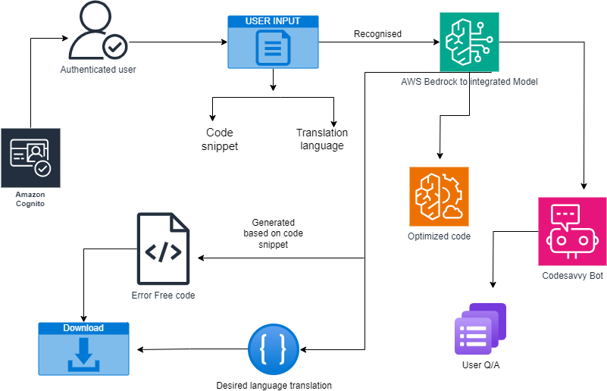
Architecture Diagram

Slide 9
Anthropic AI Model
The Anthropic AI Model is an advanced artificial intelligence framework designed to mimic human-like cognitive abilities and reasoning processes in machines.
Human-like Cognition:
The model incorporates principles of human cognition, including perception, reasoning, learning, and problem-solving.
Contextual Understanding:
It excels at understanding and interpreting context within data, enabling nuanced decision-making and behavior.
Enhanced User Experience:
By emulating human-like cognitive abilities, the Anthropic AI Model enhances user interactions with AI systems, making them more intuitive and natural.

Slide 10
Applications and Use Cases
Natural Language Processing (NLP):
The Anthropic AI Model powers advanced NLP applications, enabling machines to understand and generate human-like text with context and coherence.
Computer Vision:
In computer vision tasks, the model demonstrates human-like visual perception and object recognition capabilities.
Decision-Making:
The model supports complex decision-making processes, analyzing vast datasets to provide informed recommendations and actions.
Improved Problem-Solving:
The model's contextual understanding and reasoning capabilities lead to improved problem-solving in diverse domains, from healthcare to finance.

Slide 11
Claude 3 Sonnet AI Model
Claude 3 Sonnet is an advanced AI model developed for text summarization, code generation, and code analysis tasks.
Text Summarization:
The model excels at summarizing large volumes of text, distilling key information into concise summaries.
Code Generation:
Claude 3 Sonnet can generate code snippets based on input specifications and requirements.
Code Analysis:
It performs code analysis to identify patterns, anomalies, and optimization opportunities.

Slide 12
What is PartyRock…?
PartyRock is a playground offered by Amazon Web Services (AWS) that allows you to experiment with generative AI in a fun and intuitive way . Generative AI is a type of artificial intelligence that can be used to create new things, like text, code, or images.

Slide 13
Key features of PartyRock:
No coding required:
You can build generative AI apps without writing any code . PartyRock provides a user-friendly interface that lets you drag and drop different elements to create your app.
Access to powerful AI models:
PartyRock gives you access to foundation models from Amazon Bedrock, which are powerful AI models that can be used for a variety of tasks.
Easy to share:
You can easily share the apps you create with others using a single click.
Overall, PartyRock is a great way to get started with generative AI, even if you have no prior experience. You can use it to learn about the basics of generative AI and to build your own creative applications.

Slide 14
Amazon Bedrock
Amazon Bedrock is a relatively new service from Amazon Web Services (AWS) that simplifies building generative AI applications. Here's a breakdown of what it offers:
What is it?
A fully managed service for generative AI development .
Provides access to pre-trained foundation models (FMs) through a single API. FMs are powerful AI models trained on massive amounts of data, forming the groundwork for various applications.

Slide 15
Benefits of using Amazon Bedrock:
Choice of FMs:
Bedrock offers FMs from leading AI companies like Anthropic, Stability AI, and Amazon itself . This allows you to pick the model that best suits your needs.
Ease of Use:
It's serverless, so you don't need to manage infrastructure.
Security & Privacy:
Built with security in mind to protect sensitive data .
Faster Development:
By using pre-trained models, you can develop generative AI applications quicker than building from scratch.
Focus on Customization:
Bedrock allows you to add your own data to the FMs for fine-tuning and building unique applications.

Slide 16
Time Complexity
Time complexity measures the amount of time an algorithm takes to run as a function of the length of its input.
Big O Notation:
It represents an upper bound on the runtime of the algorithm relative to the size of the input (n).
Constant Time O(1):
Operations that take the same amount of time regardless of the input size.
Linear Time O(n):
Operations that scale linearly with the input size.
Quadratic Time O(n^2):
Operations that scale quadratically with the input size, common in nested loops.

Slide 17
Space Complexity
Space complexity measures the amount of memory space required by an algorithm relative to the size of its input.
Big O Notation:
It represents an upper bound on the memory usage of the algorithm relative to the input size (n).
Constant Space O(1):
Algorithms that use a fixed amount of memory regardless of input size.
Linear Space O(n):
Algorithms that use space linearly proportional to the input size.
Quadratic Space O(n^2):
Algorithms that use space proportional to the square of the input size, common in nested data structures.

Slide 18
THANK YOU

