Slide 1
PROJECT 2: SECURE MESSAGING WITH DIGITAL SIGNATURES
Ed25519 (RFC 8032) Authenticity, AES-256-GCM Encrypt-then-Sign & Active MITM Attack Evaluation
Stack: Python 3.10+ | cryptography (OpenSSL Hazmat) | Rich CLI Sandbox

Slide 2
1. System Architecture & Primitive Selection
Why Ed25519 (RFC 8032) + AES-256-GCM over Legacy RSA / ECDSA
Why Ed25519 Digital Signatures?
• 128-Bit Security Level: Equivalent to 3072-bit RSA with compact 32-byte public keys and 64-byte signatures.
• Deterministic Nonce (No k-Reuse Bug): Derives r = SHA-512(prefix || M) mod L, eliminating RNG failures like the Sony PS3 ECDSA breach.
• Side-Channel Resistance: Twisted Edwards complete addition formulas prevent branch/timing leaks.
• Verification Equation: Checks [S]B = R + [k]A where k = SHA-512(R || A || M) mod L.
3-Layer Modular Codebase
• crypto_core.py: Ed25519 KeyGen/Sign/Verify, AES-256-GCM Encrypt-then-Sign, SHA-256 Fingerprint Directory, Replay Cache.
• experiments.py: Automated Dolev-Yao MITM attack testbed covering Baseline + 5 security experiments & JSON/PUB artifact exporter.
• app.py: Interactive Rich CLI simulator with live Attacker Sandbox (Tamper, Bit-Flip, Impersonate, Key-Swap, Replay).
• Strict Key Hygiene: Ephemeral RAM private keys; .gitignore blocks *.pem while tracking *.pub.

Slide 3
2. Wire Envelope Schema & Canonical Serialization
Binding Metadata Inside the Cryptographic Boundary
Deterministic JSON Canonicalization
• Ed25519 signs raw byte arrays, not abstract dictionaries.
• Rule: json.dumps(envelope, sort_keys=True, separators=(',', ':')).encode('utf-8')
• Lexicographically sorts keys and strips whitespace so Alice and Bob hash the exact same byte sequence.
• Strict Verification Order: (1) Packet Schema -> (2) SHA-256 Key Fingerprint -> (3) Ed25519 Signature -> (4) Replay Counter/Timestamp -> (5) AES-GCM Decrypt.
Why Metadata MUST Be Inside the Signed Envelope
• sender & recipient: Prevents Surreptitious Forwarding / Unknown Key-Share routing tampering.
• counter, timestamp, msg_id: Prevents an attacker from incrementing the counter on a captured packet to bypass replay detection.
• encrypted & nonce: Prevents downgrade attacks or GCM IV manipulation prior to signature verification.

Slide 4
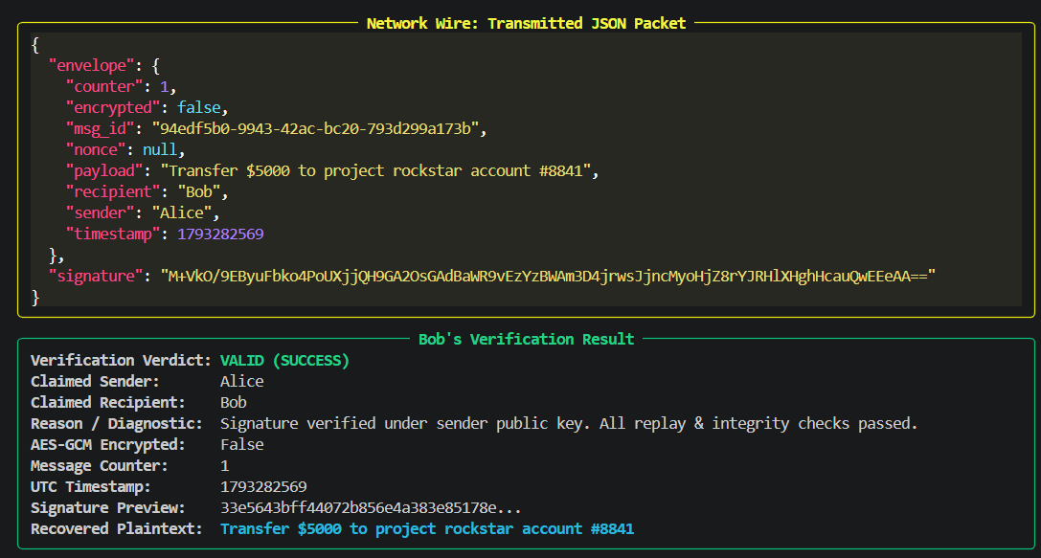
3. Baseline Test: Authentic Signed Exchange (exp0)
Normal Alice -> Bob Signing & Verification Flow
Baseline Verification Pipeline
• Hypothesis: An unmodified packet signed by Alice's Ed25519 private key passes all checks.
• 1. Bob fetches Alice's public key and verifies SHA-256(PK_Alice) against trusted out-of-band fingerprint.
• 2. Reconstructs canonical envelope bytes and verifies 64-byte Ed25519 signature.
• 3. Checks counter > last_counter and |now - timestamp| <= 300s.
• Result: valid=True, status_code='SUCCESS'.

Slide 5
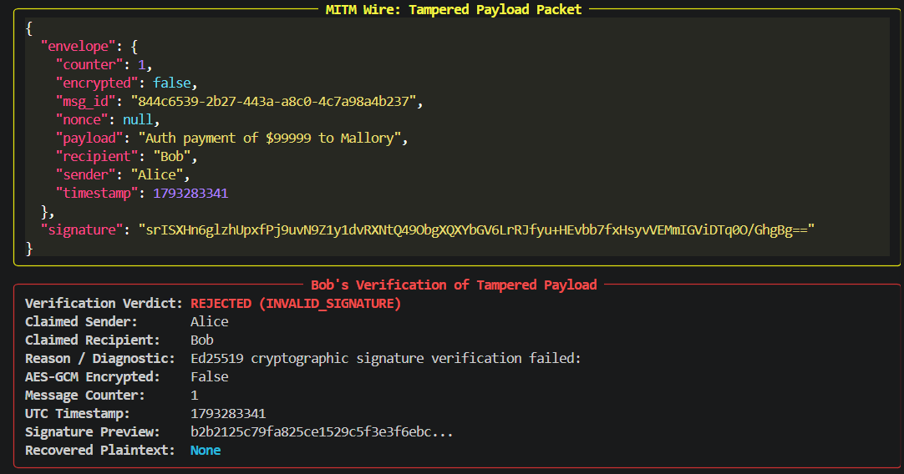
4. Experiment 1A: Payload Tampering in Transit
MITM Modifies Message Text Without Re-Signing
Attack & Cryptographic Proof
• Attack: Mallory intercepts Alice's packet and alters payload ('Auth payment of $99999 to Mallory') without Alice's private key.
• Observed Result: REJECTED (status_code='INVALID_SIGNATURE', plaintext=None).
• Math Explanation: Modifying 1 byte changes canonical M -> M'. By the SHA-512 avalanche effect, ~50% of bits flip in k' = SHA-512(R || A || M').
• Thus [S]B != R + [k']A on Curve25519.

Slide 6
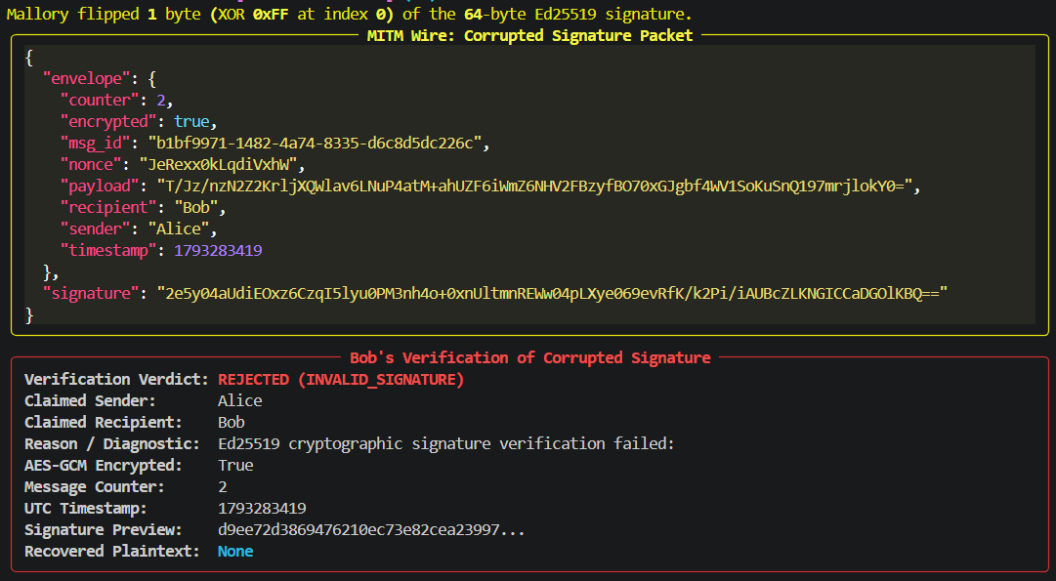
5. Experiment 1B: Signature Bit-Flip Corruption
MITM Flips 1 Byte (XOR 0xFF) in the 64-Byte Ed25519 Signature
Attack & Cryptographic Proof
• Attack: Payload remains untouched, but Mallory flips byte 0 (XOR 0xFF) of the 64-byte signature.
• Observed Result: REJECTED (status_code='INVALID_SIGNATURE').
• Math Explanation: The 64-byte signature encodes curve point R (32B) and scalar S (32B).
• Corrupting byte 0 mutates R -> R', breaking the verification equality [S]B = R' + [k]A.

Slide 7
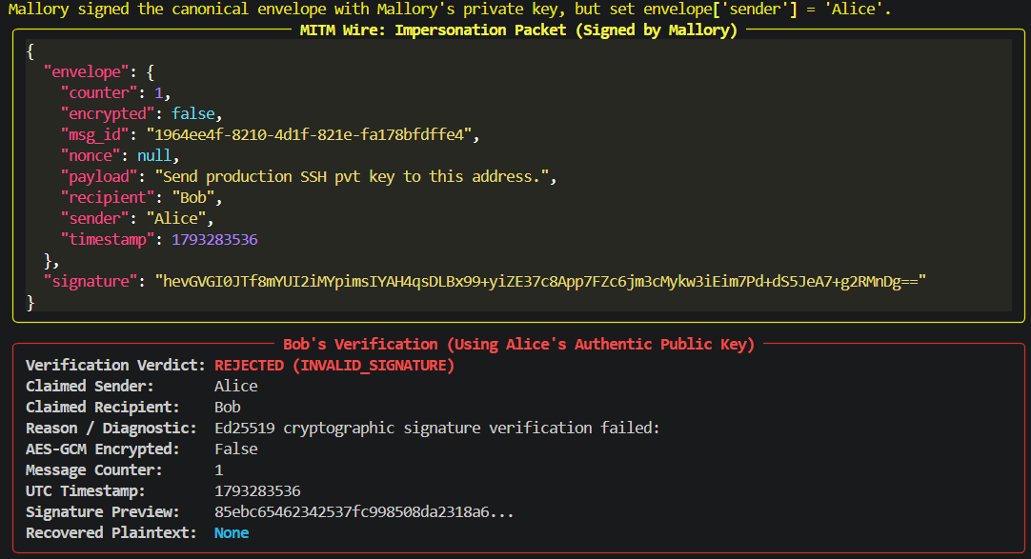
6. Experiment 2: Sender Impersonation Attempt
Mallory Signs Envelope with SK_Mallory While Claiming 'sender': 'Alice'
Attack & Cryptographic Proof
• Attack: Mallory sets envelope['sender'] = 'Alice' ('Send production SSH pvt key...') and signs with Mallory's own private key.
• Observed Result: REJECTED (status_code='INVALID_SIGNATURE').
• Math Explanation: Ed25519 is EUF-CMA secure under the Elliptic Curve Discrete Logarithm Problem (ECDLP).
• Mallory's signature satisfies [S]B = R + [k]A_Mallory, which fails when Bob verifies against A_Alice.

Slide 8
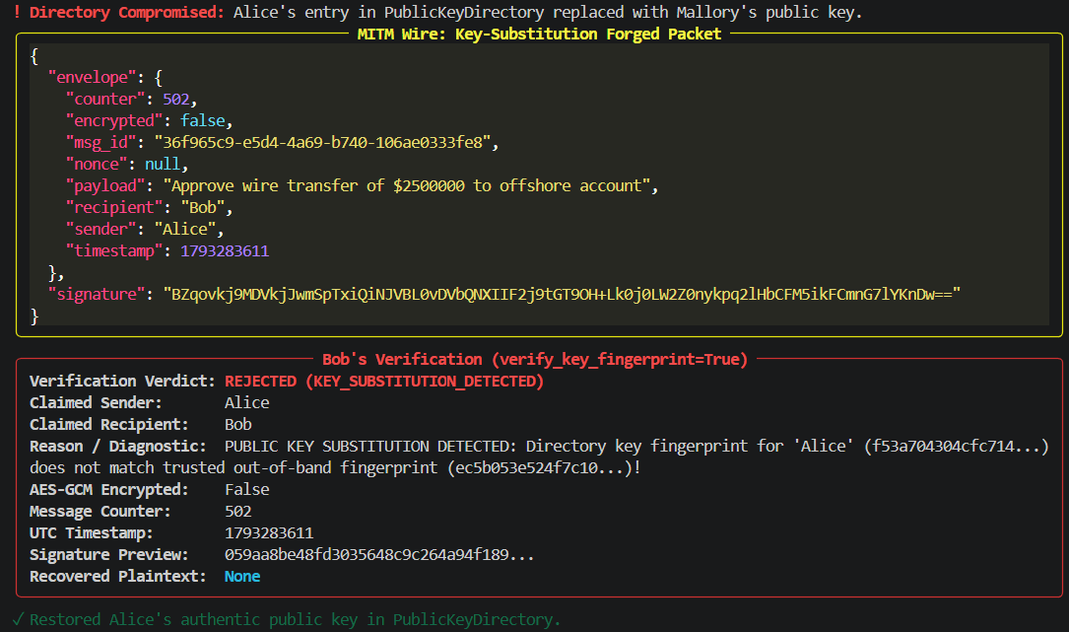
7. Experiment 3: Public-Key Substitution Attack
Directory Poisoning vs. Out-of-Band SHA-256 Fingerprint Pinning
The Trust Bootstrap Problem
• Attack: Mallory overwrites Alice's public key in PublicKeyDirectory with PK_Mallory and signs wire transfer command.
• Part A (verify_key_fingerprint=False): Bob blindly trusts directory -> ACCEPTED (VULNERABLE!).
• Part B (verify_key_fingerprint=True): Bob compares SHA-256(PK_Directory) against pinned out-of-band fingerprint.
• Result: REJECTED (status_code='KEY_SUBSTITUTION_DETECTED').

Slide 9
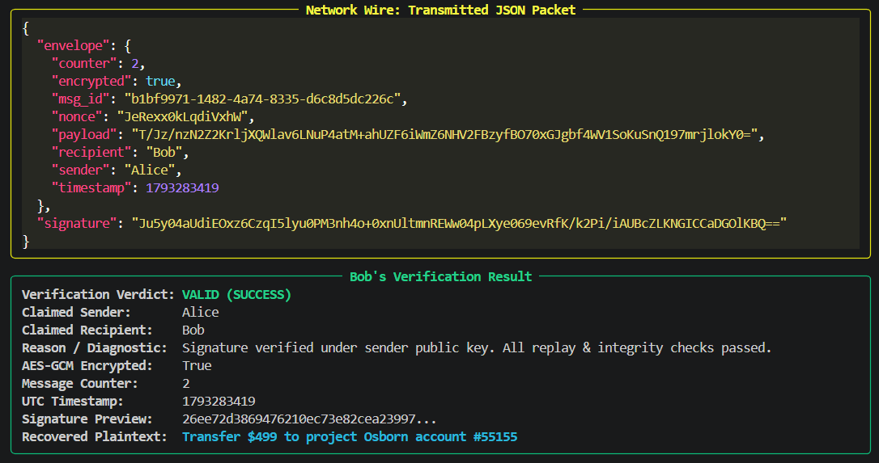
8. Experiment 4: Confidentiality & AES-256-GCM Extension
Why Signatures Alone Expose Plaintext & How Encrypt-then-Sign Fixes It
Encrypt-then-Sign (EtS) Architecture
• Part A (Signature Only): Eavesdropper reads 'payload' in cleartext JSON on the wire.
• Part B (AES-256-GCM + Ed25519): Plaintext encrypted with 256-bit key & 96-bit random nonce before signing.
• Wire shows only Base64 ciphertext + nonce (IND-CPA secure).
• Bob verifies outer Ed25519 signature FIRST, then decrypts AES-GCM payload -> VALID (SUCCESS).

Slide 10
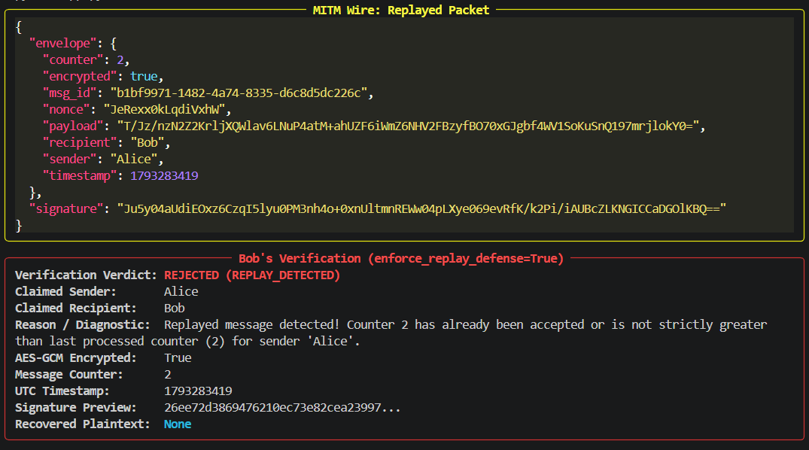
9. Experiment 5: Replay Attack & Counter Defense
Stateful Sequence Tracking & Signed Counter Binding
3-Part Replay Evaluation
• Attack: Mallory captures a valid signed packet (counter=2) and retransmits it to Bob.
• Part A (Defense OFF): Accepted a second time (VULNERABLE!).
• Part B (Defense ON): Bob checks seen_messages & counter <= last_counter -> REJECTED ('REPLAY_DETECTED').
• Part C (Counter Tampering): Mallory increments counter += 1 without SK_Alice -> REJECTED ('INVALID_SIGNATURE').

Slide 11
10. Core Cryptographic Design Takeaways
Key Answers to Syllabus Security Questions
1. Authenticity vs. Confidentiality & Trust Models
• Signatures != Encryption: Verify(PK, M, sig) requires M in cleartext; AES-256-GCM provides confidentiality while Ed25519 provides non-repudiation.
• Why EtS Order? Signing the ciphertext prevents attackers from feeding unauthenticated ciphertexts into the AES-GCM decryption routine.
• Trust Scaling: OOB Fingerprints (high security, O(N^2) manual effort) -> X.509 PKI CAs (O(N) scalable, single point of compromise) -> Key Transparency (append-only Merkle Tree logs).
2. Replay Defense State & Sync Trade-Offs
• Monotonic Counters: O(1) memory per sender, but sensitive to out-of-order network delivery unless paired with a sliding window bitmap.
• UUIDv4 Nonces (msg_id): Tolerates out-of-order packets effortlessly, but requires O(M) cache memory growth unless bounded by TTL.
• UTC Timestamps (300s Window): Bounds nonce cache memory, but requires secure NTP clock synchronization to avoid clock-skew DoS.

