Slide 1
Information Security Overview
Date: November 8, 2026

Slide 2
What Is Information?
“Information is an asset which, like other important business assets, has value to an organization and consequently needs to be suitably protected”
- BS ISO 17799-1-2000
Notes:
The ISO 17799 Standard defines information as follows:
Information needs to be treated on par with any other business asset, and appropriately protected.

Slide 3
Information Comes in Many Forms
Programs
E-mails
FAX messages
Voice Mails
NDAs / Contracts / Letters /memos / reports
Printed documents
Word processing documents
Spreadsheets
Graphics / Drawings
Presentations
Web Pages
Notes:
This slide gives details of the different forms of Information.

Slide 4
Where Does This Information Reside?
On the hard disks of
  Servers
  Desktops
  Notebooks
In back up media
  Tapes
  DATs
  CDs
  Floppies/Flash Memory
Documents
  Reports
  Forms
Notes:
As the previous slide shows what are the different forms of information. This slide gives details of some of the media types on which this information resides.

Slide 5

What Is Information Security?
Protection of information, systems and services against disruption and degradation due to disasters, mistakes or manipulation so that the likelihood and impact of security incidents are minimized.
Notes:
IT security measures help in protection of information, systems and services against disruption and degradation due to disasters, mistakes or manipulation so that the likelihood and impact of security incidents is minimized.
Since 100% security in unachievable, organizations should plan for minimizing the likelihood of security incidents, and reducing their impact should them occur.

Slide 6
Attributes of Information Security
Information security is the preservation of:
a) Confidentiality: ensuring that information is accessible only to those authorized to have access
b) Integrity: safeguarding the accuracy and completeness of information and processing methods;
c) Availability: ensuring that authorized users have access to information and associated assets when required.
Notes:
Confidentiality, Integrity and Availability are the three key elements of information security.
Confidentiality - Information should be protected from the eyes of unauthorized internal users, external hackers and from being intercepted during transmission on communication networks. The content should be protected from unauthorized access and/ or be transformed in such a way that it is not decipherable by anyone who does not know the transformation algorithm.
Integrity – Data and information within an information system should be correct and valid. This requirement is known as integrity. On receipt at the other end of a communication network, the information should appear exactly as was sent. Suitable mechanisms are required to ensure end-to-end message content and copy authentication.
Availability - The information that is stored in an information system or transmitted across networks should be available whenever required and to whatever extent as desired within pre-established time constraints.

Slide 7
Risk Vs Vulnerability & Threat
Gives rise to
Threat Agent
Exploits
Threat
Leads to
Vulnerability
Directly affect
Risk
Can damage
Assets
Exposure
Can result in
Safeguards
Prevent or reduce exposure
Notes:
CMC Internal
Threat: An event with potential to damage any one of the three information security attributes (CIA – Confidentiality, Integrity, Vulnerability)
Vulnerability: a Weakness in a policy or a system or technology that may be exploited
Risk: The probability of a threat being exploited
If a company has antivirus software only on the servers and the virus signatures are not kept up-to-date, this is a vulnerability. The company is vulnerable to virus attacks.
The threat is a virus showing up in the environment and disrupting productivity.
The likelihood of a virus showing up the environment and causing damage is the risk.
Because there is a possibility of losing or corrupting data from a virus attack, the company now has an exposure.
The countermeasures is this situation are to update the signature and install the antivirus software on all computers.

Slide 8
Threats & Risks to Information
High User knowledge of IT sys.
Theft , Sabotage,
Misuse, Hacking
Version Control Problems
VSAT
Security
Policies
Dial In
Leased
INET
Unrestricted Access
Systems / Network Failure
Lack of documentation
Virus
Cyclone
Fire
Notes:
This slide gives some of the threats and risks to information.

Slide 9
Threats to Information
Physical Theft
  Theft of devices
  Theft of media
  Social Engineering
  Dumpster diving
Logical Theft
  Illegal copying
  Stealing password
  Hacking
  Trojan
Data Corruption
  Virus attack
  Information modification
  Forgery
  Sabotage
  Fraud

Slide 10
Challenges
Provision and demonstration of secure environment to clients/users/stakeholders
Preventing loss of product knowledge to external attacks, internal thefts
Leak of confidential information to competitor
Meeting Parent company/parent body requirements
Introduce new technologies and tools
Managing costs vs. risk
Notes:
The combination of threats and risks we have just seen poses different challenges while implementing the Information security controls.

Slide 11


Business Risks
Law suits / loss of customer confidence
Corruption / loss of integrity (e.g. s/w code)
Loss of business
  due to leakage/ theft of company IPR
  Unanticipated disruption in work due to break down of communication links
Leakage of confidential information
  e.g. financial information, business strategy
Physical damage / theft
Notes:
This slide shows some of the Business risks that a company has to face, if proper information security controls are not implemented.

Slide 12
Factors Necessitating IT Security
  Policy Vulnerabilities
  Configuration Vulnerabilities
  Technology Vulnerabilities
  And People are Eager to Take
  Advantage of the Vulnerabilities…..
Notes:
There are three primary reasons which necessitate information security.
They are – Policy Vulnerabilities, Configuration Vulnerabilities, and Technology Vulnerabilities.
Most of the organizations do not include security in their Policy Document thus leaving a large security vulnerability.
Configuration and Technology Vulnerabilities are present in all those products that are not designed with security in mind. These product vendors leave the headache of security for Organisations to handle.
According to one survey, 90% of the problems are because of two reasons:
Improper configuration, and
Not applying patches as and when they are released by the vendors

Slide 13
Its Easier to Hack now
High
Tools
“Stealth”/advanced
scanning techniques
Distributed
attack tools
Denial of Service
WWW attacks
Automated probes/scan
Packet Spoofing
GUI
Sniffers
Network Mgmt Diagnostics
Attack Sophistication
Sweepers
Back doors
Hijacking Sessions
Disabling Audits
Burglaries
Exploiting Known Vulnerabilities
Password Cracking
Self-replicating code
Attacker’s
Knowledge
Password Guessing
Low
1980
1985
1990
1995
2000
2005
Notes:
Over the last two decades, attack sophistication has been on the increase as more and more tools are made available. The knowledge required by attackers to launch a sophisticated attack has been on the decrease over the same period. In other words, over the last two decades, the increase in attack sophistication has been inversely proportional with the knowledge required by attackers to launch a sophisticated attack.

Slide 14
Opportunities for Attacks
Internet attacks are easy, low risk, and hard to trace
Attack tools are sophisticated, easy to use even by novice attackers
the complexity of the Internet, protocols, and applications are all increasing
Rapid adoption of computer and network technology
Notes:
There are various kinds of attacks, some of the most common are:
Scanning, Denial of Service, Distributed Denial of Service, Buffer Overflow, and Packet Sniffing.
We will discuss each of these attacks in detail in subsequent slides.

Slide 15
Opportunities for Attacks
Thousands of exploitable vulnerabilities in technology
Lack of awareness regarding information security
Shortage of qualified system and network administrators and information security staff
Lack of coordinated effort in organizations to protect, detect, analyze, and respond to computer security events
Notes:
There are various kinds of attacks, some of the most common are:
Scanning, Denial of Service, Distributed Denial of Service, Buffer Overflow, and Packet Sniffing.
We will discuss each of these attacks in detail in subsequent slides.

Slide 16
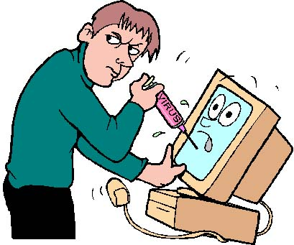


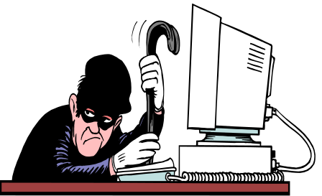

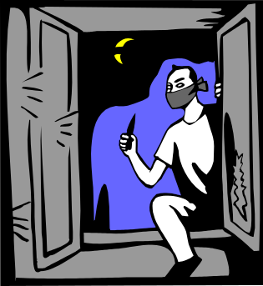
^{Fiddlers}
^{Insiders}
Types of
Attacker
^{Intruders}
^{Vandals}
^{Spies}
^{Criminals}
Notes:
Hackers of various kinds with different motivation factors which drive their behavior.
Insiders are the ones who belong to the organizations, are most trusted. Their motivation is to know more about a particular employee, company or some sort of a financial gain. They are most dangerous as they can work in promiscuous mode for a long time before their activities can be tracked.
Intruders are the type of attackers who would gain access into your system from outside and would like to compromise your systems to gain advantage of your systems. The main motive of Intruders is to gain access to systems for self ego, proving point to colleagues and some time for financial gain.
Criminals are usually involved in theft and would work only with one motive “Financial Gain”. They usually don’t understand the gain they could make with the information but would like to gain financially by selling their loot.
Spies work for competitors to gain information that would give them competitive advantage. This competitive advantage could be in terms of contract documents, product development documents etc.
Vandals are determined to bring your system down. They do most harm on the availability of the system. They may even go to an extent of physically harming the system.
Fiddlers do harm to the system unknowingly. They are not trying to bring the system down but do you some act of theirs the system is compromised. This is usually what happens when a system is handled by a person who does not know how to handle it.

Slide 17

Cost of Security
  Combination of many factors
    Cost for decreased system performance
    Cost for increased system complexity
    Cost for decreased system usability
    Increased operation and maintenance cost.
  Increased security increases the cost of the system
Notes:
Security requirements differ from system to system based on applications. Like electronic fund transfer (EFT), reservation system and control systems. Also decisive is, the amount of money the owner of the system is willing to spend for ensuring security of information.
There exists no absolute reliable and secure system. Intuitively, a secure system is a system where an intruder has to spend an unacceptable amount of time and money in order to make an intrusion.
Increased security increases the cost of the system. The amount of investment should be made with relevant care and selecting relevant model, by valuating the cost of information, taking into account all tangible and intangible benefits.
The cost of security is a combination of several factors, for example cost for decreased system performance; cost for increased system complexity; cost for decreased system usability and increased operation and maintenance cost. In order to make the system highly secure, one has to remove some of the most important functionality of the system and that in turn may increase cost because of low usability. The most classic example may be Internet connectivity.

Slide 18
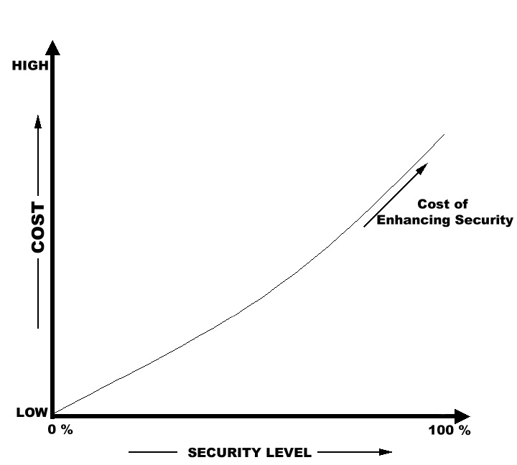
Cost of Security
Security Vs Cost
Cost for Enhancing Security increases proportional to the level of security required
Notes:
This graph gives a direct relationship between cost and security level. The higher the security level of the systems, higher would be the cost of enhancing security.

Slide 19
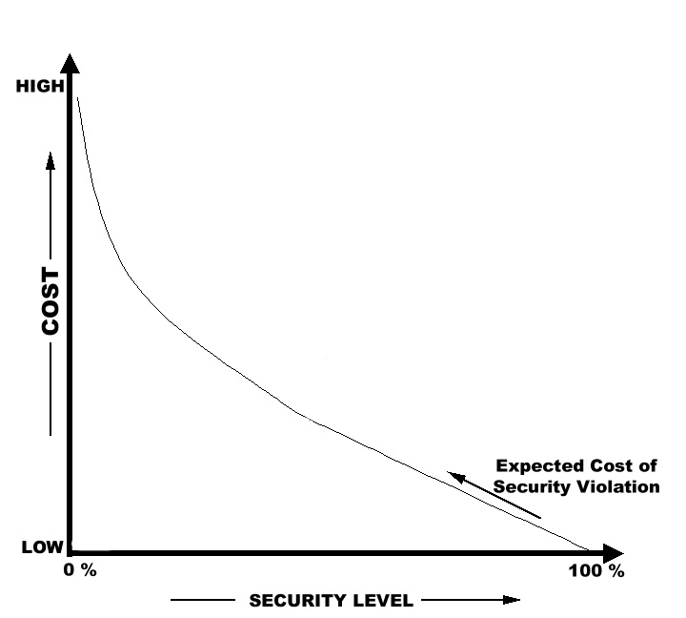
Cost of Security
Security Vs Cost
Cost incurred due to Security Violation, increases sharply if the security level is low
Notes:
The graph shows a direct exponential relationship between the Security Violation and Cost. If the preparedness for a security incident is low i.e. security level is low, the cost and effort required to restore systems back to their original state would be very high compared to the systems where some security level is already provided.

Slide 20
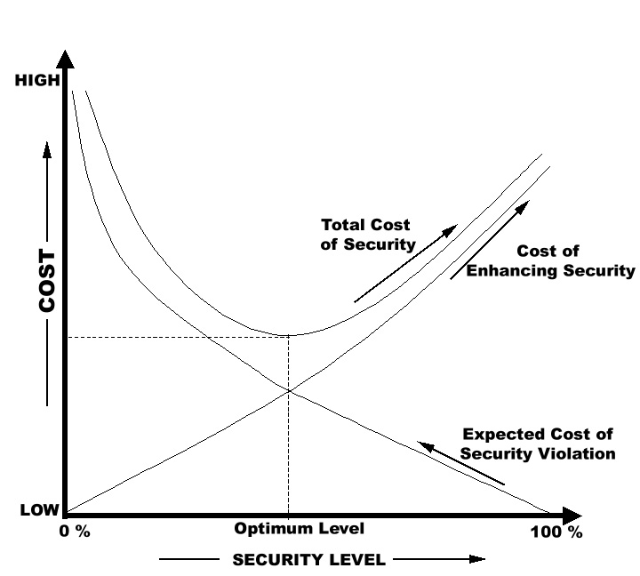
Cost of Security
Security Vs Cost
Total Cost of Security
= Cost of Enhancing Security + Expected Cost of Security Violation
Notes:
Goal of any security measure would be to balance the Total Cost of Security. If you add the Cost of Enhancing Security and Expected Cost of Security Violation you will reach to a optimum level where Total Cost of Security is minimum. It is always advisable to workout a optimal level of Total Cost of Security for your organization before implementing Security measures. It is always advisable not to spend money beyond the value of Information Asset on protecting the Information Asset.

Slide 21
The 4 Ps of Security
  People (culture, knowledge),
  Processes (procedures and guidelines),
  Products (hardware, software, n/w), and
  Partners (vendors and outsourcing organisations).
Notes:
This slide talks about the 4 Ps of Information Security.
People : People should be aware of what to do and what not to do to protect information
Processes : Suitable processes such as policies, procedures and guidelines should be adopted to protect the information
Products : Suitable products such as anti-virus, firewall, IDS etc. has to be implemented to protect the information
Partners: Suitable agreements (NDAs, contracts) should be in place when vendors and outsourcing organisations has access to our information.
According to a survey, tools can only address about 15% of the problems. Any idea who takes care of the rest of the problems?
It is human beings.

Slide 22
Information Security Controls
Information security is achieved by implementing a suitable set of controls.
A control could be a:
  policy,
  procedure,
  process,
  organizational structure, and
  software or hardware function
Notes:
We have discussed what is information, what is information security, security threats and risks. Now, we will see how to achieve information security. Information Security can be achieved by implementing suitable set of controls. So, what is a control?

Slide 23
Information Security Controls
Administrative Controls
Policies, standards, procedures, guidelines, screening personnel, security awareness training
Technical Controls
Logical access controls, encryption, security devices, identification and authentication
Physical Controls
Technical controls
Administrative Controls
Company Data and Assets
Physical Controls
Facility protection, security guards, locks, monitoring, environmental controls, intrusion detection
Notes:
The information security controls can be classified as physical controls, technical controls and administrative controls. These controls can be implemented to protect the company data and assets.

Slide 24
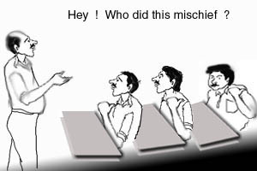
No Security Policy
Notes:
We have till now discussed the basic concepts of information security. We will now discuss security policy and their importance. Is security policy necessary. What happens if we do not have one?
If there is no security policy in an organisation, no body knows who did what. Accountability can not be established.

Slide 25
Security Policy
Security policy is an articulation of overall security objectives and provides executive guidelines.
Ensure the confidentiality, integrity, and availability of data in the organization.
Policy development must begin with the top management commitment
Notes:
Security policy can be treated as a high level document which expresses the security objectives of a company.
The main objective of security policy is to ensure the confidentiality, integrity and availability of data in the organisation.
Without Top Management commitment, Security policy cannot be implemented.

Slide 26
Security Policy
The policy defines
  What behavior is and is not allowed
  Will often set the stage in terms of what tools and procedures are needed for the organization
  Consensus among a group of governing people

Slide 27
Why Security Policy?
To demonstrate top management support
To define responsibilities and expectations
To guide security product selection and Implementation
To help prevent security incidents
To provide guidance when incidents occur
To establish basis for disciplinary actions
Notes:
What is the need for Security Policy?

Slide 28
Critical Success Factors
  Full commitment and support from top management.
  Security objectives must be in line with the business objectives
  Good understanding of security risks
  Awareness about Security policies among employees/user community.
  Comprehensive documentation.

Slide 29
What is Required?
Change in mindset (security is every body’s responsibility)
An Information Security Team
Information security awareness and education
A set of suitable Policies, Procedures and Standards supported by appropriate tools
Ongoing security management

Slide 30
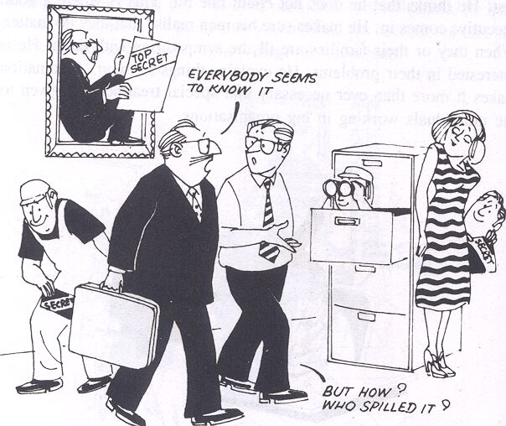
Security….?
Notes:
We would encourage you to keep your systems as secure as possible, from insiders also. The resources which are not adequately protected seems to fall apart and lead to lot of embarrassment.
If you have a breach of security please do inform it to CMCs SIRT for assistance.

Slide 31
Thank you!

