Slide 1
OO Design patterns
Acknowledgement: Freeman & Freeman

Slide 2
Adapter pattern

Slide 3
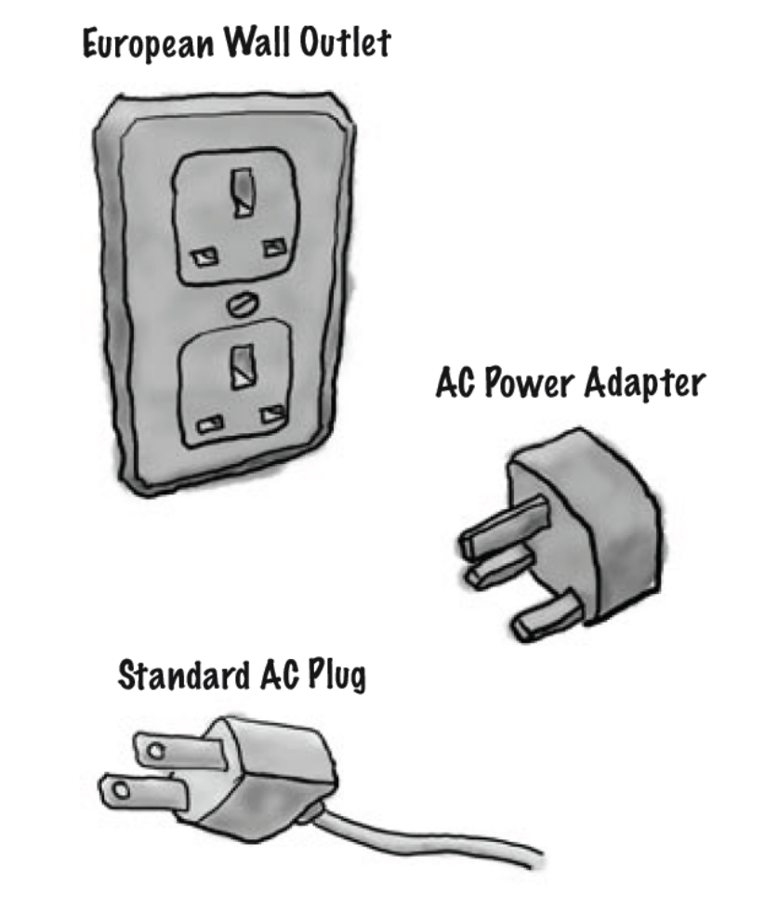
Example Scenario
The European wall outlet exposes one interface for getting power
The adapter converts one interface into another
The US laptop expects another interface

Slide 4
Adapter – in action
public interface Duck {
public void quack();
public void fly();
}
Here is a subclass of Duck
public class MallardDuck implements Duck{
public void quack() {
System.out.println(“Quack”);
}
public void fly() {
System.out.println(“Flying”);
}
}

Slide 5
Adapter – in action
public interface Turkey {
public void gobble();
public void fly();
}
Here is a subclass of Turkey
public class WildTurkey implements Turkey{
public void gobble() {
System.out.println(“Gobble gobble”);
}
public void fly() {
System.out.println(“Flying short distance”);
}
}

Slide 6
Adapter – in action
If Turkey objects are to be used instead of Duck objects
public class TurkeyAdapter implements Duck{
Turkey turkey;
public TurkeyAdapter(Turkey turkey) {
this.turkey = turkey;
}
public void quack() {
turkey.gobble();
}
public void fly() {
for (int i=0; i<10; i++) {
turkey.fly();
}
}
}

Slide 7
Adapter Pattern Explained
Adaptee
Adaptee Interface
translatedrequest()
Adapter
Target Interface
The Adapter implements the target interface and holds an instance of the Adaptee
client
request()
The client is implemented against the target interface

Slide 8
Discussion Questions
How much “adapting” does an adapter need to do? It seems like if I need to implement a large target interface, I could have a LOT of work on my hands
Does an adapter always wrap one and only one class?
What if I have old and new parts of my system, the old parts expect the old vendor interface, but we’ve already written the new parts to use the new vendor interface? It is going to get confusing using and adapter here and the unwrapped interface there. Wouldn’t I be better of just writing my older code and forgetting the adapter?

Slide 9
Adapter Pattern
An adapter pattern converts the interface of a class into an interface that a client expects
Adapters allow incompatible classes to work together
Adapters can extend the functionality of the adapted class
Commonly called “glue” or “wrapper”

Slide 10
When to Use
Need to adapt the interface of an existing class to satisfy client interface requirements
  Adapting Legacy Software
  Adapting 3rd Party Software

Slide 11
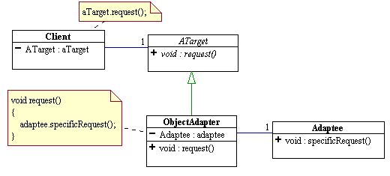
Object Adapter Pattern

Slide 12
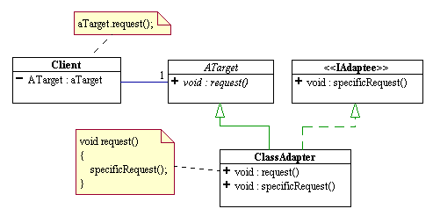
Class Adapter Pattern

Slide 13
Proxy pattern

Slide 14
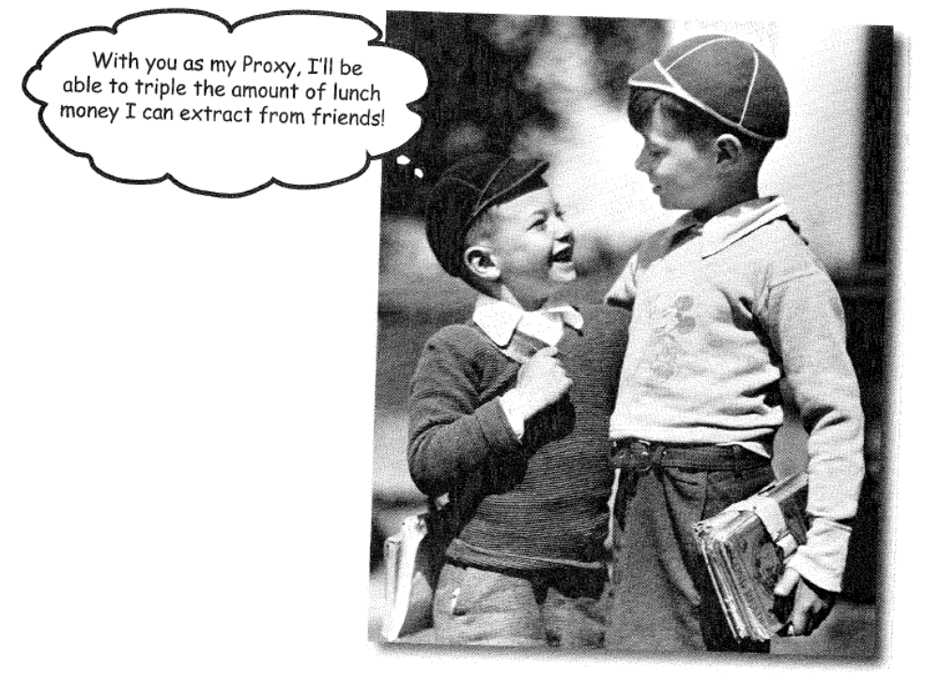
I like proxies…

Slide 15
The Problems
Expensive & inexpensive pieces of state
  Example: Large image
  Inexpensive: size & location of drawing
  Expensive: load & display
Remote objects (e.g., another system)
  Want to access it as if it were local
  Want to hide all the required communications
  Example: Java RMI
Object with varying access rights
  Some clients can access anything
  Other clients have subset of functionality available

Slide 16
The Design Goal
In all these cases desire access to object as if it is directly available
For efficiency, simplicity, or security, put a proxy object in front of the real object
We have a stand-in for the real object to control how the real object behaves

Slide 17
Proxy pattern Defined
Proxy patterns provides a surrogate or placeholder for another object to control access to it
  Remote proxy controls access to a remote object
  Virtual proxy controls access to a resource that is expensive to create
  Protection proxy controls access to a resource based on access rights

Slide 18
Proxy pattern structure
<<interface>>
Subject
request()
RealSubject
Proxy
request()
subject
request()

Slide 19
Example: Accessing Remote Object
Client
LocalProxy
RemoteObject
someMethod()
someMethod()

Slide 20
Java RMI, the big picture
Called
Caller
Caller
Called
Caller
Stub
Stub
Transport Layer (e.g. TCP or UDP)

Slide 21
Categories of Proxies
Remote proxy - as above
  Local representative for something in a different address space
  Java RMI tools help set these up automatically
  Object brokers handle remote objects (CORBA or DCOM)
Virtual proxy
  Stand-in for an object that is expensive to implement or completely access
  Example – image over the net
  May be able to access some state (e.g., geometry) at low cost
  Defer other high costs until it must be incurred
Protection proxy
  Control access to the "real" object
  Different proxies provide different rights to different clients
  For simple tasks, can do via multiple interfaces available to clients
  For more dynamic checking, need a front-end such as a proxy

Slide 22
Variants of Proxies
Firewall proxy – controls access to a set of network resources protecting the subject from “bad” clients
Smart Reference Proxy – provides additional actions whenever a subject is referenced, such as counting the number of references to an object
Caching Proxy – provides temporary storage for results of operations that are expensive. It can allow multiple clients to share the results to reduce computation or network latency
Synchronization Proxy – provides safe access to a subject from multiple threads
Complexity hiding Proxy – hides the complexity of and controls access to a complex set of classes. Sometimes called as Façade proxy for obvious reasons
Copy-on-Write Proxy – controls the copying of an object by deferring the copying of an object until it is required by a client. This is a variant of the Virtual proxy.

Slide 23
Consequences
Advantages traded-off against cost of extra level of indirection
Can hide information about the real object
  Where it is (remote proxy)
  When it is loaded (virtual proxy)
  How it is accessed (protection proxy)
The proxy interface is either:
  The same as the real object
  A subset of the real object

Slide 24
Proxies/Adapters/Facades
Proxies and Adapters both place a stand-in object between the client and the real object
Adapters do so to change the real object's interface
Proxies do so to optimize access to the object via the same interface.
Facades ease the use of sub-systems of objects

Slide 25
Observer pattern

Slide 26
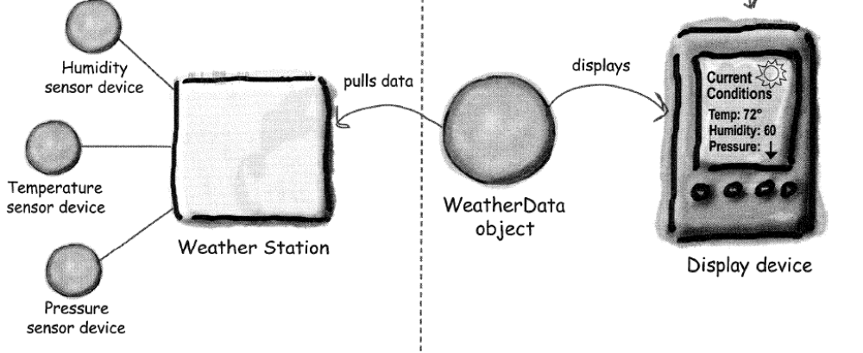
Weather Monitoring application
Display elements: Current conditions, Weather statistics, Simple forecast

Slide 27
WeatherData class
WeatherData
return most recent weather measurements
getTemperature()
getHumidity()
getPressure()
measurementsChanged()
// other methods
Gets called whenever the measurements have been updated

Slide 28
WeatherData Implementation
public class WeatherData {
// instance variable declarations
public void measurementsChanged() {
float temp = getTemperature();
float humidity = getHumidity();
float pressure = getPressure();
currentConditionsDisplay.update (temp, humidity, pressure);
statisticsDisplay.update (temp, humidity, pressure);
forecastDisplay.update (temp, humidity, pressure);
}
// other WeatherData methods here
}

Slide 29
The Problem
Given
  Clusters of related classes
  Tight connections within each cluster of classes
  Loose state dependency between clusters
Desired
  Keep each cluster state consistent when state changes in cluster it depends on
  Provide isolation such that changed cluster has no knowledge of specifics of dependent clusters

Slide 30
Example: UI & Application
Application classes represent information being manipulated.
UI provides way to view and alter application state.
May have several views of state (charts, graphs, numeric tables).
Views may be added at any time.
How to tell views when application state has changed?

Slide 31
Observer Pattern
The observer pattern defines a one-to-many dependency between objects so that when one object changes state, all of its dependents are notified and updated automatically

Slide 32
Observer/Subject
(AKA: publish/subscribe)
Observables: objects with interesting state changes
Observers: objects interested in state changes
Observers register interest with observable objects.
Observables notify all registered observers when state changes.

Slide 33
Observer Pattern - Class diagram
Observable
observers
Observer
attach(Observer)
detach(Observer)
notify()
*
*
update()
for ( o in observers ) {
o->update()
}
ConcObserver
myState
ConcObservable
subject
update()
getState()
myState = subject->getState

Slide 34
Weather station (example)

Slide 35
Interaction Diagram
: aConcObservable
: aConcObserver-1
: aConcObserver-2
setState()
notify()
update()
getState()
update()
getState()

Slide 36
When to Use Observer
Two subsystems evolve independently but must stay in synch.
State change in an object requires changes in an unknown number of other objects
(broadcast)
Desire loose coupling between changeable object and those interested in the change.

Slide 37
Consequences
Subject/observer coupling (loose coupling)
  Subject only knows it has a list of observers
  The only thing the Subject knows about an Observer is that it implements a certain interface
  Observers can be added at any time
  Does not know any Observer concrete class
  Subjects don’t need to be modified to add new types of Observers
  Subjects and Observers can be reused independently
Supports broadcast communication
  Observables know little about notify receivers
  Changing observers is trivial
Unexpected & cascading updates
  change/notify/update -> change/notify/update
  May be hard to tell what changed

Slide 38
Observer Pattern – Key points
Observer pattern defines a one-to-many relationship between objects
Subjects/Observables update observers using a common interface
Observers are loosely coupled in that the Observable knows nothing about them, other than that they implement observer interface
You can PUSH or PULL data from the Observable when using the pattern (pull is considered more “correct”)
Don’t depend on specific order of notification for your observers

Slide 39
Composite pattern

Slide 40
The Problem
Problem
  Have simple primitive component classes that collect into larger composite components
Desire
  Treat composites like primitives
  Support composite sub-assemblies
  Operations (usually) recurse to subassemblies
Solution
  Build composites from primitive elements

Slide 41
Examples - 1
File systems
  Primitives = text files, binary files, device files, etc.
  Composites = directories (w/subdirectories)
Make file dependencies
  Primitives = leaf targets with no dependents
  Composites = targets with dependents
Menus
  Primitives = menu entries
  Composites = menus (w/submenus)

Slide 42
Examples - 2
GUI Toolkits
  Primitives = basic components (buttons, textareas, listboxes, etc).
  Composites = frames, dialogs, panels.
Drawing Applications
  Primitives = lines, strings, polygons, etc.
  Composites = groupings treated as unit.
HTML/XML
  Pages as composites of links (hypertext)
  Pages as collections of paragraphs (with subparagraphs for lists, etc.)

Slide 43
Class Diagram (Alternative 1)
Component
generalOp()
add(Component c)
delete(Component c)
getChild(int i)
children
Leaf
Composite
generalOp()
generalOp()
add(Component c)
delete(Component c)
getChild(int i)
for all (c in children)
c.generalOp();

Slide 44
Class Diagram (Alternative 2)
Component
generalOp()
children
Leaf
Composite
generalOp()
generalOp()
add(Component c)
delete(Component c)
getChild(int i)
for all (c in children)
c.generalOp();

Slide 45
Example Object Structure
aComposite
aLeaf
aLeaf
aComposite
aLeaf
aLeaf
aLeaf
aLeaf

Slide 46
Example: Drawable Figures
Drawable
drawit(Graphics g)
DrawableLine
DrawableRect
drawit(Graphics g)
drawit(Graphics g)
DrawableComposite
DrawableComposite(Vector comps)
drawIt(Graphics g)
subObjects

Slide 47
Discussion
Use to model whole/part hierarchies
Clients (usually) ignore differences between primitives & composites
Clients access (most) components via the generic interfaces
  Primitives implement request directly
  Composites can handle directly or forward
Arbitrary composition to indefinite depth
  Tree structure – no sharing of nodes
  General digraph – supports sharing, multiple parents – be careful!
Eases addition of new components
  Almost automatic
Overly general design?

