Slide 1

Statistical Methods in AI (CSE/ECE 471)
09.01.2020
Lecture-3: Intro to Performance Measures, Benchmarking
Ravi Kiran (ravi.kiran@iiit.ac.in)
Vineet Gandhi (v.gandhi@iiit.ac.in)
Center for Visual Information Technology (CVIT)
IIIT Hyderabad

Slide 2
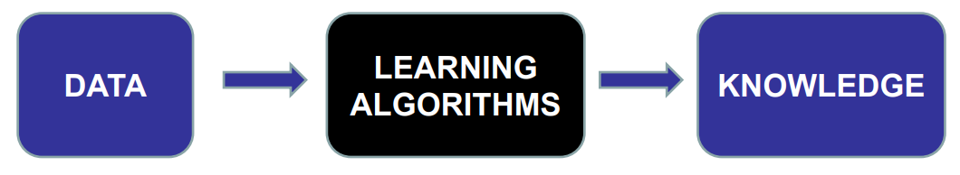
Machine Learning
Study of Algorithmic methods that use data to improve their knowledge of a task

Slide 3
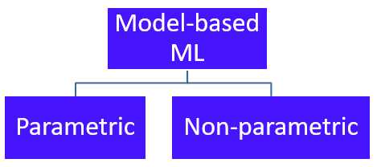
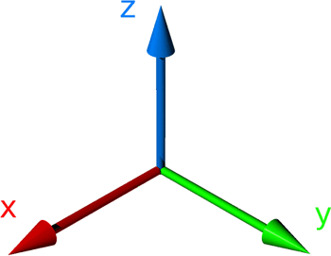
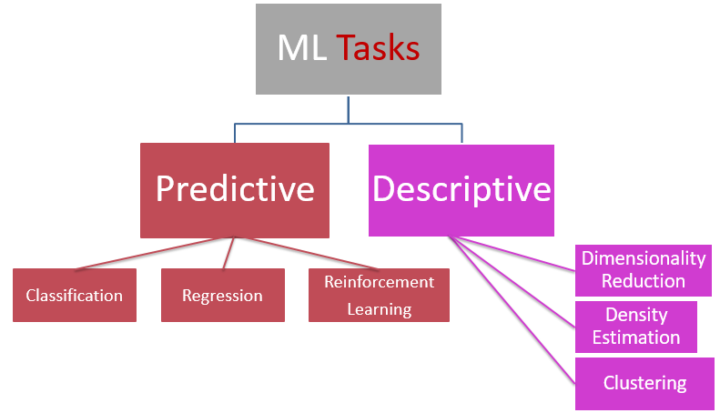
ALGORITHMS
OPTIMIZATION
Representation
DATA
Supervised
Unsupervised
TASKS
EVALUATION

Slide 4
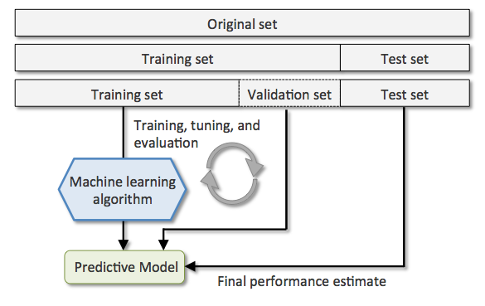
An interview analogy
Collect worked out problems (Q, S are both known)
Prepare on ALL the available problems.
Go for interview.
Collect worked out problems (Q,S are both known)
Randomly set aside a small number of problems.
Prepare on rest of the problems.
Take a mock interview containing all the ‘set aside’ problems.
Score answers and compare with solution.
Use mistakes to decide which topics to prepare better on.
Go for interview.

Slide 5
The Train-Validation-Test paradigm
Notes:
- Public Static Void Main(String[] args)

Slide 6
The Train-Validation-Test paradigm
ALGORITHMS
OPTIMIZATION
EVALUATION
DATA
TASKS
Representation
Notes:
- Public Static Void Main(String[] args)

Slide 7
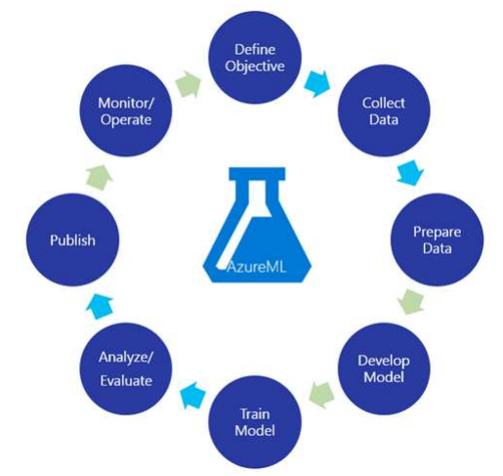
The Train-Validation-Test paradigm

Slide 8
ALGORITHMS
OPTIMIZATION
Representation
DATA
Supervised
Unsupervised
TASKS
EVALUATION

Slide 9
Supervised Learning
Classification
Regression

Slide 10
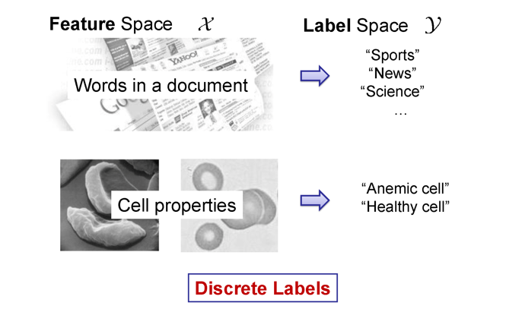
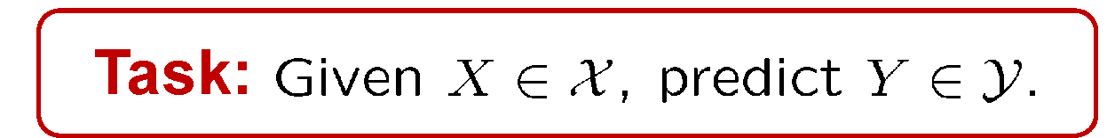
ML::Tasks → Predictive → Classification

Slide 11
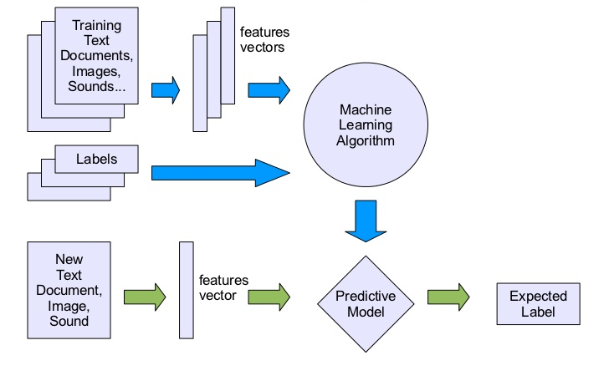
The Train-Validation-Test paradigm

Slide 12
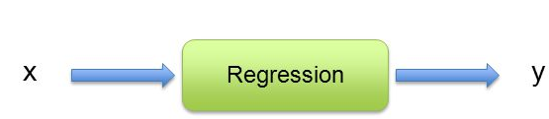
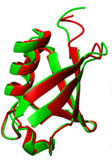
Classification
Binary
Multi-class
Multi-label
Structure
Supervised Learning
{0,1}
1-of-K
n-of-K
E.g. graph/sequence

Slide 13
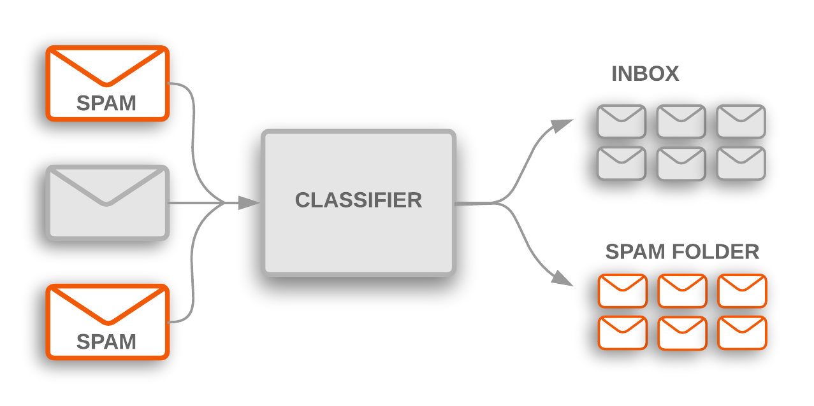
Binary Classification
Notes:
https://cdn-images-1.medium.com/max/1600/1*4LfCWX60hhREvuIerhjlyg.png

Slide 14
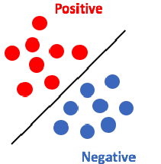
Binary classification
→ E.g. Spam = YES
→ E.g. Spam = NO

Slide 15

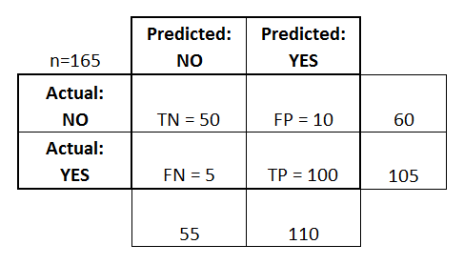

Performance Measures - Accuracy

Slide 16
Pool of 100 patients’ data used for validation of a cancer prediction ML model
Prediction:
  3 have cancer
  Rest (100-3=97) are healthy.
Reality:
  1 of the 3 did not actually have cancer !
  3 from 97 predicted healthy actually have cancer
Accuracy =

Slide 17
Pool of 100 patients’ data used for validation of a cancer prediction ML model
Prediction:
  3 have cancer
  Rest (100-3=97) are healthy.
Reality:
  1 of the 3 did not actually have cancer !
  3 from 97 predicted healthy actually have cancer
Accuracy = (100 - 4) / 100 = 96% !

Slide 18
Pool of 100 patients’ data used for validation of a cancer prediction ML model
Prediction:
  3 have cancer → selected for chemotherapy
  Rest (100-3=97) are healthy.
Reality:
  1 of the 3 did not actually have cancer !
  3 from 97 predicted healthy actually have cancer → should have been selected for chemotherapy
Accuracy = (100 - 4) / 100 = 96% !

Slide 19
Performance Measures - Accuracy

Slide 20


Performance Measures – Accuracy, TPR, FPR

Slide 21



Slide 22
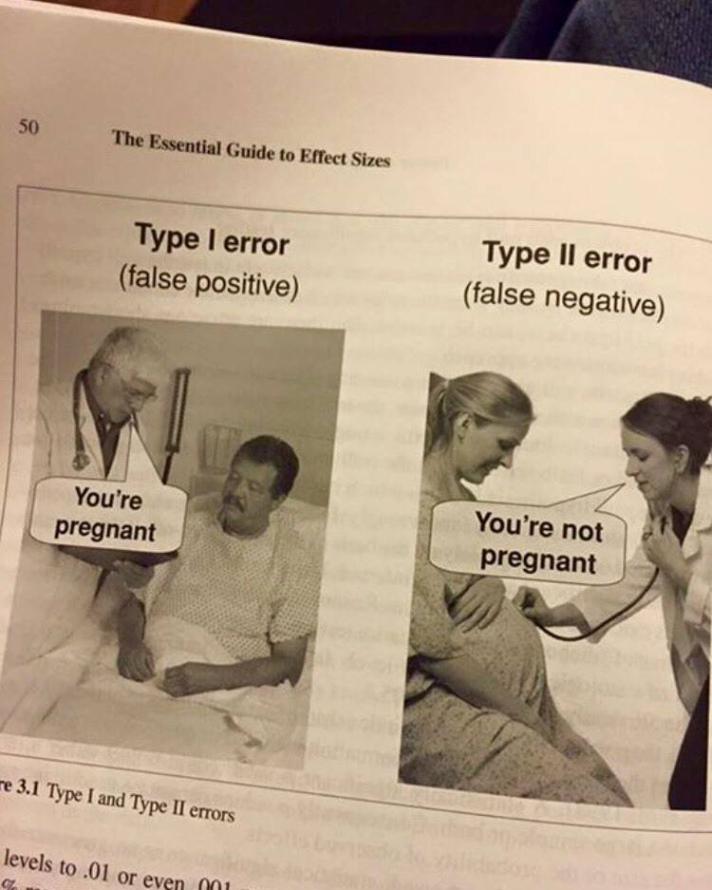

Slide 23
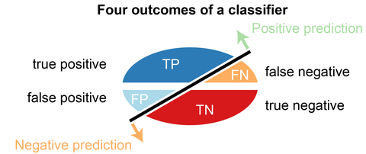
Summary of Measures

Slide 24
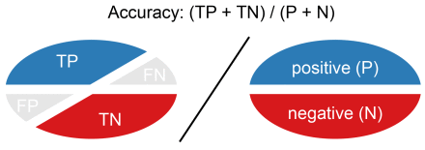
Summary of Measures
% of correct predictions

Slide 25
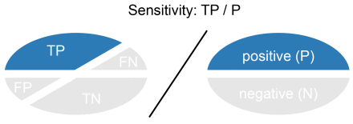
Summary of Measures
% of correct predictions
% of + class correctly predicted
[aka Recall / TPR]

Slide 26
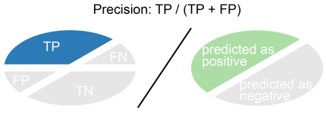
Summary of Measures
% of correct predictions
% of + class correctly predicted
[aka Recall / TPR]
correct prediction of + class
[aka Precision]

Slide 27
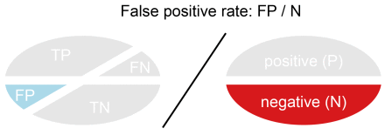
Summary of Measures
% of correct predictions
% of + class correctly predicted
[aka Recall / TPR]
correct prediction of + class
[aka Precision]
% of – class incorrectly predicted

Slide 28
Cancer-Prediction System
Precision =
Recall =
Accuracy =

Slide 29
Cancer-Prediction System
Precision = 2/(2+1) = 67%
Recall = 2/(2+3) = 40%
Accuracy = (94+2)/100 = 96%

Slide 30
Precision and Recall – examples
A system which needs to launch a missile at a terrorist hideout located in a dense urban area.
Precision not 100% ➔ civilian casualties
  A system which needs to identify cancer-risk patients
  Recall not 100% ➔ some patients will die of cancer

Slide 31
Accuracy vs Precision vs Recall
Accuracy : Performance w.r.t both classes
Recall : Performance w.r.t ‘+’ class
Precision : Reliability of predictions w.r.t ‘+’ class
% of correct predictions
% of + class correctly predicted
[aka Recall / TPR]
correct prediction of + class
[aka Precision]

Slide 32
Utility and Cost
Sometimes, there is a cost for each error
  E.g. Earthquake prediction
    False positive: Cost of preventive measures
    False negative: Cost of recovery
Detection Cost (Event detection)
  Cost = C_{FP} * FP + C_{FN} * FN

Slide 33

Farmer Shri MoneyBags and ML-FruitPicker
MB : I want an automated fruit picker and packer. I will pay an unholy amount for it.
You (having just finished this lecture) : Sure
You (Thinking): I love unholy amounts of money
(rapid cuts of time passing, you collecting data, referring to SMAI slides, coding ; dramatic music in background)

Slide 34

Farmer Shri MoneyBags and ML-FruitPicker
After 6 months …
MB : Well ?
You : I have a High Precision ML-FruitPicker. But its Recall is 20% !
MB : (confused) Precision ? Recall ?
You : (thinking) Should I go over first 3 lectures of SMAI with MB ? He’ll probably run away !
You : It rejects 80% of good, pickable fruit, but whatever it picks, those fruits are good !
MB : I’ll take your system. How do I transfer unholy amount of money to you ?
You :
MB (seeing your shocked face) : See, in a batch of 100 fruits, 10 fruits are usually bad. Among the 90 good ones, your system will select 18 of them on average. But from any given selection, I pack only 8.

Slide 35
Accuracy vs Precision vs Recall
Monitor Precision if a false positive carries higher cost.
Monitor Recall if a false negative carries higher cost.
% of correct predictions
% of + class correctly predicted
[aka Recall / TPR]
correct prediction of + class
[aka Precision]

Slide 36
Accuracy vs Precision vs Recall
Precision → Cost of inclusion
Recall → Cost of exclusion
% of correct predictions
% of + class correctly predicted
[aka Recall / TPR]
correct prediction of + class
[aka Precision]

Slide 37
Summary of Measures
% of correct predictions
% of + class correctly predicted
[aka Recall / TPR]
correct prediction of + class
% of – class incorrectly predicted

Slide 38

F1-score: A unified measure
What to do when one classifier has better precision but worse Recall, while other classifier behaves exactly opposite?
  F-measure (Information Retrieval)
    F₁ =

Slide 39
Utility and Cost
What to do when one classifier has better Precision but worse Recall, while other classifier behaves exactly opposite?
  F-measure (Information Retrieval)
    F₁ =
F1 measure punishes extreme values more !
Definition of Recall and Precision have same numerator, different denominators. A sensible way to combine them is harmonic mean.

Slide 40
Classification
Binary
Multi-class
Multi-label
Structure
Supervised Learning
{0,1}
1-of-K
n-of-K
E.g. graph/sequence

Slide 41
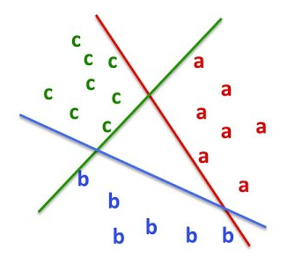

How to use 2-class measures for multi-class ?
Convert into 2-class problems !
- Average Precision, Recall etc.
Avg. accuracy may not be very meaningful with imbalanced class label distribution

Slide 42
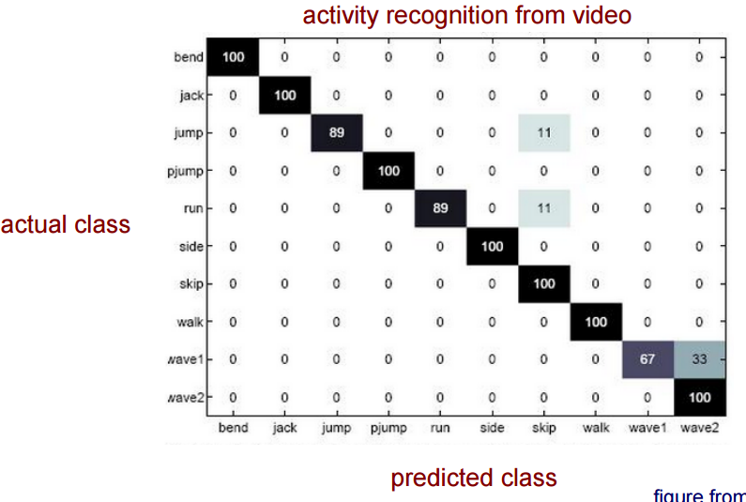
Multi-class problems - Confusion matrix
Courtesy: vision.jhu.edu

Slide 43
Multi-class Classification: Measures
Mean <measure> +- standard deviation
Median <measure> +- median absolute deviation

Slide 44
Exam analogy: Did you prepare at least a little ?
Compute <Performance Measure> (e.g. Accuracy) for TRAINING SET
Verify it is “decent”

Slide 45
Classification
Binary
Multi-class
Multi-label
Structure
Supervised Learning
{0,1}
1-of-K
n-of-K
E.g. graph/sequence

Slide 46


Example-based
is the number of examples.
is the ground truth label assignment of the example..
is the example.
is the predicted labels for the example.
What fraction of labels are predicted correctly ?
Precision =
What % of correct labels were predicted ?
Recall =
Accuracy = Fraction of samples predicted correctly

Slide 47
Baselines
0 cost-to-build classifiers
Binary
  Equal # of samples / class → Random Guessing (50% accuracy)
  Class imbalance
    → Guess according to class proportion (Accuracy = )
    0-Rule: Majority class (Accuracy = ) [slightly stronger baseline]
Notes:
https://blog.revolutionanalytics.com/2016/03/classification-models.html

Slide 48
Summary
Many metrics:
  Accuracy, TP, FP, Precision, Recall, AP/mAP
  Class imbalance and decision-cost imbalance must be taken into account
Confusion Matrix: Important to analyze and refine solution.
Notes:
Summary-5????

Slide 49
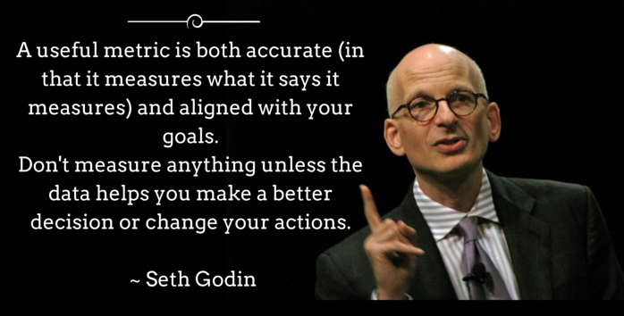

Slide 50
References and Reading
Code
  https://scikit-learn.org/stable/modules/model_evaluation.html#classification-metrics

