Slide 1
PHARMACY MANAGEMENT SYSTEM

Slide 2
Group Members
RAJA TAIMOOR MEHMOOD (21-ARID-658)
SAYEDA KHADIJA ALI (21-ARID-675)

Slide 3
TOOLS AND TECHNOLOGIES
VS CODE
SUBLIME
WAMP

Slide 4
LANGUAGES
HTML
CSS
JAVA SCRIPT
JQUERY
PHP

Slide 5
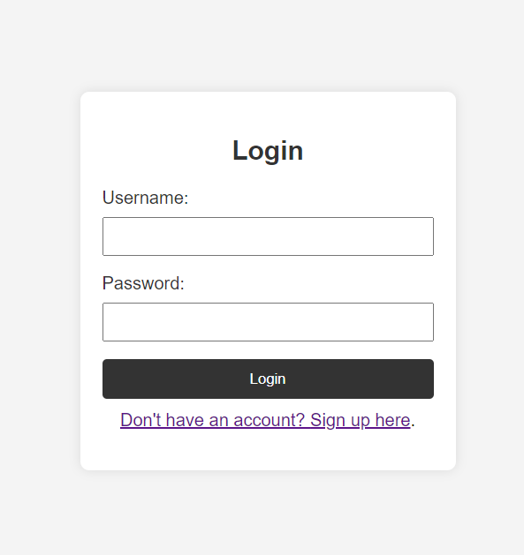
FRONT END

Slide 6
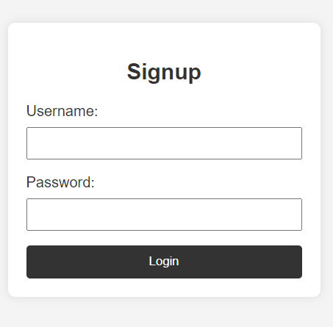
FRONT END

Slide 7
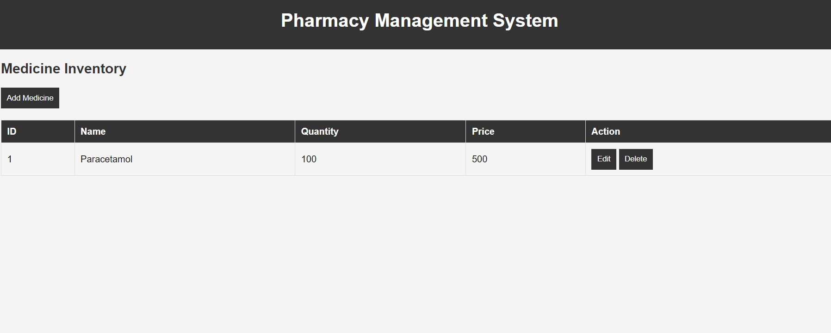
FRONT END

