Slide 1
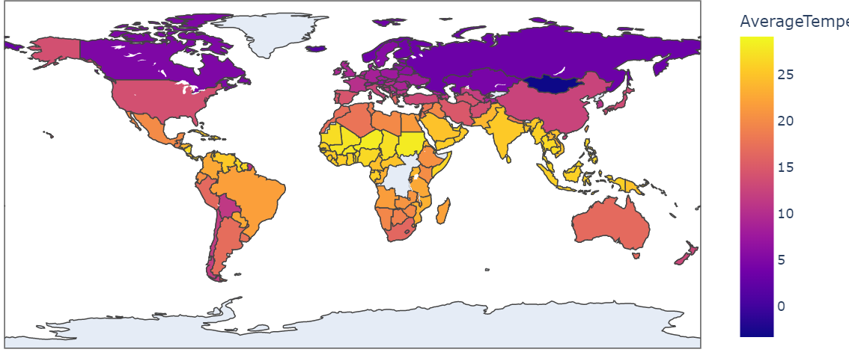
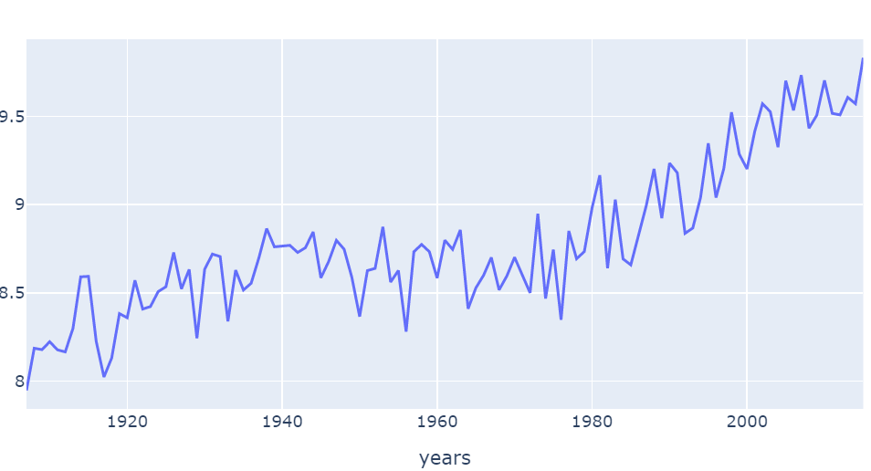
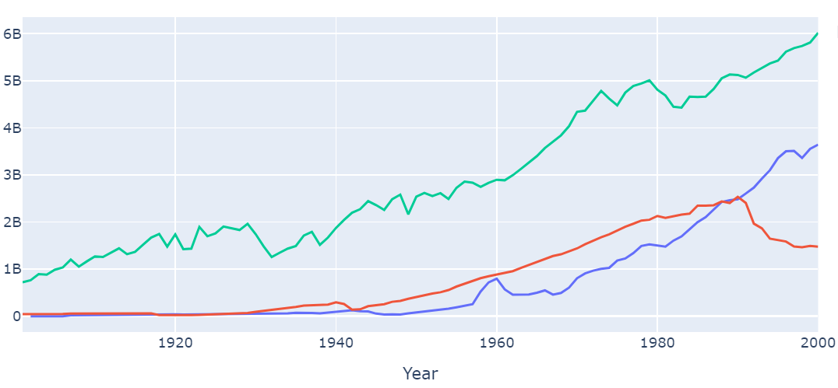

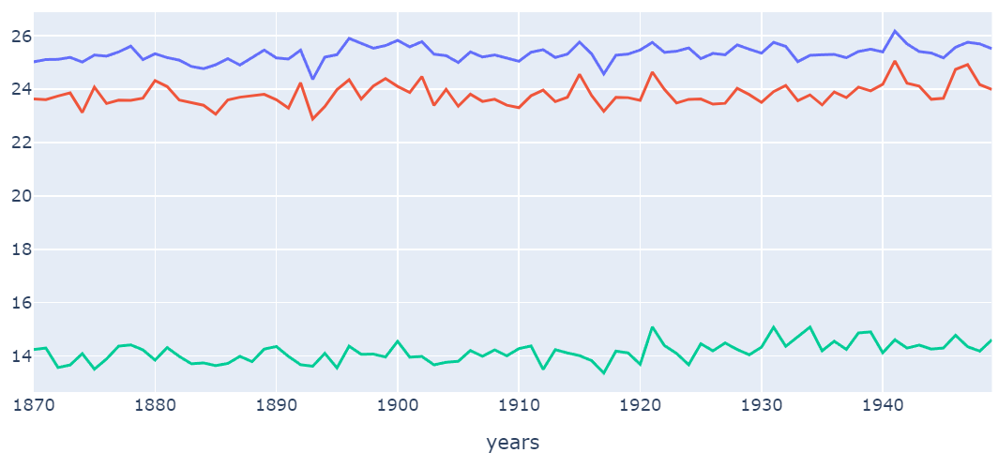
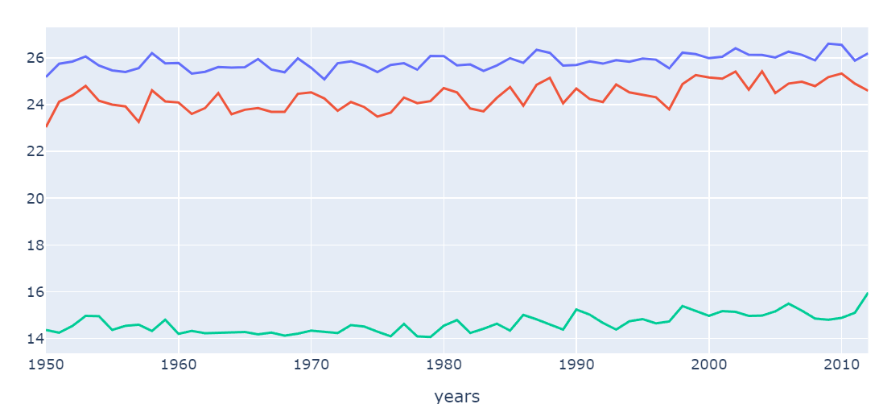
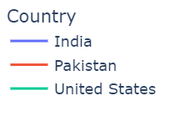


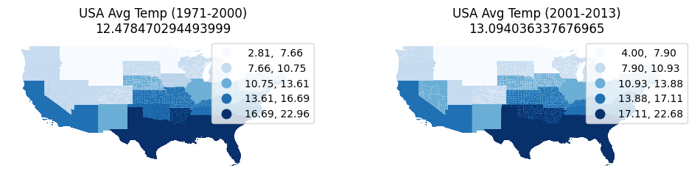

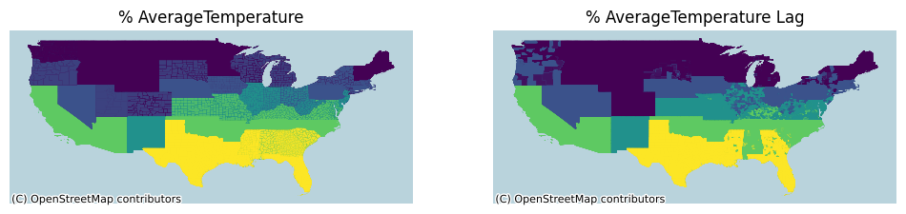




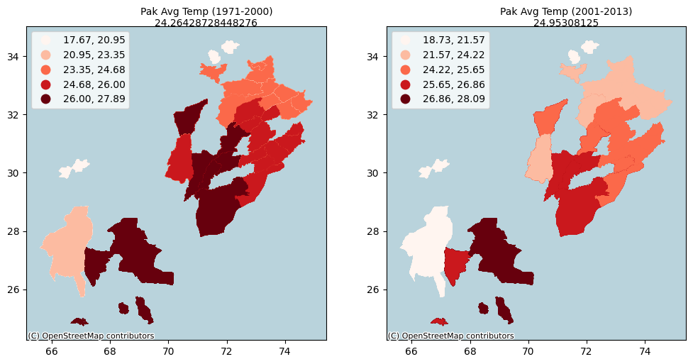
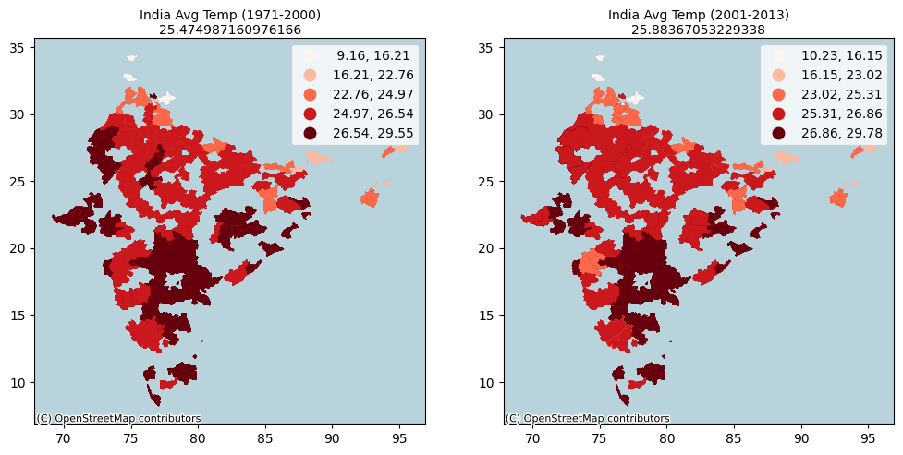
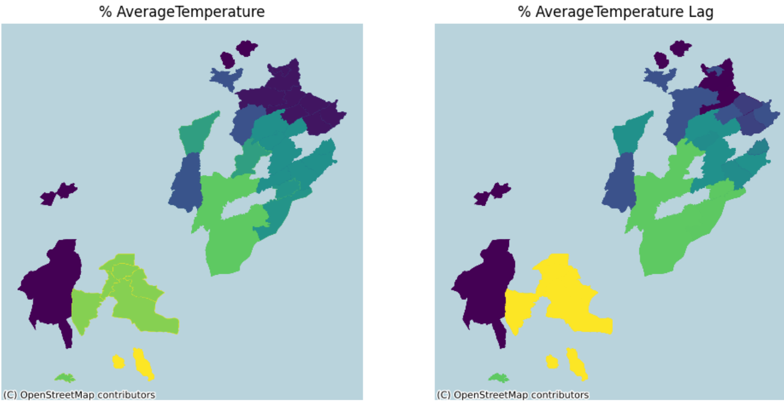
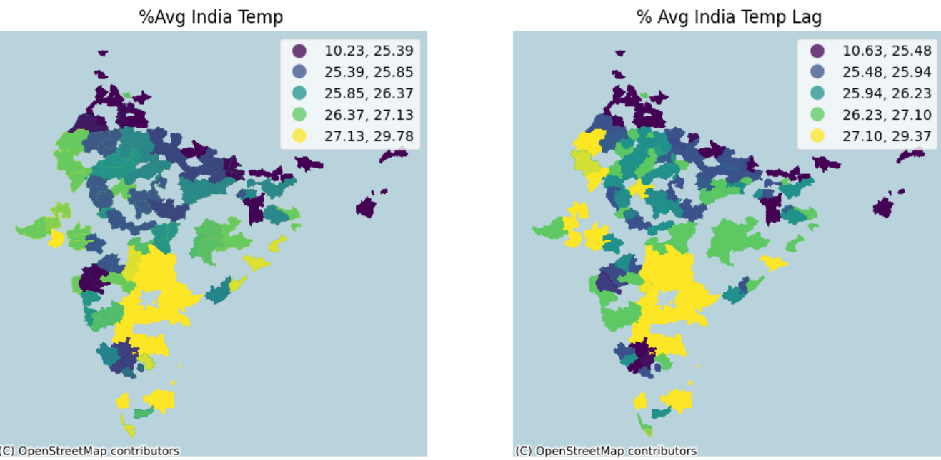
Global Warming Spatial Analysis
Raja Mohammad Uzair Aamir (BSCS20013)
Session: Spring 2023
Supervisor: Dr. Adnan Siddique
Course: Spatial Data Science
1. Introduction
3. Data
This project aims to analyze global temperature trends to assess the extent of global warming . It identifies the main contributor to global warming, also examines the temperature trends of two affected countries. The study emphasizes the urgent need for effective measures to mitigate the effects of global warming on the environment.
The following datasets were used in this project:
Average temperatures of the world dataset.
Dataset containing average temperatures of countries..
Top contributor of CO2 Emission dataset
Shape files of Pakistan, India, and USA.
2. Problem Statement
Occurrence of Global Warming
Analyzing trend of top contributor to CO2 emissions
Analyzing temperature trends of two severely affected countries
Global Avg Temperature of the World Countries
4. Methodology
5. Results
World temperature trend analysis:
We can clearly see that after 1950, the temperature is rising at a very rapid raid which is a sign of global warming
I undertook a sequence of systematic steps to conduct a comprehensive analysis of global warming using spatial data science technique, which are:
World temperature trend analysis:
Analyzed the "Avg Temperatures of World Dataset" from 1907-2015 to determine the occurrence of global warming.
Primary contributor analysis:
Conducted an analysis of the "Top Contributor of CO2 Emission" dataset to identify the biggest contributor of global warming.
Country temperature trend analysis:
Conducted temperature trend analysis of Pakistan, India, and the USA . USA being biggest emitter whereas Pak, India being affected countries
USA temperature trend analysis:
Examined temperature trends in the USA, focusing on the biggest contributor's state.
Conducted auto-correlation analysis for the state.
Pakistan and India temperature trend analysis:
Analyzed temperature trends in Pakistan and India to determine the impact of global warming.
Applied global auto-correlation analysis for each country.
.
Trend of World Temp (1900-2013)
Primary contributor analysis:
The top 3 contributors of Carbon emissions are shown in which USA is leading, so we select USA for analysis
Country Temp Trend analysis:
We can see that all the three countries rapidly from 1950-2013 time period, Here Pakistan is showing the most variations
Top Contributors of Global Warming
Trend of Temp (1870-1950)
USA Temp Trend Analysis
Trend of Temp (1950-2013)
India, Pakistan Analysis
The cities of India and Pakistan are plotted showing the increase in temperature rapidly , and similar temperature areas are likely together
(Discussion) Observations from USA, India and Pakistan Analysis
USA being the biggest contributor of Global Warming, not only affected its temperature (1.53°) from 2000 to 2013 but, it also affected India and Pak
USA played a major role in the increase of the temperature of these Pakistan observed 0.7 ° change, whereas India observed 1.5 ° change,
Areas
The Moran’s I value for all these 3 countries were in 0.96 to 0.97 which show strong auto correlation between all these countries temperatures
Conclusion:
Conclusion:
It is crucial to take serious measures to overcome global warming, as failure to do so will result in disastrous consequences for our planet and future generations
Acknowledgments: Please add acknowledgements here.

