Slide 1





AIRPLANE CRASH ANALYSIS

Slide 2



BETTER SAFETY IS ALWAYS SOUGHT AFTER BY ALL MEANS POSSIBLE
A GOOD WAY TO ACHIEVE BETTER SAFETY IF TO LEARN FROM PAST MISTAKES...

Slide 3

ANALYZING THEM AND IDENTIFYING PROBLEMS TO SOLVE
EVENTUALLY LEADING TO SAFER FLIGHTS!

Slide 4
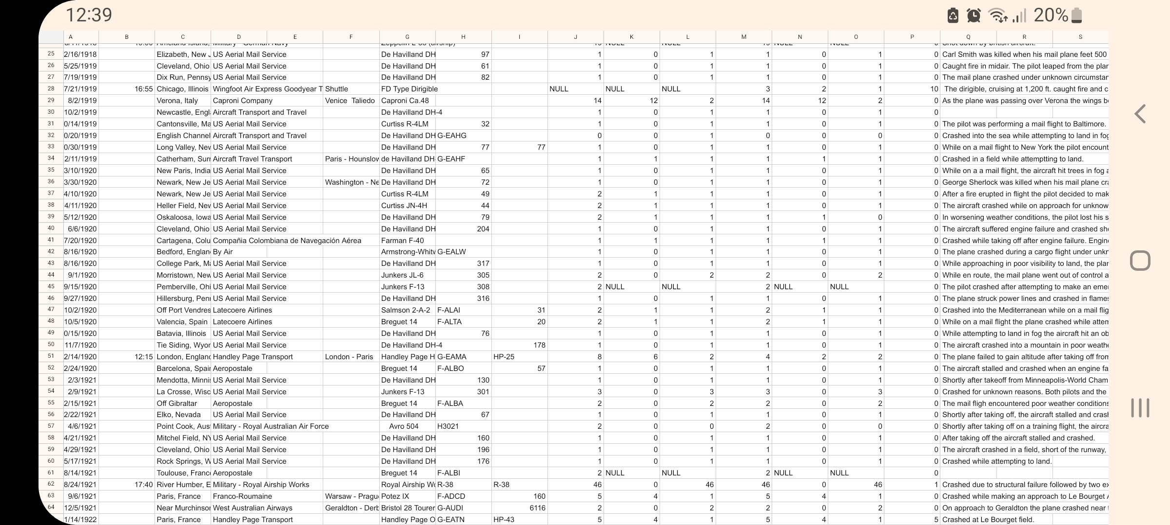
USING VARIOUS DATA COLLECTED ABOUT AIRPLANE CRASHES

Slide 5
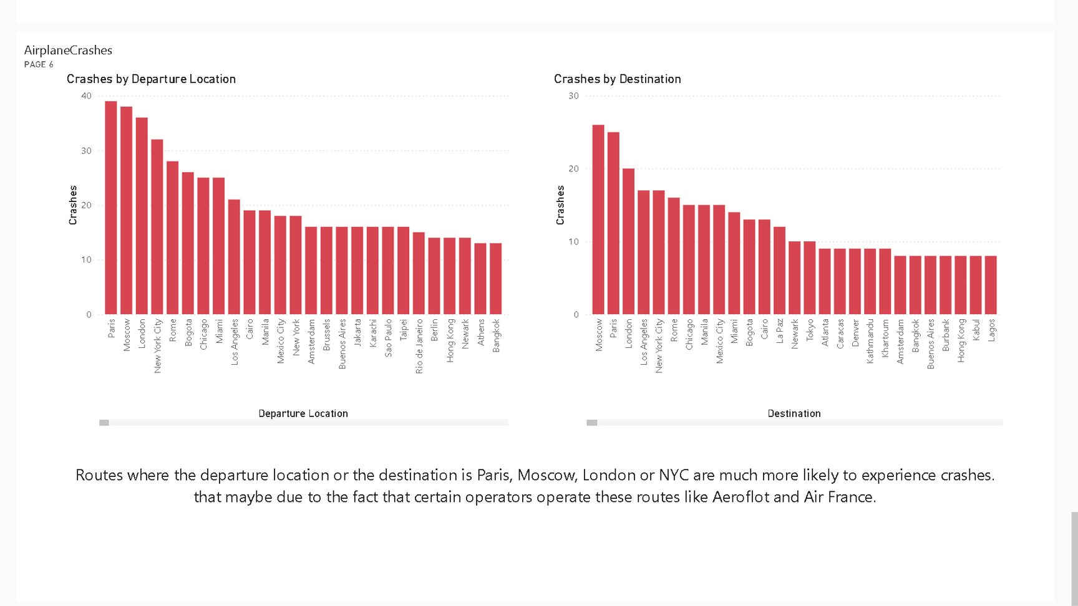
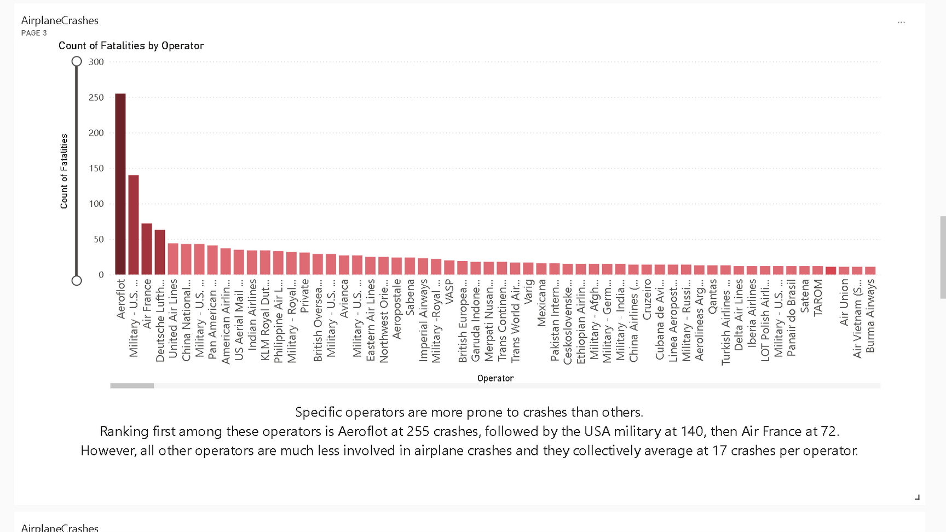
ANALYZING VARIOUS ASPECTS
LIKE ROUTES AND OPERATORS

Slide 6
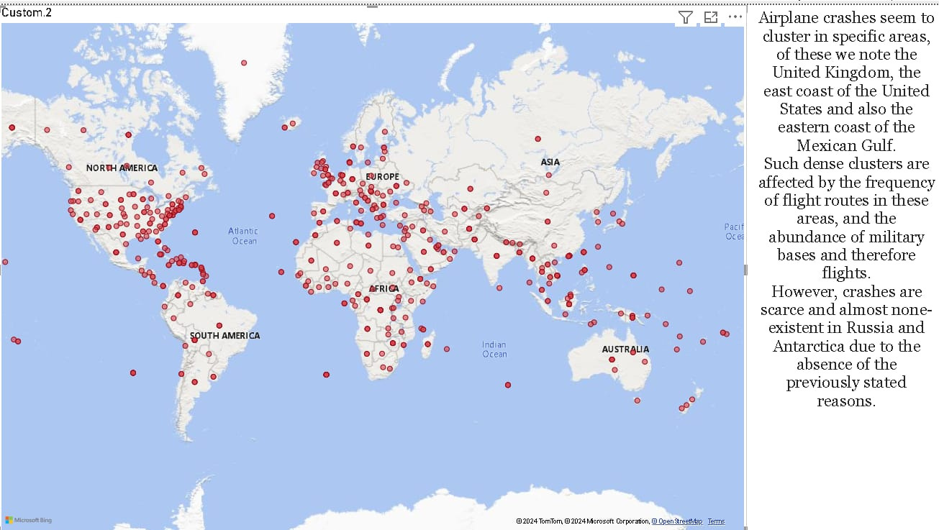
AND CRASH DISTRIBUTIONS ON THE MAP

Slide 7
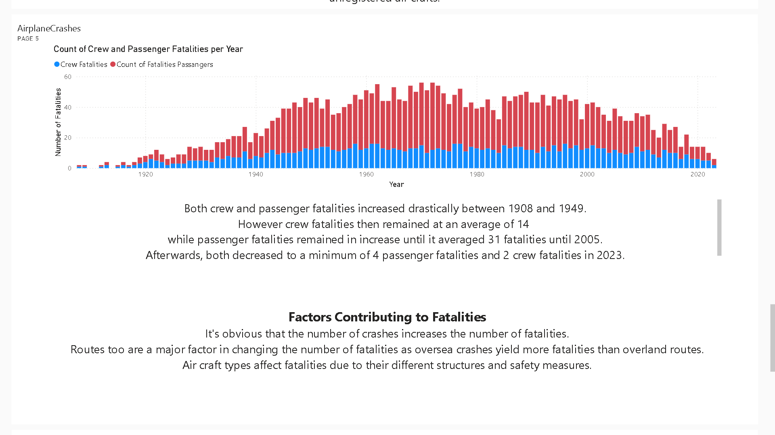
IDENTIFYING RISK FACTORS AND HOW TO AVOID THEM

Slide 8

EVENTUALLY AVOIDING MOST FUTURE CRASHES AND ACHIEVING MORE SAFE FLIGHTS!

Slide 9
THANK YOU FOR WATCHING!

