Slide 1
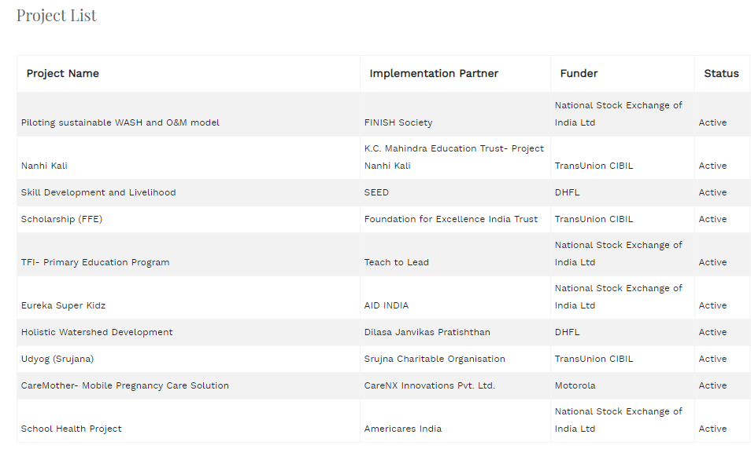
Project List (preferably enhance existing page, but if adding more columns makes it clumsy we can think of creating new one by leveraging exiting code)
1. Add Start Date, End Date, Managed by (Name of organization of PMO user), Planned Budget (from Total Budget Tab)
3. Ability to download as CSV file
2. Ability to sort on all columns
Download
Start Date | End Date
Apr 1, 2018 | Mar 31, 2019
MMM, d, YYYY | MMM, d, YYYY
Managed by
Samhita
Corporate
NGO
Budget Planned
10,00,000

