Slide 1
Rajadurai M 715521104307 PSG I Tech
Final Project

Slide 2
PROJECT TITLE
Number Classification using CNN over the MNIST dataset
Creating a Deep Learning Model and Training it such that it is able to identify the numbers using pixel values of the Image

Slide 3


AGENDA
Problem Statement
Project Overview
End Users
Solution and Value Proposition
Unique Aspects of the Solution
Modelling
Results
3/21/2024 Annual Review

Slide 4

PROBLEM STATEMENT
The task involves developing an efficient convolutional neural network (CNN) model to accurately classify handwritten digits from the MNIST dataset. With a training set of 60,000 images and a test set of 10,000 images, the model will be trained using CNN architecture, comprising convolutional and pooling layers followed by fully connected layers. Preprocessing steps include resizing, normalization, and possibly data augmentation. Training involves optimizing parameters using stochastic gradient descent and minimizing categorical cross-entropy loss. Evaluation metrics such as accuracy, precision, recall, and F1-score will assess the model's performance, with hyperparameter tuning, regularization, and cross-validation ensuring robustness. Ultimately, the goal is to deploy a reliable model for digit recognition tasks, including optical character recognition systems and automated form processing.

Slide 5

PROJECT OVERVIEW
The objective of this project is to design and train a CNN architecture capable of accurately recognizing handwritten digits. Specifically, the model should be able to:
Successfully classify each digit image into one of the ten categories (0-9).
Achieve high accuracy on both training and testing datasets.
Generalize well to new, unseen digit images.

Slide 6

WHO ARE THE END USERS?
This kind of system is majorly used in the identification of data (classification) into various categories such that the image/element can be matched.
Places and Situations such as:
Paper Form Scanning
License Plate Detection
ID Card Scanning
Notebook to E-Book Conversion and so on…

Slide 7

YOUR SOLUTION AND ITS VALUE PROPOSITION
Our image classification solution harnesses cutting-edge machine learning and deep learning techniques to accurately identify handwritten numerical data. With a focus on precision and efficiency, our system automates data extraction and processing, reducing manual effort and minimizing errors. Its versatility enables adaptation to various applications and industries, while seamless integration ensures easy deployment into existing workflows. Scalability allows our solution to handle large volumes of data, catering to growing organizational needs. Prioritizing data privacy and compliance, we ensure robust security measures and adherence to relevant regulations. Ultimately, our solution delivers enhanced accuracy, efficiency, versatility, integration, scalability, and compliance, empowering organizations to optimize data identification and categorization processes with confidence.

Slide 8

THE WOW IN YOUR SOLUTION
The dataset comprises grayscale pixel values representing handwritten numbers, fed into a CNN model for classification. By analyzing these pixel values, the model accurately identifies the corresponding numbers. Additionally, the pixel values enable recreation of the original handwritten images, providing visual representation of the classified numbers. This capability allows users to visually inspect the handwritten numbers that the model recognizes, enhancing interpretability and understanding of the classification process. Overall, the combination of pixel analysis and image recreation empowers comprehensive exploration and validation of the model's classification outcomes.
3/21/2024 Annual Review
8

Slide 9
MODELLING
This model is a Convolutional Neural Network (CNN) designed for handwritten digit classification using the MNIST dataset. Here's a breakdown of its architecture:
Input Layer (Conv2D): The input layer consists of a 2D convolutional operation with 8 filters, each with a kernel size of 5x5. This layer processes the input images, which are grayscale and of size 28x28 pixels.
MaxPooling Layer: After each convolutional layer, a max-pooling operation is applied with a pool size of 2x2. This helps reduce the spatial dimensions of the feature maps while retaining the most important information.
Dropout: Dropout layers with a dropout rate of 0.25 are added after each max-pooling layer to prevent overfitting by randomly dropping a fraction of the neurons during training.
Convolutional Layer: Another convolutional layer is added with 16 filters and a kernel size of 3x3, followed by max-pooling and dropout layers similar to the previous layers.
Flatten Layer: After the final convolutional layer, the feature maps are flattened into a one-dimensional vector to be fed into the fully connected layers.
Fully Connected Layers: Two fully connected (dense) layers are added with 256 and 10 neurons, respectively. The first dense layer uses ReLU (Rectified Linear Unit) activation function to introduce non-linearity, while the second layer uses softmax activation function to output probabilities for each class (0-9).
Dropout: Another dropout layer with a dropout rate of 0.5 is added before the final dense layer to further prevent overfitting.
9

Slide 10
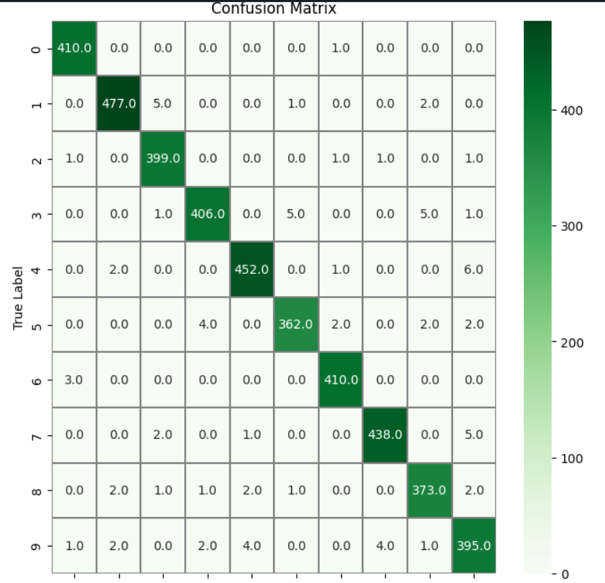
RESULTS
Demo Link
10

