Slide 1
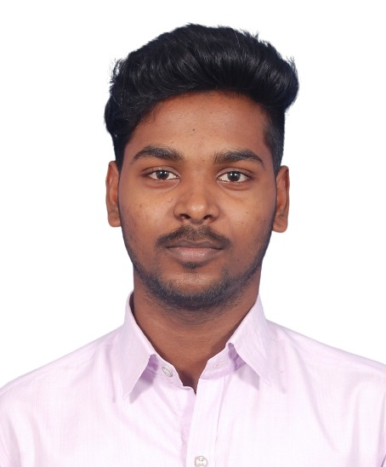

Insert your photo
Bio
Strong knowledge in Microsoft Technologies and Front end Technologies. 6 months of experience as a .Net developer.
Experience
Web development experience using C#.NET, ASP.NET, MVC, HTML ,CSS,JS and jQuery.
Developed Web pages using ASP.Net and C#.Net.
Deployed and maintained applications on Azure cloud technologies.
Using SQL Server writing queries,stored procedures and functions.
Experience in versioning tools like DevOps, GIT.
Having Knowledge in Angular and React.
Rajadurai Sermaraj
.Net Developer
rajadurai.sermaraj@kanini.com
Skills
Web Development
SQL Server, MongoDB
Web API, MVC
Angular JS
Domain
Healthcare

