Slide 1

Travel Package Analysis
Presented By:
Jagarlamudi Mokshagna
Panduru Shyam
Noorbasha Rajak

Slide 2
Data Analysis Life Cycle :
Collect The Data
Load The Data
Analyze The Data
Find The Insights
Summary Of The Data
Data Driven Decisions

Slide 3
About me
Name : Jagarlamudi Mokshagna
Background : Bachelor Of Technology (CSE AI ML)
Why you want to learn Data Science : The field is constantly evolving, offering opportunities to learn new tools and techniques to improve efficiency
LinkedIn URL : https://www.linkedin.com/in/mokshagna-jagarlamudi-5ba5b0374/
GitHub URL : https://github.com/mokshagna78

Slide 4
Agenda (This should be the PPT flow)
Business Problem and Use case domain understanding(If Required)
Objective of the Project
Web Scraping – Details (Websites, Processor you followed)
Summary of the Data
Exploratory Data Analysis:
Data Cleaning Steps
Data Manipulation Steps
Univariate Analysis Steps
Bivariate Analysis Steps
Key Business Question
Conclusion (Key finding overall)
Q&A Slide
Your Experience/Challenges working on Web Scraping – Data Analysis Project.

Slide 5
Business Problem & Use Case (Domain Understanding) :
Business Problem :
Travel websites provide numerous tour packages with different prices, discounts, durations, and ratings. However, it is difficult for customers to quickly identify the best travel packages based on value, duration, and savings.
Use Case :
Travel companies and customers can benefit from analyzing travel package data to understand:
Pricing patterns across different destinations
Discount strategies used by travel platforms
Relationship between trip duration and package price
Savings offered through discounts
This analysis helps in identifying cost-effective travel packages and market trends

Slide 6
Objective of the Project :
The main objectives of this project :
To scrape travel package data from a travel website.
To clean and preprocess the scraped dataset.
To perform Exploratory Data Analysis (EDA) on the travel package data.
To identify patterns between price, discounts, savings, and trip duration.
To visualize insights using univariate, bivariate, and multivariate analysis.
The final goal is to extract meaningful insights from travel package data.

Slide 7
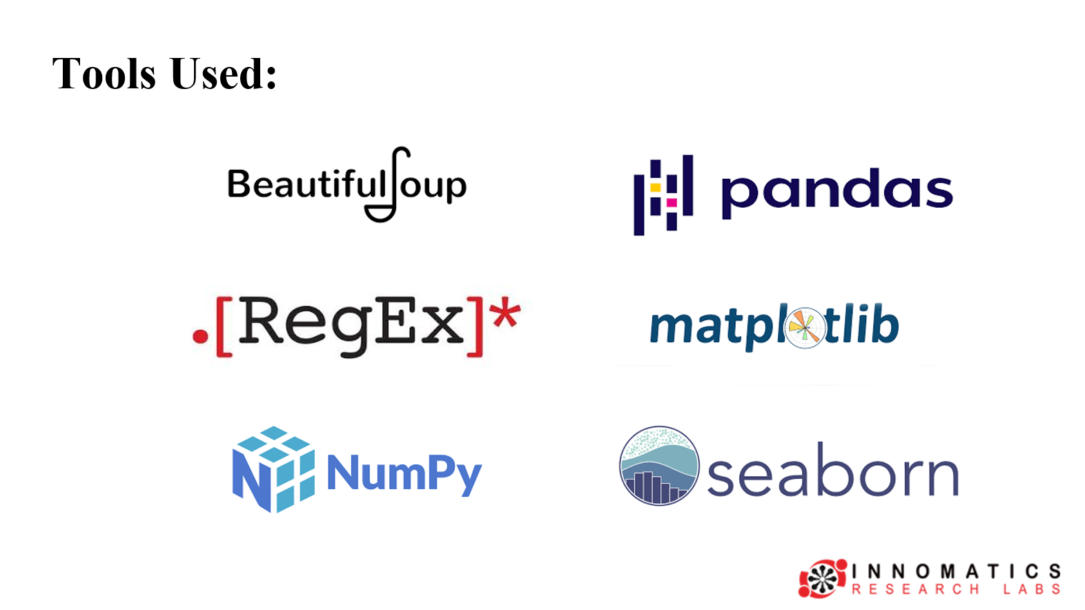

Slide 8

Web Scraping – Details
Website:
Travel Triangle Tour Packages
(https://traveltriangle.com/tour-packages?destination_type=india&)
Tools Used :
Python
Requests
BeautifulSoup
Pandas
Web Scraping Process :
Sent HTTP requests to multiple pages of the website.
Parsed HTML content using BeautifulSoup.
Extracted relevant package details from HTML elements.

Slide 9
Summary of the Data :
Dataset Size :
1000 Rows & 9 columns
Variable | Description
Location | Travel destination
Discount | Discount percentage
Discount_Price | Price after discount
Original_Price | Actual package price
Rating | Customer rating
Days | Trip duration in days
Nights | Trip duration in nights
Savings | Money saved
Savings_Percentage | Percentage savings

Slide 10
Raw Data
Cleaned Data
Variable | Description
Name | Package Name
Stay | Days & Nights
Location | Destination Place
Discount | Discount percent
Discount Price | Price after Discount
Original Price | Price Before Discount
Rating | Customer Rating About Trip
Packages | Places Covered In Package
Page No | In which Page No The Package Consist
Variable | Description
Location | Travel destination
Discount | Discount percentage
Discount_Price | Price after discount
Original_Price | Actual package price
Rating | Customer rating
Days | Trip duration in days
Nights | Trip duration in nights
Savings | Money saved
Savings_Percentage | Percentage savings

Slide 11
Exploratory Data Analysis (EDA) :
Exploratory Data Analysis was performed to understand the structure of the dataset and identify patterns in travel package pricing
EDA helps to:
Understand data distribution
Detect anomalies and outliers
Identify relationships between variables
Extract meaningful insights from the dataset
Data Collection
Data Cleaning
Data Exploration
Data Visualization

Slide 12
Data Cleaning Steps :
Several preprocessing steps were performed to clean the scraped dataset
Steps performed:
Removed special characters such as ₹ and commas from price columns
Converted price columns to numeric data types
Extracted numerical values from text fields using regex
Separated trip duration into Days and Nights
Removed unwanted columns such as links and page numbers
Handled missing values where necessary
These steps ensured that the dataset became structured and analysis-ready

Slide 13
Data Manipulation Steps :
New features were created to enhance analysis
Savings :
Savings = Original Price − Discount Price
This helps identify how much money customers save on a travel package.
Savings Percentage :
Savings Percentage = (Savings / Original Price) * 100
This shows the effectiveness of discounts offered by travel packages.
Feature engineering helped create more meaningful variables for analysis

Slide 14
Outliers :
data points that differ significantly from the rest of the dataset, lying at an abnormal distance from other values
Here we are using box plot for visualizing outliers
How to find outliers :
by using the IQR
IQR full form is inter quartile range
IQR = Q3 – Q1 (Formula to find iqr)
Where:
Q1(1st Quartile) = 25th percentile of the data
Q2(3rd Quartile) = 75th percentile of the data
IQR = Spread of the middle 50% of the data set

Slide 15
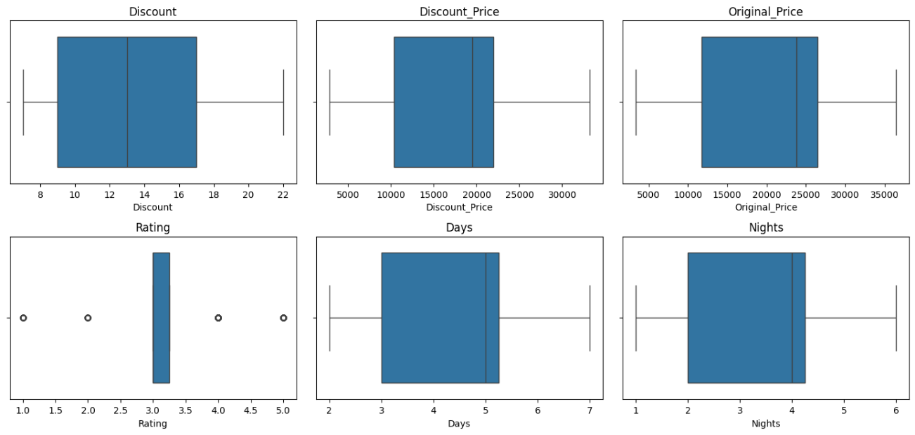

Slide 16
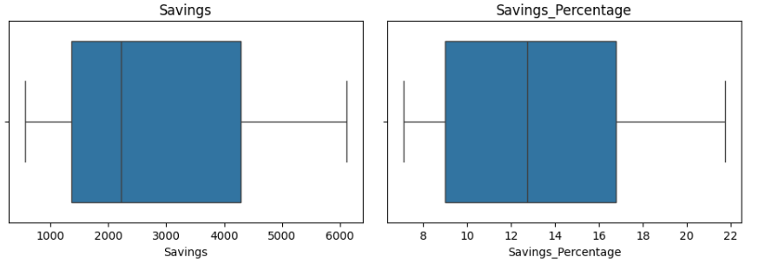

Slide 17
Univariate Analysis Steps :
Univariate analysis focuses on examining one variable at a time to understand its distribution and characteristics
visualizations used :
Histogram
Count plot
Donut
The goal of this analysis :
Understand the distribution of travel package prices
Analyze discount patterns
Study rating distribution
Observe trip duration patterns
These plots help identify distribution patterns, frequency, and potential outliers
in the dataset

Slide 18
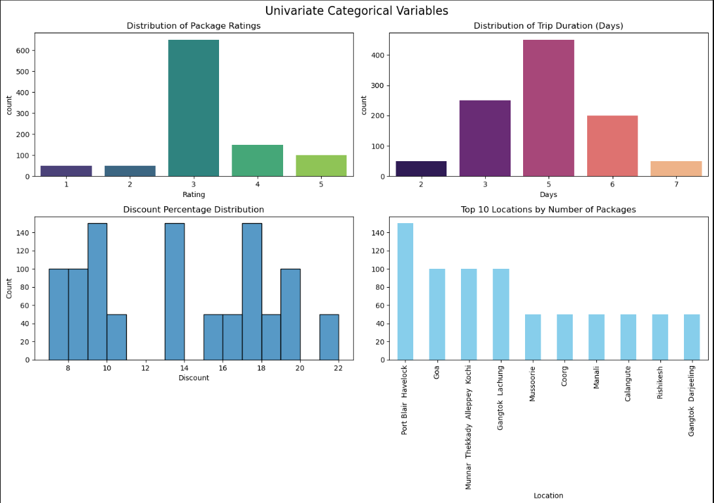
Visualizations In Univariate Analysis :
Categorical

Slide 19
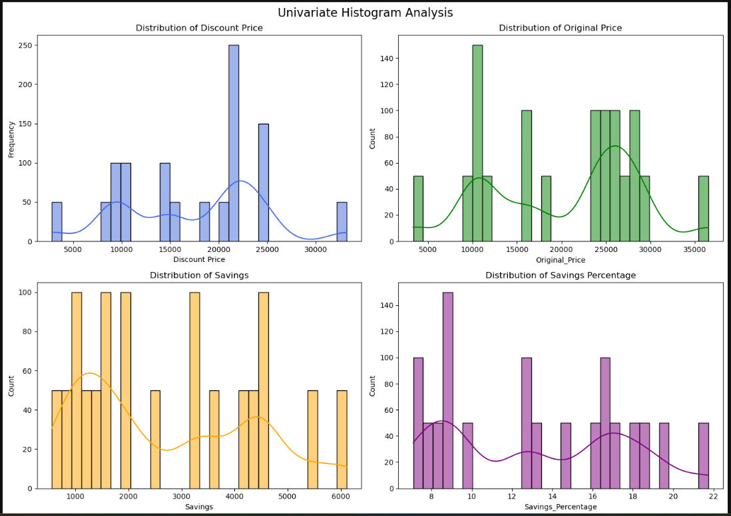
Numerical

Slide 20
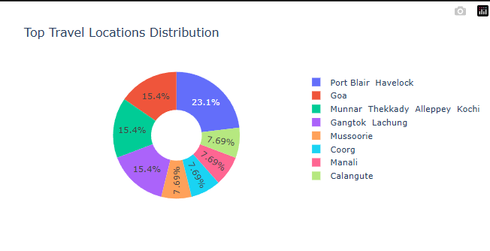
Donut for univariate analysis

Slide 21
Bivariate Analysis :
Bivariate analysis examines the relationship between two variables to understand how one variable influences another
visualizations used :
Bar plot
Scatter plot
The goal of this analysis :
Identifying Relationship
Understanding Patterns
Comparing Groups
Predicting Outcomes
Spotting Outliers
These visualizations help analyze relationships between travel package variables such as trip duration, price, discount, and savings

Slide 22
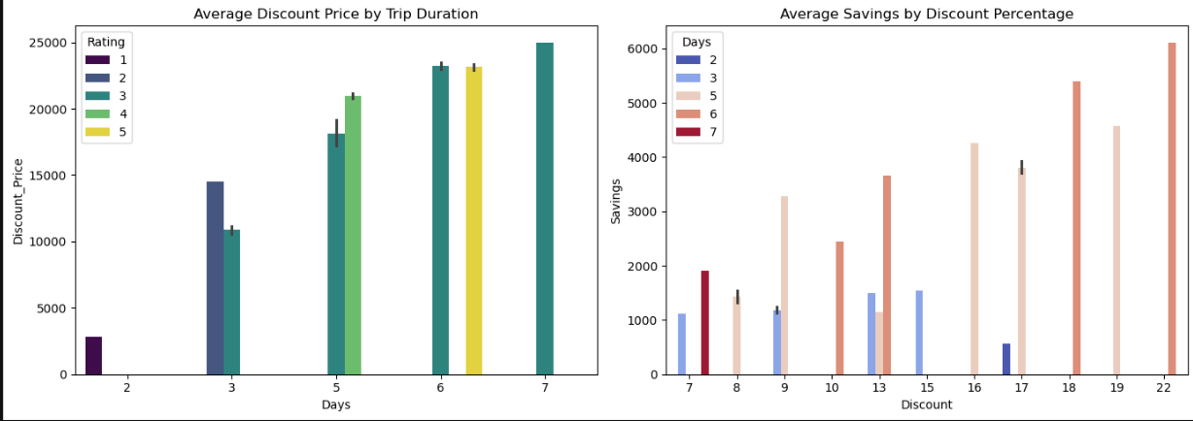
Visualizations In Bivariate Analysis :
Bar Plot bivariate

Slide 23
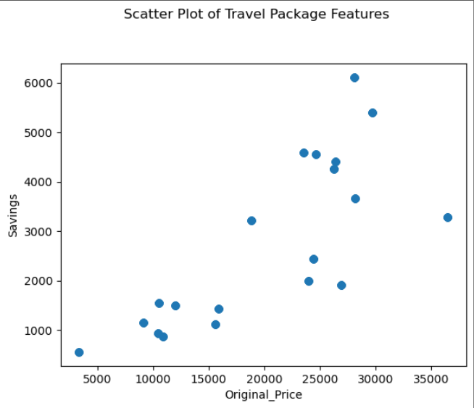
Scatter plot for bivariate analysis

Slide 24
Multivariate Analysis :
Multivariate analysis examines the relationship between three or more variables simultaneously
visualizations used :
Correlation Heatmap
Pair plot
The goal of this analysis :
Understanding Relationships
Data Reduction(Dimensionality Reduction)
Prediction & Forecasting
Classification & Clustering
These visualizations help analyze how multiple variables interact with each other in
the dataset

Slide 25
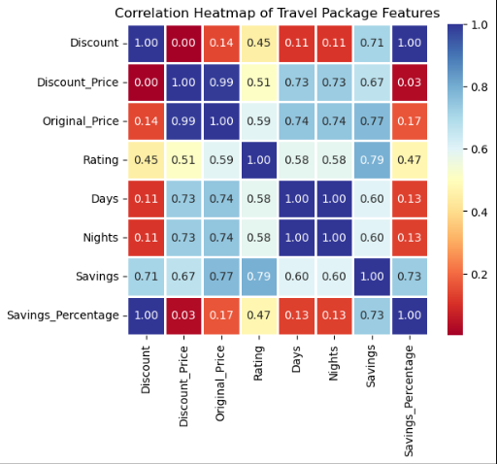
Visualizations In Multivariate Analysis :
Correlation Heatmap

Slide 26
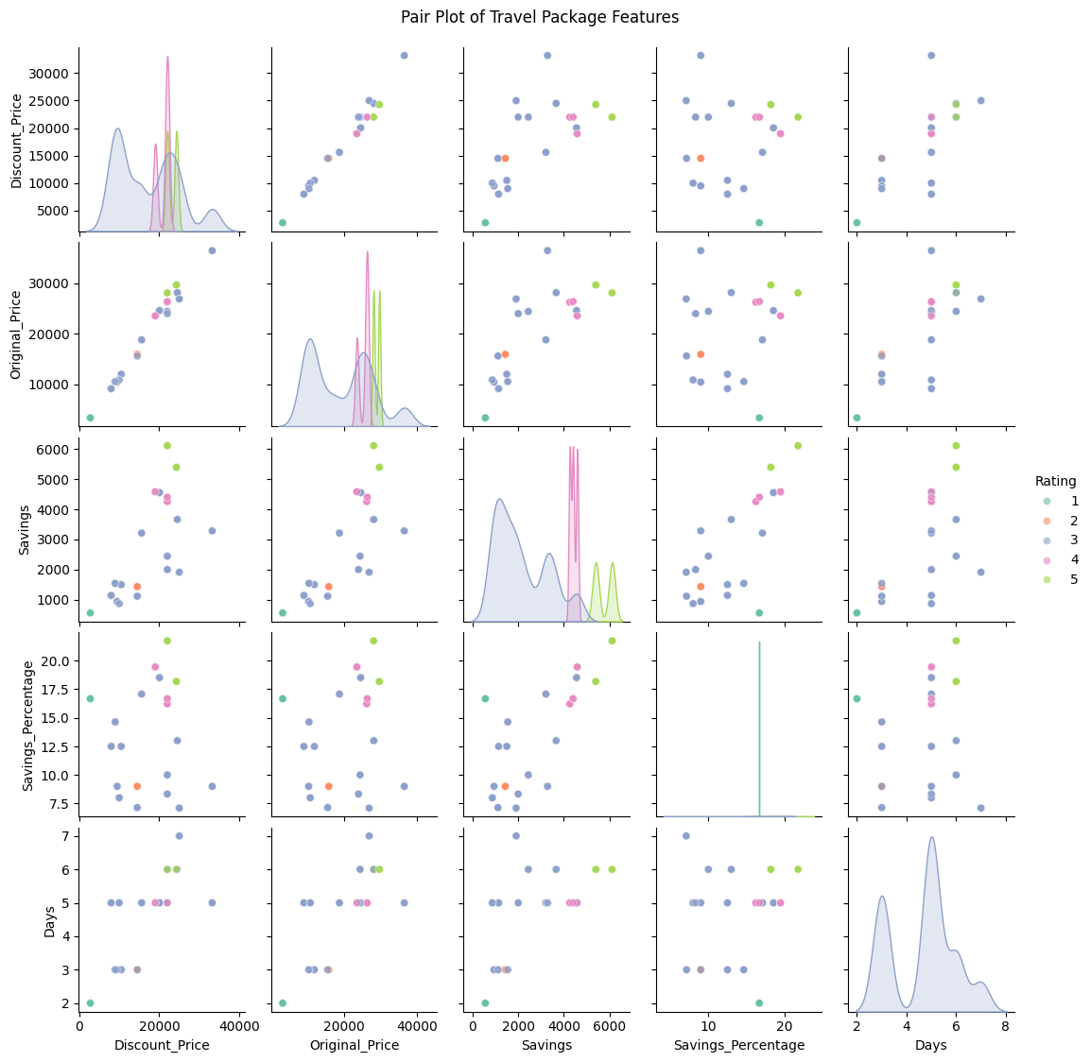
Pair Plot :

Slide 27
Business Insight From Project :
Pricing Strategy Insight
Discount Strategy Insight
Customer Value Insight
Demand Pattern Insight
Market Competitiveness Insight

Slide 28
Key Business Questions :
This analysis aims to answer the following business questions:
Does trip duration affect travel package price?
Do higher discounts lead to higher savings?
What is the relationship between original price and discounted price?
What is the relationship between original price and discounted price?
Understanding these questions helps identify travel pricing patterns and discount strategies.

Slide 29
Conclusion (Key Findings) :
The analysis of travel package data revealed several important insights :
Travel package prices vary based on duration and discounts
Discounted prices are strongly related to original package prices
Savings increase when discount percentages increase
Trip duration plays a role in determining package pricing
This project demonstrates how web scraping and exploratory data analysis can extract meaningful insights from real-world travel data.

Slide 30
Experience & Challenges :
During this project, several challenges were encountered :
Extracting structured data from website HTML pages
Cleaning price values containing symbols and commas
Handling inconsistent text formats in scraped data
This project helped improve skills :
Web Scraping
Data Cleaning
Exploratory Data Analysis
Data Visualization

Slide 31

THANK YOU

