Slide 1
Predicting Student Final Grade (G3) using XGBoost & Segmentation Capstone Project – Group 3
Team Members:
Numika Shetty, Chandan Chauhan, Raja Kumar, Vilakshan Kumar
Program: Accelerator Program in Business Analytics and Data Science Batch: 20
Dataset: UCI Student Performance Dataset Target Variable: G3 (Final Grade: 0–20)
Modelling Constraint: G1 & G2 excluded to prevent data leakage

Slide 2
Background & Problem Definition
Background & Context
Used by teachers and academic support teams
Helps identify at-risk students early and enable targeted interventions
Prediction Error (Operational Impact)
Overprediction: High risk → may miss students needing support
Underprediction: Safer → may lead to extra but useful support → Focus: Minimize overprediction
Why Regression?
G3 is a continuous score (0–20)
Provides detailed insights vs pass/fail classification
Enables better prioritization and targeted actions
Goal: Enable early identification of students needing support
Supports interventions like tutoring, counseling, attendance tracking
Dataset: UCI Student Performance (Portuguese schools). Subjects: Mathematics & Portuguese
Problem Statement
Build a Regression model to predict G3 (Final Grade: 0–20)
Use demographic, academic, and behavioral features
Users & Impact

Slide 3
Dataset Overview & Quality Checks
Dataset Context
UCI Student Performance Dataset (Portuguese schools)
Two datasets: Mathematics (395) + Portuguese (649)
Combined into 1044 records with subject indicator
Feature Overview
~30 features across:
Demographic: Age, gender, family background
Academic: Study time, past failures, school support
Lifestyle: Alcohol use, free time, social activity
Target: G3 (Final Grade: 0–20)
Leakage Control: G1 & G2 removed
Data Quality
No missing values
Correct data types (categorical, ordinal, numeric)
No duplicate records
Quality Checks Performed
Schema & merge validation
Range checks (G3, absences)
Feature validation (leakage removal)
Handled Outliers

Slide 4
Preprocessing & Feature Engineering
Preprocessing Strategy
Encoding:
Categorical → One-hot encoding
Ordinal → Retained as numeric
Numeric → No transformation
Consistency:
ColumnTransformer pipeline used
Handles unseen categories & aligns train-test features
Leakage Prevention:
G1 & G2 removed to ensure realistic predictions
Feature Engineering
Created derived features to capture hidden patterns:
Support Score: Family + school support
Attendance Risk: High absences flag
Lifestyle Index: Alcohol + social activity
Study Load Index: Study vs free time balance
Failure Flag: Past academic struggles
Rationale
Captures behavioral, academic, and support factors
Improves model’s ability to detect complex relationships
Final Feature Set
Combination of encoded, original, and engineered features
Pipeline saved for reproducibility & consistent deployment

Slide 5
Data Split Strategy
Reproducibility Measures
Fixed random seed (random_state = 42)
Deterministic and consistent data splits
Saved split indices for:
Experiment consistency
Result comparison & debugging
Preprocessing pipeline ensures consistent transformations
Leakage Prevention Checklist
G1 & G2 removed before splitting
Target (G3) excluded from features
No overlap between train, validation, test sets
Test set used only once for final evaluation
Preprocessing fitted only on training data
Data Split Strategy
70% Train | 15% Validation | 15% Test
Train → Model learning
Validation → Tuning & model selection
Test → Final unbiased evaluation → Ensures no data leakage & reliable performance measurement
Why 3-Way Split?
Separates learning, tuning, and evaluation stages
Prevents overfitting to validation/test data
Ensures true generalization performance
Stratification (Grade Bins)
Maintains balanced grade distribution across splits:
0–5 (Very Low), 6–10 (Low), 11–15 (Medium), 16–20 (High) → Reduces sampling bias and improves model reliability

Slide 6
Model Development (XGBoost Pipeline)
Model Selection
Chosen XGBRegressor for:
Strong performance on tabular data
Captures non-linear relationships
Built-in regularization (controls overfitting)
Handles mixed feature types effectively
Model Configuration
Objective: reg:squarederror
Evaluation Metric: RMSE
Random State: 42
Trained on train set, evaluated on validation set
Overfitting Analysis
Large gap between train & validation performance
Model learns training data well but fails to generalize → Indicates overfitting (learning noise, not patterns)
Operational Impact
Reduces reliability of predictions on new students
Risks missing or misclassifying at-risk students
Early Stopping Approach
Not used due to API limitation (XGBoost 3.x sklearn wrapper)
Validation RMSE monitored manually during training
Metric | Train | Validation
RMSE | 1.67 | 3.14
MAE | 1.20 | 2.42
R² | 0.82 | 0.32

Slide 7
Hyperparameter Tuning
Tuning Approach
Used RandomizedSearchCV for optimization
Efficient for large search space
Faster than GridSearch
Selection Metric: Validation RMSE
Hyperparameters Tuned
Model Complexity: n_estimators (300–1000), max_depth (3–6)
Learning Control: learning_rate (0.03–0.1)
Regularization: gamma, reg_alpha (L1), reg_lambda (L2)
Generalization: subsample, colsample_bytree
Leaf Control: min_child_weight
Tuning Strategy
Balanced bias vs variance
Reduced overfitting via:
Lower depth & learning rate
Sampling (row & feature)
Regularization penalties
Model Selection
Primary Metric: RMSE
Secondary Metric: MAE → Selected model with lowest validation RMSE
Model | Validation RMSE
Baseline | 3.137
Tuned Model | 2.952

Slide 8
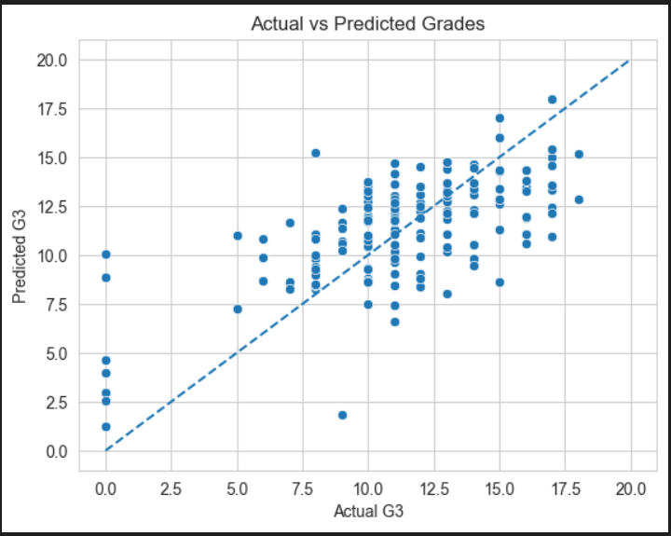
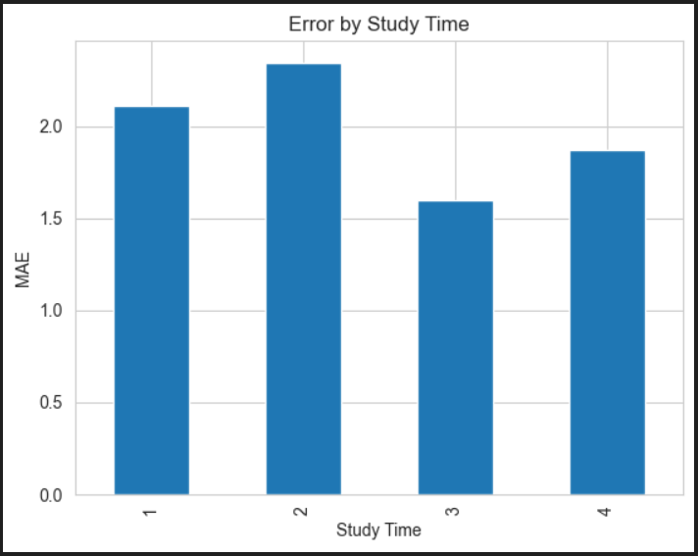
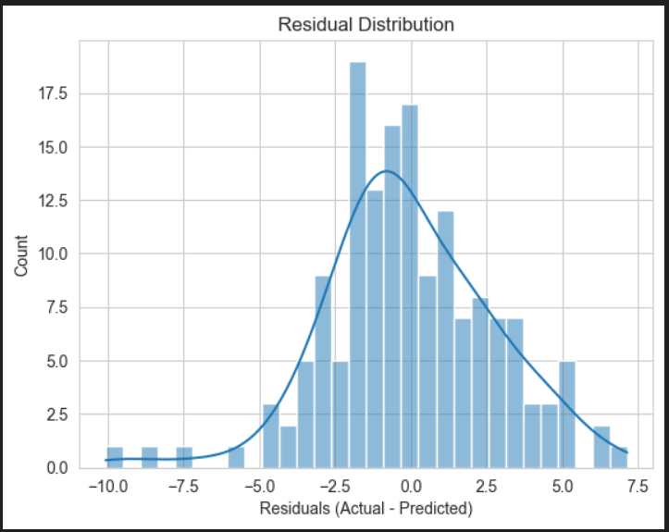
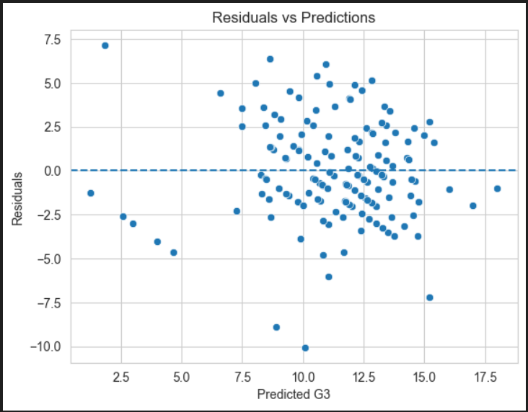
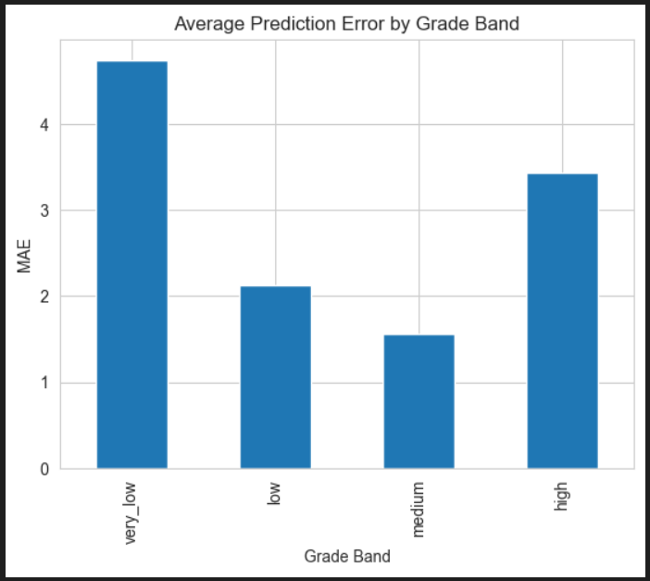
Final Model Evaluation
Evaluation Approach
Tested on unseen data (not used in training/tuning) → Ensures true generalization performance
Model Performance Insights
Predictions closely follow actual values (good mid-range accuracy)
Higher errors at extremes (very low & high grades)
Model shows balanced errors (no strong bias)
Residual Analysis
Residuals centered around zero → unbiased model
Random scatter → no systematic prediction pattern/errors
Error by Grade Bands
Best Performance: Medium (11–15) → stable patterns
Higher Errors:
Very Low (0–5) → inconsistent behavior
High (16–20) → slight underprediction
Moderate error in Low (6–10)
Metric | Value
MAE | 2.144
RMSE | 2.776
R² | 0.437

Slide 9
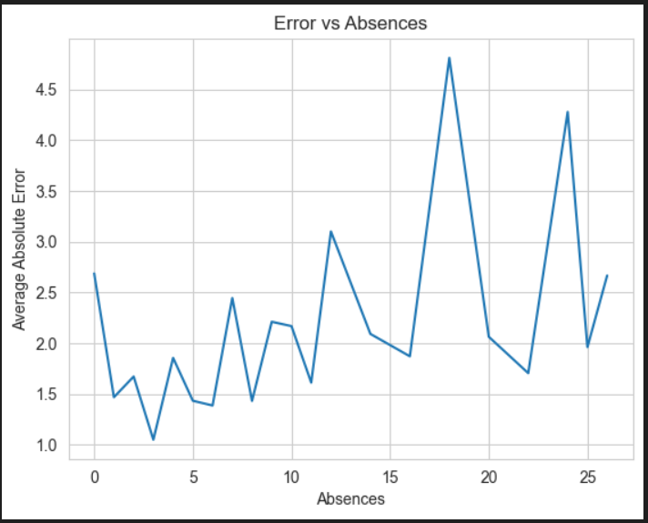
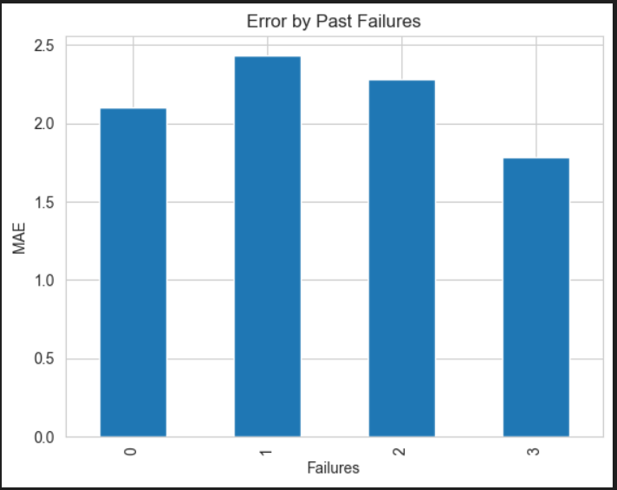
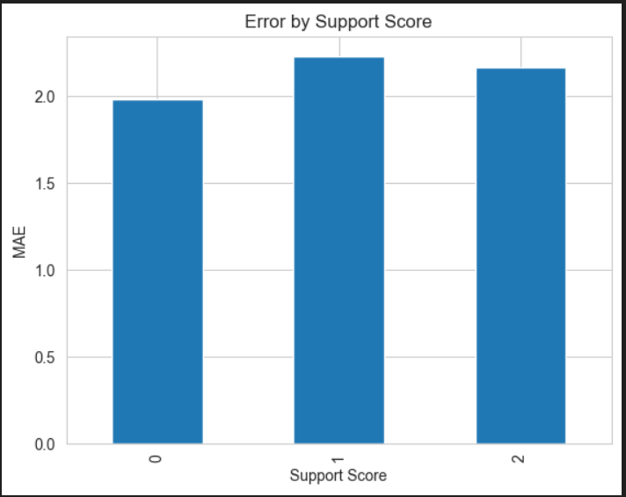
Error Analysis
Approach
Error slicing across key factors:
Absences, Study Time, Past Failures, Support
Evaluated using MAE (absolute error) to identify patterns
Key Findings
Absences: High absences → higher error & poor performance
Study Time: Higher study time → lower error & better predictability
Past Failures: More failures → higher error & inconsistent outcomes
Support: Strong family/school support → lower error & stability
Prediction Patterns
Underprediction: High-performing students
High variability: Very low-performing students → Model shows regression toward mean (struggles at extremes)
Core Insights
Highest errors in very_low & high grade bands
Absences & past failures are strongest risk indicators
Support & study habits improve both performance and predictability
Recommended Actions
Targeted tutoring for students with past failures
Attendance monitoring & counselling for high absences
Structured study plans for low study-time students
Strengthen family & school support systems
Provide digital access support for underserved students

Slide 10
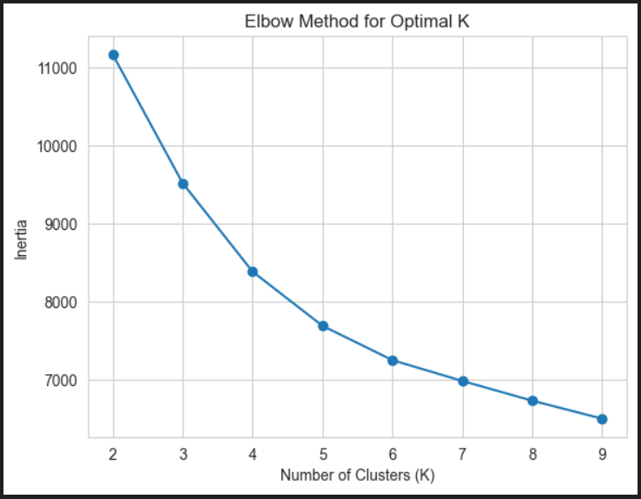
Clustering: Student Segmentation
Objective
Segment students based on behavioral & academic patterns → Enables targeted interventions beyond individual predictions
Feature Selection
Excluded: G1, G2, G3 (to avoid leakage)
Used:
Academic: study time, failures, absences
Derived: support score, study load, attendance risk
Lifestyle & demographics
Clustering Approach
StandardScaler for normalization
K-Means Clustering
Optimal clusters: K = 4 (Elbow Method)
Validation: Hierarchical clustering confirmed stability
Cluster Segments
C0 & C2 – Moderate Performers (Majority)
Stable behavior, average performance
→ Regular support & monitoring
C1 – At-Risk Students
High failures, low study time, lowest grades
→ Targeted tutoring & mentoring
C3 – Low Attendance Group
High absences, irregular engagement
→ Attendance tracking & counseling
Key Insights
Performance driven by behavioral patterns, not single factors
Small at-risk group drives poor outcomes
Attendance & study habits are key differentiators
Cluster | Size | Segment | Avg G3 | Key Traits | Suggested Support Action
C0 | 203 | Moderate Performers | 12.80 | Average studytime, moderate absences | Regular academic support and guidance
C1 | 172 | At-Risk Students | 7.83 | High failures, low studytime | Targeted tutoring and mentoring programs
C2 | 646 | Moderate Performers | 11.85 | Balanced behavior, average performance | Continuous monitoring and support
C3 | 23 | Low Attendance Group | 10.43 | High absences, irregular engagement | Attendance monitoring and counseling

Slide 11
Recommendation
Key Recommendations
Targeted Tutoring (At-Risk Students – C1): Remedial classes & personalized support plans
Attendance Monitoring (C3): Tracking systems & counseling for frequent absentees
Structured Study Programs: Guided schedules & time management support
Strengthen Support Systems: Increase parental involvement & school support initiatives
Digital Access Support: Provide internet & learning resources for underserved students
Limitations
Moderate Accuracy: R² ~0.43 (partial variance explained)
Self-Reported Data Bias: Possible inaccuracies
Limited Features: Missing socio-economic, psychological, teacher factors
Generalizability: Data from only 2 schools
Initial Overfitting: Required tuning for stability
Next Steps
Feature Enrichment: Add motivation, teacher feedback, socio-economic data
Advanced Models: Explore ensembles, deep learning, time-series analysis
Model Monitoring: Track drift & retrain periodically
Deployment: Integrate into school decision systems
Fairness Checks: Evaluate across gender & socio-economic groups
Final Conclusion
ML enables early prediction of student performance
Combination of XGBoost + clustering delivers actionable insights
Supports data-driven interventions to improve student outcomes

