Slide 1
Amazon Advertising Predicting retail sales driven by online display ads
By Jessica Otaguro

Slide 2

Can we predict a product’s sales (attributed to advertising) on amazon.com based on its product rating, ad spend, and other attributes on the ad platform?

Slide 3
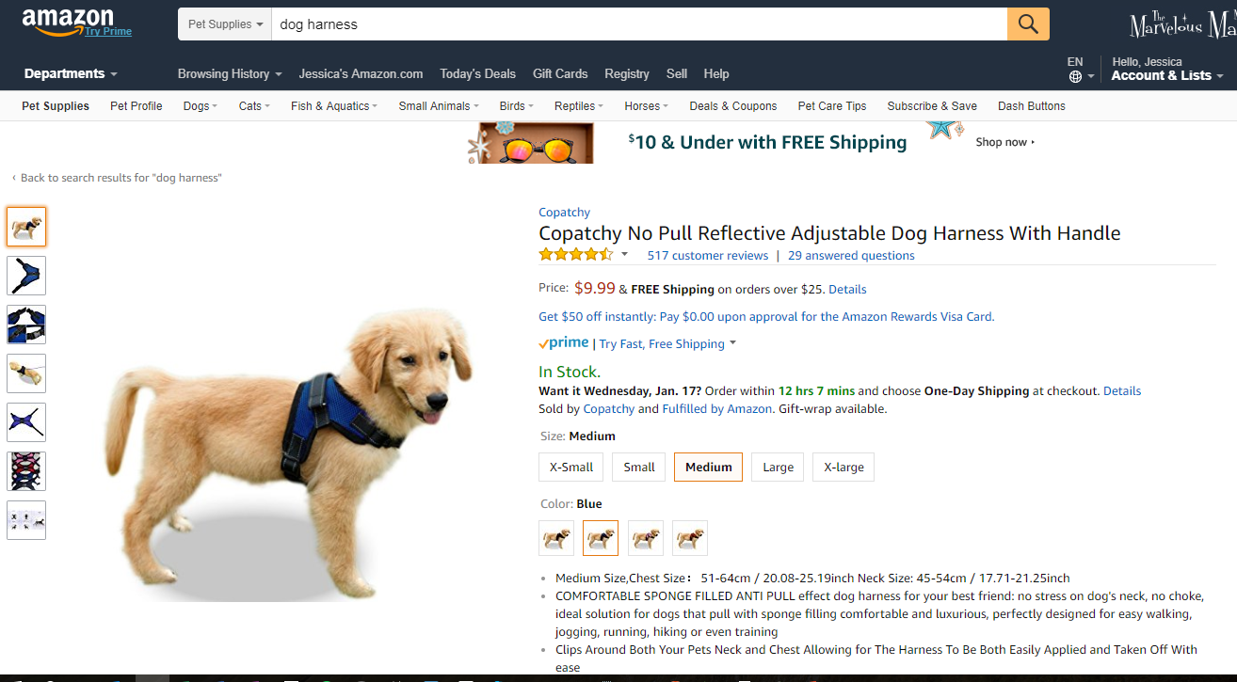
Amazon Ad Platform
1. User shops on Amazon for a dog harness. She is in the market for dog supplies.

Slide 4
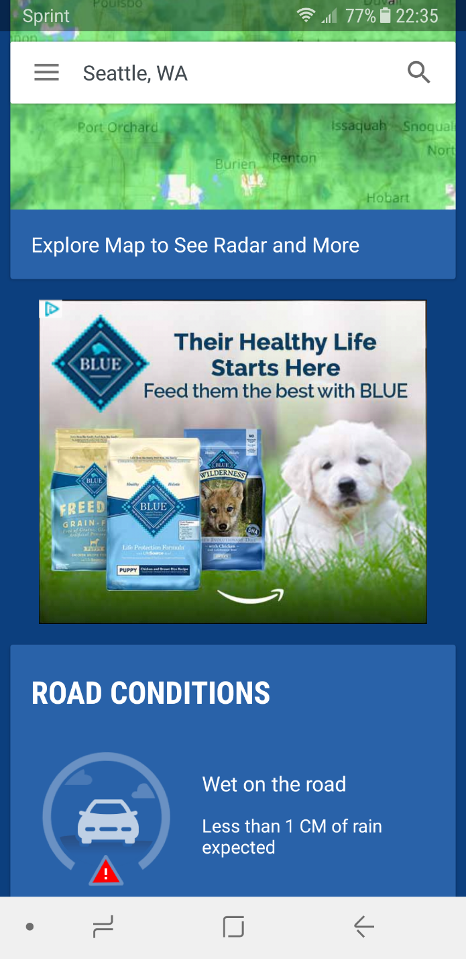
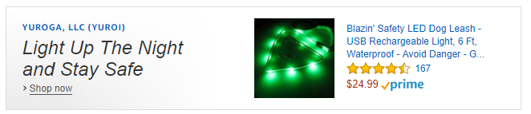
Amazon Ad Platform
2. User can be targeted with ads on any device, site, or mobile app for products related to her browsing habits

Slide 5
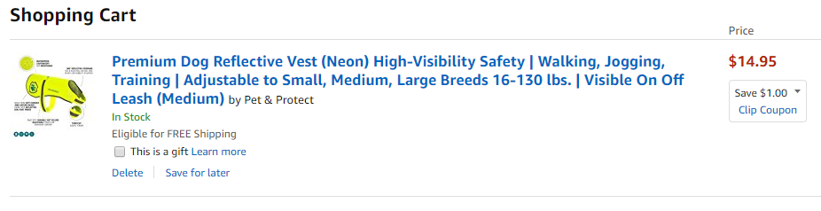
Amazon Ad Platform
3. When user purchases the item, the ad impression that the user viewed will be attributed with the sale.

Slide 6
Amazon Ad Platform
Process is encompassed by a campaign paid for by the advertiser.
E.g. during Super Bowl, DiGiorno may run a football-related ad campaign before and up to the game.

Slide 7
Data
16 columns, including:
Advertiser
Name
Country (US and Canada)
Campaign
Start and end dates
Device type (Desktop, Mobile web, Mobile App)
Performance optimization type (e.g. Purchases, Clicks, Views)
Spend
Impressions
Clicks
Detail page views
Units sold
Total sales
26,170 rows (2525 include nulls, 9%)
Still Need:
Product
Rating
Price
Number of reviews
Category
Campaign
Bid rates
Targeting
Notes:
If I have time, would like to gather advertiser brand size, bids, targeting segments, product info, serve location
Not much cleaning needed
Need to analyze rows with nulls to determine best course of action for them

Slide 8
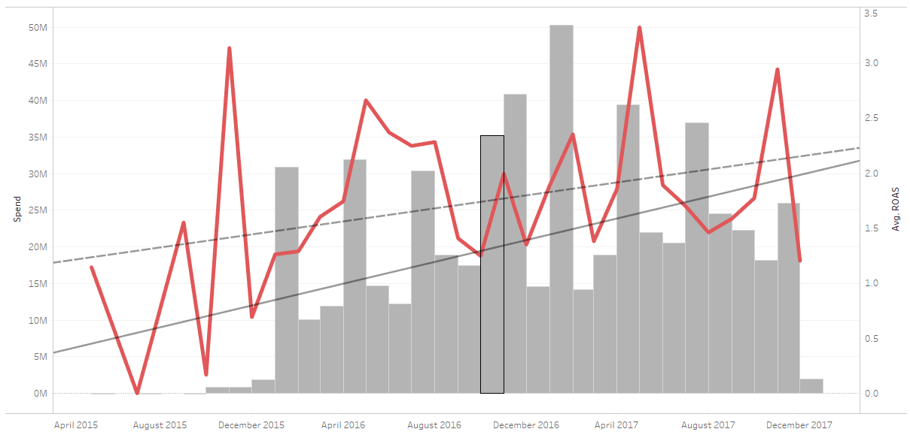
Insights
ROAS and spend have been increasing over time

Slide 9
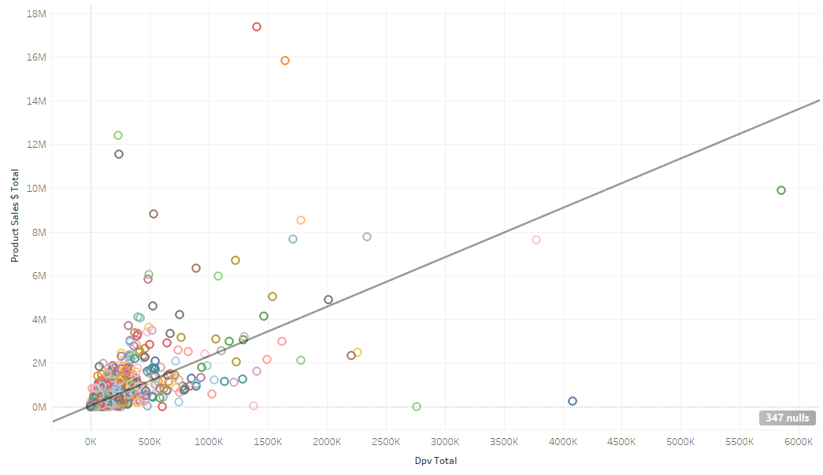
Insights
Detail page views positively correlated with sales

Slide 10
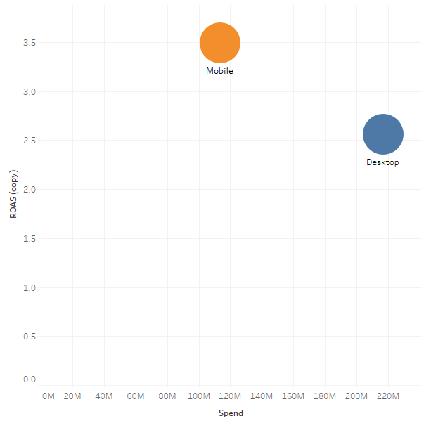
Insights
Campaigns are serving more ads on Desktop, yet there is a higher return on Mobile. Can we maximize the spend on Mobile devices?

Slide 11
Next Steps
Gather additional data
Product info
Advertiser info
Modeling

