Slide 1
Amazon Advertising Predicting retail sales driven by online display ads
By Jessica Otaguro

Slide 2

Can we predict a product’s sales (attributed to advertising) on amazon.com based on its product rating, ad spend, and other attributes on the ad platform?

Slide 3
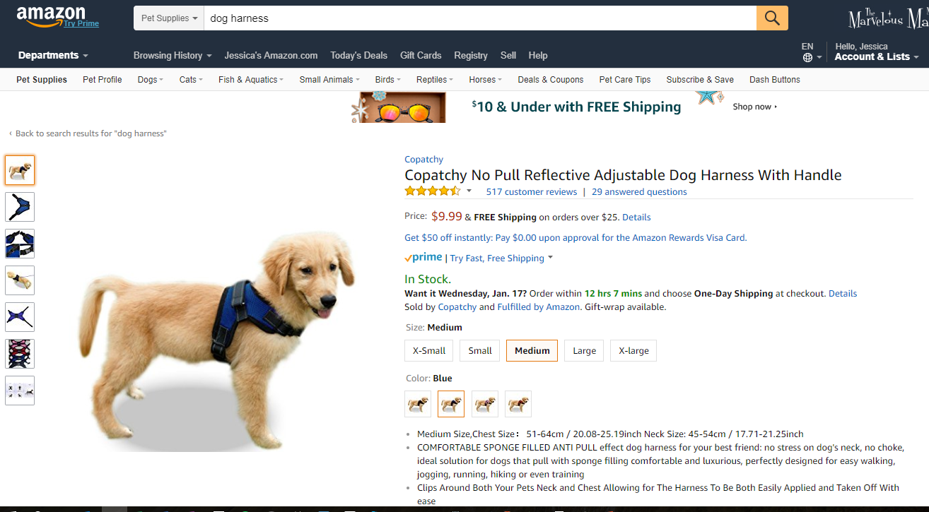
Amazon Ad Platform
1. User shops on Amazon for a dog harness. She is in the market for dog supplies.

Slide 4
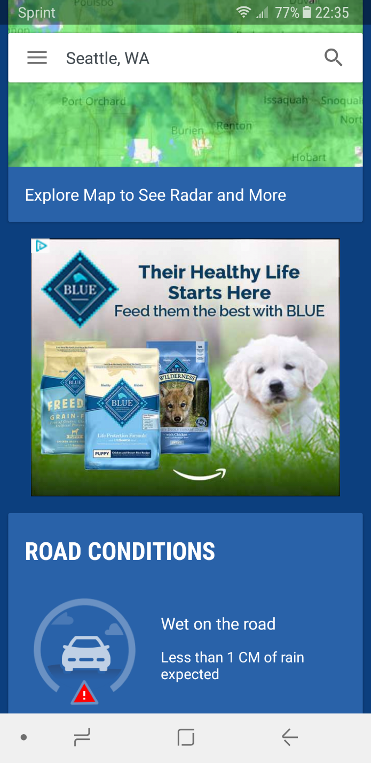
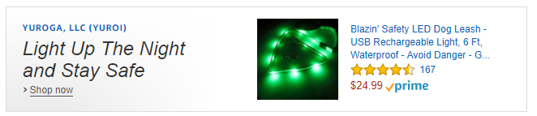
Amazon Ad Platform
2. User can be targeted with ads on any device, site, or mobile app for products related to her browsing habits

Slide 5
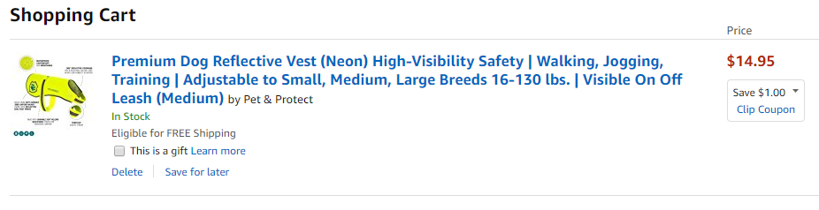
Amazon Ad Platform
3. When user purchases the item, the ad impression that the user viewed will be attributed with the sale.

Slide 6
Amazon Ad Platform
Process is encompassed by a campaign paid for by the advertiser.
E.g. during Super Bowl, DiGiorno may run a football-related ad campaign before and up to the game.

Slide 7
Data
Pulled from advertising data warehouse
16 columns, including:
Advertiser
Name
Country (US and Canada)
Product
Rating
Price
Number of reviews
Category
26,170 rows (2525 include nulls, 9%)
Campaign
Start and end dates
Device type (Desktop, Mobile web, Mobile App)
Performance optimization type (e.g. Purchases, Clicks, Views)
Spend
Impressions
Clicks
Detail page views
Units sold
Total sales
Notes:
If I have time, would like to gather advertiser brand size
Not much cleaning needed
Need to analyze rows with nulls to determine best course of action for them

Slide 8
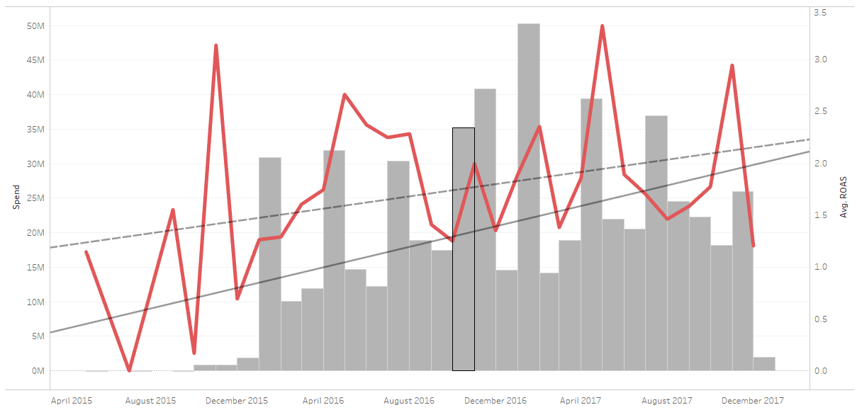
Insights
ROAS and spend have been increasing over time

Slide 9
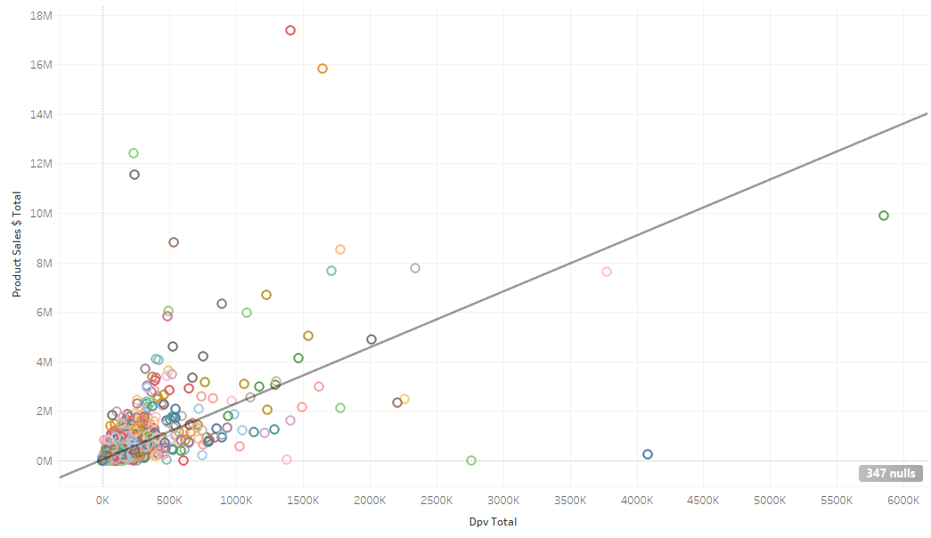
Insights
Detail page views positively correlated with sales

Slide 10
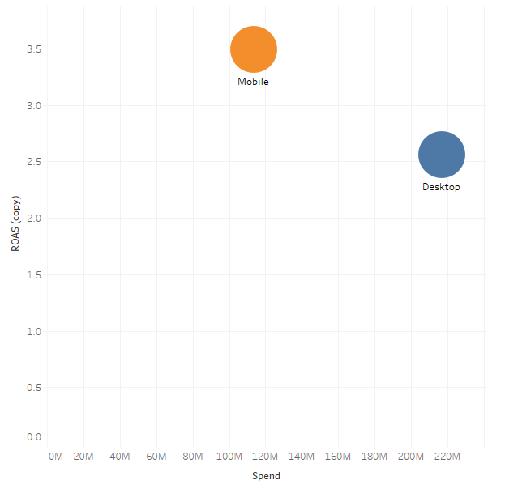
Insights
Campaigns are serving more ads on Desktop, yet there is a higher return on Mobile. Can we maximize the spend on Mobile devices?

Slide 11
Next Steps
Gather additional data
Product info
Advertiser info

