Slide 1

Rajalakshmi Suresh| INSAID – GCDAI
22-Apr-2021

Slide 2
Problem Statement
1. EDA – ‘Analysis on Facebook Dataset’
2. Get insights
Types of Users who are active on Facebook
Usability of Mobile & Web applications
Enhancements to the existing features and new inclusions to attract more users - Future

Slide 3
Facebook Users

Slide 4
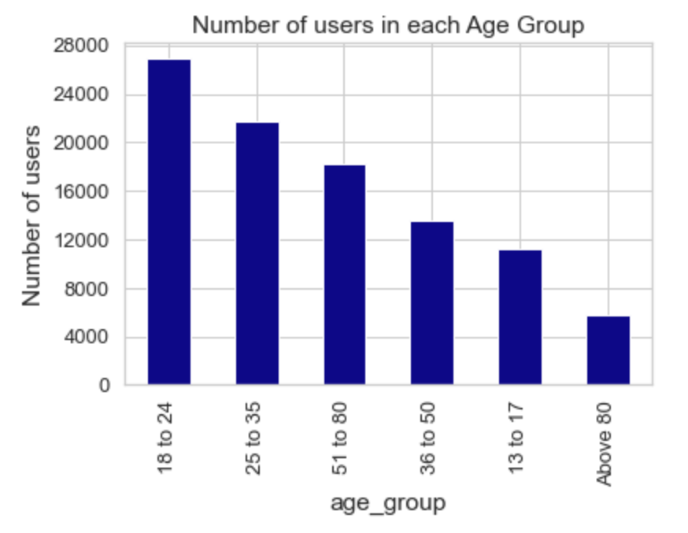
Classification based on Age
Maximum no. of users are between 18 to 35 years of age

Slide 5
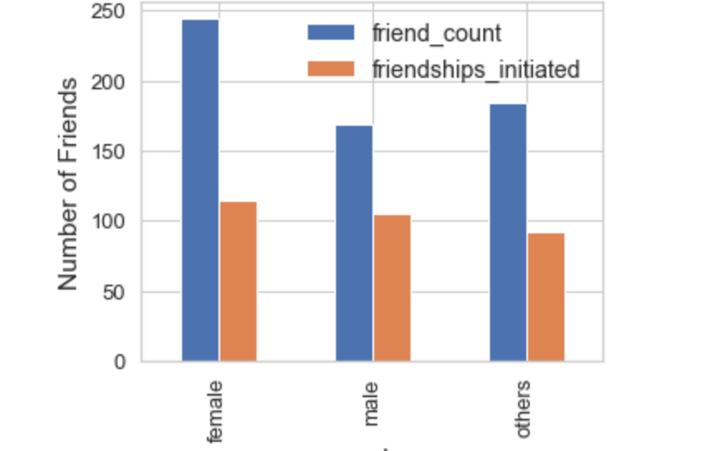
Users who are interested in Friendships
Female users have more no. of friends and have initiated more Friendships

Slide 6
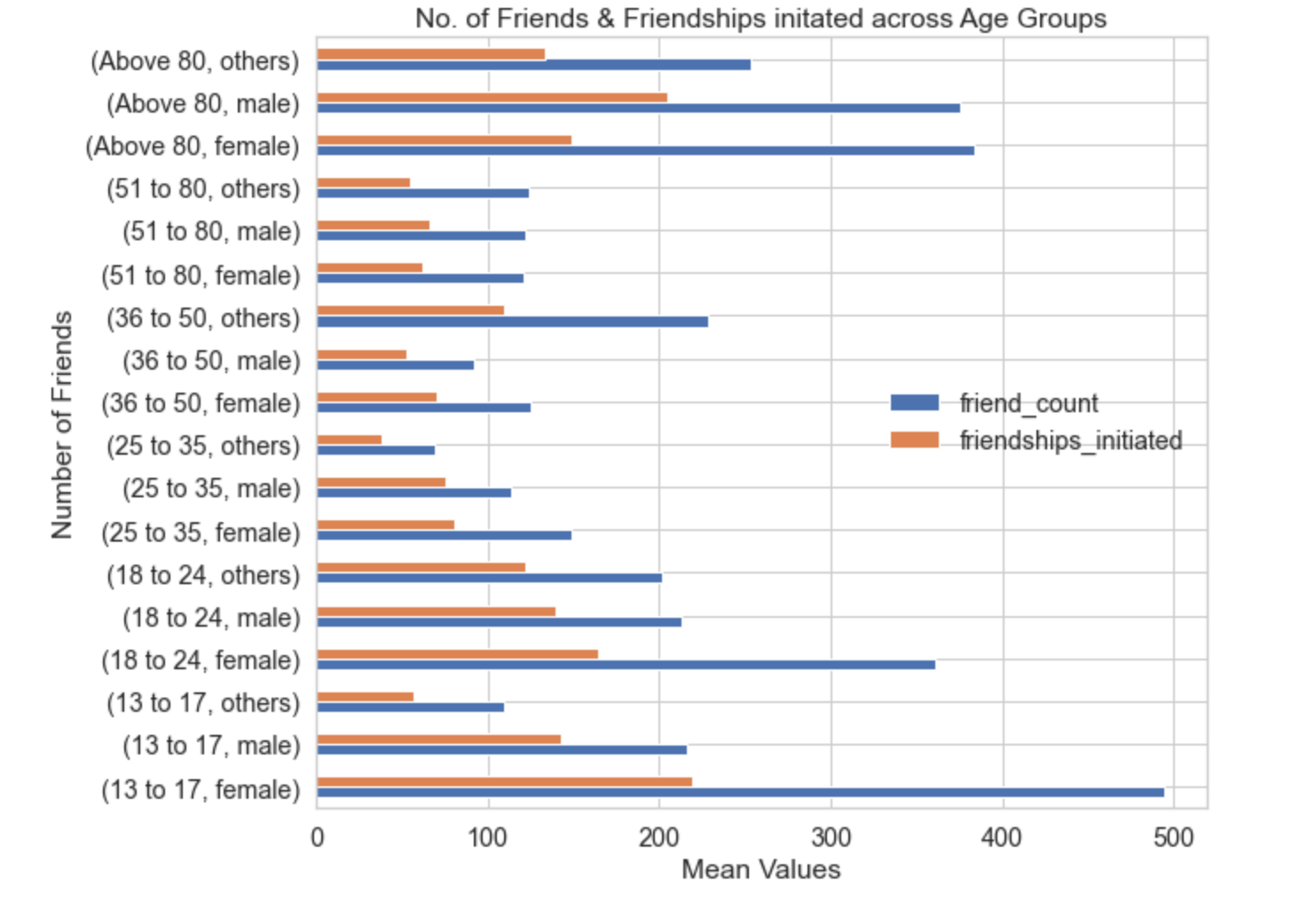

Slide 7
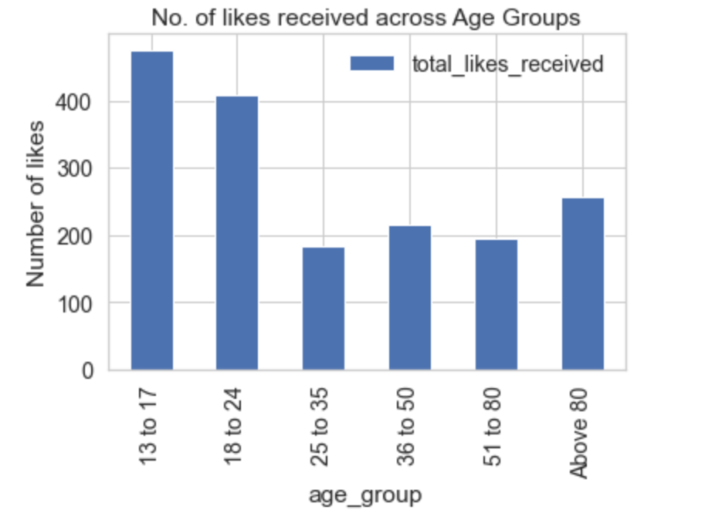
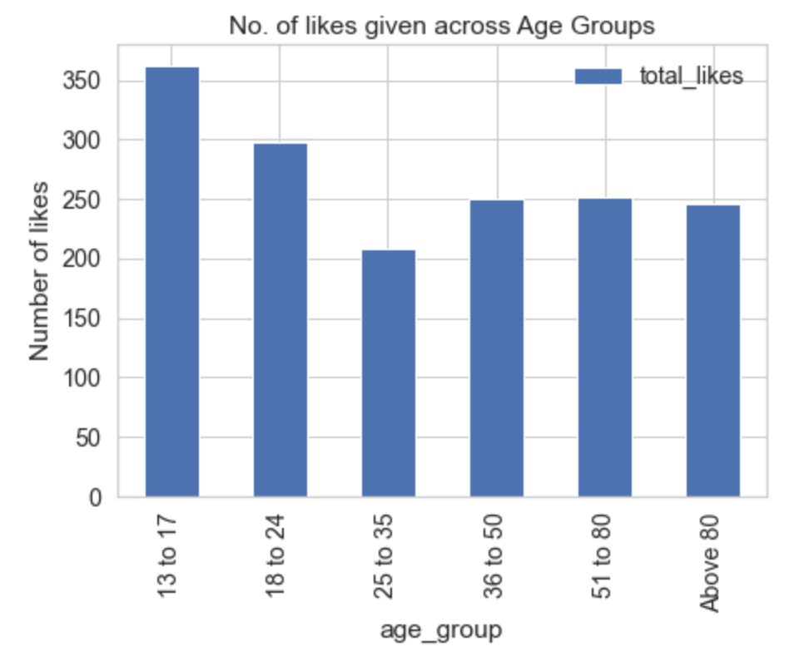
Likes given & received – classified by Age Groups
Users between 13 to 24 years of age are using the features for Likes

Slide 8
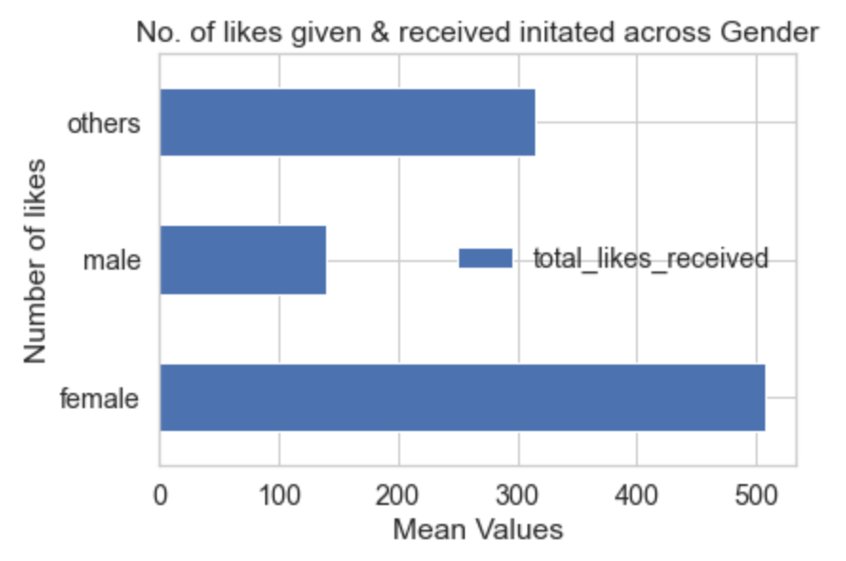
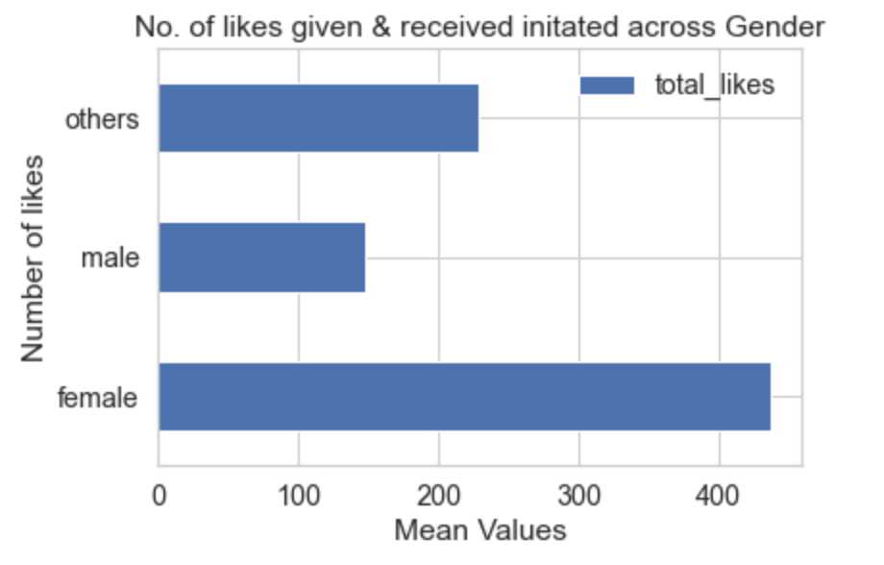
Likes given & received – classified by Gender
Female users are using the features for Likes

Slide 9
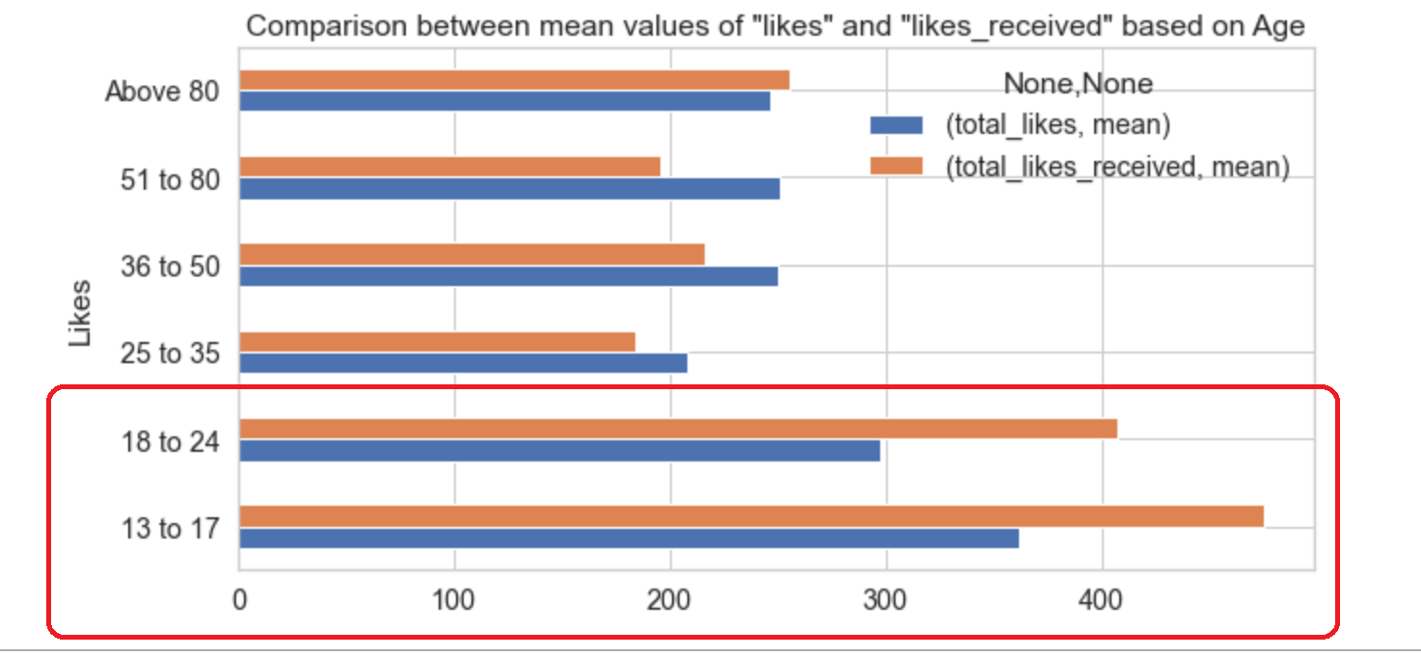

Slide 10
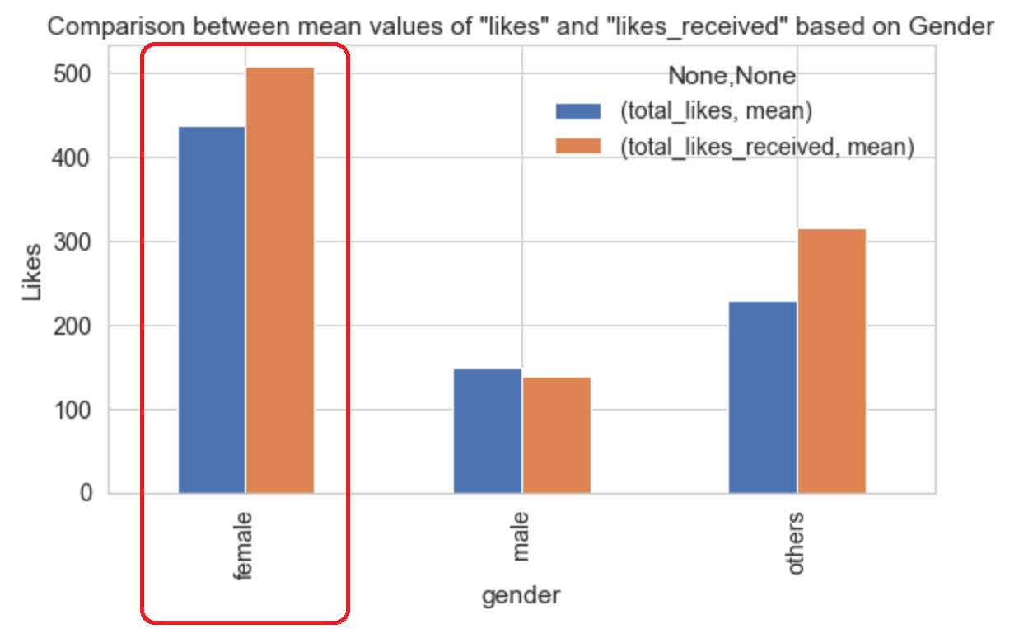

Slide 11
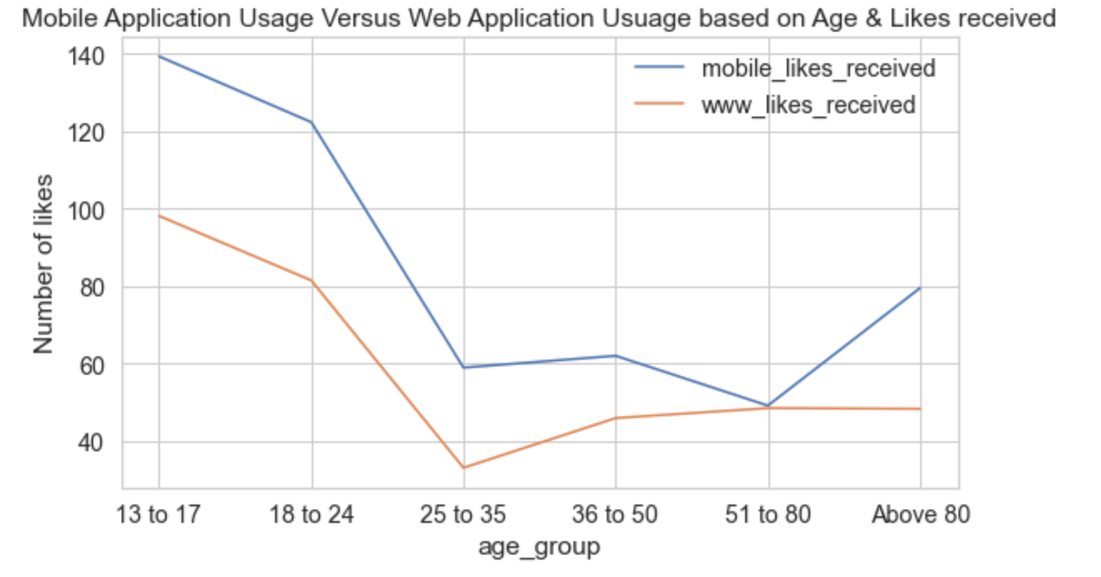
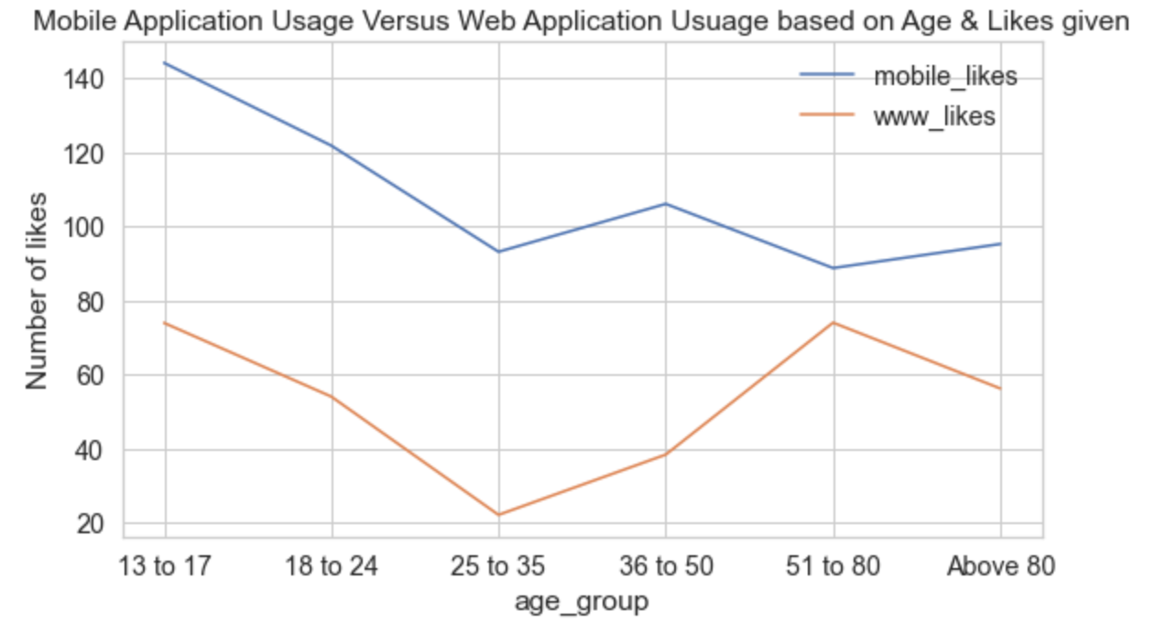
Comparison based on the Application Usage - 1

Slide 12
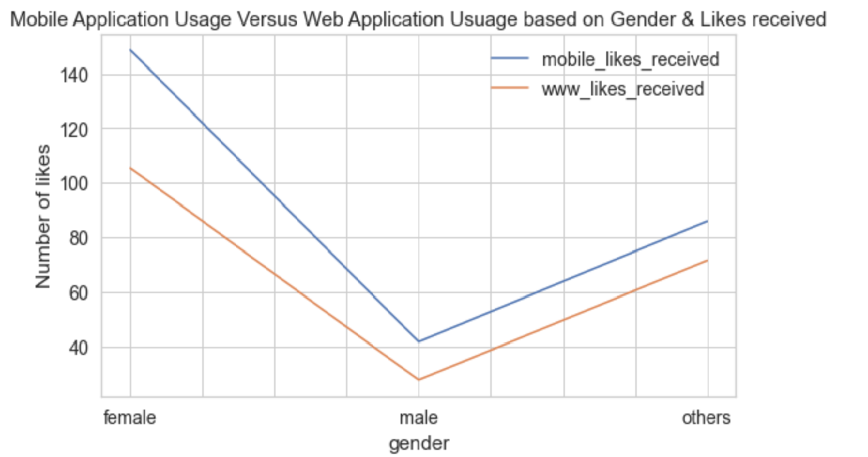
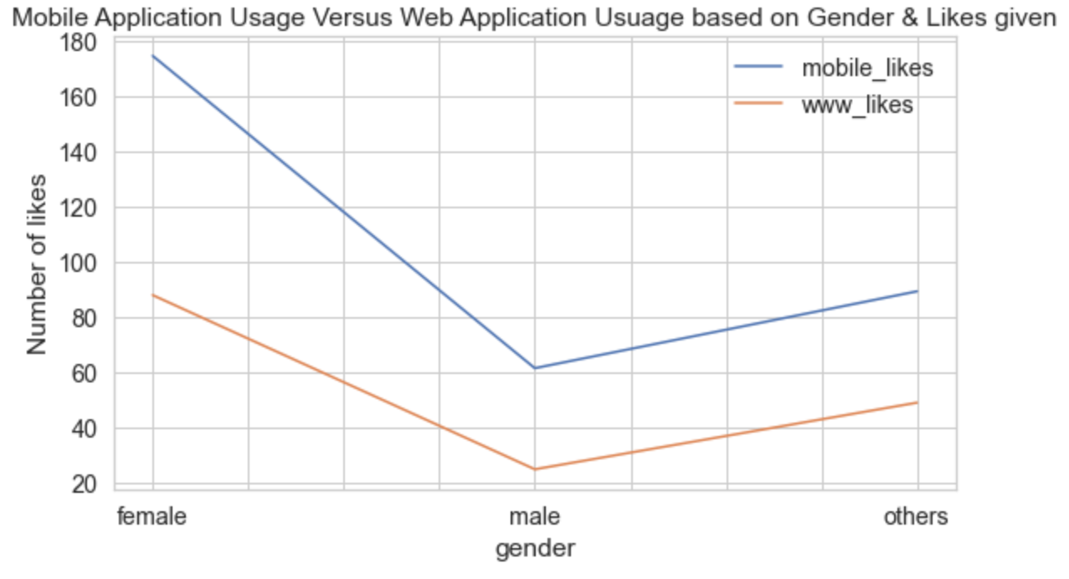
Comparison based on the Application Usage - 2

Slide 13
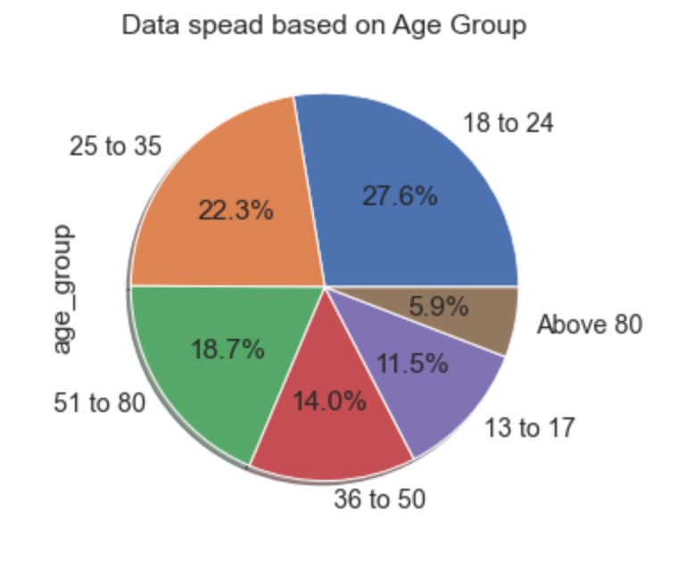
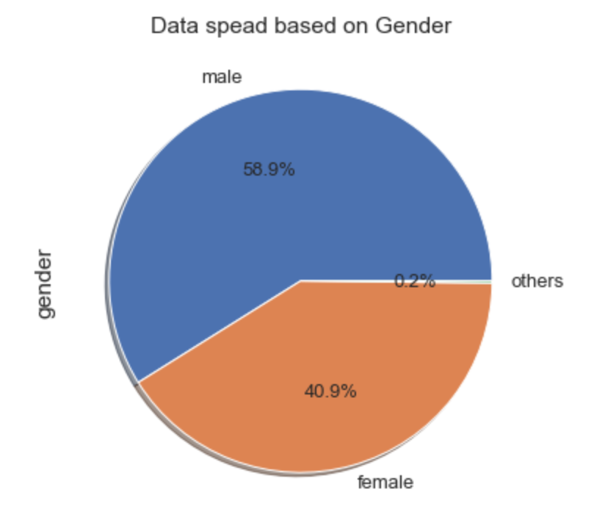
Distribution or spread of data across Age Group & Gender

Slide 14
Conclusion
Maximum no. of users belong to age-groups between 18 to 24 years & 25 to 35 years (around 50%).
Female users have more than friends and are interested in friendships (more than 20%) than Male and Other gender users.
On an average users belonging to 13 to 24 years age-group have more no. of friends (more than 50%).
On an average users belonging to 18 to 35 years age-groups have initiated more no. of friend requests compared (more than 50%). This figure seems more appropriate based on the no. of users.
Since likes received are positively skewed, mean of total likes received across age-groups shows that users 13 to 24 have more no. of likes received.
On an average users belonging to 13 to 24 years age-groups have given more no. of likes.
Female users have more no. likes received and given.
There are users with longest tenure more than 2000 days, who seem to be still active.
Comparison between usage of mobile and web applications based on categories, friend counts and friendships initiated, likes and likes received shows around 80% users using Facebook Mobile application.
People are silhouetted as they pose with mobile devices in front of a screen projected with a Facebook logo

Slide 15
Actionable Insights
Facebook could improve the usability of features or add new features to their mobile application, since 80% users are using mobile application across various age-groups and gender.
Maximum no. of active users are between 13 to 35 years of age, so Facebook could introduce new games or any other features that can attract other age-groups including youngsters
Maximum no. of users are Females, so Facebook could develop strategies to attract other genders along with Female users too
At least 1 to 2% of users seem to be inactive, Facebook could plan to prompt inactive users. Even if the users are still inactive after certain no. of prompts, Facebook can arrive at a plan to manage such data.

Slide 16

THANK YOU

