Slide 1
2-3 Trees in Data Structures
Search, Insert, and Deletion Operations

Slide 2
Introduction to Trees
• Tree data structures are hierarchical models used in computer science to represent data.
• Types of trees include Binary Search Trees (BST), AVL Trees, Red-Black Trees, B-Trees, and 2-3 Trees.
• Trees offer efficient search, insert, and delete operations.

Slide 3
2-3 Trees Overview
• A 2-3 Tree is a type of B-tree of order 3, ensuring that it remains balanced.
• Like other balanced trees (AVL, Red-Black), it ensures operations take O(log N) time in the worst case.
• Each node in a 2-3 tree is either a 2-node (1 value, 2 children) or a 3-node (2 values, 3 children).

Slide 4
Properties of 2-3 Trees
• All data values are stored in sorted order.
• It is a balanced tree, meaning all leaf nodes are at the same level.
• Each node can either be a 2-node (with 1 data value) or a 3-node (with 2 data values).
• Insertions are always done at leaf nodes.

Slide 5
Search Operation
To search for a key K in a 2-3 tree T:
1. If T is empty, return False.
2. If the current node contains K, return True.
3. If at a leaf node and it doesn’t contain K, return False.
Recursive steps:
• If K < leftVal, explore the left subtree.
• If leftVal < K < rightVal, explore the middle subtree.
• If K > rightVal, explore the right subtree.

Slide 6
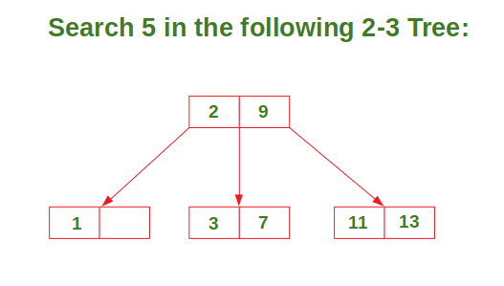
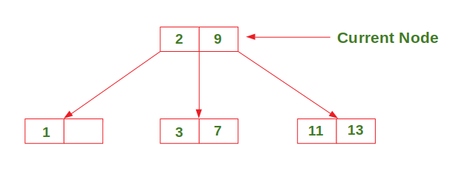
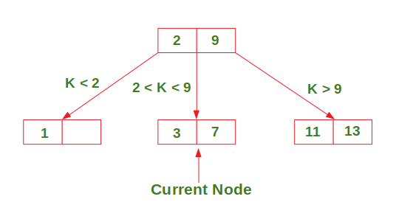
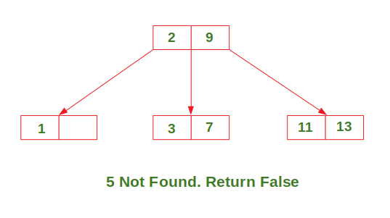

Slide 7
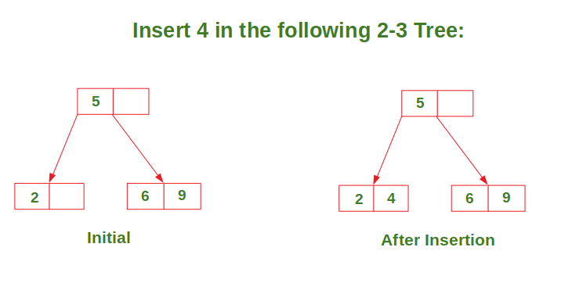
Insertion - Case 1
Inserting into a node with only one data element.
• The new value is added without breaking any tree properties.

Slide 8
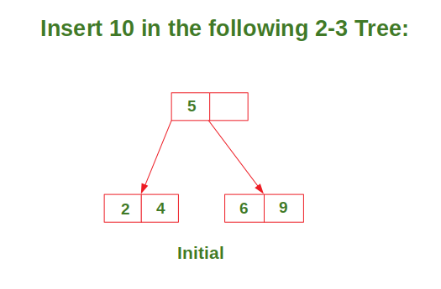
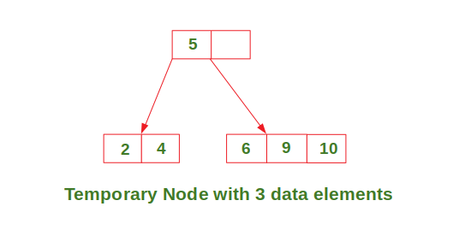
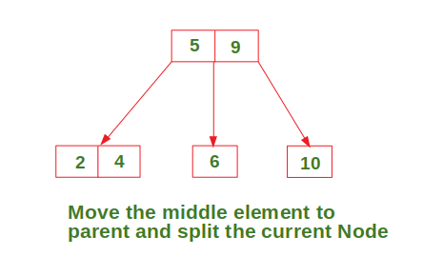
Insertion - Case 2
Inserting into a node with two data elements, where the parent has only one data element.
• The node splits, and one value is pushed to the parent node.

Slide 9
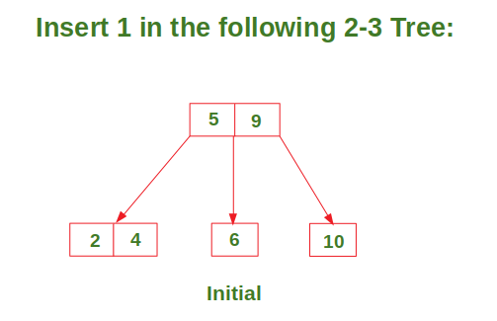
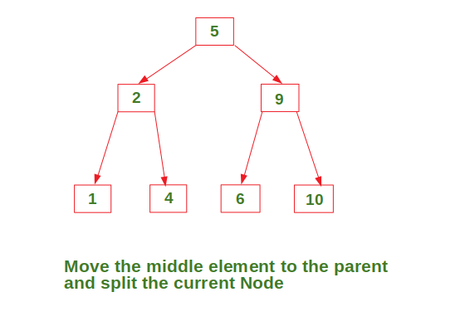
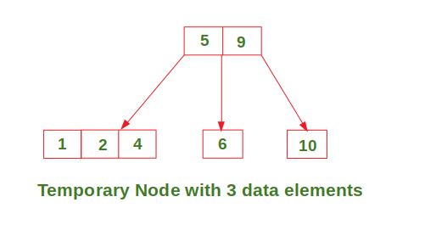
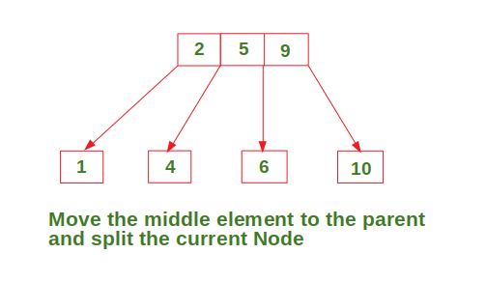
Insertion - Case 3
Inserting into a node with two data elements, where the parent also contains two data elements.
• A split happens, and balancing is required.

Slide 10
Deletion Operation
To delete a value, it is replaced by its in-order successor and then removed.
If a node is left with less than one data value then two nodes must be merged together.
If a node becomes empty after deleting a value, it is then merged with another node.
To Understand the deletion process-
Deletion in a 2-3 tree involves swapping with the in-order successor and removing the value from the leaf node.
If a node has less than one data value after deletion, nodes must be merged to maintain balance.

Slide 11
Rebalancing After Deletion
After deletion, merging of nodes is required to maintain the 2-3 tree properties.
• This ensures that all nodes are balanced and the tree structure remains valid.

Slide 12


Consider the 2-3 tree given below
delete the following values from it: 69,72, 99, 81.
To delete 69, swap it with its in-order successor, that is, 72. 69 now comes in the leaf node. Remove the value 69 from the leaf node.

Slide 13


To delete 72, 72 is an internal node. To delete this value swap 72 with its in-order successor 81 so that 72 now becomes a leaf node. Remove the value 72 from the leaf node.
Now there is a leaf node that has less than 1 data value thereby violating the property of a 2-3 tree. So the node must be merged.
To merge the node, pull down the lowest data value in the parent’s node and merge it with its left sibling.

Slide 14
Conclusion
2-3 trees offer efficient operations for search, insert, and deletion.
• By maintaining balance, these trees ensure O(log N) time complexity for all operations.

