Slide 1
Binary Search Trees (BST)
Dr. K. Arul Deepa
DIST, CEG

Slide 2
Introduction to Binary Search Trees
A Binary Search Tree (BST) is a hierarchical data structure in which each node contains a key and pointers to two children.
Properties:
Left subtree: keys ≤ root
Right subtree: keys ≥ root

Slide 3
Binary Search Tree Properties
Binary Search Tree Property: All nodes in the left subtree are less than the parent node, and all nodes in the right subtree are greater than or equal to the parent node.

Slide 4
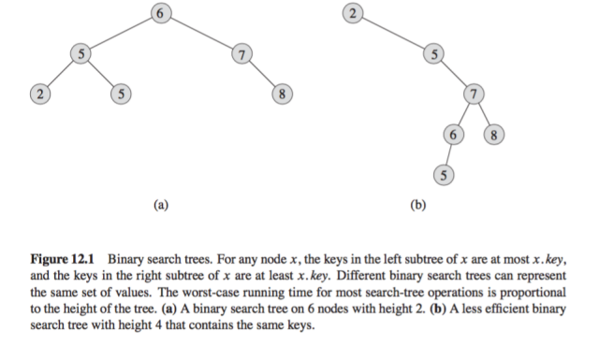
BST Example

Slide 5
Basic Operations Overview
Operations:
1. Search
2. Insertion
3. Deletion
4. Traversal (Inorder, Preorder, Postorder)
Complexity:
- Best Case: O(log n)
- Worst Case: O(n)

Slide 6
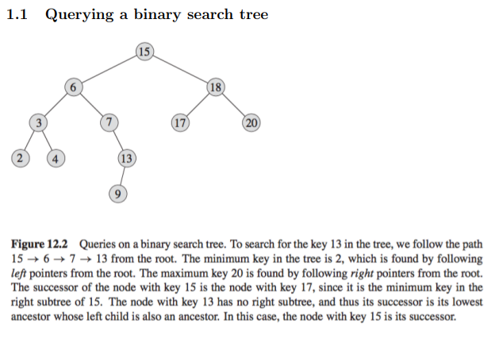

Slide 7
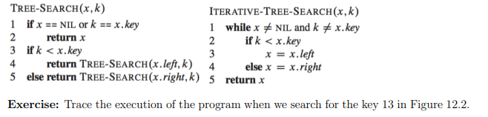
Tree Search

Slide 8
Search in BST
Problem Statement: Search for a key in a BST.
Algorithm:
BST-Search(x, k):
if x == NIL or k == x.key:
return x
if k < x.key:
return BST-Search(x.left, k)
else:
return BST-Search(x.right)
Complexity: O(h) where h is the height of the tree.

Slide 9
Iterative Search in BST
Iterative Algorithm:
BST-Search-Iterative(x, k):
while x ≠ NIL and k ≠ x.key:
if k < x.key:
x = x.left
else:
x = x.right
return x
Explanation: This avoids recursion by using a loop.

Slide 10
Search – C Code
// function to search a key in a BST
struct Node* search(struct Node* root, int key)
{
// Base Cases: root is null or key is
// present at root
if (root == NULL || root->key == key)
return root;
// Key is greater than root's key
if (root->key < key)
return search(root->right, key);
// Key is smaller than root's key
return search(root->left, key);
}

Slide 11
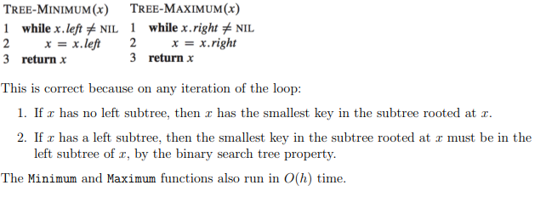
Minimum and Maximum in BST

Slide 12
Minimum and Maximum in BST
Finding Minimum: Traverse left subtree until NIL.
Algorithm:
BST-Minimum(x):
while x.left ≠ NIL:
x = x.left
return x
Finding Maximum: Traverse right subtree until NIL.
Algorithm:
BST-Maximum(x):
while x.right ≠ NIL:
x = x.right
return x
Examples: Illustrate finding minimum and maximum in a BST.

Slide 13
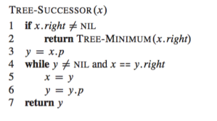
In order - Successor

Slide 14
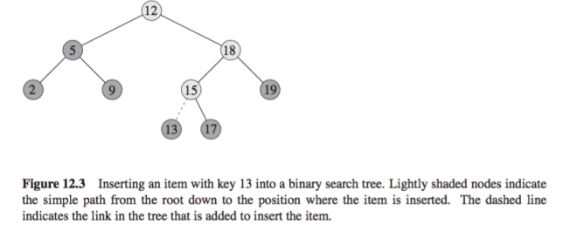
Insertion

Slide 15
Insertion
Initilize the current node (say, currNode or node) with root node
Compare the key with the current node.
Move left if the key is less than or equal to the current node value.
Move right if the key is greater than current node value.
Repeat steps 2 and 3 until you reach a leaf node.
Attach the new key as a left or right child based on the comparison with the leaf node’s value.

Slide 16
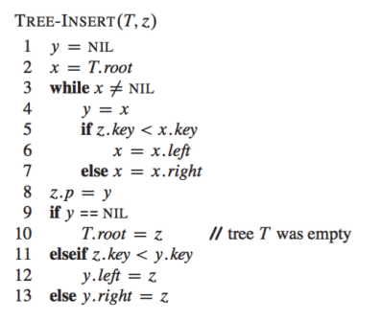
Insertion

Slide 17
Insertion C- code
// Define the structure for a BST node
struct Node {
int key;
struct Node* left;
struct Node* right;
};
// Function to create a new BST node
struct Node* newNode(int item) {
struct Node* temp =
(struct Node*)malloc(sizeof(struct Node));
temp->key = item;
temp->left = temp->right = NULL;
return temp;
}
// Function to insert a new node with the given key
struct Node* insert(struct Node* node, int key) {
// If the tree is empty, return a new node
if (node == NULL)
return newNode(key);
// If the key is already present in the tree,
// return the node
if (node->key == key)
return node;
// Otherwise, recur down the tree. If the key
// to be inserted is greater than the node's key,
// insert it in the right subtree
if (node->key < key)
node->right = insert(node->right, key);
// If the key to be inserted is smaller than
// the node's key,insert it in the left subtree
else
node->left = insert(node->left, key);
// Return the (unchanged) node pointer
return node;
}

Slide 18
Deletion in BST
Case 1. Delete a Leaf Node in BST
Case 2. Delete a Node with Single Child in BST
Case 3. Delete a Node with Both Children in BST

Slide 19
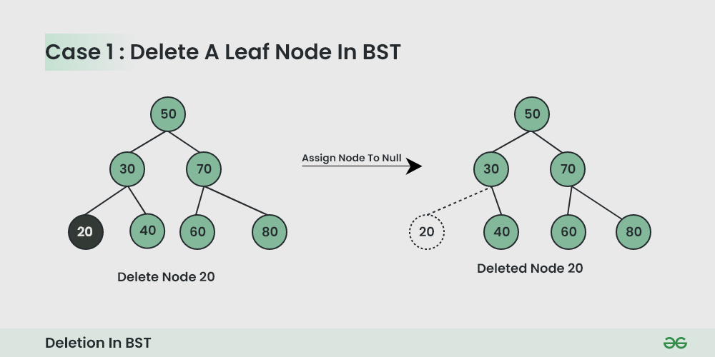
Case 1. Delete a Leaf Node in BST

Slide 20
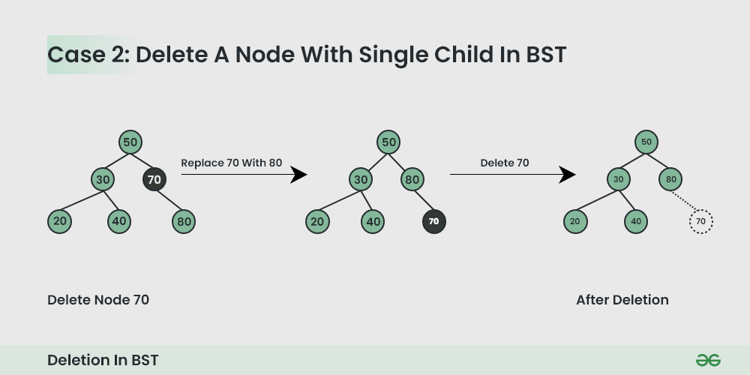
Case 2. Delete a Node with Single Child in BST

Slide 21
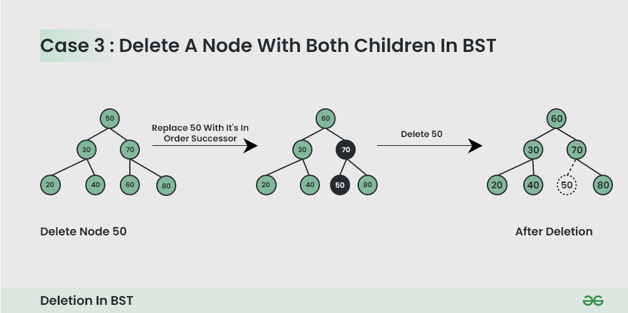
Case 3. Delete a Node with Both Children in BST

Slide 22
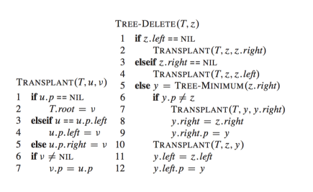
Deletion in BST

Slide 23
Deletion C program
// Note that it is not a generic inorder successor
// function. It mainly works when the right child
// is not empty, which is the case we need in
// BST delete.
struct Node* getSuccessor(struct Node* curr) {
curr = curr->right;
while (curr != NULL && curr->left != NULL)
curr = curr->left;
return curr;
}
// This function deletes a given key x from the
// given BST and returns the modified root of
// the BST (if it is modified)
struct Node* delNode(struct Node* root, int x) {
// Base case
if (root == NULL)
return root;
// If key to be searched is in a subtree
if (root->key > x)
root->left = delNode(root->left, x);
else if (root->key < x)
root->right = delNode(root->right, x);
else {
// If root matches with the given key
// Cases when root has 0 children or
// only right child
if (root->left == NULL) {
struct Node* temp = root->right;
free(root);
return temp;
}
// When root has only left child
if (root->right == NULL) {
struct Node* temp = root->left;
free(root);
return temp;
}
// When both children are present
struct Node* succ = getSuccessor(root);
root->key = succ->key;
root->right = delNode(root->right, succ->key);
}
return root;
}
struct Node* createNode(int key) {
struct Node* newNode =
(struct Node*)malloc(sizeof(struct Node));
newNode->key = key;
newNode->left = newNode->right = NULL;
return newNode;
}
// Utility function to do inorder traversal
void inorder(struct Node* root) {
if (root != NULL) {
inorder(root->left);
printf("%d ", root->key);
inorder(root->right);
}
}

Slide 24
Example of BST Traversals
Illustrate the output of Inorder, Preorder, and Postorder traversals on a sample tree.

Slide 25
Height and Balance of BST
Height of a tree affects operation complexity:
- Balanced tree: O(log n)
- Unbalanced tree: O(n)
Example: Compare a balanced vs unbalanced BST.

