Slide 1
Network Management - SNMP

Slide 2
What is Network Management?
Basic tasks that fall under this category are:
Configuration Management
Keeping track of device settings and how they function
Fault Management
Dealing with problems and emergencies in the network (router stops routing, server loses power, etc.)
Performance Management
How smoothly is the network running?
Can it handle the workload it currently has?

Slide 3
Functional Areas of Network Management
Configuration Management - inventory, configuration, provisioning
Fault Management - reactive and proactive network fault management
Performance Management - # of packets dropped, timeouts, collisions, CRC errors
Security Management - SNMP doesn’t provide much here
Accounting Management - cost management and chargeback assessment
Asset Management - statistics of equipment, facility, and administration personnel
Planning Management - analysis of trends to help justify a network upgrade or bandwidth increase

Slide 4
What is SNMP?
SNMP is a tool (protocol) that allows for remote and local management of items on the network including servers, workstations, routers, switches and other managed devices.
Comprised of agents and managers
Agent - process running on each managed node collecting information about the device it is running on.
Manager - process running on a management workstation that requests information about devices on the network.

Slide 5
Advantages of using SNMP
Standardized
universally supported
extendible
portable
allows distributed management access
lightweight protocol

Slide 6
Client Pull & Server Push
SNMP is a “client pull” model
The management system (client) “pulls” data from the agent (server).
SNMP is a “server push” model
The agent (server) “pushes” out a trap message to a (client) management system

Slide 7
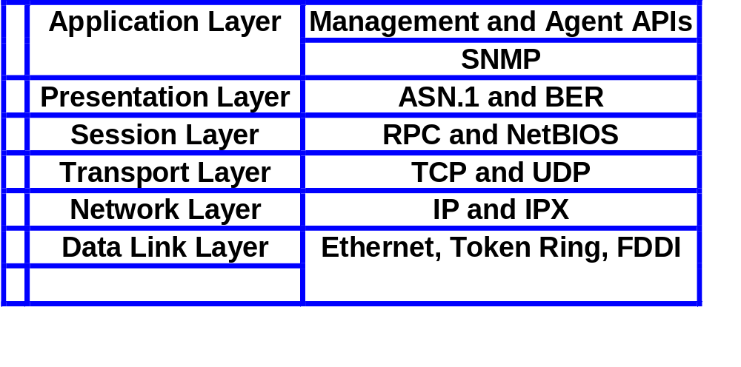
SNMP & The OSI Model

Slide 8
Ports & UDP
SNMP uses User Datagram Protocol (UDP) as the transport mechanism for SNMP messages
Ethernet Frame
IP Packet
SNMP Message
CRC
UDP Datagram
Like FTP, SNMP uses two well-known ports to operate:
UDP Port 161 - SNMP Messages
UDP Port 162 - SNMP Trap Messages

Slide 9
The Three Parts of SNMP
SNMP network management is based on three parts:
SNMP Protocol
Defines format of messages exchanged by management systems and agents.
Specifies the Get, GetNext, Set, and Trap operations
Structure of Management Information (SMI)
Rules specifying the format used to define objects managed on the network that the SNMP protocol accesses
Management Information Base (MIB)
A map of the hierarchical order of all managed objects and how they are accessed

Slide 10
Nodes
Items in an SNMP Network are called nodes. There are different types of nodes.
Managed nodes
Typically runs an agent process that services requests from a management node
Management nodes
Typically a workstation running some network management & monitoring software
Nodes that are not manageable by SNMP
A node may not support SNMP, but may be manageable by SNMP through a proxy agent running on another machine
Nodes can be both managed nodes and a management node at the same time (typically this is the case, since you want to be able to manage the workstation that your management application is running on.)

Slide 11
Community Names
Community names are used to define where an SNMP message is destined for.
They mirror the same concept as a Windows NT or Unix domain.
Set up your agents to belong to certain communities.
Set up your management applications to monitor and receive traps from certain community names.

Slide 12
SNMP Agents
Two basic designs of agents
Extendible Agents
Open, modular design allows for adaptations to new management data and operational requirements
Monolithic Agents
not extendible
optimized for specific hardware platform and OS
this optimization results in less overhead (memory and system resources) and quicker execution

Slide 13
Proxy & Gateway Agents
Proxy & Gateway Agents extend the capabilities of SNMP by allowing it to:
Manage a device that cannot support an SNMP agent
Manage a device that supports a non-SNMP management agent
Allow a non-SNMP management system to access an SNMP agent
Provide firewall-type security to other SNMP agents (UDP packet filtering)
Translate between different formats of SNMP messages (v1 and v2)
Consolidate multiple managed nodes into a single network address (also to provide a single trap destination)

Slide 14
Four Basic Operations
Get
Retrieves the value of a MIB variable stored on the agent machine
(integer, string, or address of another MIB variable)
GetNext
Retrieves the next value of the next lexical MIB variable
Set
Changes the value of a MIB variable
Trap
An unsolicited notification sent by an agent to a management application (typically a notification of something unexpected, like an error)

Slide 15
Traps
Traps are unrequested event reports that are sent to a management system by an SNMP agent process
When a trappable event occurs, a trap message is generated by the agent and is sent to a trap destination (a specific, configured network address)
Many events can be configured to signal a trap, like a network cable fault, failing NIC or Hard Drive, a “General Protection Fault”, or a power supply failure
Traps can also be throttled -- You can limit the number of traps sent per second from the agent
Traps have a priority associated with them -- Critical, Major, Minor, Warning, Marginal, Informational, Normal, Unknown

Slide 16
Trap Receivers
Traps are received by a management application.
Management applications can handle the trap in a few ways:
Poll the agent that sent the trap for more information about the event, and the status of the rest of the machine.
Log the reception of the trap.
Completely ignore the trap.
Management applications can be set up to send off an e-mail, call a voice mail and leave a message, or send an alpha-numeric page to the network administrator’s pager that says:
Your PDC just Blue-Screened at 03:46AM. Have a nice day. :)

Slide 17
Languages of SNMP
Structure of Management Information (SMI)
specifies the format used for defining managed objects that are accessed via the SNMP protocol
Abstract Syntax Notation One (ASN.1)
used to define the format of SNMP messages and managed objects (MIB modules) using an unambiguous data description format
Basic Encoding Rules (BER)
used to encode the SNMP messages into a format suitable for transmission across a network

Slide 18
SMIv1
Structure of Management Information
SMIv1 is described in RFCs 1155, 1212, 1215
These RFCs describe:
How MIB modules are defined with CCITT X.208 ASN.1 data description language
The subset of the ASN.1 language that is used in MIBs
The addition of the APPLICATION data type to ASN.1, specifically for use with SNMP MIBs
All ASN.1 constructs are serialized using the CCITT X.209 BER for transmission across the wire
definition of the high-level structure of the Internet branch (iso(1).org(3).dod(6).internet(1)) of the MIB naming tree
the definition and description of an SNMP managed object

Slide 19
SMIv2
Structure of Management Information
SMIv2 is described in RFCs 1442, 1443, 1444
These RFCs describe:
SMIv2 is a backward compatible update to SMIv1
The only exception is the Counter64 type defined by SMIv2
Counter64 cannot be created in SMIv2
RFC 2089 defines how bilingual (SMIv1 & SMIv2) agents handle the Counter64 data type
IETF requires that new and revised RFCs specify MIB modules using SMIv2

Slide 20
ASN.1
Abstract Syntax Notation One
ASN.1 is nothing more than a language definition. It is similar to C/C++ and other programming languages.
Syntax examples:
-- two dashes is a comment -- The C equivalent is written in the comment
MostSevereAlarm ::= INTEGER -- typedef MostSevereAlarm int;
circuitAlarms MostSevereAlarm ::= 3 -- MostSevereAlarm circuitAlarms = 3;
MostSevereAlarm ::= INTEGER (1..5) -- specify a valid range
ErrorCounts ::= SEQUENCE {
circuitID OCTET STRING,
erroredSeconds INTEGER,
unavailableSeconds INTEGER
} -- data structures are defined using the SEQUENCE keyword

Slide 21
BER
Basic Encoding Rules
The relationship between ASN.1 and BER parallels that of source code and machine code.
CCITT X.209 specifies the Basic Encoding Rules
All SNMP messages are converted / serialized from ASN.1 notation into smaller, binary data (BER)

Slide 22
SNMP Data Types
Yellow items defined by ASN.1
Orange items defined by RFC 1155
INTEGER -- signed 32-bit integer
OCTET STRING
OBJECT IDENTIFIER (OID)
NULL -- not actually data type, but data value
IpAddress -- OCTET STRING of size 4, in network byte order (B.E.)
Counter -- unsigned 32-bit integer (rolls over)
Gauge -- unsigned 32-bit integer (will top out and stay there)
TimeTicks -- unsigned 32-bit integer (rolls over after 497 days)
Opaque -- used to create new data types not in SNMPv1
DateAndTime, DisplayString, MacAddress, PhysAddress, TimeInterval, TimeStamp, TruthValue, VariablePointer -- textual conventions used as types

Slide 23
Managed “Objects” & MIBs
Always defined and referenced within the context of a MIB
A typical MIB variable definition:
sysContact OBJECT-TYPE -- OBJECT-TYPE is a macro
SYNTAX DisplayString (SIZE (0..255))
ACCESS read-write -- or read-write, write-only, not-accessible
STATUS mandatory -- or optional, deprecated, obsolete
DESCRIPTION
“Chris Francois
cfrancois@acm.org
(360)650-0000”
::= { system 4 }

Slide 24
Basic Message Format
Message Length
Message Version
Message Preamble
Community String
PDU Header
SNMP Protocol Data Unit
PDU Body

Slide 25
SNMP Message Formats
Message Length
SNMP Message Preamble
Message Version
Message Length
Community String
Message Version
PDU Type
Community String
PDU Length
PDU Type
PDU Length
Enterprises MIB OID
PDU Header
Agent IP Address
Request ID
Standard Trap Type
Error Status
Specific Trap Type
Error Index
Time Stamp
Length of Variable Bindings
Length of Variable Bindings
Length of First Binding
Length of First Binding
OID of First Binding
OID of First Binding
Type of First Binding
Type of First Binding
Value of First Binding
PDU Body
Value of First Binding
Length of Second Binding
Length of Second Binding
OID of Second Binding
OID of Second Binding
Type of Second Binding
Type of Second Binding
Value of Second Binding
Value of Second Binding
Additional Variable Bindings
Additional Variable Bindings

