Slide 1

Analysis of Amcat Data
Borra Rajamaheshwar Reddy
IN1240188

Slide 2
About me
•This is Borra Rajamaheshwar Reddy and I completed my B.Tech CSEprogram at GNA UNIVERSITY
•I am passionate about Data Science as it enables me to confidently analyze data and provide valuable insights.
LINKEDIN URL: www.linkedin.com/in/rajamaheshwarreddy
GITHUB URL:
https://github.com/RajamaheshwarReddy

Slide 3
Introduction
Problem Statement:
The Aspiring Mind Employment Outcome 2015 (AMEO) dataset, provided by Aspiring Minds, focuses on the employment outcomes of engineering graduates. This dataset encompasses various aspects, including demographic features, standardized scores reflecting cognitive, technical, and personality skills, as well as employment-related variables such as salary, job titles, and job locations. With around 4000 data points and approximately 40 independent variables, this dataset offers a comprehensive insight into the factors influencing the employment outcomes of engineering graduates.
Objective:
The primary objective of this study is to analyze the factors affecting the employment outcomes of engineering graduates. This includes exploring the relationships between demographic features, standardized skill scores, and employment-related variables such as salary, job titles, and job locations. By conducting thorough data analysis and statistical modeling, the aim is to identify significant predictors of employment success among engineering graduates.

Slide 4
Web Scrapping Details
Web Site Scrapped :
data provided by Innomatics Research labs
Libraries/Techniques :
Data Collection : data provided by innomatics research labs
Data Cleaning : Pandas , numpy
Data Visualization: Matplotlib, Seaborn

Slide 5
Data Cleaning
Step 1: Check for Duplicates:
Find the Duplicates and drop them, keep preference as first.
Step 2: Identify the Corrupted Data:
Remove the Corrupted values, symbols or text etc..,
Step 3 : Handling missing values:
Identify missing values using `isna()` or `isnull()` View the missing values
Replace the missing values after changing the dtypes of the columns with respective Mean(), Median(),
Step 4 : Handling Outliers:
Find the skewness for each column and based on the value move forward. Identify the Outliers using IQR method or Z-score method and view them.
Step 5: Treating Outliers:
Either Drop the Outliers if they have no effect on your Data Frame.
Do the 4 Transformation techniques that are available to reduce the outliers to use it as a new column for better visualization.

Slide 6
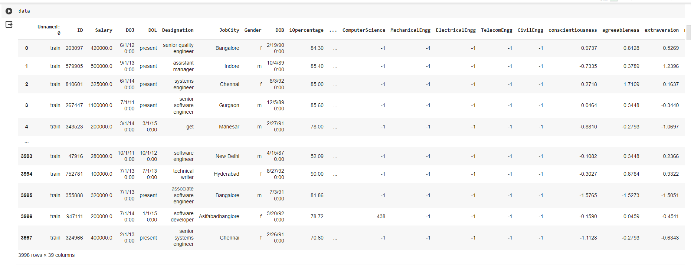
Data Frame

Slide 7
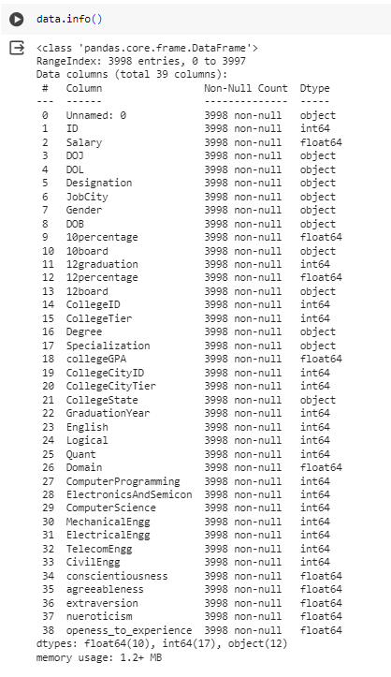
Data After cleaning

Slide 8
Data Manipulation
Data Manipulation contains the following steps:
Type Casting of Data Frame columns to the respective dtypes.
Filtering the Dataset according to the need for better understanding.
Data Frame operations like `Column Renaming`, `Dropping rows and columns`, `Resettingndex` etc..,
Sorting the data in a data frame.
pplying string operations, Array operations , list operations etc.., on the data.

Slide 9
UNIVARIATE ANAYLYSIS:
Univariate data consists of only one variable. The analysis of univariate data is thus the simplest form of analysis since the information deals with only one quantity that changes.
Categorical
Countplot used
Numerical
Bar plot, box plot

Slide 10
BIVARIATE ANALYSIS:
Bivariate data involves two different variables. The analysis of this type of data deals with causes and relationships and the analysis is done to find out the relationship among the two variables.
Categorical and Categorical:
Stacked bar plot
Categorical and Numerical
Box plot
Numerical and Numerical
Scatter plot

Slide 11
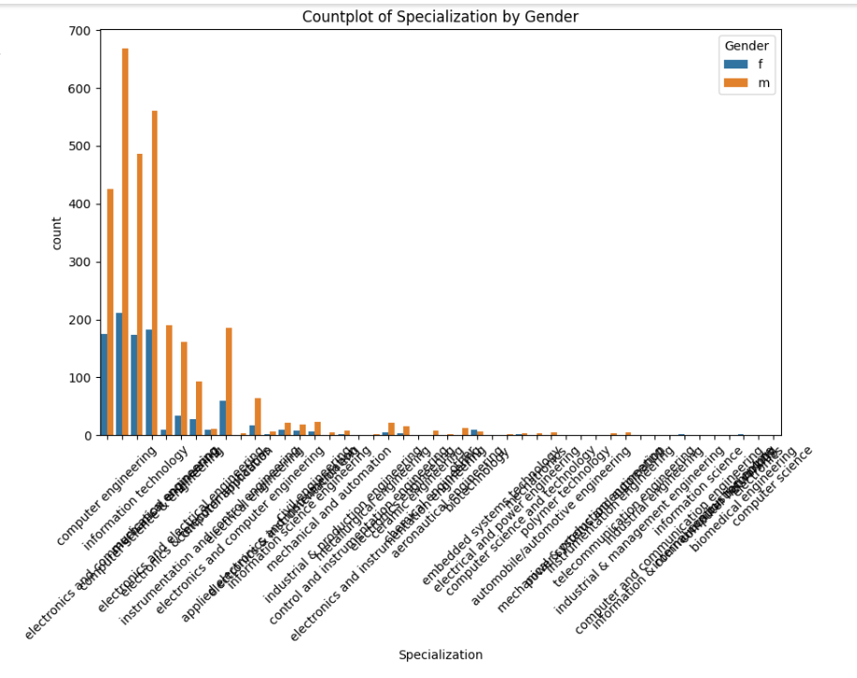
Who is more interested in Specialization ?

Slide 12
Conclusion:
Skill Proficiency and Employment Success:
The dataset highlights the importance of cognitive, technical, and personality skills in determining employment outcomes. Higher standardized scores in these areas correlate with better job prospects and potentially higher salaries for engineering graduates.
Demographic Influences:
Demographic features such as gender, age, and educational background also play a role in shaping employment outcomes. Gender disparities may exist in terms of job opportunities, salary offers, and specialization preferences, warranting further investigation and potential interventions to promote gender equity in the engineering workforce.
Salary Expectations and Job Roles:
The analysis supports the claim that certain job roles, such as Programming Analyst, Software Engineer, Hardware Engineer, and Associate Engineer, offer competitive salary prospects for fresh graduates with a Computer Science Engineering background. However, further analysis may be needed to assess the variability in salary offers across different job titles and locations.

Slide 13

THANK YOU

