Slide 1
Simplify Non-Linear Model
Aakash Goel (Senior Data Scientist @ Microsoft)

Slide 2
Agenda
Background
Non-Linear Model
Combine Model Prediction
Weights Visualization
Different Neural Network architecture

Slide 3
Background
Real world data-sets usually have one problem i.e. data can not be separated by just a single line. So, what is the next thing after a line? May be a circle, maybe two lines or maybe some curve. This is where neural networks can show their full potential.

Slide 4
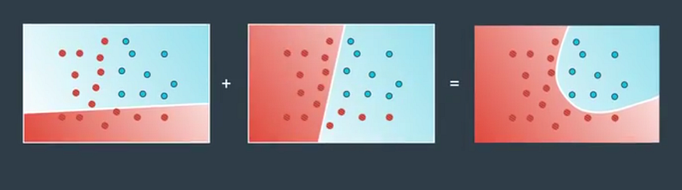
Non-Linear Model == Combination of Linear Model

Slide 5
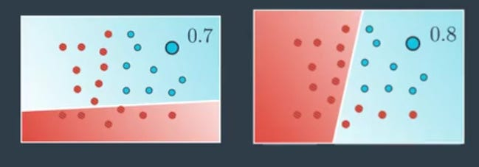
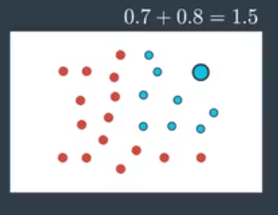
How to combine model prediction – Method 1 (Simply Sum)

Slide 6
How to combine model prediction – Method 2 (\weighted Sum)
what if we wanted to weight this sum? What, if say, we wanted the model in the left to have more of a saying the resulting probability than the right? Well, we can add weights. For example, we can say “Seven times the left one plus five times the right one.”
7*0.7 + 5*0.8 = 8.9

Slide 7
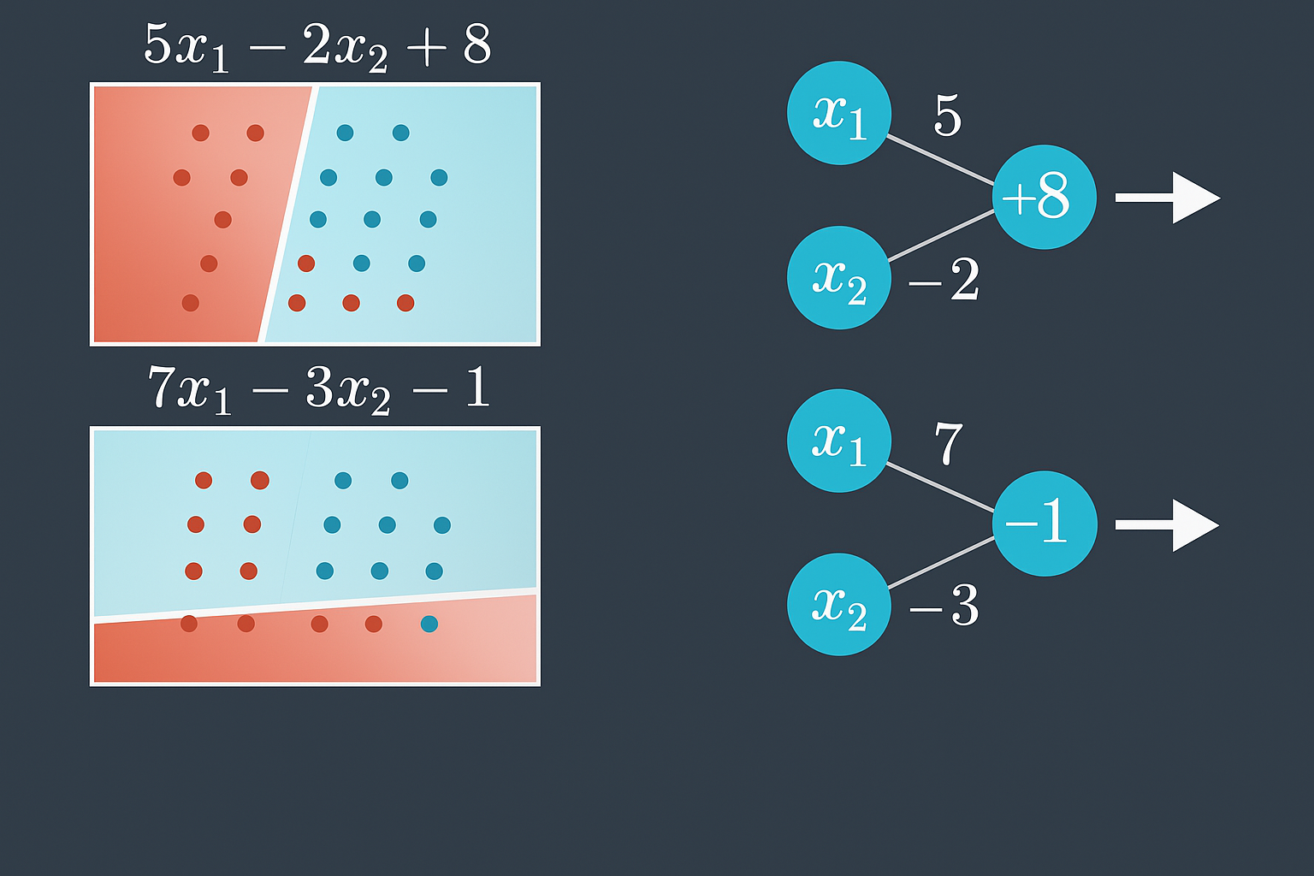
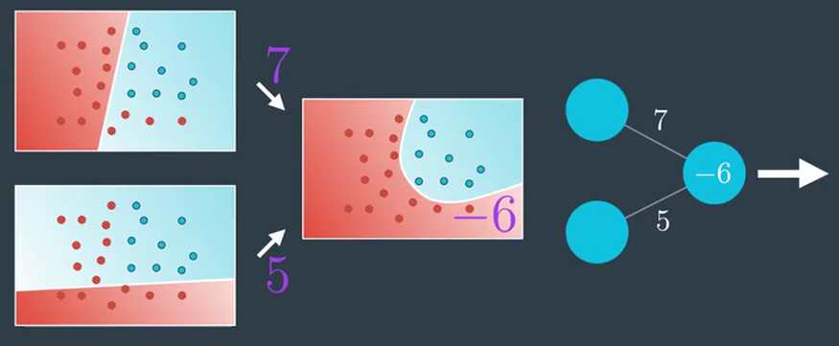
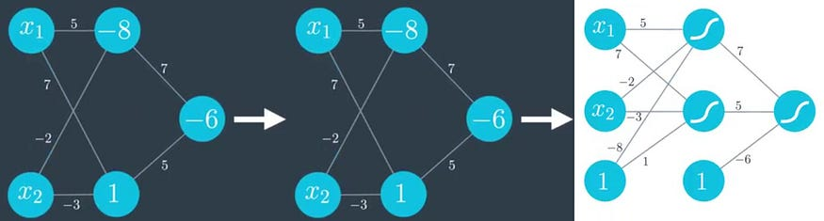
Weights Visualization

Slide 8
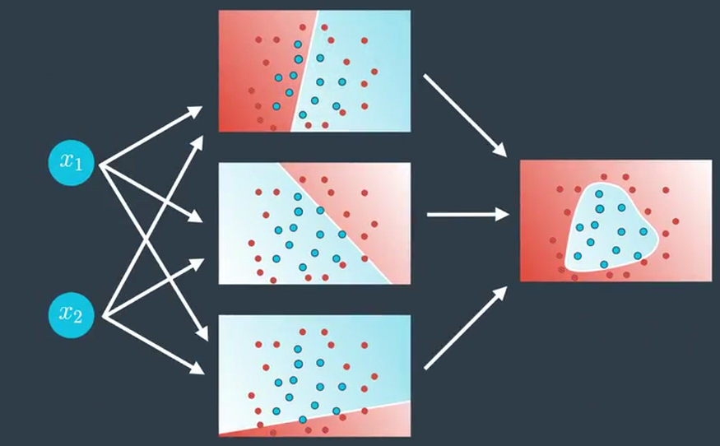
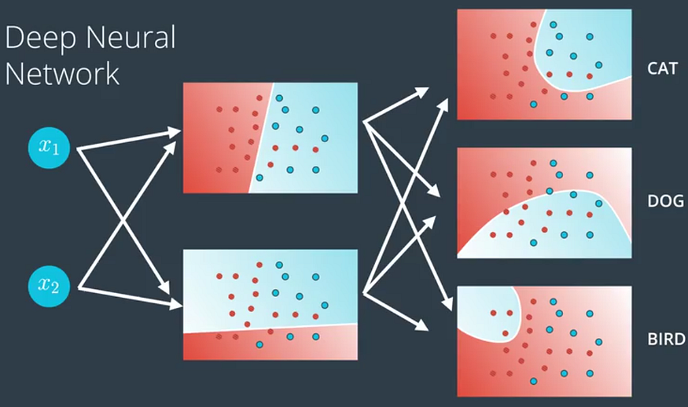
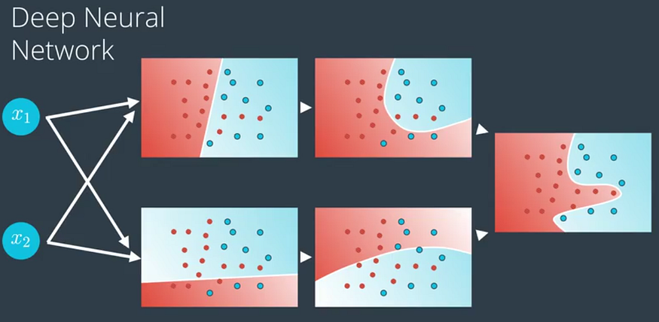
Large Number of Hidden Layer
Different Neural Network Architecture
Output Layer with more nodes
More Number of Hidden Layer

Slide 9
Thanks ☺

