Slide 1


TERRAFORM
Google Cloud
© Rajamohan – TERRAFORM

Slide 2
Terraform Using Google Cloud Platform

Slide 3
Course Introduction

Slide 4
Udemy Tips

Slide 5
IAC, Terraform & Installation

Slide 6
Traditional IT
How Application Dev Lifecycle works
Business create requirement
BA – Convert Requirement into Technical detail
Cloud Architect/ Tech lead : Infrastructure design
If more hardware require – contact procurement
Buying new hardware in Datacenter may take weeks to months
Infrastructure team – Provision hardware
Dev Team start working on Application
This flow has very slow App Deployment
Expensive, Scaling is issue
Lots of different team involved will lead to error.
Need to overcome above issue – Public Cloud Provider is the solution : AWS, GCP
In Cloud, Resource provisioning is very fast. From month to weeks
Public cloud provider will manage everything for you.

Slide 7
Interaction with Cloud
Cloud Console/Portal
Compared to Traditional Flow this is better
With few clicks, can provision VM in Cloud
But good enough if managing limited resource
With Programmatic way – API
Python, java, Shell
Different Team write different script for resource provisioning
There is no unique approach
Different Organization try to solve same problem, but different way
There comes Some common unifying approach, language, tool for infrastructure creation inside Cloud
Docker, Puppet, Ansible, terraform, packer

Slide 8
IAC
Resource provisioning using Code
Create Shell/Python script for creating VM
But writing/maintaining such code is tedious task
resource "google_compute_instance"
"first-instance"{
name = "hello-1"
zone = "us-central1-a" machine_type = "n1-standard-1" boot_disk {
initialize_params {
image = "debian-
cloud/debian-9"
}
}
network_interface { network = "default"
}
}
Create N/W
Wait for above step to finish
Provision Subnet
Create Firewall rule
Wait for above step to finish
Compute engine instance with all parameter

Slide 9


Terraform
Terraform is the one of the most popular tool for Infrastructure provisioning
Free – Open source
Developed by HashiCorp
Quick & easy to get started with single binary file
Master HCL – terraform in short span of time
Terraform has multiple provider are available.
Apart from Public cloud, lots pf different other provider are available for network, DNS, Firewall, database
Write configuration in HCL/JSON.
HCL is preferred.
Terraform is agentless tool
It is not configuration tool. Work well with Ansible.

Slide 10
Terraform is idempotent
Python/Shell script
To create VM
run 3 times
3 resource will be created It will cost 3 times.
Terraform
HCL script
To create VM
run 3 times
Only 1 resource will be created
It will not cost 3 times.

Slide 11
Native tool
Cloud Native tool available for infrastructure provisioning
Azure – Template
Google – Deployment manager
AWS - Cloud Formation
JSON/Yaml
Terraform is cloud agnostic.
With Multiple provider, resource can be provisioned for multiple cloud.

Slide 12
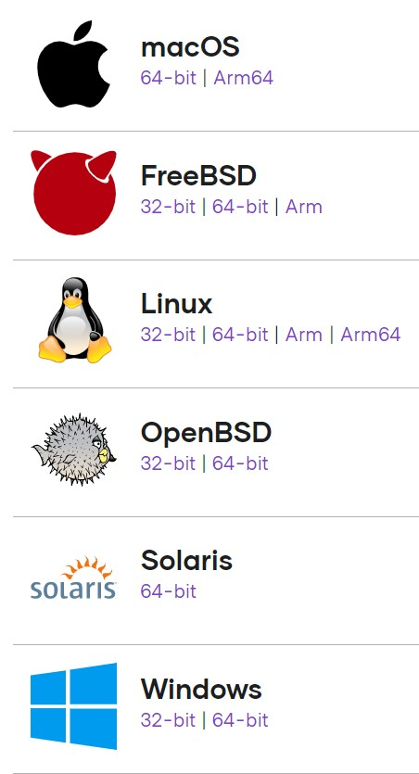
Terraform Installation
Available for all major OS:
Visit : https://www.terraform.io/downloads.html
Download Binary
Unzip it.
Export Path variable
Windows – will see
export PATH=$PATH:path to terraform binary
verify with terraform version
Editor – Free to use any of your favorite editor
Let’s see in action

Slide 13
Terraform Basics - I

Slide 14
Terraform Workflow
Scope
Identify the infrastructure for your project.
Author
Write the configuration for your infrastructure.
Initialize
Install the plugins Terraform needs to manage the infrastructure.
Plan
Preview the changes Terraform will make to match your configuration.
Apply
Make the planned changes.

Slide 15
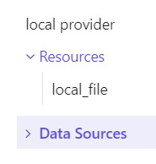
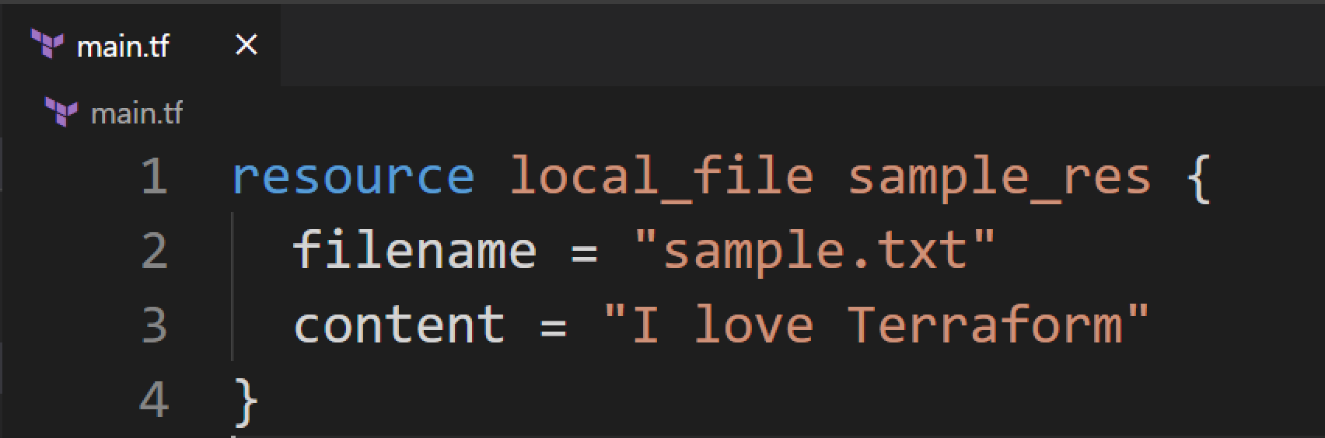

Scope & Author
Identify what resource need to provision
Create Local File – sample.txt with some content
Write configuration file for it in HCL language
.tf Extension
Resource Type - Local
Resource
Name
Block
Arguments

Slide 16
Create first Terraform File

Slide 17
Terraform
init, Plan & apply

Slide 18
init, Plan & apply
init
first command after writing configuration files
initialize a working directory
Download plugin
local_file
random
plan
Creates execution plan
Doesn’t change any infrastructure
apply
execute all changes & provision resource specified in configuration files

Slide 19
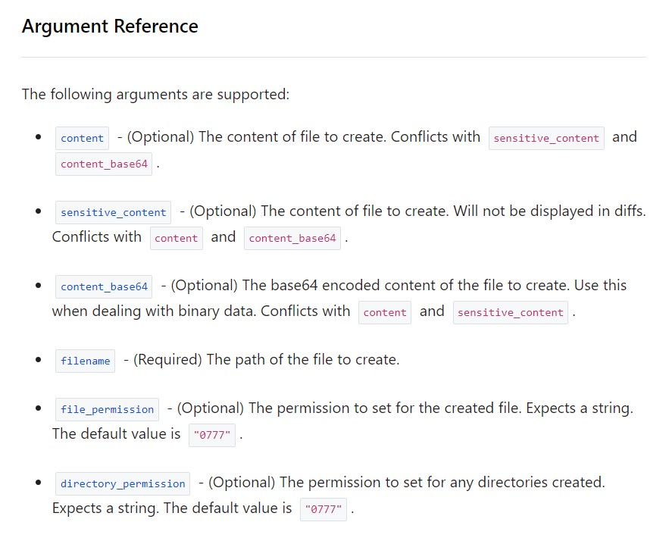
argument
local_file

Slide 20
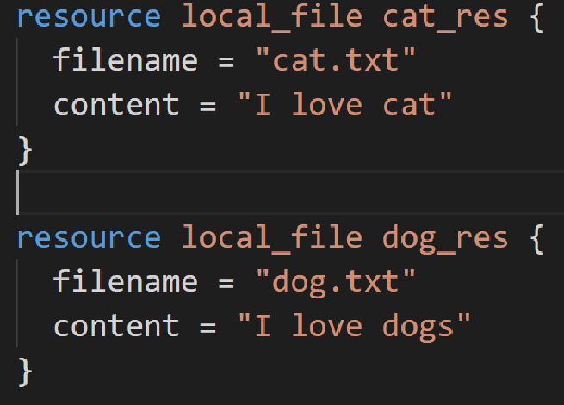

Multiple Resource
resource local_file cat_res { filename = "cat.txt" content = "I love cat"
} cat.tf
Main.tf
resource local_file dog_res { filename = “dog.txt" content = "I love dogs"
} dog.tf

Slide 21
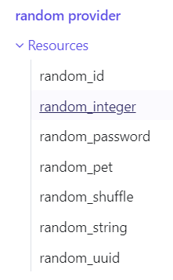
Random Provider
The "random" provider allows the use of randomness within Terraform configurations.
This is a logical provider, which means that it works entirely within Terraform’s logic, and doesn't
interact with any other services.
Let’s see in action

Slide 22
Variables
Main.tf
variables.tf
resource local_file sample_res { filename = “sample.txt" content = "I love Terraform"
}
variable filename {
type = string default = "sample.txt"
}
variable content { type = string
default = "I Love Terraform"
}
resource local_file sample_res { filename = var.filename content = var.content
}

Slide 23
Types of variables
string – “cat”
number – 234, 6.5
bool - true/false
list – sequence of value
list(string) =>[“red”, “green”, “blue”]
Tuple – group non homogeneous data type
tuple([string, number, bool]) => [“dog”, 23, true]
map – like key value : Dictionary
{name = “Ankit", age = 32}
set – only unique values
object – complex data type

Slide 24
Use Variables
variable filename {
type
default
= string
= "sample.txt"
var.filename
}
variable filename {}
Terraform apply will ask
terraform apply -var "filename=sample.txt"
export TF_VAR_filename=sample.txt"

Slide 25
Variable Definition File
terraform.tfvars
terraform.tfvars.json
*.auto.tfvars
*.auto.tfvars.json

Slide 26
Which Variable will load first
export TF_VAR_filename=sample.txt“
terraform.tfvars file
variable.auto.tfvars file
terraform apply -var "filename=sample.txt”

Slide 27
Multiple Provider
main.tf
resource "local_file" "rand_res" { filename = “sample.txt"
content = "I love terraform”
}
resource "random_string" "rand_name" { length = 20
}

Slide 28
Implicit Dependency
resource "local_file" "rand_res" { filename = "implicit.txt" content = "I love terraform "
}
resource "random_string" "rand_name" { length = 20
}
resource "local_file" "rand_res" { filename = "implicit.txt"
content = "I love random text ${random_string.rand_name.id}"
}

Slide 29
Explicit Dependency
resource "local_file" "rand_res" { filename = “explicit.txt" content = "I love terraform "
}
resource "random_string" "rand_name" { length = 20
}
resource "local_file" "rand_res" { filename = "implicit.txt"
content = "I love random text ${random_string.rand_name.id}“
depend_on = [random_string.rand_name]
}

Slide 30
Output
resource "random_string" "rand_name" { length = 20
}
output name {
value = random_string.rand_name.id
}
output.tf

Slide 31
Lifecycle Rules
lifecycle – resource attributes
create_before_destroy - Create the resource first and then destroy older
prevent_destroy - Prevents destroy of a resource
ignore_changes - Ignore Changes to Resource – Specific tag or all

Slide 32
Provider version
terraform { required_providers {
local = {
source = "hashicorp/local" version = "2.1.0"
}
}
}
provider "local" {
# Configuration options
}
https://www.terraform.io/docs/language/expressions/version-constraints.html

Slide 33
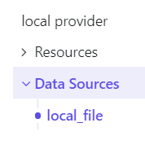
Data source
local_file reads a file from the local filesystem.
data "local_file" "foo" {
filename = "sample1.txt"
}
output name1 {
value = data.local_file.foo.content
}

Slide 34
Terraform + GCP

Slide 35
Setup GCP Project
SERVICE ACCOUNT

Slide 36
Google Provider
Terraform has multiple provider to intract with different public cloud
Infrastructure provision inside GCP from Terraform
https://registry.terraform.io/providers/hashicorp/google/latest/docs
terraform {
required_providers {
google = {
source = "hashicorp/google" version = "3.84.0"
}
}
}
provider "google" { project, region, zone
}

Slide 37
Connect with GCP
Google Provider Configuration
Projectid, zone, region
Multiple ways to authenticate with GCP
Username/Password - gcloud auth application-default login
Google Cloud VM
Service Account – Keys : Preferred in Production
Create Google Cloud Storage Bucket.
resource "google_storage_bucket" "gcs1"{ name = "bucketname"
}

Slide 38
Approach to Provision resource
What this resource do
Cloud Console resource provisioning
Terraform script with minimum attributes (all required)
Add more arguments

Slide 39
Google Cloud Storage
Object storage solution in GCP
Unstructured Data storage
Image
Video
Binary File, etc…
Cloud storage can be used for long term archival storage
Can be access object over http, Rest API
Let’s see in action

Slide 40
GCS + Terraform

Slide 41
Google Cloud Network
No Network – No Cloud
To create any resource, Network is must
VPC – Virtual Private Network
VPC contains subnets – Logical grouping of IP in single region
3 Types of VPC
Default VPC
Auto Mode
Custom Mode
Let’s see in action –
How to create VPC
Create Subnet
Create firewall Policy

Slide 42
Network + Terraform

Slide 43
GCE + Terraform

Slide 44
Cloud Run + Terraform

Slide 45
Cloud Function + Terraform

Slide 46
BigQuery + Terraform

Slide 47
PubSub + Terraform

Slide 48
Spanner + Terraform

Slide 49
Cloud SQL + Terraform

Slide 50
BigTable + Terraform

Slide 51
MemoryStore + Terraform

Slide 52
THANK YOU
© Rajamohan– TERRAFORM

