Slide 1
What’s Big Data?
Big data is the term for a collection of (large) data sets
difficult to process using on-hand database management tools or traditional data processing applications.
The challenges include capture,storage, search, sharing, transfer, analysis, and visualization.

Slide 2

Big Data EveryWhere!
Lots of data is being collected
and warehoused
  Web data, e-commerce
  purchases at department/
  grocery stores
  Bank/Credit Card
  transactions
  Social Network

Slide 3
CHARACTERISTICS(V’s)
Volume
Variety
Velocity
Veracity
Value

Slide 4
Type of Data
Structured data
Unstructured data
Semistructured data

Slide 5
Map-Reduce
MapReduce - based on java.
The MapReduce algorithm -MAP and REDUCE.
MAP takes a set of data -→another set(key,value)
REDUCE combines those data from Mapper O/P tuples into a smaller set of tuples.

Slide 6
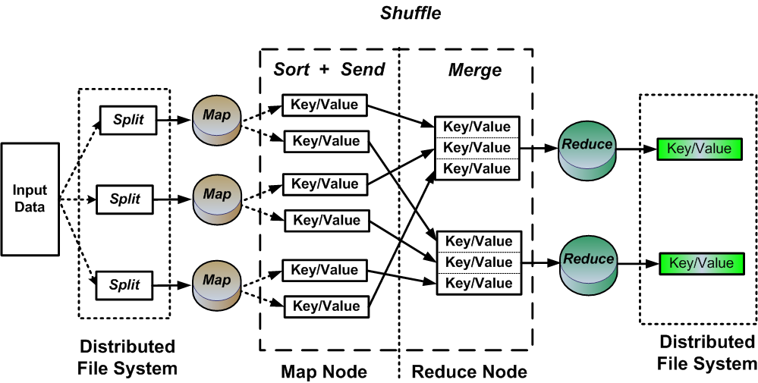
MAP-REDUCE ARCHITECTURE

Slide 7
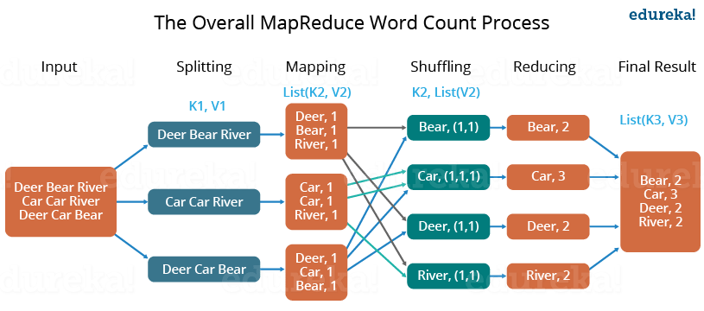

Slide 8
HADOOP YARN
Apache Yarn – “Yet Another Resource Negotiator”
Two compenents
Node Manager(SLAVE)
Resource Manager(MASTER)

Slide 9
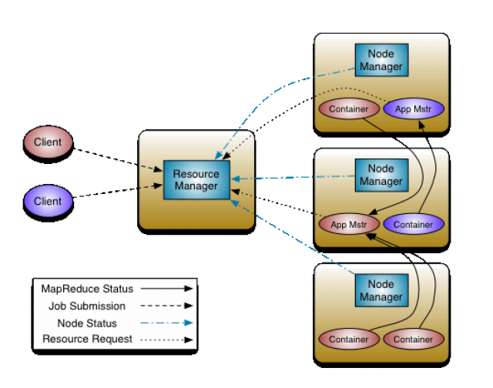
YARN ARCHITECTURE

Slide 10
HIVE
Hive -process structured data in Hadoop.
It is a platform used to develop SQL type scripts to do MapReduce operations.

Slide 11
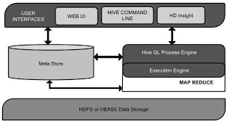
HIVE ARCHITECTURE

Slide 12
PIG
Apache Pig is an abstraction over MapReduce.
It is a tool/platform which is used to analyze larger sets of data representing them as data flows.
Pig -used with Hadoop- data manipulation

Slide 13
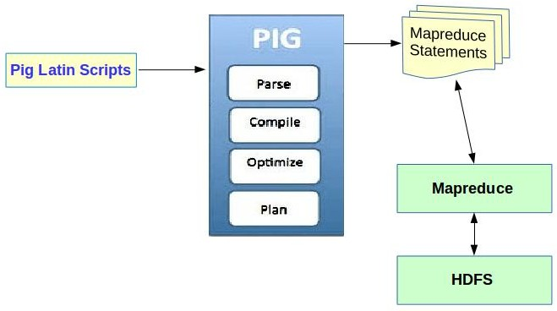
PIG ARCHITECTURE

Slide 14
SQOOP
TOOL for transferring data
IMPORT-from RDBMS to HDFS
EXPORT-from HDFS to RDBMS

Slide 15
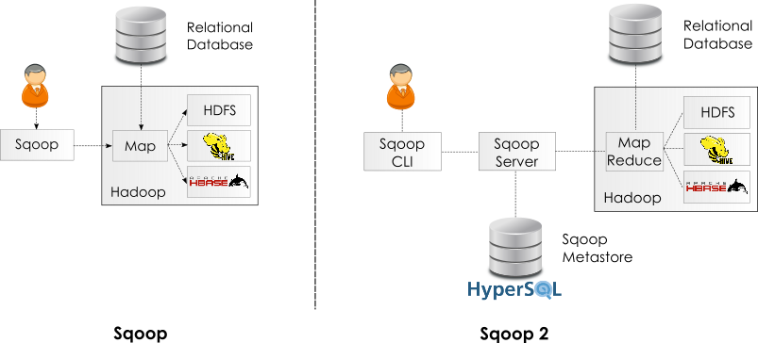
SQOOP ARCHITECTURE

Slide 16
FLUME
Efficiently collecting, aggregating and moving large amounts of log data-DIFFERENT SOURCES.
CENTRALISED DATA STORE

Slide 17
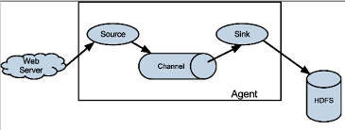
FLUME ARCHITECTURE

