Slide 1
Enhancing Water Quality Monitoring System With Data Science
Group ID :
Akash Tiwari – 2022-M-07042000
Rajan Maurya - 2022-M-14082002
Guided By: Sandeep Kulkarni

Slide 2
Table of contents
01
02
03
04
Introduction
Literature Review
Research Gaps
Objective
05
06
07
08
Design
Methodology
Result
Social Welfare
09
10
Conclusion
References

Slide 3
Introduction
"Water is not just a resource; it's the lifeblood of our planet, connecting us all in a shared responsibility for its preservation and equitable access."

Slide 4
Water scarcity and pollution pose significant challenges to global sustainability. Traditional methods of water quality monitoring are often time-consuming and costly, necessitating innovative solutions for real-time assessment. This presentation introduces a novel approach that integrates Internet of Things (IoT) technology with data science methodologies to address these challenges. By leveraging IoT hardware equipped with sensors for pH, turbidity, temperature, and more, coupled with machine learning algorithms, our system aims to provide Automated Water Reports And Predictive Analysis. Through a user-friendly website interface, users can access Real-time Data Visualization and make informed decisions regarding water consumption and management.

Slide 5
Literature Review
"Ensuring clean water isn't just about technology; it's about improving lives. By providing real-time monitoring and predictive analysis, we're making safe water accessible, helping communities thrive."

Slide 6
Jemy Joseph, Manju K M, Sajith M R, Sujith Nair, Vishnu P Viay and Sithara Krishnan(2018) peformed a study on “Water Management System using IoT”. They developed IoT based water management system to solve water wastage problems. Their main purpose of developing this system is approximating water level present in the tank and prevent overflow or analyze the water usage.[1]
Devireddy Pravallika, Devireddy Prathyusha, Devireddy Srinivasa Kumar (2018) performed “IoT Based Water Level Monitoring System with an Android Application”. They proposed a smart system with Internet of Things. Water level can be checked through android application from anywhere. They give motor access also in the android application.[2]
Gowthamy J, Chinta Rohith Reddy, Pijush Meher, Saransh Shrivastava, Guddu Kumar(2018) In this paper, a prototype water monitoring system using IoT is presented. For this some sensors are used. The collected data from the sensors are used for analysis purpose for better solution of water problems. The data is sends to the cloud server via Wi-Fi module ESP8266.[3]

Slide 7
Research Gaps
"Water is not just a resource; it's the lifeblood of our planet, connecting us all in a shared responsibility for its preservation and equitable access."

Slide 8
Despite the advancements made in real-time water quality monitoring systems integrating data science, web-based visualization, and IoT technologies, there remain several research gaps that warrant further investigation and development. These research gaps include:
Integration of Additional Water Quality Parameters: While the existing literature primarily focuses on monitoring parameters such as pH, conductivity, temperature, and turbidity, there is a need to incorporate a wider range of water quality indicators. Parameters such as dissolved oxygen levels, heavy metal concentrations, and microbial contamination could significantly enhance the comprehensiveness of water quality monitoring systems.[5]
Enhanced Data Analytics Techniques: Although current systems utilize data analytics techniques such as statistical analysis and machine learning algorithms, there is room for improvement in the sophistication and effectiveness of these methods. Future research could explore more advanced analytical approaches, including deep learning and predictive modeling, to improve the accuracy and predictive capabilities of real-time water quality monitoring systems.[6]

Slide 9
Scalability and Accessibility: Many existing studies focus on small-scale deployments or laboratory settings, limiting their applicability to larger geographic regions or real-world scenarios. Research is needed to develop scalable and accessible solutions that can be deployed across diverse environments, including remote or resource-constrained areas where internet connectivity may be limited.[7]
Cost-Effectiveness and Sustainability: The cost of implementing and maintaining real-time water quality monitoring systems can be a significant barrier, particularly in resource-constrained settings. Further research is needed to develop cost-effective solutions that prioritize sustainability and long-term usability, including the use of low-cost sensor technologies, open-source software, and community-driven maintenance models.[8]

Slide 10
Objectives
"By harnessing the power of technology, we strive to not only monitor water quality in real-time but also empower communities to safeguard this precious resource for generations to come."

Slide 11
Implement automated visualization techniques to generate insightful and user-friendly representations of water quality data, facilitating easy interpretation and analysis for stakeholders.
Create a user-friendly website interface that enables individuals to conveniently order water for sale or purchase, integrating seamlessly with the IoT-based monitoring system.
Develop a predictive model using machine learning algorithms to identify and classify water samples as "safe" or "unsafe" based on a threshold value of a particular water quality parameter, such as pH, conductivity, etc.
Document the project's methodologies, findings, and recommendations to contribute to the body of knowledge in IoT-based water quality monitoring and management.
Establish a centralized database system to store and manage the data collected from IoT devices, ensuring reliability, accessibility, and scalability for future analysis and decision-making.

Slide 12
Website
Designing the website for water quality monitoring involves several key considerations to ensure user-friendliness and functionality. Here's an overview of the design process:
User-Centric Design: The website's design prioritizes user experience, featuring intuitive navigation and a clear layout to ensure easy access to essential water quality information and enhance user engagement.
Prediction Feature: Leveraging advanced machine learning algorithms, the website offers insightful predictions regarding water drinkability based on input parameters, empowering users with valuable foresight into potential water quality issues.
Comprehensive Reporting: Through automated reporting functionality, the website generates detailed reports on water quality trends, enabling users to monitor changes over time and make informed decisions regarding water consumption and management strategies.
Accessibility and Compatibility: Designed with accessibility in mind, the website ensures seamless user experience across various devices and platforms, enhancing accessibility and usability for all users, regardless of their preferred device or browsing environment.

Slide 13
Design
"Design is the blueprint of functionality, shaping every drop of innovation in water monitoring systems."

Slide 14
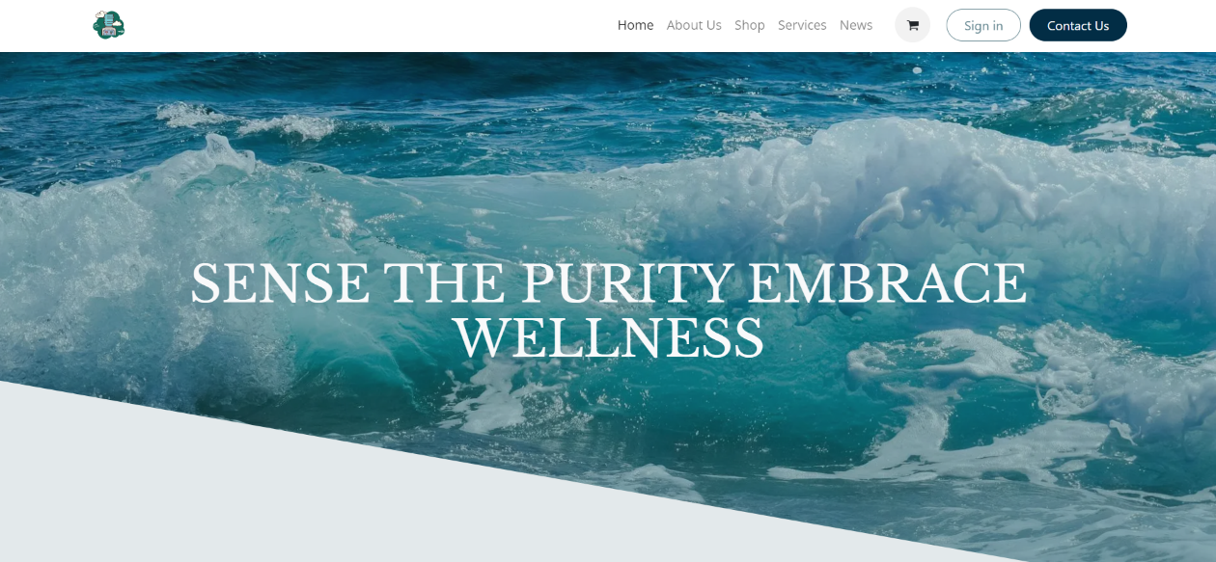
Website User Interface

Slide 15
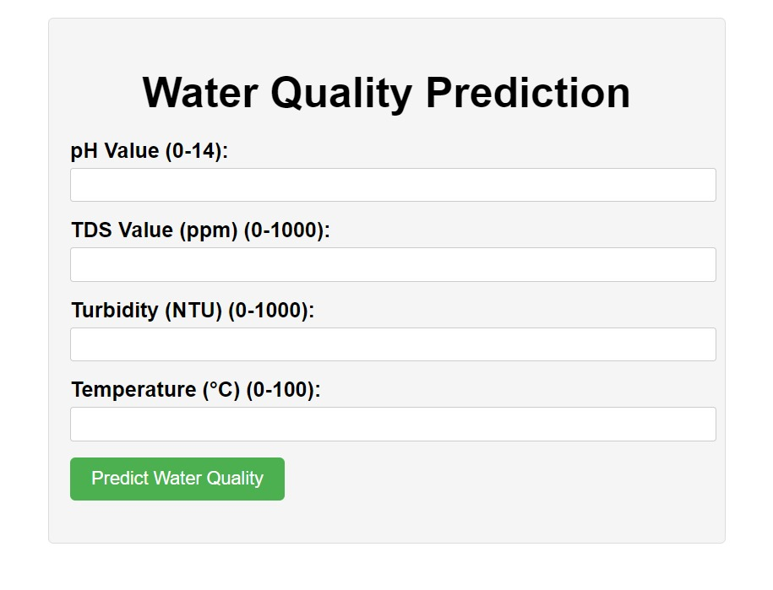
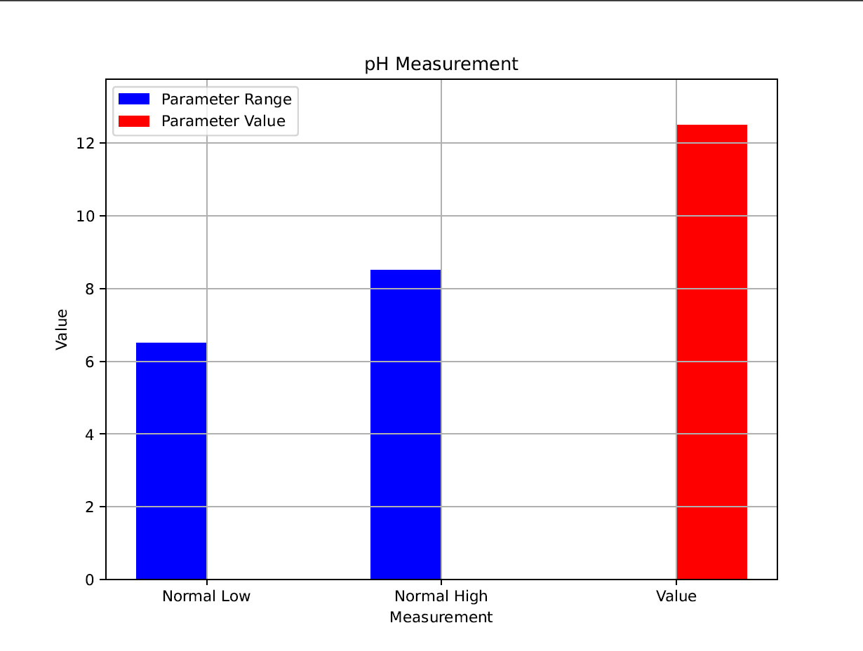
Analytics
Water Quality Prediction
Automated Data Report

Slide 16
Methodology
"In methodology lies the blueprint for success, where meticulous planning and systematic execution pave the way for ground-breaking innovations and tangible results."

Slide 17
1. User Interface Design: The website's interface prioritizes user experience, ensuring intuitive navigation for easy access to features such as prediction and automated reporting.
2. Machine Learning Integration: Advanced algorithms are integrated to enable predictive analysis of water quality based on user-provided parameters.
3. Automated Reporting and Data Visualization: A robust system generates comprehensive reports on water quality trends and employs various techniques to present information clearly, aiding informed decision-making.
4. Backend Development: Efficient programming ensures seamless functionality and reliable performance of prediction and reporting features.

Slide 18
Results
"The essence of our results lies in their transformative potential, where data-driven insights not only illuminate current water quality trends but also empower proactive decision-making for a sustainable future."

Slide 19
Our project yields transformative outcomes by providing profound insights into water quality. Through real-time monitoring and predictive analysis, stakeholders gain actionable insights for informed decision-making. Our system accurately predicts water safety, enhancing proactive management efforts. The automated reporting feature ensures easy access to critical information, facilitating swift action. By generating comprehensive reports on water quality trends, users can track changes over time and make informed decisions. These results signify a significant step towards sustainable water management and community well-being. Leveraging technology, we address pressing environmental challenges and secure a brighter future for all. Our commitment to innovation and sustainability underscores the importance of collaborative efforts in safeguarding precious water resources for generations to come.

Slide 20
Social Welfare
"Ensuring clean water isn't just about technology; it's about improving lives. By providing real-time monitoring and predictive analysis, we're making safe water accessible, helping communities thrive."

Slide 21
Awareness: Our project educates communities about water quality issues and encourages sustainable water management practices.
Health: We prevent waterborne diseases and improve public health through real-time monitoring and analysis.
Engagement: We involve community members in monitoring and managing local water resources, promoting collective responsibility.
Cost-Savings: Our model offers a cost-effective alternative to traditional water quality surveys, saving governments money.
Efficiency: Our project offers a more efficient alternative to traditional water quality assessment methods, saving time and resources by providing real-time data collection.

Slide 22
Conclusion
Concluding our project is not just marking an end; it's acknowledging the beginning of a new chapter in water management.

Slide 23
In conclusion, our project represents a significant advancement in addressing water quality challenges and promoting social welfare. By providing real-time monitoring, predictive analysis, and fostering community engagement, we empower individuals and governments to make informed decisions about water management. Through initiatives focused on education, health impact, economic development, and cost-effectiveness, we pave the way for sustainable water resource management. Moving forward, continued collaboration and innovation will be crucial in expanding our impact and ensuring access to clean water for all, thereby safeguarding the well-being of both present and future generations.

Slide 24
References
Jemy Joseph., Manju K M., Sajith M R., Sujith Nair., Vishnu P Viay. Sithara Krishnan,” Water Management System Using IoT”, International Research Journal of Engineering and Technology (IRJET), 1887-1890, Apr-2018.
Devireddy Pravallika, Devireddy Prathyusha, Devireddy Srinivasa Kumar,” IoT Based Water Level Monitoring System with an Android Application”, International Journal on Recent and Innovation Trends in Computing and Communication, 94-97, June-2018.
Gowthamy J, Chinta Rohith Reddy, Pijush Meher, Saransh Shrivastava, Guddu Kumar,” Smart Water Monitoring System using IoT”, International Research Journal of Engineering and Technology (IRJET),1170-1173,Oct-2018.
H Susilawati*, T M Hidayat, I Maulana, S Rahayu and I Nurichsan,” Designing web-based and android application to monitoring and estimating price of the use of water discharge”, Journal of Physics: Conference Series, 1402 (2019) 033090.

Slide 25
References
Aniket Nikam, Nisha Warhade, Rohit Dhawale, Siddhant Prabhu, Ganesh Deshmukh, “Fully Automated System for Monitoring Water Usage using SMS and Android Application”, International Research Journal of Engineering and Technology (IRJET), e-ISSN: 2395 -0056.
Haesung Tak, Daegeon Kwon, and Hwan-Gue Cho, “Water Tank Monitoring and Visualization System Using Smart-Phones “, International Journal of Machine Learning and Computing, Vol. 3, No. 1.
Jumadi M.Parenreng, Mustari S Lamada, Nurul Isra Humaira B, Fhatiah Adibah, Andi Akram Nur Risal, “Smart Water Tank for Control and Monitoring Based on IoT Technology”,IOTA Research Article.
Dongjiang Lia), Songlin Hu,” Research on water management system based on Android”, RESEARCH ARTICLE | APRIL 18, 2018

Slide 26
Thank You

