Slide 1

Student Name:
STUDENT NAME 1 - REGISTER NO.
STUDENT NAME 2 - REGISTER NO.
Guide
:
GUIDE NAME & QUALIFICATIONS

Slide 2
NLP LOG PROCESSOR
& BUG REPORTER
AI-Powered Log Analysis and Automated Bug Reporting using NLP
III B.Sc. COMPUTER SCIENCE | FINAL YEAR PROJECT

Slide 3
ABSTRACT
Applications generate huge volumes of log data, and finding bugs in them by hand is slow and error-prone. The NLP Log Processor and Bug Reporter uses Natural Language Processing with the Google Gemini AI engine to read log files and live log streams, identify errors, and turn them into structured bug reports with a category, priority, root cause and suggested fix. Sensitive data such as passwords and API keys is masked before analysis, repeated errors are grouped automatically, and every report is stored in a PostgreSQL database and shared to GitHub, Slack or Jira.

Slide 4
OBJECTIVES
Study common log formats and the types of errors found in application logs.
Build an NLP pipeline using Google Gemini to detect, categorise and prioritise bugs.
Protect sensitive data by masking secrets and personal details before analysis.
Group repeated errors and track their occurrences and resolution time (MTTR).
Build a web dashboard that stores every report and alerts the team instantly.

Slide 5
SYSTEM ANALYSIS
Existing System
Developers read through log files manually -- slow and tiring.
Critical errors are easily missed among thousands of lines.
Bug reports are written by hand, so they are inconsistent and delayed.
Proposed System
Automatic bug detection and classification using NLP and Gemini AI.
Category, priority, root cause and fix generated in seconds.
Reports stored in a database and shared to GitHub, Slack and more.

Slide 6
SYSTEM REQUIREMENTS
HARDWARE SPECIFICATION:
Processor
:
Intel Core i5 or above
RAM
:
8 GB minimum; 16 GB recommended
Storage
:
Minimum 256 GB
Internet Connection
:
Stable 4G/5G or wifi connection

Slide 7
SOFTWARE SPECIFICATION:
Operating System
:
Windows 11
Frontend
:
React and Tailwind CSS
Backend
:
Python, FastAPI and Gemini AI
Database
:
PostgreSQL (SQLite as fallback)
Tool
:
Visual Studio Code

Slide 8
WORKING PRINCIPLE
How the Log Analysis Flow Works
1
2
3
4
5
Upload
Redact
Gemini NLP
Deduplicate
Store & Alert
Log files or a live log stream
➜
Passwords, keys and personal data masked
➜
Finds, categorises and prioritises bugs
➜
Repeated errors grouped and counted
➜
Saved in database and sent to the team
A local Random Forest classifier (Scikit-learn) gives backup classification when the AI engine is unavailable.

Slide 9
SYSTEM MODULES
01
02
03
Log Ingestion Module
Data Redaction Module
NLP Analysis Module
04
05
06
Deduplication Module
Data Storage Module
Alert & Integration Module

Slide 10
BUG CATEGORIES
1
Application Bug
Code errors such as exceptions and crashes
2
Performance Issue
Slow responses, timeouts and high memory
3
Network Error
Connection failures and unreachable services
4
System Failure
Server, disk or database outages
5
Security Alert
Unauthorised access and exposed secrets

Slide 11
FUTURE ENHANCEMENTS
Automatic code fixes raised as pull requests.
Prediction of failures before they happen.
Support for cloud and Kubernetes log sources.
Mobile app for instant incident alerts.

Slide 12
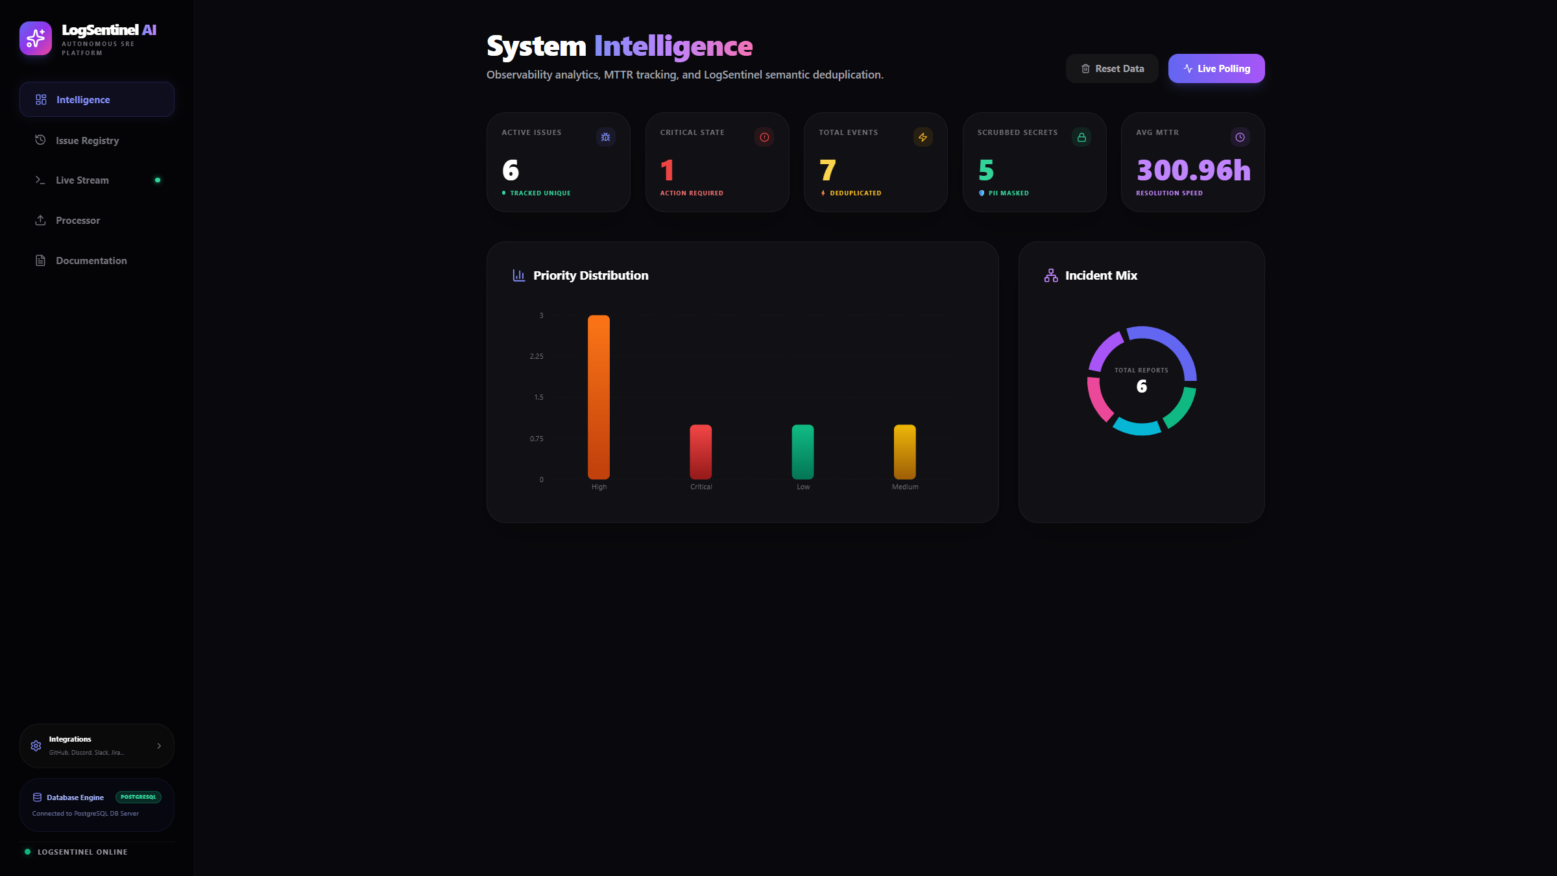
Dashboard Overview

Slide 13
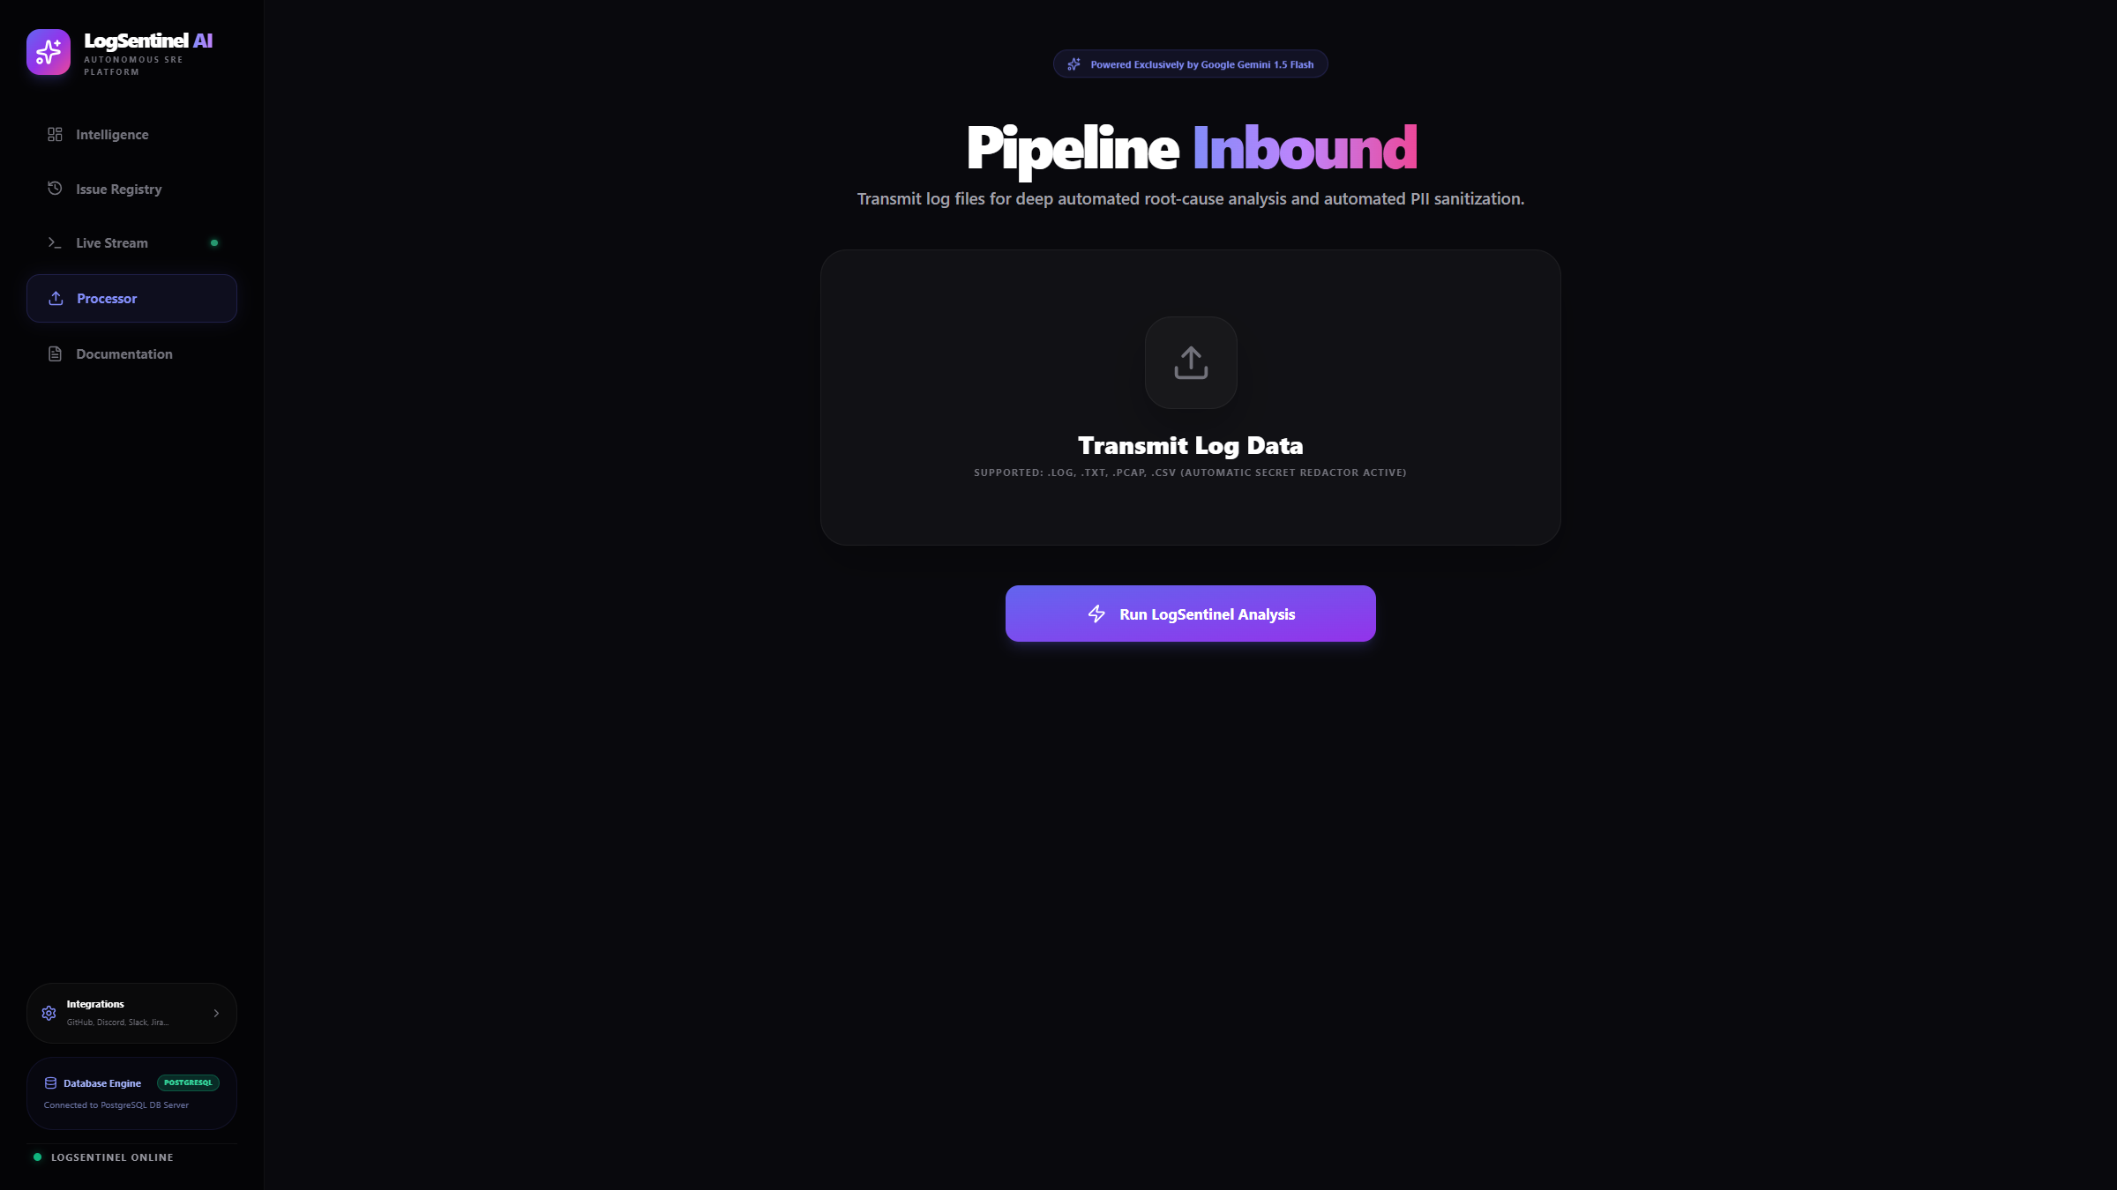
Log Upload Processor

Slide 14
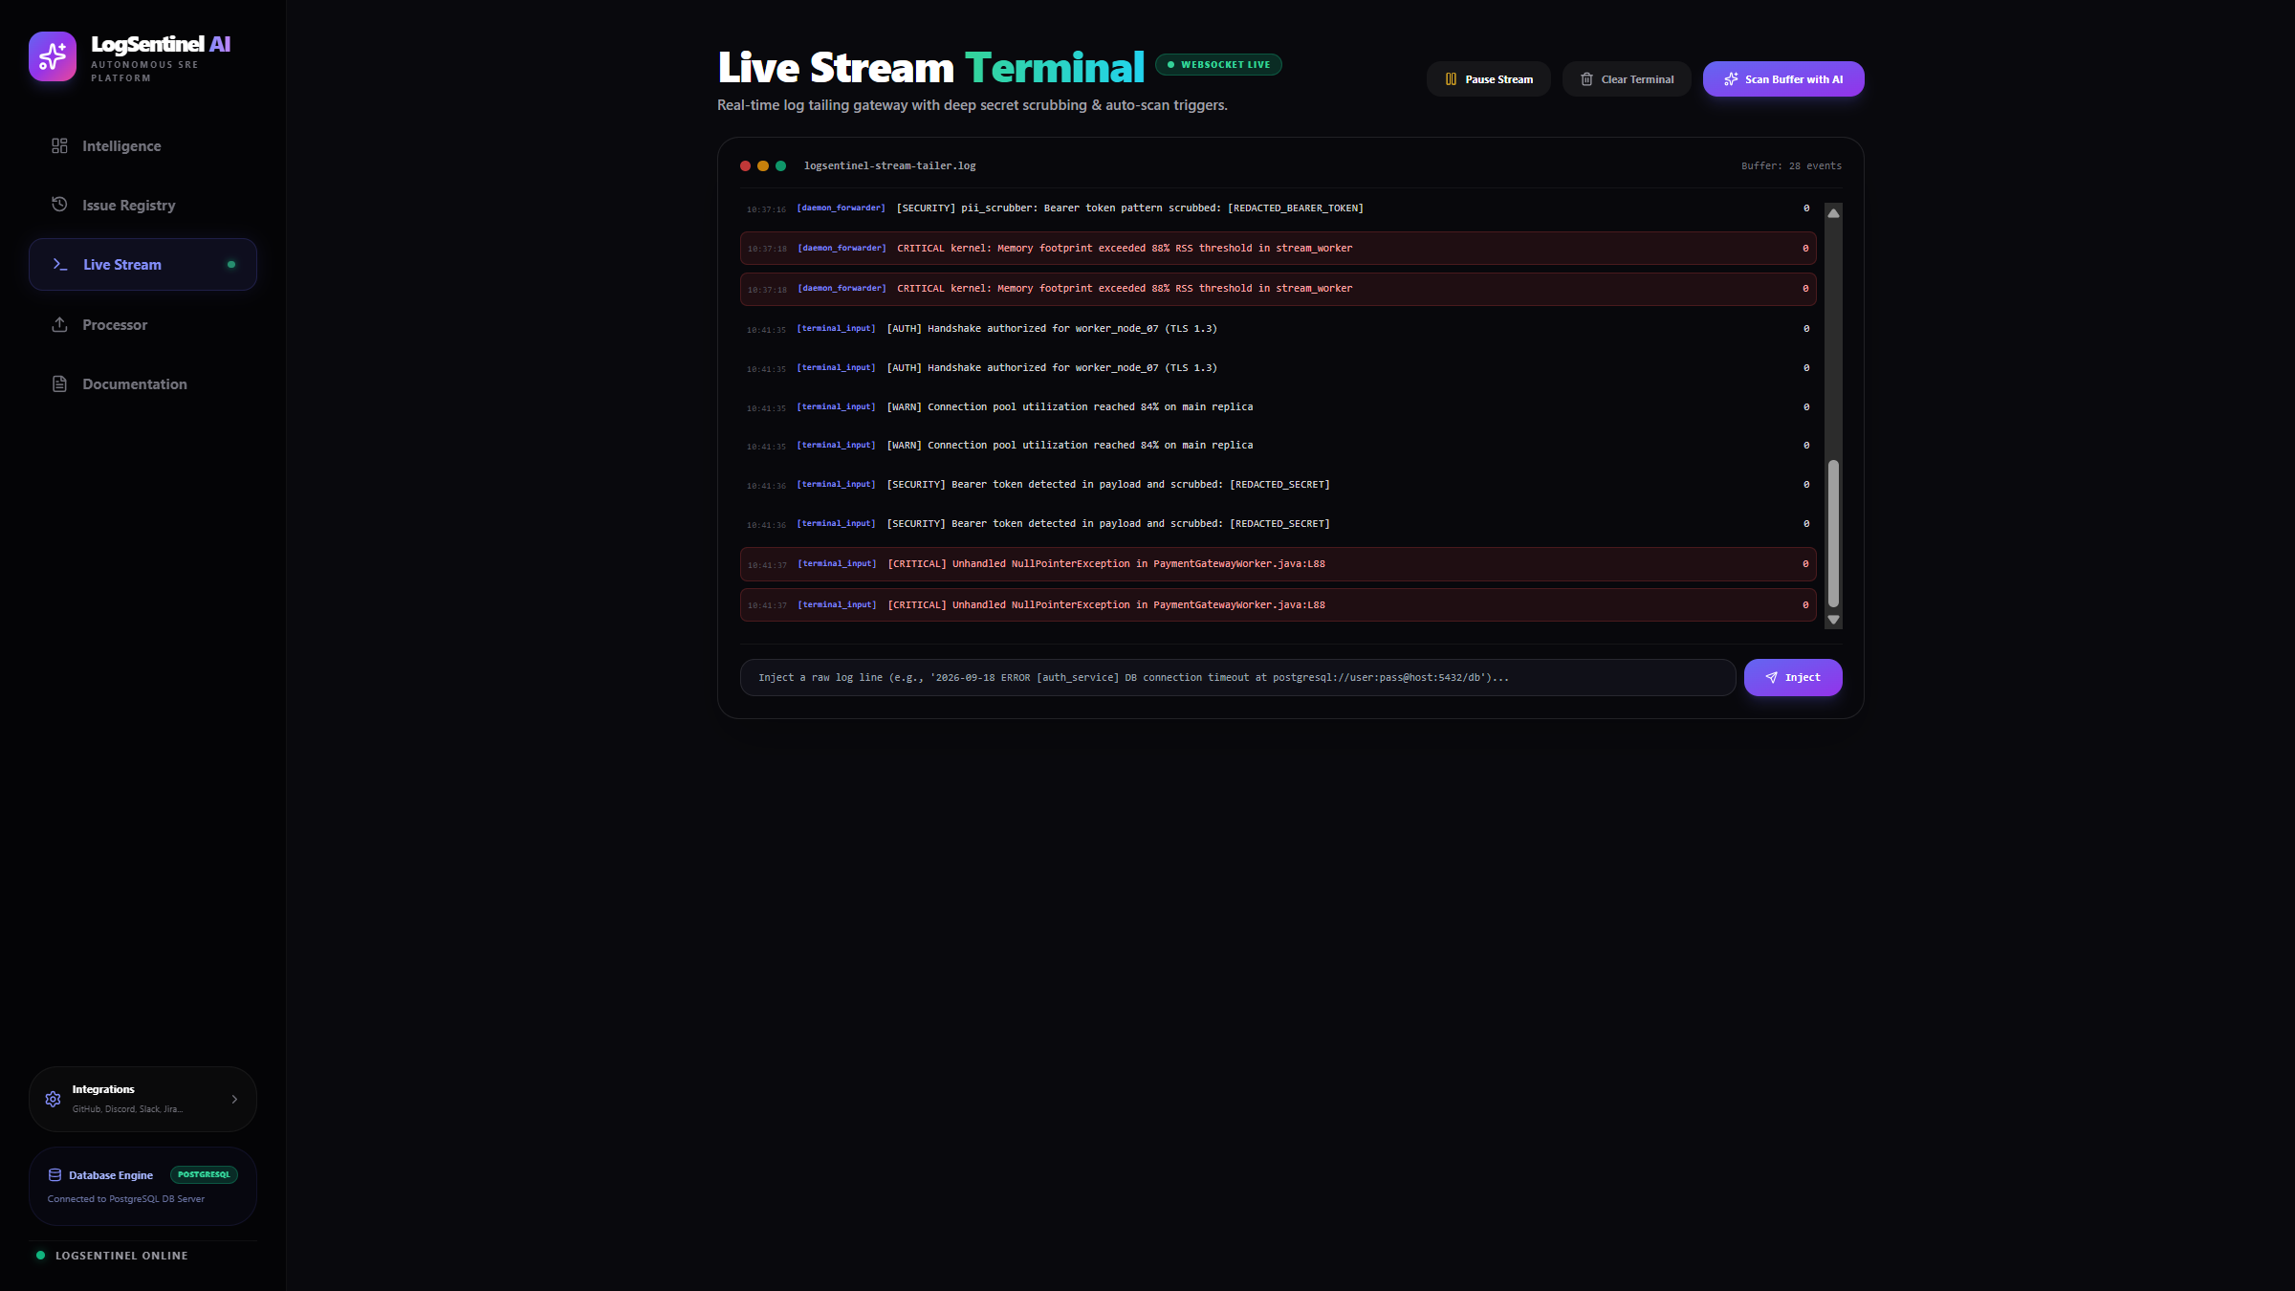
Live Stream Terminal

Slide 15
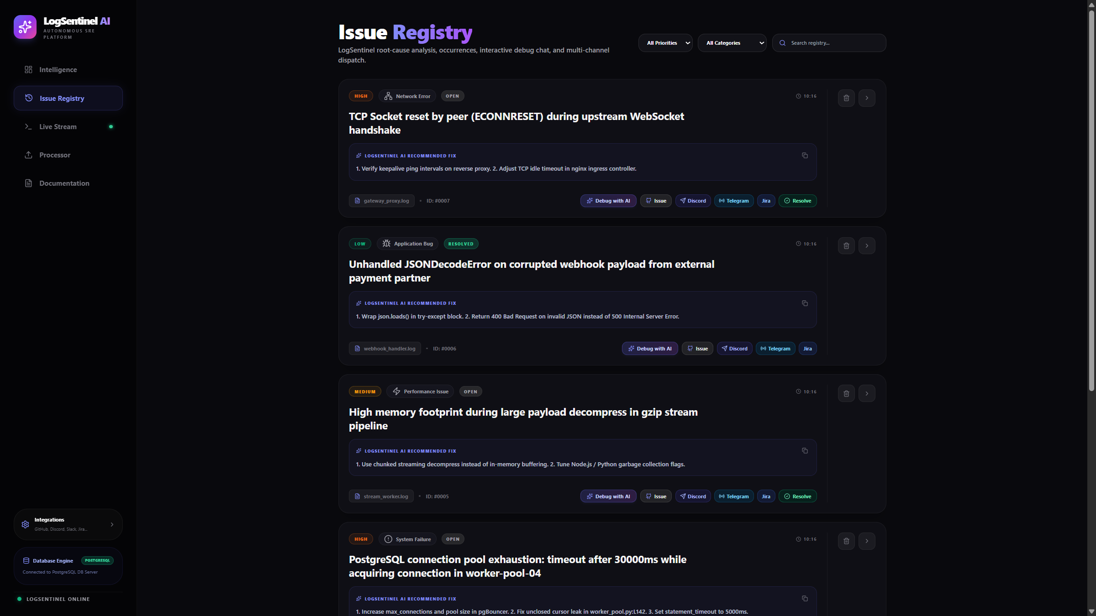
Issue Registry Management

Slide 16
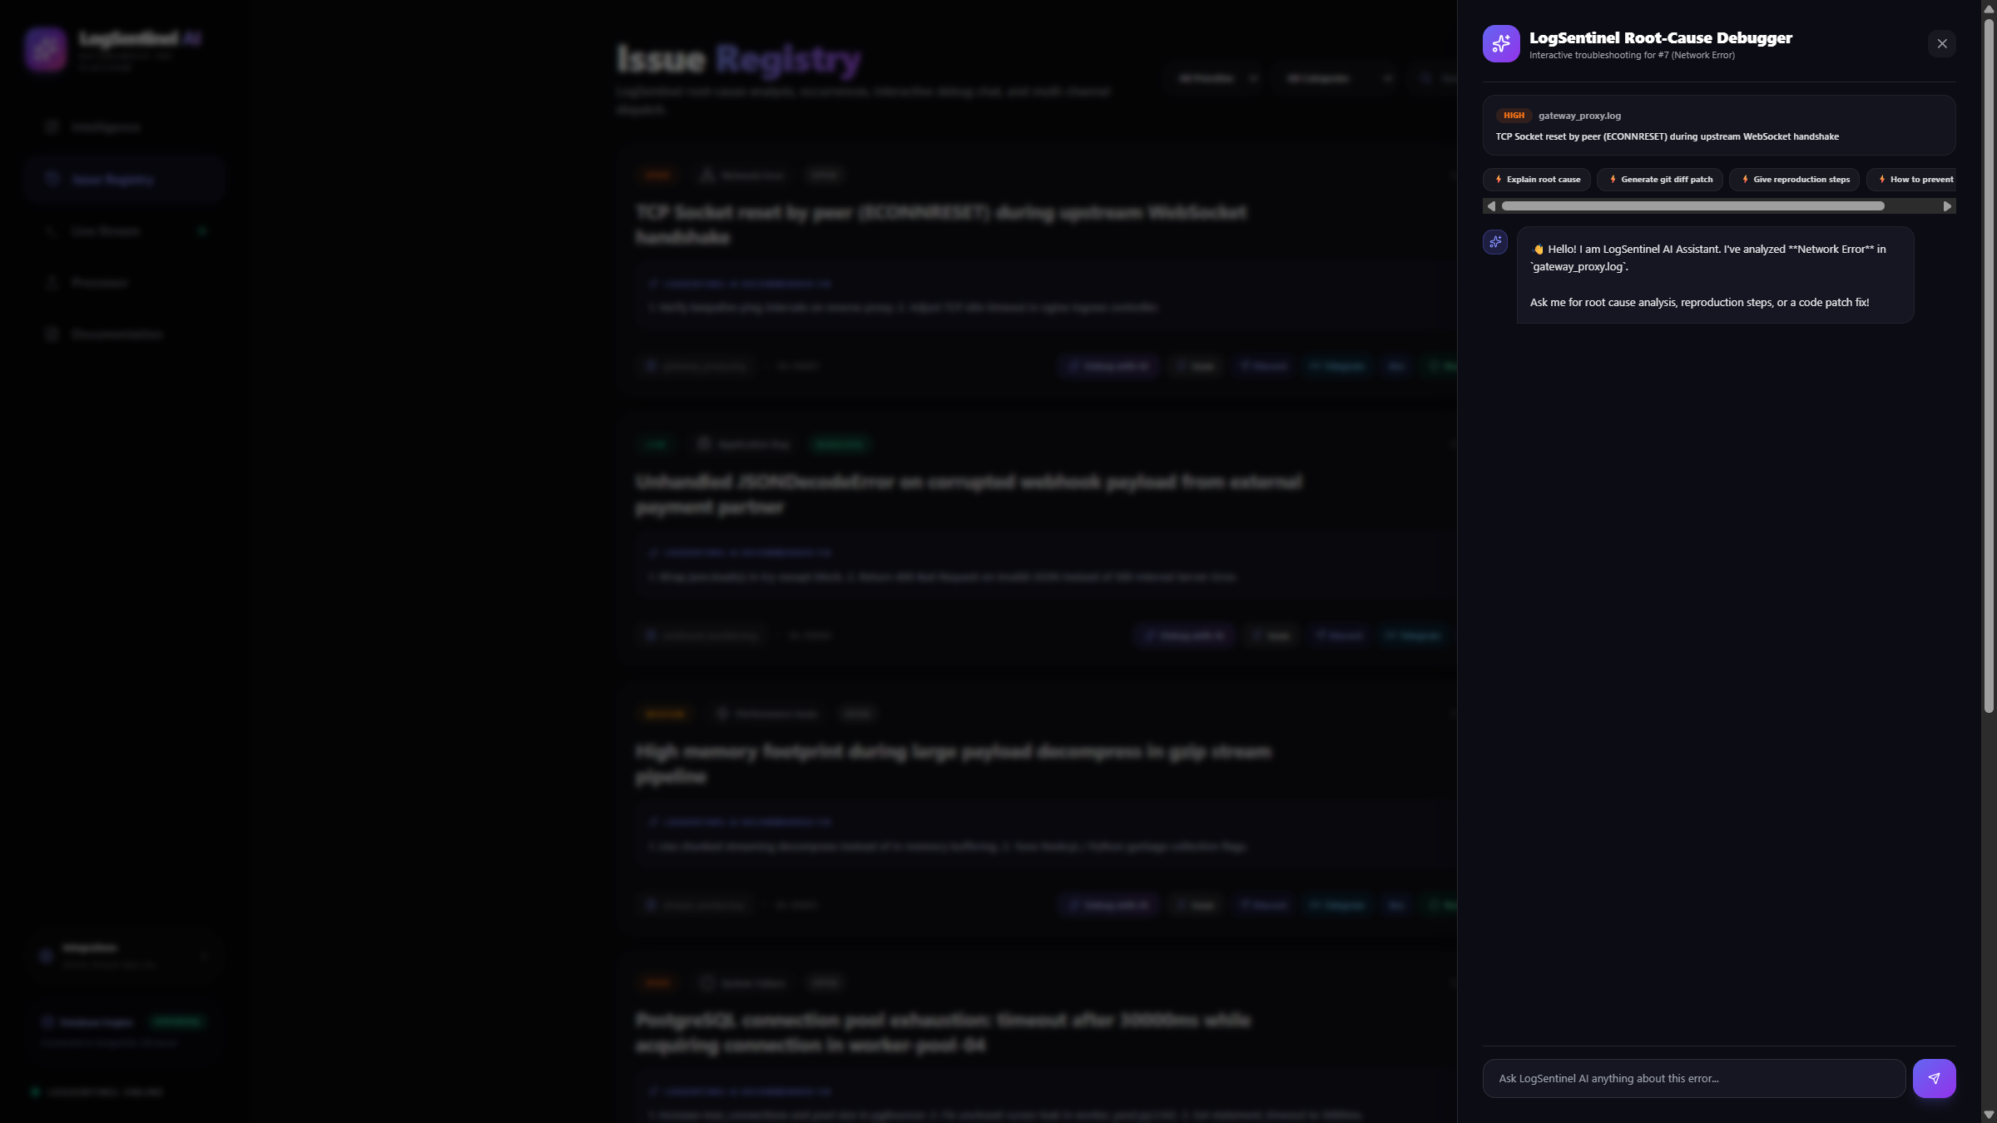
AI Root-Cause Debugger

Slide 17
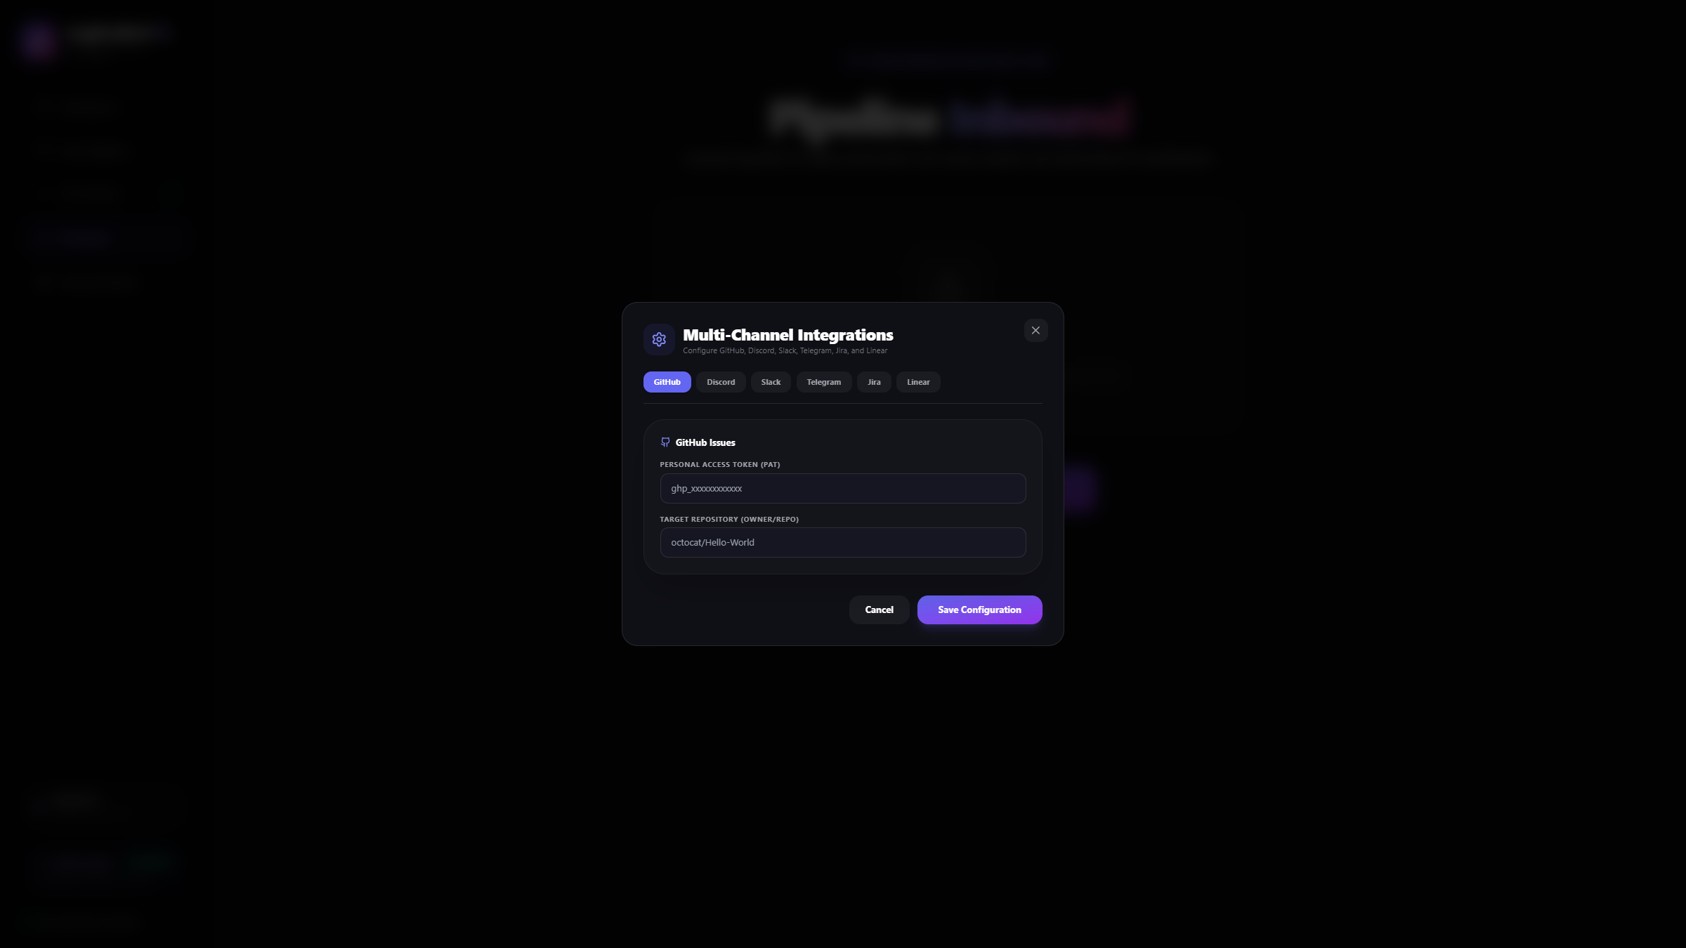
Enterprise Integrations

Slide 18
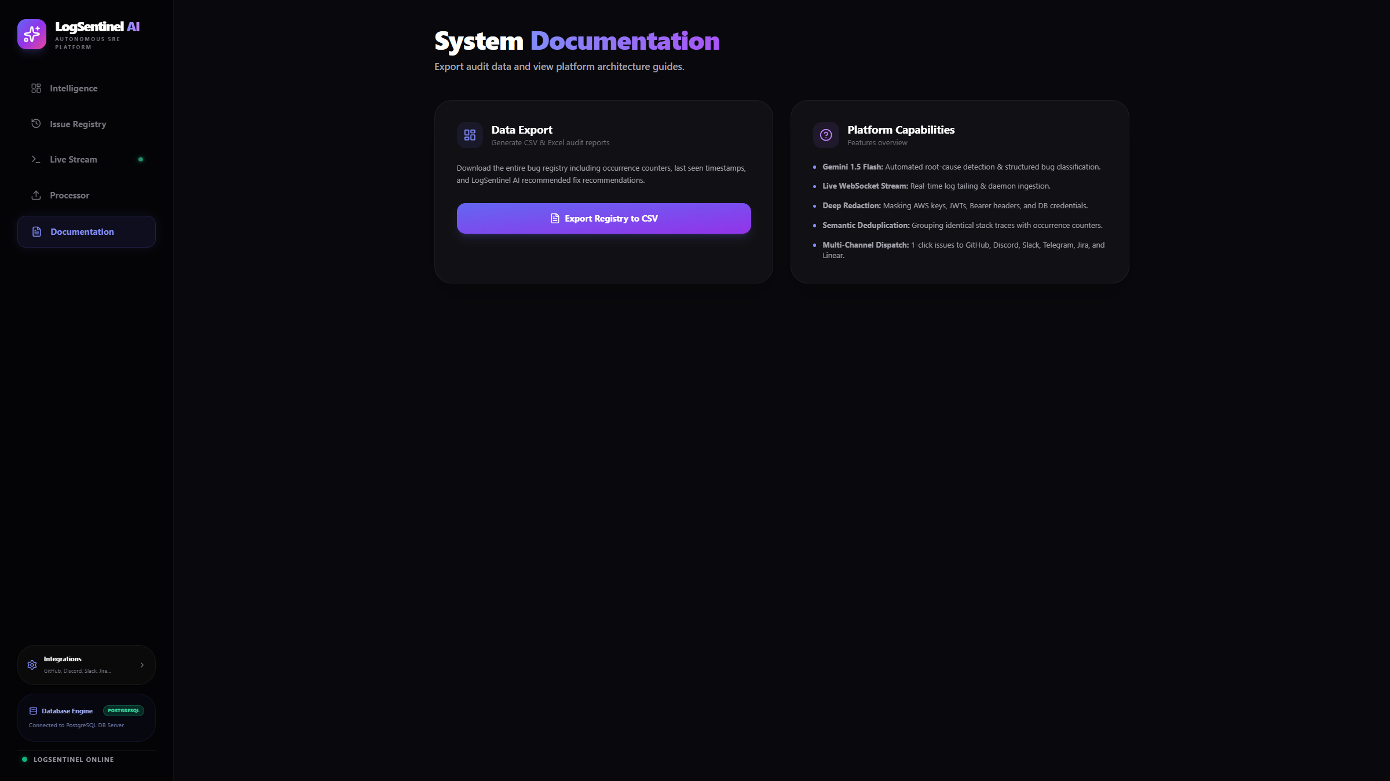
System Documentation

Slide 19
THANK YOU
NLP Log Processor & Bug Reporter | III B.Sc. Computer Science

