Slide 1
ONLINE EXAMINATION SYSYTEM
RAJAN KUMAR
1031310587

Slide 2
Brief Information
Name : RAJAN KUMAR
Year : 4th
Organization : SOFTEL REVOLUTION
Designation : Web software Designer and Developer
Name of Supervisor : Mr. Zakir Alam
Period : June 1,2016 to June 20,2016
Duration : 20 Days
Field of Internship : Web software Development/ Designing
Place : PATNA, INDIA

Slide 3
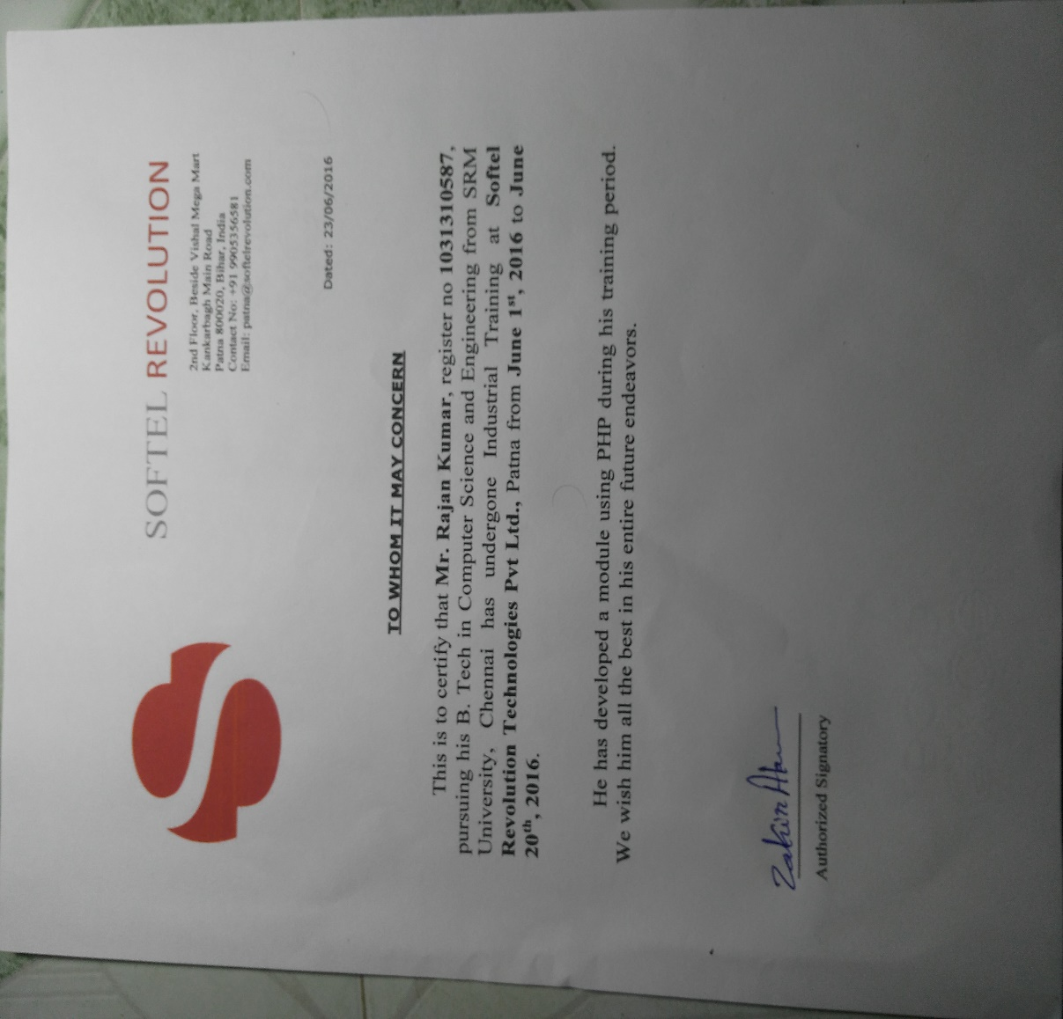
Certificate by the Organization

Slide 4
About Company :-
Softel Revolution Technologies Pvt. Ltd. is a dynamic company operating as an offshore programming and IT solutions provider.
Softel Revolution Technologies Pvt. Ltd. provides assistance ranging from Enterprise-wide web solutions to customized web-design and database-oriented projects, aimed at fetching clients the maximum benefit the Internet has to offer.

Slide 5
Language Used:
HTML
CSS
JS
PHP
MySQL

Slide 6
Screenshots

Slide 7
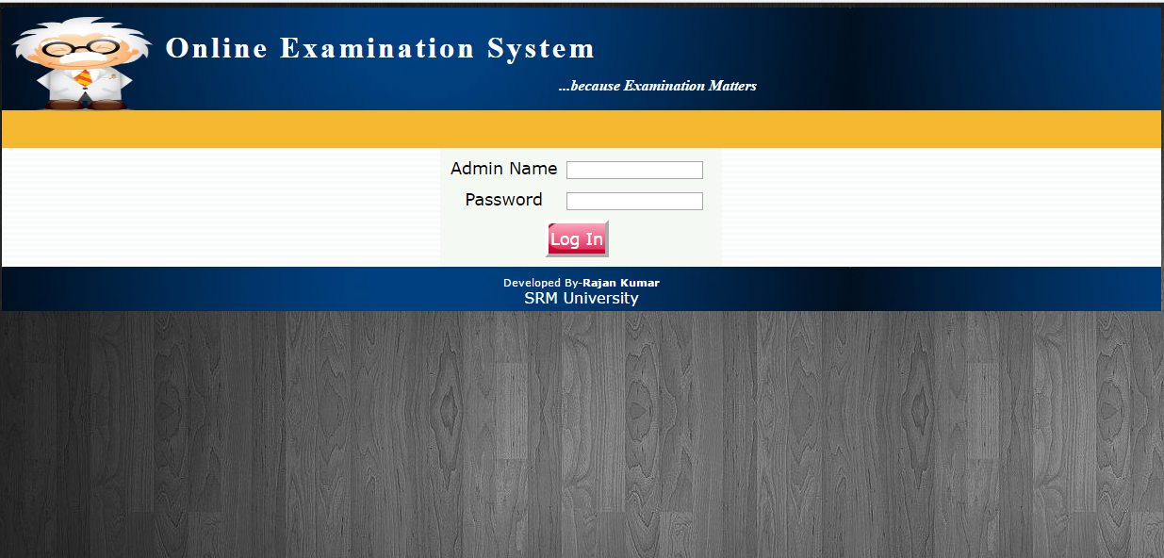

Slide 8
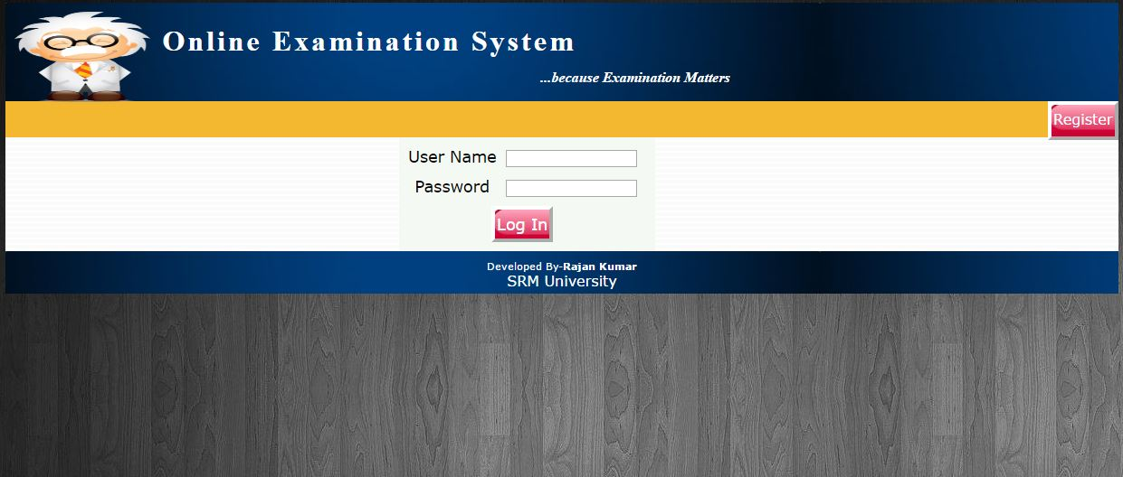

Slide 9
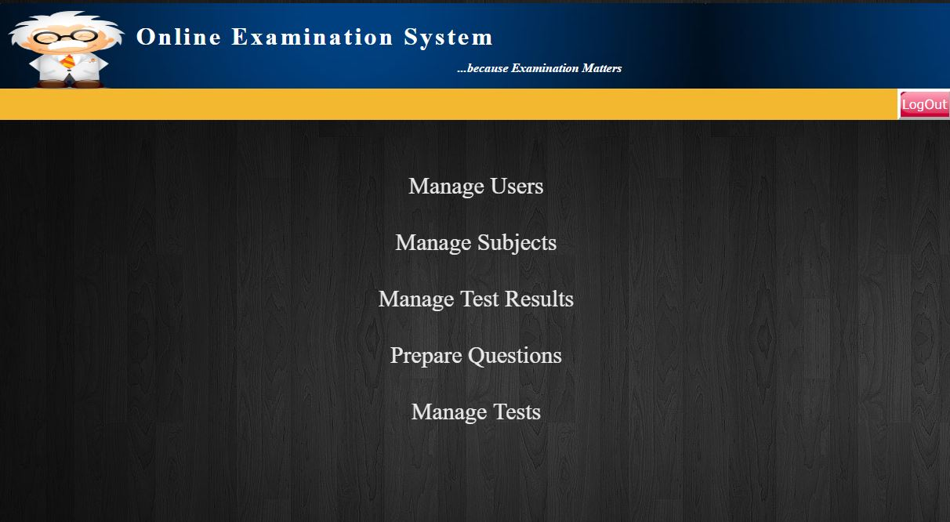
Code Snippet :-

Slide 10
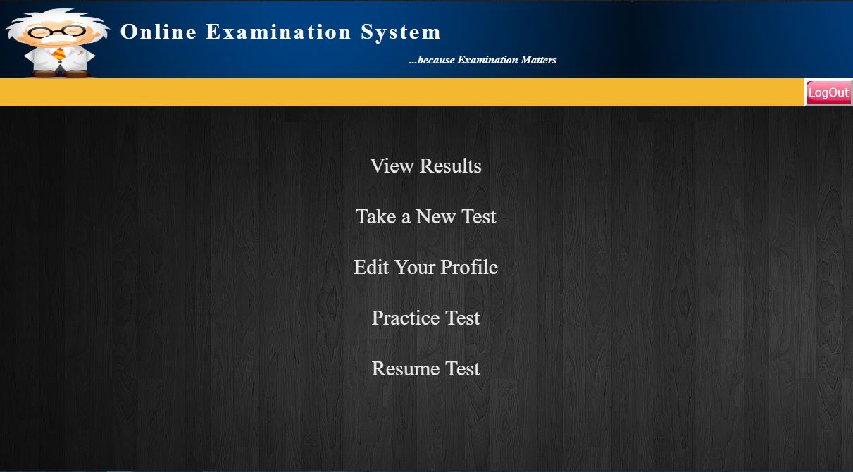

Slide 11
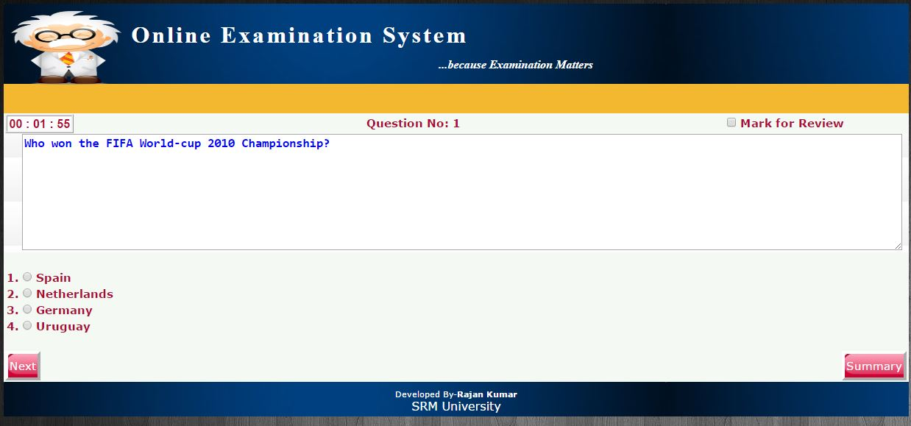

Slide 12
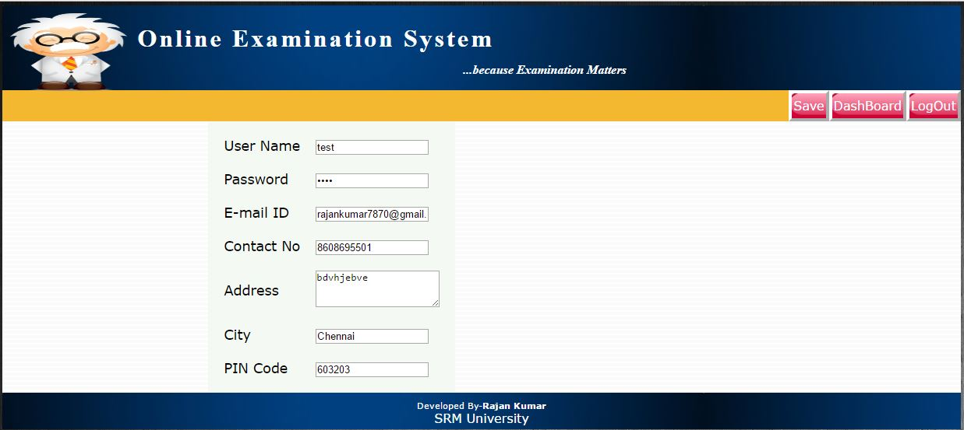

Slide 13
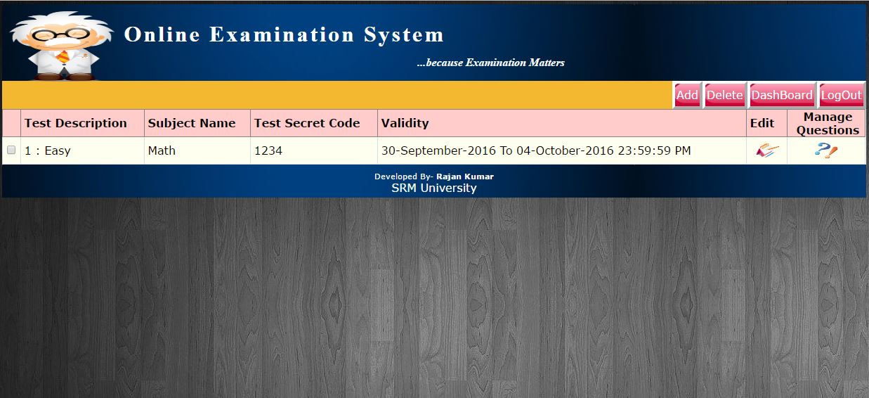

Slide 14
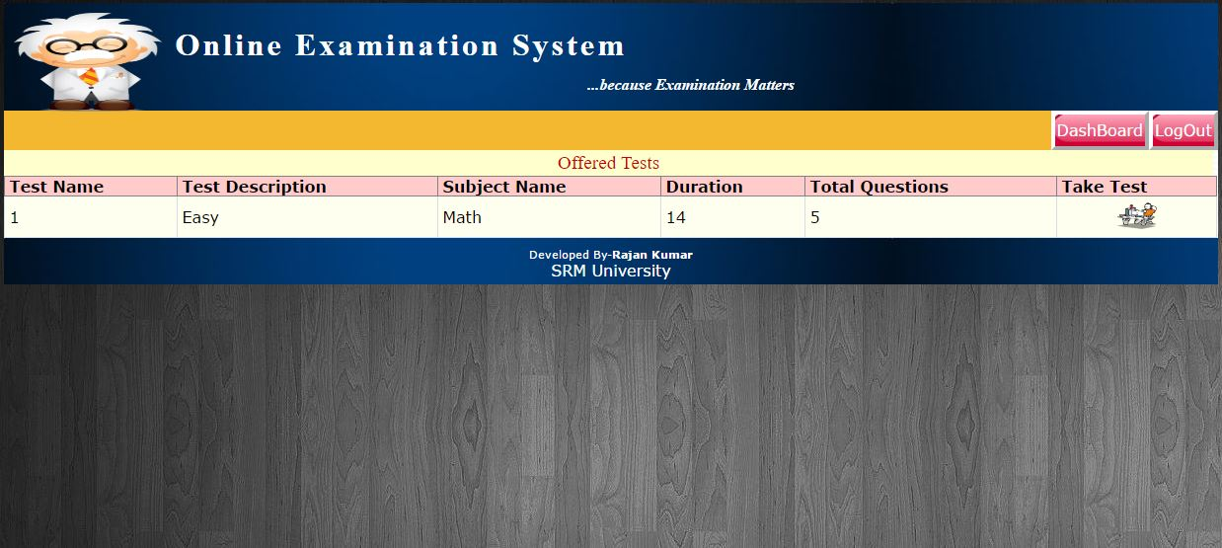

Slide 15
Learning Outcomes:-
Learnt about :
PHP
MySQL
HTML
CSS

Slide 16
Thank You.

