Slide 1
STUDENT INFORMATION SYSTEM

Slide 2
Overview: -
INTRODUCTION
BENEFITS
TOOLS
MODULES
SCRENNSHOTS
CONCLUSION
REFERENCES

Slide 3
INTRODUCTION
Student Information Systems are the primary systems for managing information about students in Schools/ Colleges.
Student information systems provide capabilities for entering student records, tracking student attendance, and managing many other student-related data needs in a college or university.
The Student Information System is a student-level data collection system that allows the Department to collect and analyze more accurate and comprehensive information.

Slide 4
INTRODUCTION (CONTD…)
Handling the Student details.
Maintaining the Student Marks Details.
Maintaining records of absences and attendance.
Handling the Student examination details.
Maintaining records of examination.

Slide 5
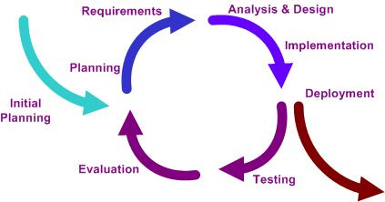
METHODOLOGY: -
Iterative and Incremental Life Cycle

Slide 6
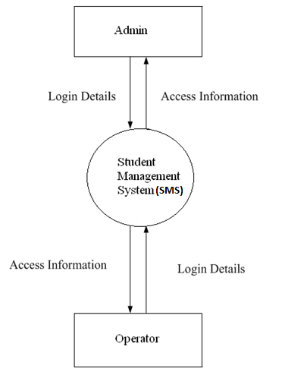
Context Diagram of SIS: -

Slide 7
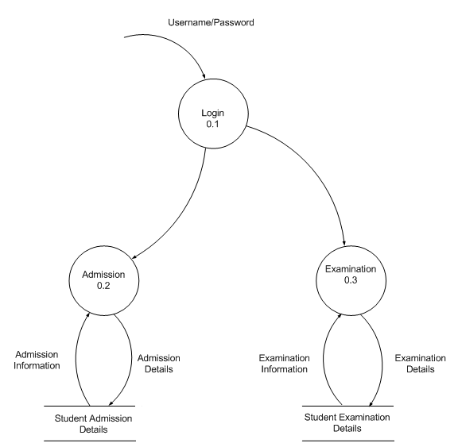
Level-1 Data Flow Diagram Of SIS

Slide 8
Level-2 DFD For marks: -

Slide 9
Level-2 DFD For Subject: -

Slide 10
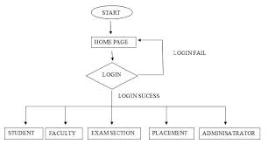
Flow-Chart Diagram For System

Slide 11
BENEFITS: -
A well-designed student record system ensures that data are readily available to manage the education system efficiently and to effectively meet the needs of students.
Scalable and Customizable
Complete automation of all operations.
Enhanced interaction with teachers.
Access to attendance, timetable, marks, grades and examination schedule.
Free to use.

Slide 12
TOOLS:-
PHP
HTML
CSS
JS
JQuery

Slide 13
MODULES:-
Administrator Module
Teacher Module

Slide 14
Administrator Module:-
Register new user :- Administrator has to register new users that will be subscribing the classes of teachers.
Cancel a user registration:- If any registered user does not want to subscribe the classes, cancels his registration.

Slide 15
Teacher Module:-
Similarly as Administrator, teachers have to sign up using their official college id and password.
After signing is done ,teachers need to create classes of the subjects taught by them.
Teachers are provided with other application to manage their classes and login.

Slide 16
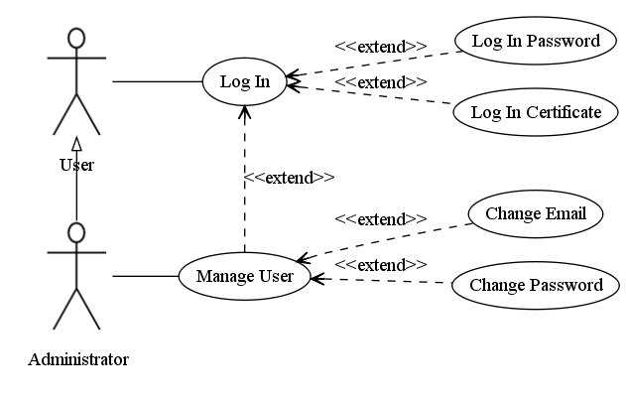
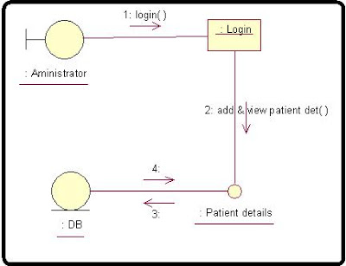
Login Use-case:-

Slide 17
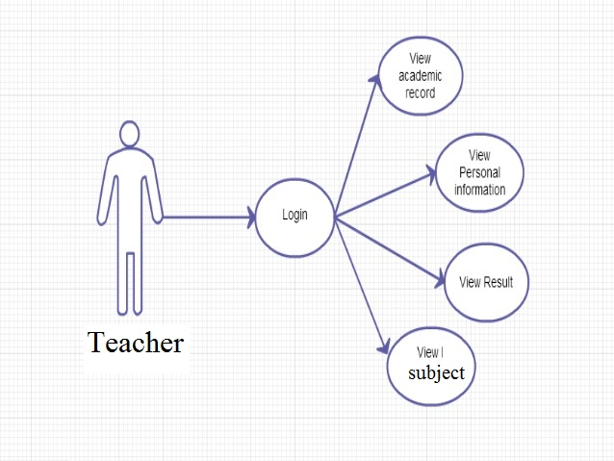
Teacher Log-in:-

Slide 18
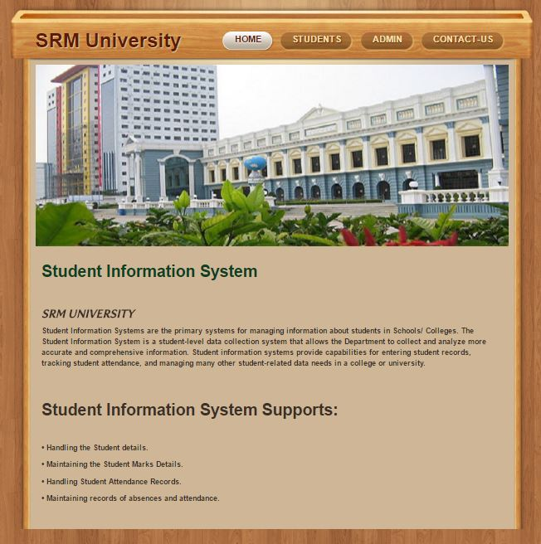
SCREENSHOTS: -
Home- Page

Slide 19
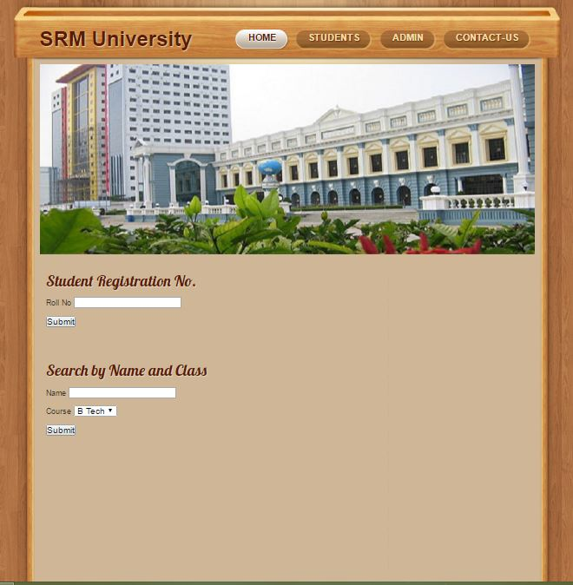
Student- Search Page

Slide 20
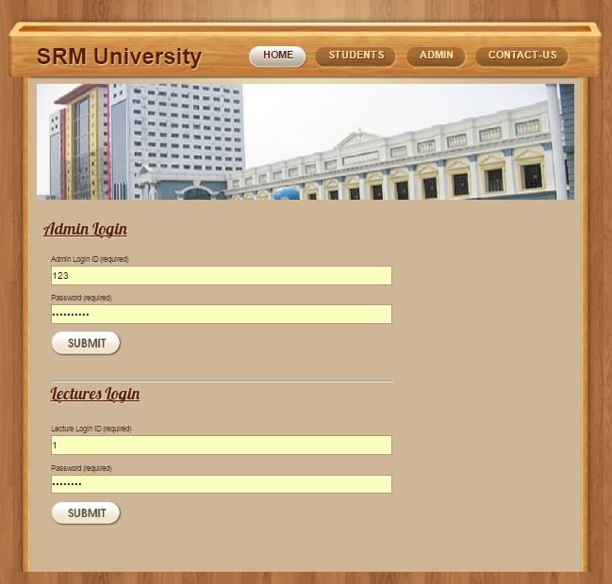
Admin/ Lecturer Login Page

Slide 21
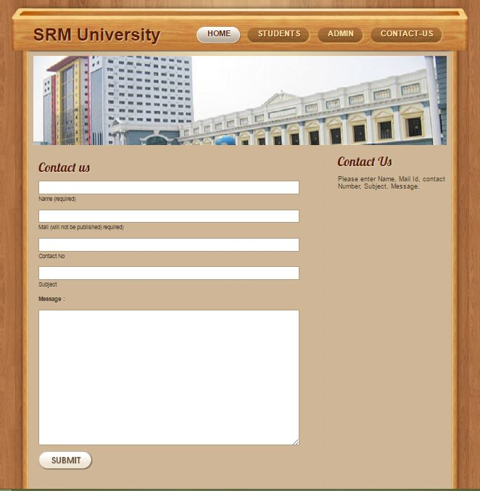
Contact Page

Slide 22
Future Enhancements
This Project can be implemented in more than two languages.
Other Possible ModulesLab Management
Library
Hostel

Slide 23
Conclusion:-
It is easy to use.
The project is user friendly approach.
The usage of software increases the efficiency, decreases the effort.
It has been thoroughly tested and implemented.

Slide 24
REFERENCES: -
PHP book by Vasvani (TMH publications)
Beginning PHP5 by WROX
www.google.com
www.wikipedia.com
www.w3schools.com
www.codeguru.com
JavaScript Bible by Danny Goodman

Slide 25
THANK YOU !

