Slide 1
Bioinformatics algorithm club
Jan 22 2024

Slide 2
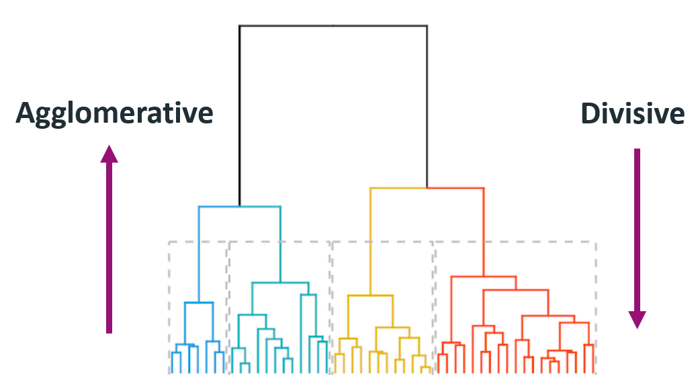
Hierarchical clustering: A Method to build a hierarchy of cluster
Hierarchical clustering construct a clusters for all values of k (k =1 to n) either by bottom-up (agglomerative) or top-down(divisive) approach
The only difference between k = r and k = r + 1 is that one of the r clusters splits up in order to obtain r + 1 clusters (or, to put it differently, two of the r + 1 clusters combine to yield r clusters)
Applications:
analyze gene expression data by building clusters of genes with similar patterns of expression
Phylogenetic analysis ….
Notes:
cluster analysis is mostly used as a descriptive or exploratory tool, in contrast with statistical tests which are carried out for inferential or confirmatory purposes. That is, we do not wish to prove (or disprove) a preconceived hypothesis; we just want to see what the data are trying to tell us.
Ponder: does the top-down and bottom-up approach result the same cluster?

Slide 3
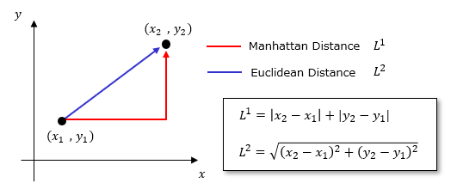
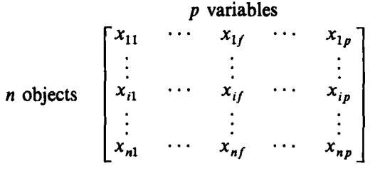

Mathematics behind:
Similarity metric:
Manhattan Distance
Euclidean Distance
Mathematical requirement of distance metric:
i) d(i, j) ≥ 0
ii) d(i, i) = 0
iii)d(i, j) = d(j, i)
iv) d(i, j) < d(i, h) + d(h, j)
A generalization of both the Euclidean and the Manhattan metric is the Minkowski distance
Weighted Euclidean distances:

Slide 4
Need for data transformation in clustering
To avoid the dependence on the choice of measurements
To minimize the outliers effects (one may use the mean absolute deviation instead of standard deviation to minimize the outliers effect)
Techniques:
Data standardization
Normalization
Minmax scaling
How the distribution in the data change with different data transformation?

Slide 5
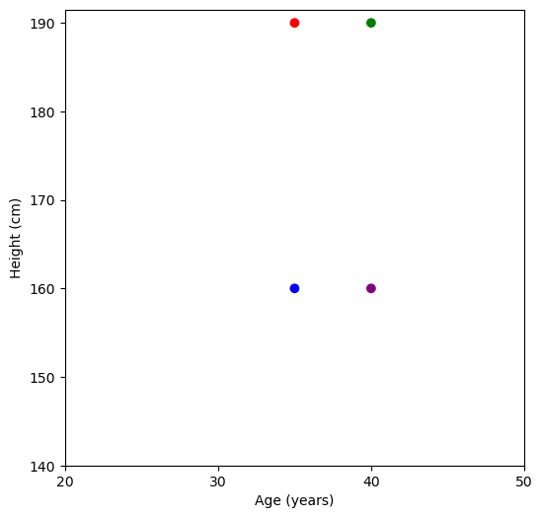
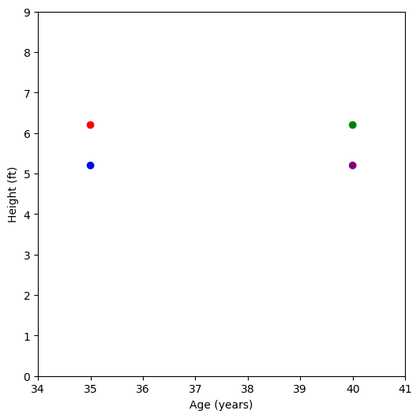
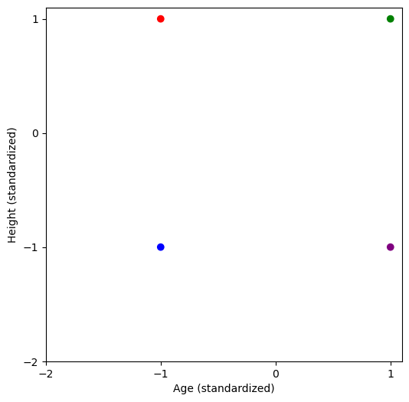
Data standardization
Person | Age (yr) | Height (cm)
A | 35 | 190
B | 40 | 190
C | 35 | 160
D | 40 | 160
Height (ft)
6.2
6.2
5.2
5.2

Slide 6
Agglomerative (bottom-up clustering)
To start with each data point belongs to their own cluster(i.e. at step 0 we have n clusters)
Iteratively construct the similarity matrix and formed a cluster based on the optimum similarity

Slide 7
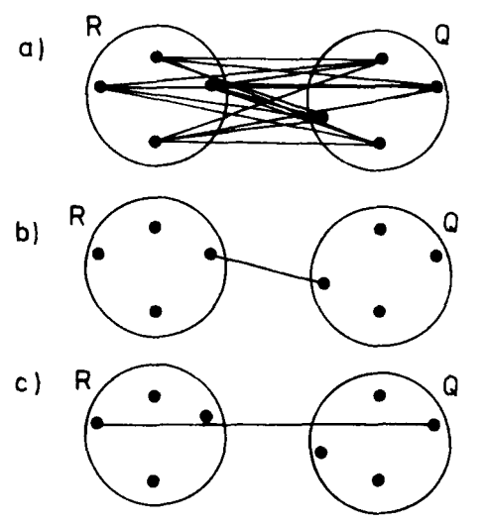
Pseudocode
Start with all data points in their own cluster
Compute the similarity matrix, cluster those together which has optimum similarity score
Case1: Similarity matrix between cluster and cluster Case2: Similarity matrix between cluster and data point
Different techniques:
Group average (UPGMA)
Nearest neighbor
Furthest neighbor
Notes:
UPGMA: unweighted pair group method using arithmetic mean

Slide 8
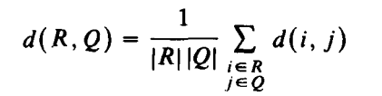
UPGMA - unweighted pair group method using arithmetic mean

Slide 9
Discussion question
Does the bottom-up (agglomerative) and top-down (divisive) techniques produce the same cluster?
pros/cons of hierarchical clustering over K-means clustering?
How to handle the missing data points in the data set for clustering?
What about using the dissimilarity metric instead of similarity metric?

