Slide 1

Real Time Driver Drowsiness Monitoring System
PRESENTED TO- PRESENTED BY-
PROJECT EVALUATION COMMITTEE PRADEEP KUMAR(2000540100110)
CSE DEPARTMENT RAJ CHAUDHARY(2000540100120)
BBDITM(054) RAJAN TIWARI(2000540100122)
RAJAT GUPTA(2000540100123)

Slide 2
INDEX
Title Page
Index
Introduction
Road Safety Concern
Comparative Study( Of Different Papers by using Table)
Data Flow Diagram
Real Time Monitoring
Technologies Used
Benefits of our System
Scheduling
Conclusion & Future work
Thank you

Slide 3

INTRODUCTION
Road accidents due to driver drowsiness pose a signiﬁcant threat to public safety. Our Real-Time Driver Drowsiness Monitoring System aims to address this issue by continuously analyzing driver behavior and alerting them when signs of drowsiness are detected.
Def : A Drowsiness monitoring system is an advanced technological solution designed to monitor and analyze a person's physiological and behavioral indicators in real-time to assess their level of alertness and detect signs of drowsiness or fatigue.

Slide 4

ROAD SAFETY CONCERNS
Microsleeps: Drowsy drivers may experience brief episodes of microsleep, during which they briefly fall asleep for a few seconds without realizing it, leading to a loss of control.
Reduced Reaction Time: Drowsy drivers have slower reaction times, making it difficult to respond to sudden changes in traffic or road conditions.
Impaired Decision-Making: Fatigue can impair a driver's judgment and decision-making abilities, increasing the risk of making poor choices on the road.
Difficulty Maintaining Speed: Drowsy drivers may struggle to maintain a consistent and safe speed, potentially causing accidents due to erratic driving.

Slide 5
Comparative Study( Of Different Papers by using Table)-
S. No | Title | Author | Publication | Methodology | Year
1. | Deep-Learning Method to Predicting Traffic Accidents Due to Drowse | Shivam Singh, Shreya Bansal, Anjum Parvez | 2022 International Conference on Cyber Resilience (ICCR), | Data Preprocessing Feature Engineering Hyperparameter Tuning | 2022
2. | Prevention from Road Accidents by Detecting Driver Drowsiness | S Priyadarshini | Recent Trends in Information Technology and its Application, | Perform data cleaning to remove noise, outliers, and artifacts. Annotation and Labeling Continuous Monitoring and Feedback | 2022
3. | Development of a Driver Safety Monitoring Device with Ignition Interlock. | Joseph Kayode, Kevin J Agim, Omolayo M Ikumapayi, Adeyinka OM Adeoye | International Journal of Safety & Security Engineering 12 (6), | Requirements Analysis Build prototypes for field testing | 2022
4. | Arduino based real time drowsiness and fatigue detection for bikers using helmet | M Oviyaa, P Renvitha, R Swathika, I Joe Louis Paul, S Sasirekha | 2nd International Conference on Innovative Mechanisms for Industry Applications (ICIMIA) | Choose appropriate sensors (e.g., cameras, alcohol sensors) Monitoring and Maintenance | 2022

Slide 6
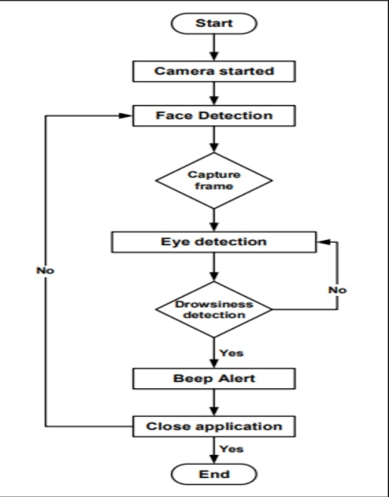
FLOW DIAGRAM OF WORKING MODEL
The Driver as the source of input (e.g., facial images, vital signs)
The Drowsiness Monitoring Algorithm as the process that analyzes the input data
The Alert Generation process as the output that notifies the driver of their drowsiness
The Vehicle as the destination of the alert
A Drowsiness Monitoring Algorithm diagram, showing the input data (e.g., facial images, vital signs) and the process of analyzing the data to determine the driver's drowsiness level.
An Alert Generation diagram, illustrating how the system generates and delivers alerts to the driver and the vehicle.

Slide 7
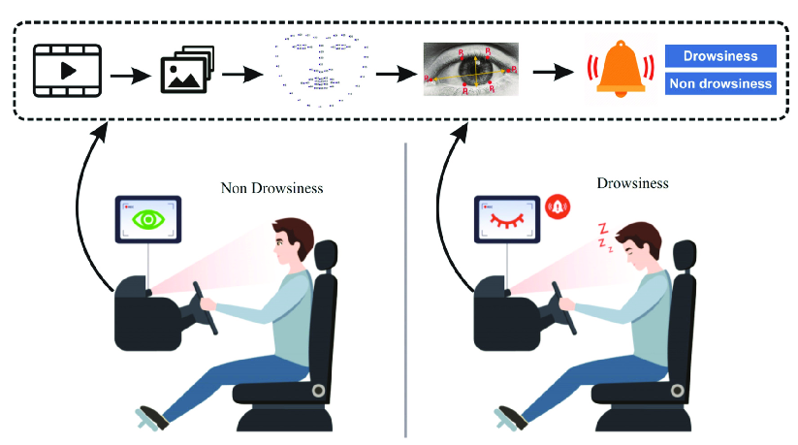
REAL-TIME MONITORING
Continuous Monitoring: Our system employs continuous monitoring of vital parameters, including eye movement, head position, and blink frequency.
Drowsiness Detection: By meticulously analyzing these parameters, the system identifies signs of drowsiness in the driver's behavior.
Timely Alerts: When drowsiness is detected, the system promptly issues alerts to the driver, ensuring they receive immediate warnings.
Preventative Action: These timely alerts empower the driver to take necessary precautions, such as resting or adjusting their driving behavior.
Real-Time Surveillance: Our system operates in real-time, allowing for proactive intervention, significantly reducing the likelihood of accidents caused by driver drowsiness.

Slide 8
TECHNOLOGIES USED:
Python : Python is a popular programming language used in machine learning-based driver drowsiness detection systems . It is used for data preprocessing, feature extraction, and training machine learning models.
TensorFlow : is an open-source machine learning framework developed by the Google Brain team. It is designed to facilitate the development and deployment of machine learning and deep learning models.
Java : Java is a widely used programming language in real-time driver drowsiness monitoring systems . It is used for developing the system's user interface, data storage, and communication with external devices.
MATLAB : MATLAB is a programming language used in real-time driver drowsiness detection systems . It is used for signal processing, feature extraction, and machine learning-based classification .
JavaScript : JavaScript is a programming language used in web-based driver drowsiness monitoring systems . It is used for developing the system's user interface, data visualization, and communication with external devices.
OpenCV : Which stands for "Open Source Computer Vision Library," is an open-source computer vision and machine learning software library.

Slide 9

BENEFITS OF OUR SYSTEM
Accident Prevention: The primary benefit is the prevention of accidents caused by drowsy driving. The system can alert the driver when it detects signs of drowsiness, giving them a chance to take corrective action and avoid a potential collision.
Enhanced Road Safety: By proactively addressing drowsiness, these systems reduce the risk of accidents, making roads safer for all users, including the drowsy driver themselves and other road users.
Reduced Fatalities and Injuries: Drowsy driving is a significant contributor to road fatalities and injuries. Drowsiness detection systems can help mitigate these tragic outcomes by preventing accidents or reducing their severity.
Improved Productivity: For commercial drivers and long-haul truckers, staying alert is critical. Drowsiness detection systems help maintain driver alertness, enhancing productivity and reducing the risk of accidents during long trips.

Slide 10
SCHEDULING
The following table shows the expected flow of work for the accomplishment of the required result.
No | Description | Duration (in weeks) | Complexity (Out of 10) | Status
1 | Researching algorithms that aid in fatigue monitoring. | 1 | 7 | Done
2 | Literature Survey of Seeing Machines Face LAB. | 1 | 5 | Done
3 | Literature Survey of LC Technologies | 1 | 5 | Done
4 | In-depth understanding and study of python Language along with a Machine Learning Framework known as TensorFlow. | 1 |  | Pending
5 | Implementation of the Algorithms for Eye Detection and Image Processing. | 1 | _ | Pending
6 | Actual implemention of the Drowsiness Detection System. | 1 | _ | Pending
7 | Writing, compiling and execution of the codes necessary for the implementation of the Drowsiness Detection System | 1 | _ | Pending

Slide 11
CONCLUSION
Transforming road safety
Cultivating Responsible Driving Habits
Lives Saved, Injuries Prevented
Continuous Evolution for Optimal Performance
A Safer Future for All

Slide 12
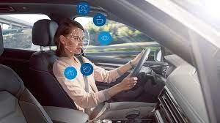
FUTURE WORK
Enhanced Accuracy and Sensitivity:
Continuously improve drowsiness detection algorithms to reduce false alarms and missed detections.
Real-World Validation:
Extensively test and validate the system under diverse conditions to enhance its robustness and reliability.
User Experience Optimization:
Develop non-intrusive and personalized alert mechanisms to enhance driver experience.
Edge Computing Integration:
Explore on-board data processing using edge computing for real-time responsiveness and performance in remote areas.
Multi-Modal Data Fusion:
Integrate various data sources (e.g., cameras, physiological sensors) for more accurate detection.

Slide 13
REFERENCES [1] Deep-Learning Method to Predicting Traffic Accidents Due to Drowse Shivam Singh, Shreya Bansal, Anjum Parvez 2022 International Conference on Cyber Resilience (ICCR), 1-6, 2022 [2] Prevention from Road Accidents by Detecting Driver Drowsiness S Priyadarshini Recent Trends in Information Technology and its Application 5 (2), 2022 [3] Development of a Driver Safety Monitoring Device with Ignition Interlock. Joseph F Kayode, Kevin J Agim, Sunday A Afolalu, Omolayo M Ikumapayi, Adeyinka OM Adeoye International Journal of Safety & Security Engineering 12 (6), 2022 [4] Mobile Application on Drowsiness Detection When Driving Car Akshat Singhal, Sunil Kumar VLSI, Microwave and Wireless Technologies: Select Proceedings of ICVMWT 2021, 337-345, 2022

Slide 14
[5] Driver drowsiness monitoring system using visual behaviour and machine learning M.Aishwarya, Sampuram Salini, P.Deepthi, V. Anantha Krishna International journal of creative research thoughts 6 June 2022 [6] Research on a real-time driver fatigue detection algorithm based on facial video sequences Tianjun Zhu, Chuang Zhang, Tunglung Wu, Zhuang Ouyang, Houzhi Li, Xiaoxiang Na, Jianguo Liang, Weihao Li Applied Sciences 12 (4), 2224, 2022 [7] Deep Learning based Drowsiness Detection and Monitoring using Behavioral Approach P William, Mohd Shamim, Ajay Reddy Yeruva, Durgaprasad Gangodkar, Swati Vashisht, Amarendranath Choudhury 2022 2nd International Conference on Technological Advancements in Computational Sciences (ICTACS), 592-599, 2022 [8] Low-cost real-time driver drowsiness detection based on convergence of ir images and eeg signalsKwang-Ju Kim, Kil-Taek Lim, Jang woon Baek, Miyoung Shin 2021 international conference on artificial intelligence in information and communication (ICAIIC), 438-443, 2021

Slide 15
[9] Real Time Eye Monitoring System Using CNN for Drowsiness and Attentiveness System Rahul Pai, Avinash Dubey, Nikhita Mangaonkar 2021 Asian Conference on Innovation in Technology (ASIANCON), 1-4, 2021 [10] Deep learning based approach for real-time driver drowsiness detection Atiqul Islam Chowdhury, Amit Raha Niloy, Nusrat Sharmin 2021 5th International Conference on Electrical Engineering and Information Communication Technology (ICEEICT), 1-5, 2021 [11] Real-time detection for drowsy driving via acoustic sensing on smartphones Yadong Xie, Fan Li, Yue Wu, Song Yang, Yu Wang IEEE Transactions on Mobile Computing 20 (8), 2671-2685, 2020 [12] HybridFatigue: A real-time driver drowsiness detection using hybrid features and transfer learning Qaisar Abbas International Journal of Advanced Computer Science and Applications 11 (1), 2020

Slide 16
Thank you!

