Slide 1
Permutation (ORDER matters)
Definition:
Permutation counts how many ways you can arrange things when the order is important.
🎯 Real Example:
You’re creating a 3-digit password using the numbers 1, 2, and 3.
Possible arrangements (order matters):
- 123
- 132
- 213
- 231
- 312
- 321
Total = 6 permutations
If the order changes, it's considered a different result.

Slide 2
Combination (ORDER does NOT matter)
Definition:
Combination counts how many ways you can select things when the order is not important.
🎯 Real Example:
You have 3 friends: A, B, and C, and you want to pick any 2 people for a team.
Possible selections (order doesn’t matter):
- AB
- AC
- BC
Total = 3 combinations
"AB" and "BA" are the same here because the order doesn't matter.

Slide 3
Permutation & Combination
A B C D
N – Number of Elements = 4
R – Number of combinations = 2
Order Maters
Order does not Maters
AB BA CA DA
AC BC CB DB
AD BD CD DC
AB BA CA DA
AC BC CB DB
AD BD CD DC
= 12
= 6
nPr = n!
(n-r)!
nPr = 4!
(4-2)!
nCr = n!
(n-r)!r!
nCr = 4!
(4-2)!2!
= 12
= 6

Slide 4
Example
Selecting Fruits
Imagine you're at a fruit stand and you want to choose a snack consisting of two fruits. You have three options: apples (A), bananas (B), and oranges (O).
1.Permutation: If you want to see all possible arrangements of selecting two fruits, considering different orders, you'd use permutations.
Permutation of 2 fruits out of 3: 3! / (3-2)! = 3! / 1! = 6
So, there are 6 different ways you can arrange two fruits (e.g., AB, AO, BA, BO, OA, OB).
2.Combination: If you're interested in unique combinations of fruits regardless of the order in which you select them, you'd use combinations.
Combination of 2 fruits out of 3: 3! / [(3-2)! * 2!] = 3! / (1! * 2!) = 3
So, there are 3 unique combinations of two fruits (e.g., AB, AO, BO).

Slide 5



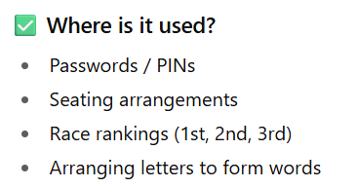
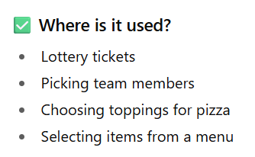
Usage

Slide 6
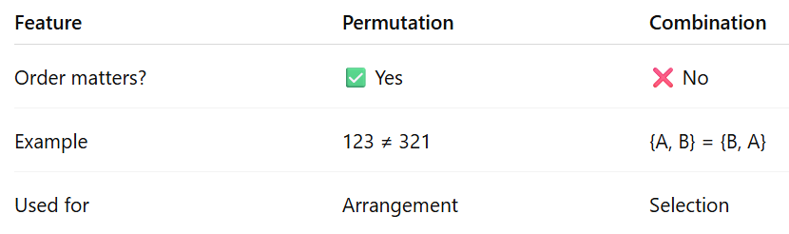
Comparison Table

