Slide 1
Big Data Analytics Crop Yield Prediction using Machine Learning
Group -11
Venu Mounica Boppana
Divya Kuchi
Manasa Rajaneni
Narasimha Rao Papineni

Slide 2
Outline
Introduction
Abstract
Existing System
Disadvantages
Proposed System
Advantages
Architecture
Dataset Description
Implementation Methodologies
Output
Evaluation Metrics
Result Analysis
References

Slide 3
Introduction
Agriculture is that the backbone of each economy.
Since the invention of recent innovative technologies and techniques the agriculture field is slowly degrading.
Owing the cultivating techniques and thus the seasonal climatic conditions also are being modified against the elements assets like soil ,water, temperature etc.
Crop yield prediction is very important agriculture problem.

Slide 4
Abstract
Crop yield prediction involves predicting yield of the crop from obtainable historical information like weather parameter, soil parameter and historic crop yield.
This system target predicting the yield of the crop supported the present information by mistreatment random forest algorithm.
The prediction can help to the farmer to predict the yield of the crop before cultivating onto the agricultural field.

Slide 5
Existing System
This system covers Data Mining concept. Various data mining algorithms such as Naive Bayes and k-Mean. It also provides classification of soil based on Genetic algorithm, Association Rule Mining.
This will prove to be extremely beneficiary while developing and will help in mining the dataset obtained from sensors employed remotely.

Slide 6
Disadvantages
In this system takes into consideration the past production of data which will help the farmer get insight into the demand and the cost of various crops in market.
Time Consuming.
Needs manual calculations.

Slide 7
Proposed System
This system mainly concentrates on weather forecasting, crop yield prediction and crop cost fore casting. These factors help the farmers to cultivate the best food crops.
Farmers can adapt to climate changes to some degree by shifting planting dates. Choosing varieties with different growth duration, or changing crop rotations.
The Statistical numeric data related to agriculture is undertaken.

Slide 8
Advantages
These techniques will help in predicting the rainfall, crop yield forecasting and cost prediction of crops.
Accurate information about history of crop yield is an important thing for making decisions related to agricultural risk management.
The farmer will check the yield of the crop as per acre, before cultivating onto the field.

Slide 9
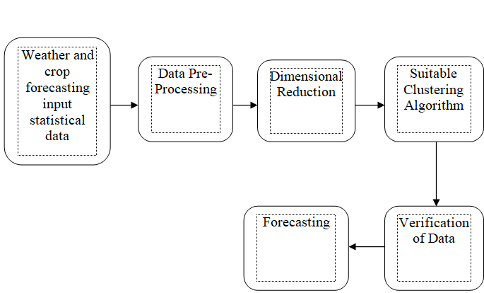
Architecture

Slide 10
Dataset Description
The dataset contains over 3977 data input variables in which 3181 data inputs are for training and 796 for testing.
The training data that is 3977 data input variables are classified into 11 classes.
By using this dataset, we are going to build a model which will classify the crop yield.

Slide 11
Implementation Methodologies
Random Forest Algorithm:Random Forest Algorithm belongs to the family of supervised learning algorithms.
The general motive of using random forest algorithm creates decision trees on data samples and then gets the prediction from each of them and finally selects the best solution by means of voting.
Let the number of training cases be N ,and the number of variables in the classifier be M.
The number m of input variables are used to determined the decision at a node of the tree; m should be much less than M.

Slide 12
Implementation methodologies
Choose a training set for this tree by choosing N times with replacement from all N available training cases.
Use the rest of the cases to estimate the error of the tree, by predicting their classes.
For each node of the tree, randomly choose m variables on which to base the decision at that node.
Calculate the best split on these m variables in the training set.
Each tree is fully grown and not pruned.

Slide 13

Implementation Methodologies

Slide 14
Implementation Methodologies
Support Vector Machine(SVM): An SVM classifies data by finding the best hyper plane that separates all data points of one class from those of the other class.
The best hyper plane for an SVM means the one with the largest margin between the two classes.
The support vectors are the data points that are closest to the separating hyper plane.

Slide 15
Implementation Methodologies
Logistic Regression: Logistic Regression is a classification algorithm. It is used to predict a binary outcome (1 / 0, Yes / No, True / False) given a set of independent variables.
To represent binary / categorical outcome, we use dummy variables. You can also think of logistic regression as a special case of linear regression when the outcome variable is categorical, where we are using log of odds as dependent variable. In simple words, it predicts the probability of occurrence of an event by fitting data to a logic function.

Slide 16
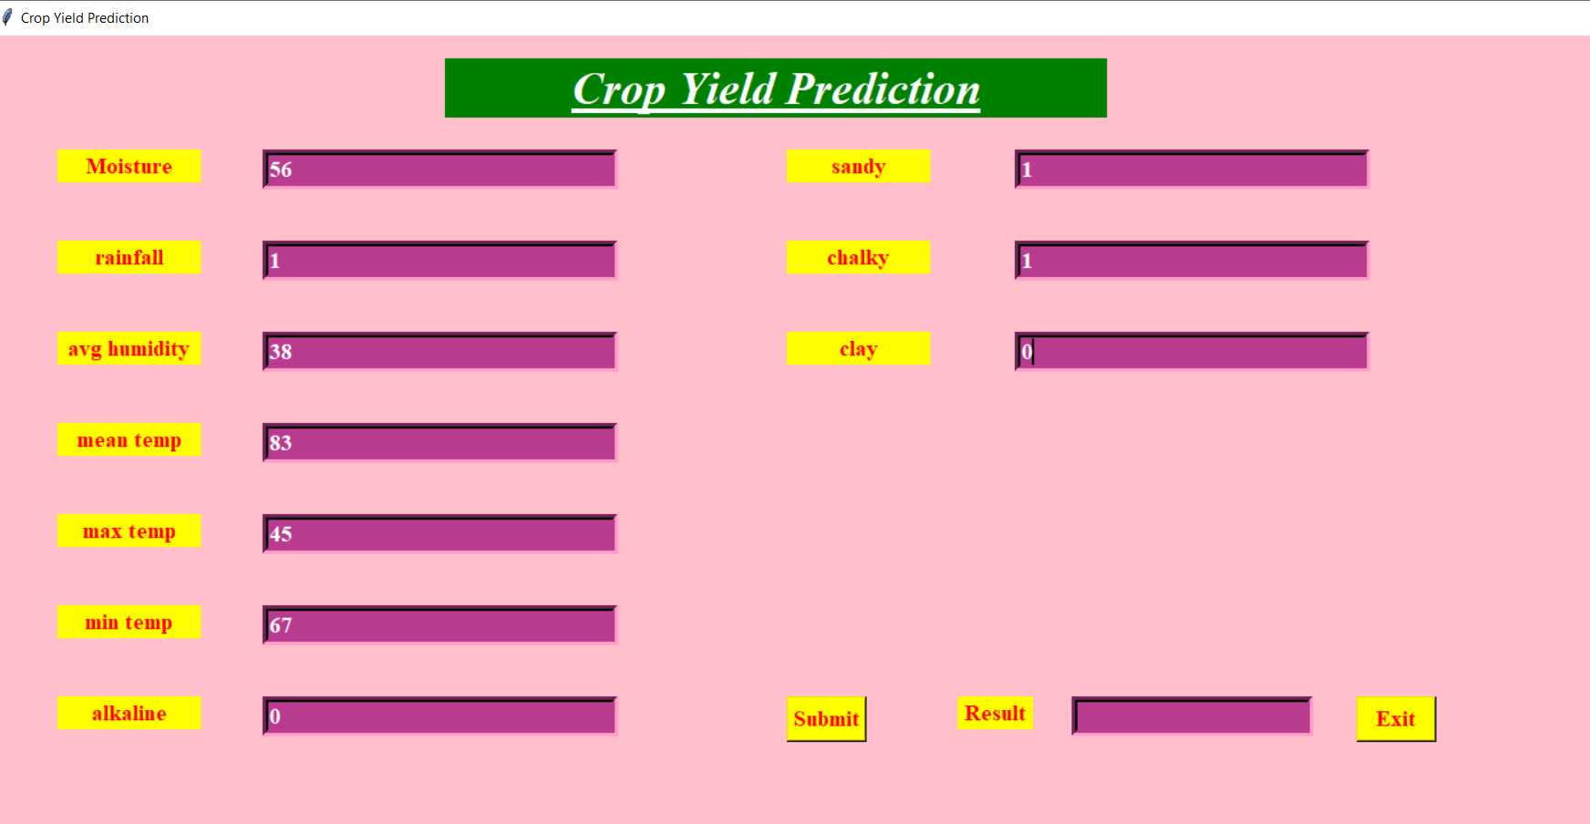
Output

Slide 17
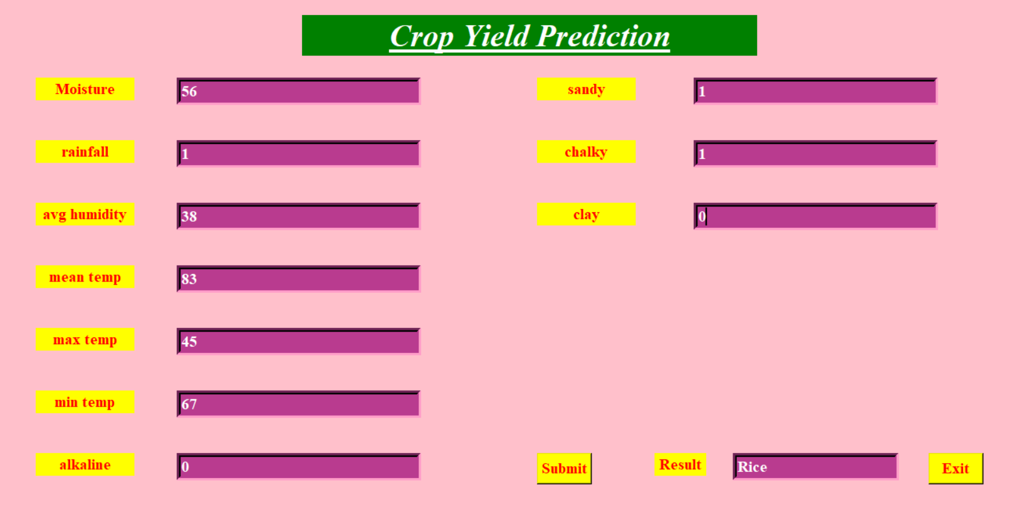
Output

Slide 18
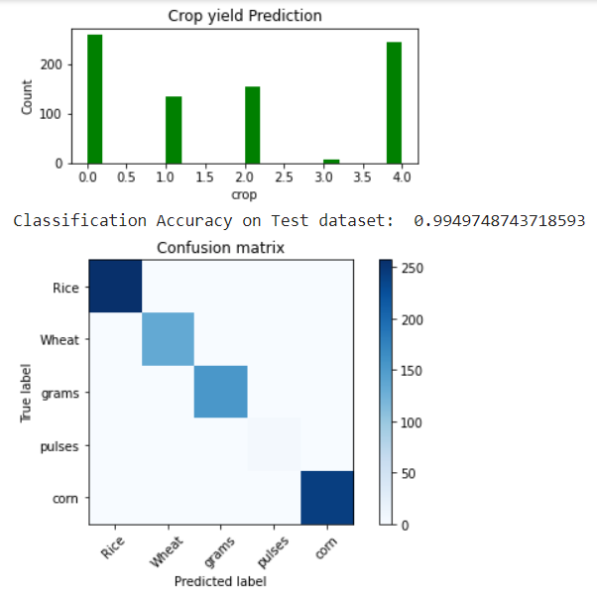
Output for Random forest
A Data set is given as input to the Decision Tree algorithm and the output is predicted. The accuracy is 99%.

Slide 19
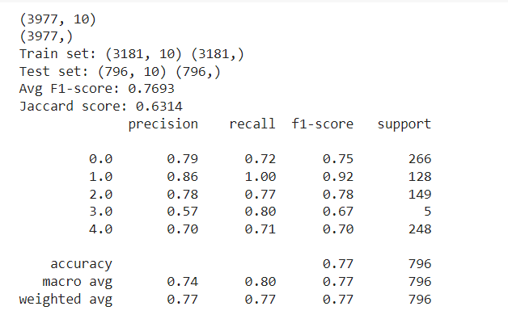
Output for support vector machine
A Data set is given as input to the svm algorithm and the output id predicted. The accuracy is 77%.

Slide 20
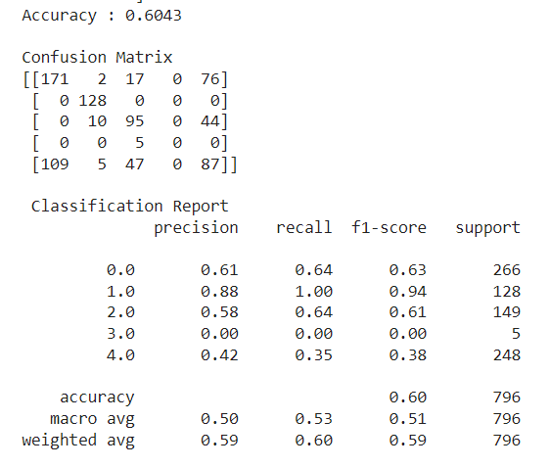
Output for Logistic Regression
A Data set is given as input to the Logistic regression and the output is predicted. The accuracy is 60%.

Slide 21
Evaluation Metrics
Classification Accuracy
Logarithmic Loss
Confusion Matrix
Area Under Curve
F1 score
Mean Absolute Error
Mean Squared Error
Jaccard Index

Slide 22
Result Analysis
Therefore we can attain an accurate crop yield prediction using the Random Forest algorithm.
Random Forest algorithm achieves a largest number of crop yield models with a lowest models.
It is suitable for massive crop yield prediction in agricultural planning. This makes the farmers to take the right decision for right crop such that the agricultural sector will be developed by innovative ideas.

Slide 23
References
[1]Liu J, Goering CE, Tian L, ”Neural network for setting target corn yields”. T ASAE 44(3): 705-713, 2001.
[2]Wang Y, Witten I, ”Inducing model trees for continuous classes”. Proc. 9th Eur. Conf. Machine Learning (van Someren M & Widmer G, eds), pp: 128-137, 1997.
[3]P. Revathi, R. Revathi, Dr.M.Hemalatha, ”Comparative Study of Knowl- edge in Crop Diseases Using Machine Learning Techniques”. Inter- national Journal of Computer Science and Information Technologies (IJCSIT), Vol. 2 (5), 2180-2182, 2011.

Slide 24
THANK YOU

