Slide 1
BCPR283
Assignment 1 Part A practical Project
Rajan Gurung

Slide 2
All the work is done as a part of pair programming between Jack Dang and Me(Rajan)
Both of us are equally involved in completing this project and have understood all the code wrote by each other including the unit test.
The test for class SudokoFileHandler and SudokuSerialize are done by me and the rest are written by jack but combined later together to make more than 40 unit test.
All the Diagram was created together apart from wireframe and storyboard.

Slide 3
MoSCoW Features
Must be able to load a file
Must be able to save a file
Must be able to check if the file is of type .csv
Must be able check the size is not a prime number that is 7*7 or 1*1
Must be able check the size in the small square mode is 0 that is if (it is 6*6 array than only possible 2*3 or 3*3) because 36 mod 6 is 0
Must be able to restart a map
Must be able to convert a String into a 1 dimensional Array
Must be able to convert a 1 dimensional Array into a String
Must be able to Check that the file has at least 4*4 min and at most 9*9
Get value of a given cell by column
Get value of a given cell by row
Get value of a given cell by squareIndex and positionIndex
Set value of a given cell by column
Set value of a given cell by row
Set value of a given cell by squareIndex and positionIndex
Check if a value of a cell is unique in that row
Check if a value of a cell is unique in that column
Check if a value of a cell is unique in that square
Check if user has won
Check if user’s input is valid
Modifying the values stored in CSV file

Slide 4
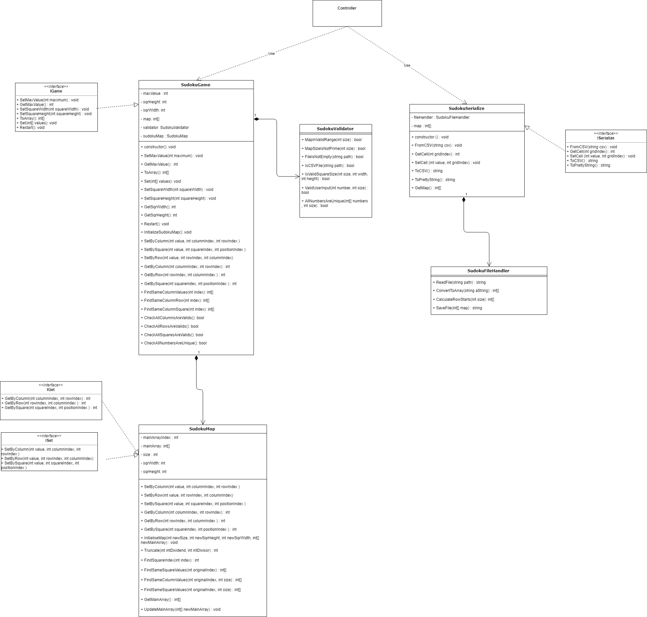
Class Diagram
Notes:
Please find the original file on the assignment1_final folder

Slide 5
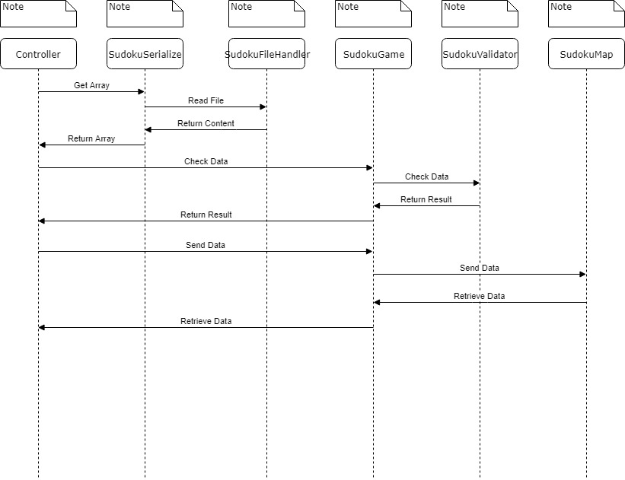
Sequence Diagram
Notes:
Please find the original file on the assignment1_final folder

Slide 6
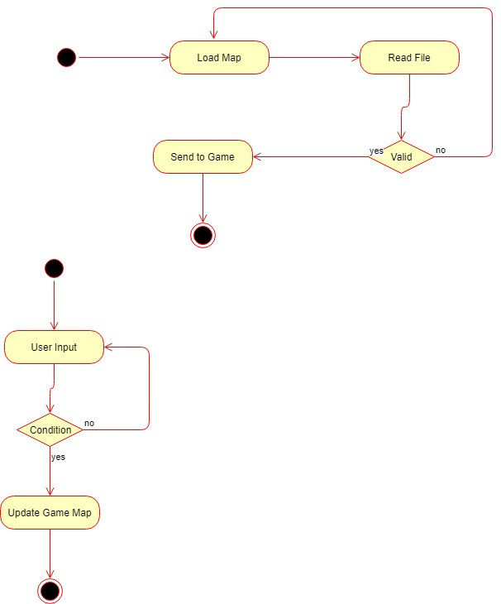
Activity Diagram
Notes:
Please find the original file on the assignment1_final folder

Slide 7
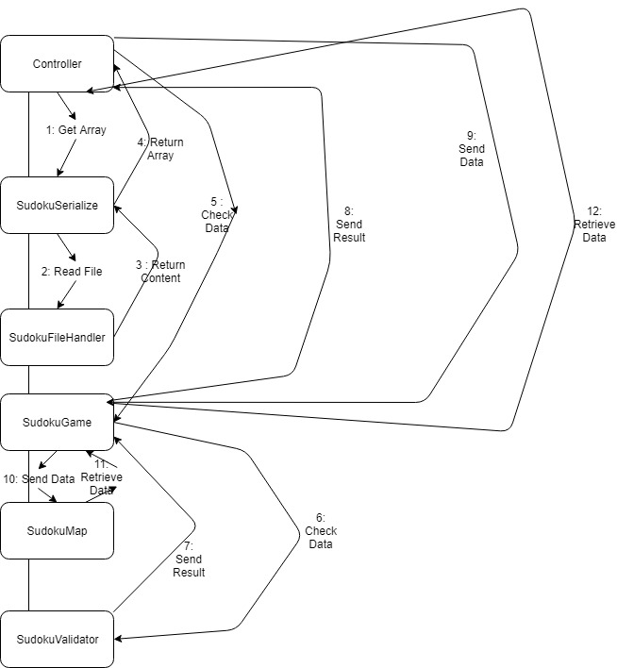
Collaboration Diagram
Notes:
Please find the original file on the assignment1_final folder

Slide 8
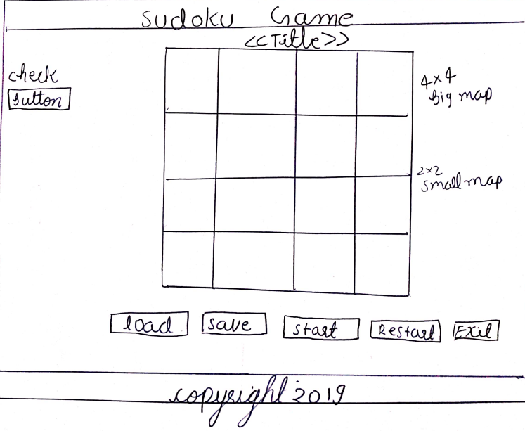
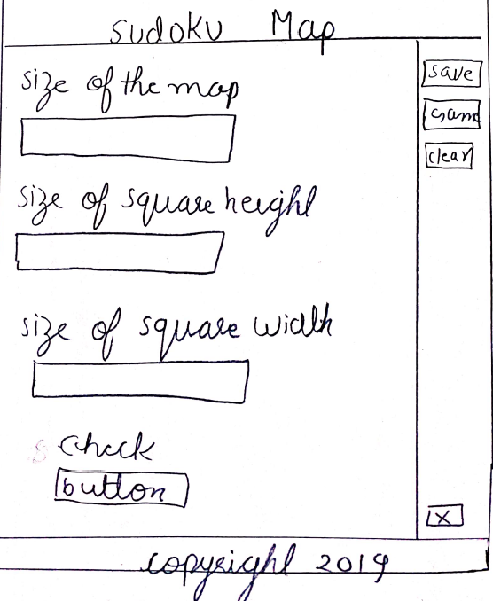
Wireframe
Notes:
Please find the original file on the assignment1_final folder

Slide 9
Storyboard
Scenario: size 4, square width 2 and square height 2
When the user clicks on the game this is the initial screen that will be shown without the map for the Sudoku.
To play the game, the user must first click on the button "Load" and select the CSV file to generate the map.
If the CSV file is not in correct format or empty an error message will be shown.
The user will be given a built-in three maps by the developer but a user can create another map by setting map size from the Sudoku Map Screen.
Once the map is generated the user has to click on the "start" button that let the user insert the number.
All the number should be a single-digit number.
Once the user is happy with all the placement of the number, the user can click on the "check" button to verify, if the numbers are unique in rows, column and square.
If the numbers are unique the user will be given a message "You have solved the puzzle" and if numbers are similar in columns or rows the message saying "Please try again".
The user can also save the puzzle by clicking on the "save" button. When the "save" button is pressed it automatically generated the map and the map is saved in the folder "Game Map".
When the user clicks on the "restart" button all the insert number will be removed and the user can start solving the puzzle from beginning.
When the user wants to quit the game, the user can just click on the "Exit" button.
Notes:
Please find the original file on the assignment1_final folder

Slide 10
Storyboard
Scenario: The user wants to create their map.
Once the user enters this screen they will be given an option to change the size of the map. In addition to this, they can also change the square height and width.
Once the three field is inserted, the user must click on the "Check" button to see the input is a valid number to generate the map.
If the number is valid messages will be shown saying " Successful " and on the other hand in case of invalid a message saying "unsuccessful " will be shown.
In addition to this, if the save button is pressed without entering the number and checking them an empty file will be created.
Once the message is "Successful" the user must click on the "save" button to save the custom map.
To play the game the user must go to the game screen and load the custom map.
If the user wants all their input field to be clear, the user can click on the "clear" button.
Clicking on the cross button will exit the screen.
Notes:
Please find the original file on the assignment1_final folder

Slide 11
Unit Test

Slide 12
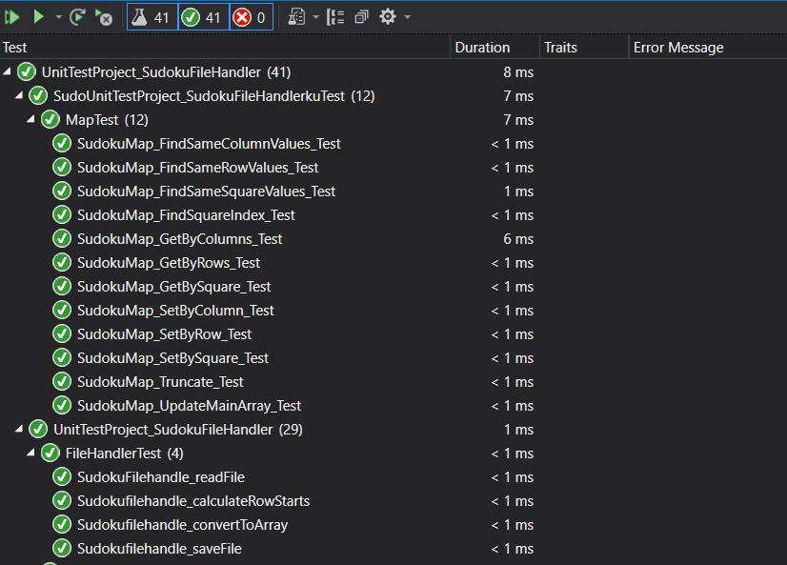
Unit test
41 unit test is passed

Slide 13
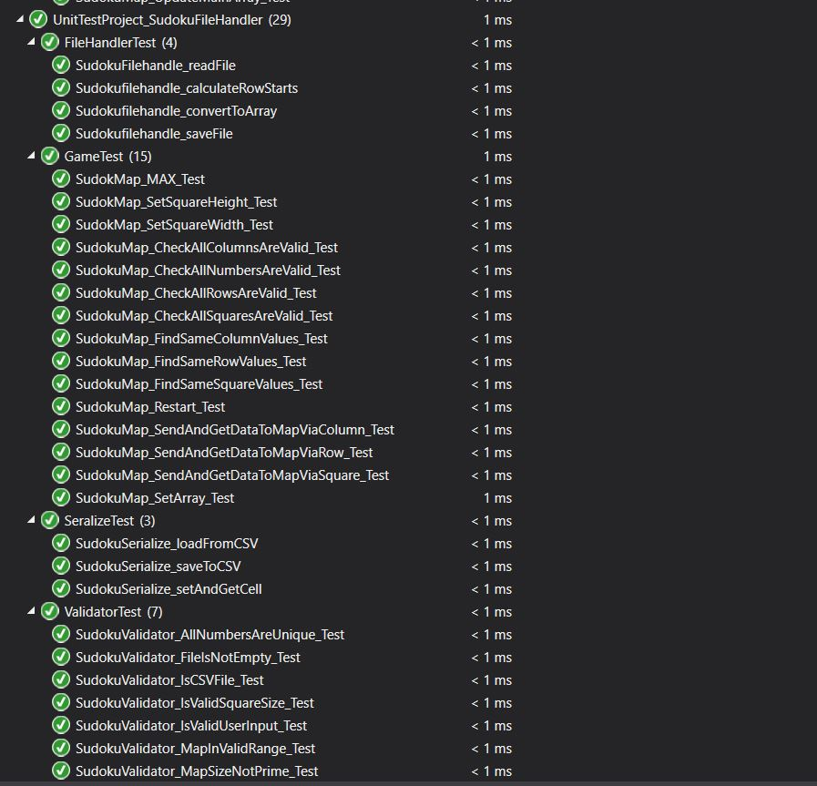
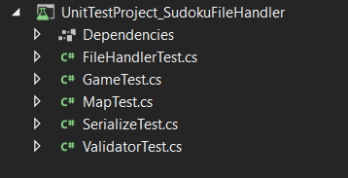
Unit test
Unit Test files
Unit Test Report

Slide 14
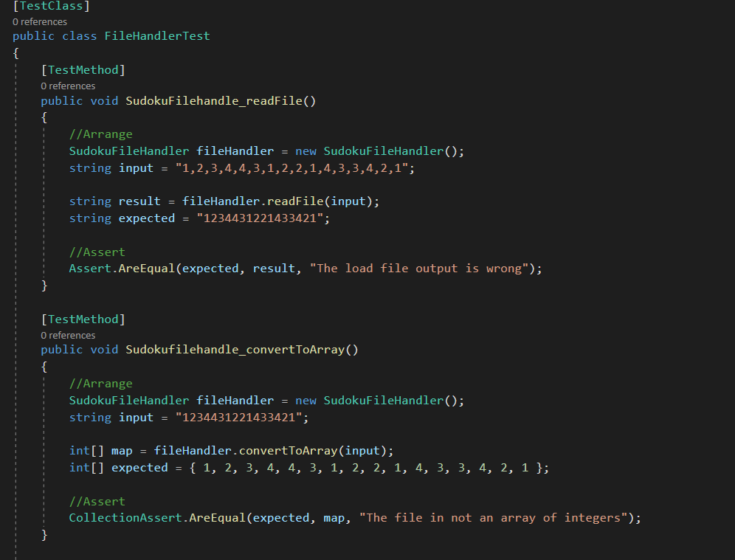
Unit test
FileHandlerTest

Slide 15
MoSCow Features

Slide 16
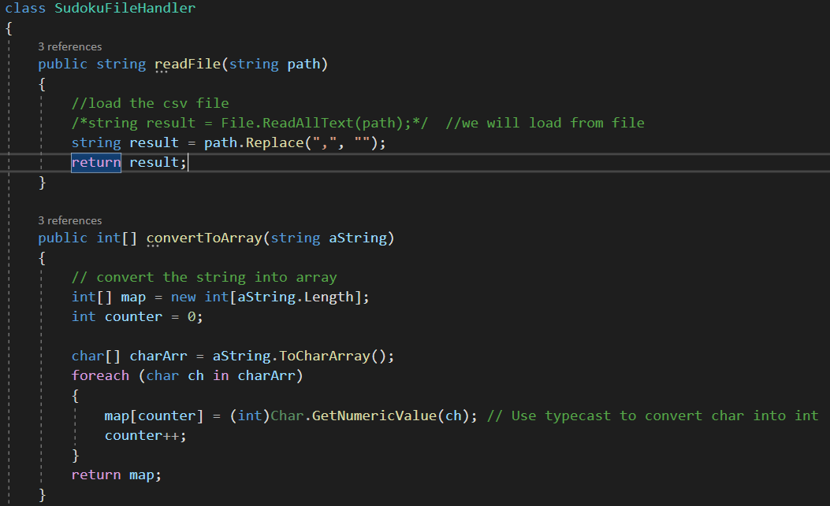
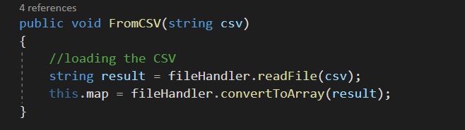
Must be able to load a file
SudokuFileHandler
SudokuSerialize
Notes:
All the explanation is done by writing as a comment inside the code .

Slide 17
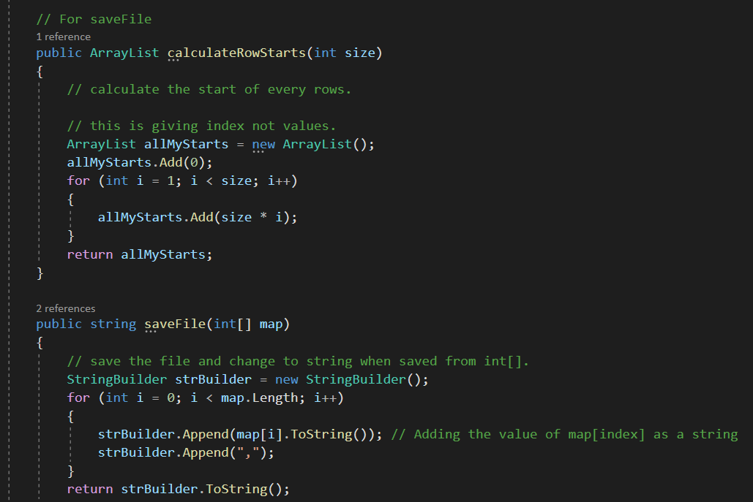
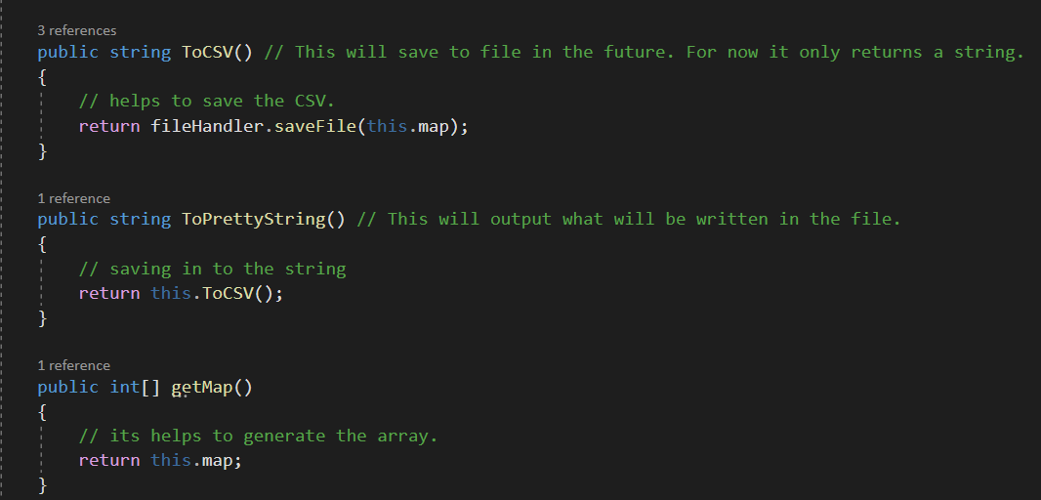
Must be able to save a file
SudokuFileHandler
SudokuSerialize
Notes:
All the explanation is done by writing as a comment inside the code .

Slide 18
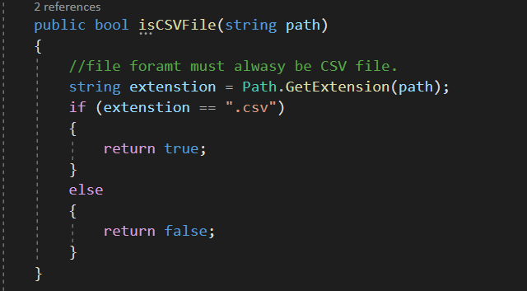
Must be able to check if the file is of type .csv
SudokuValidator
Notes:
All the explanation is done by writing as a comment inside the code .

Slide 19
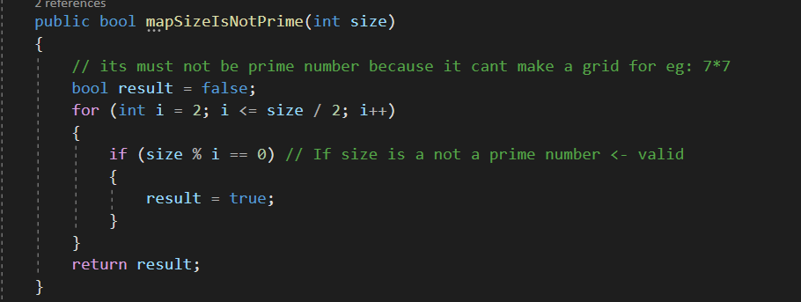
Must be able check the size is not a prime number that is 7*7 or 1*1
SudokuValidator
Notes:
All the explanation is done by writing as a comment inside the code .

Slide 20
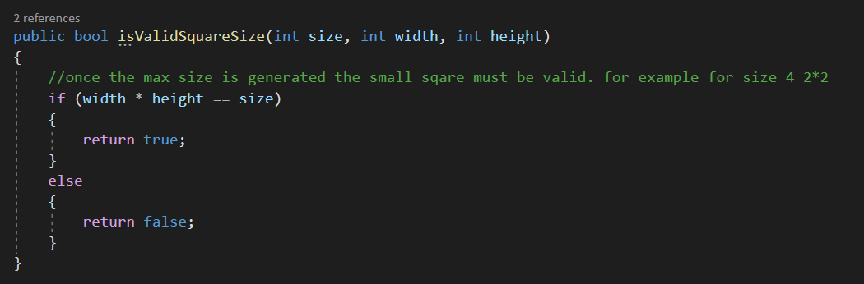
Must be able check the size in the small square mode is 0 that is if (it is 6*6 array than only possible 2*3 or 3*3) because 36 mod 6 is 0
SudokuValidator
Notes:
All the explanation is done by writing as a comment inside the code .

Slide 21
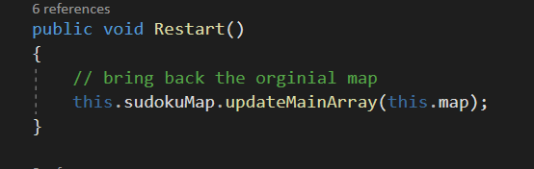
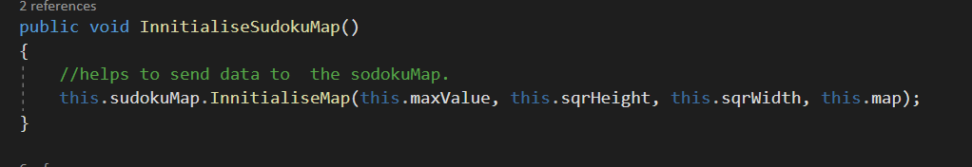
Must be able to restart a map
SudokuGame
When restart method is called than a map is taken to the original state
Notes:
All the explanation is done by writing as a comment inside the code .

Slide 22
Must be able to convert a String into a 1 dimensional Array
SudokuFileHandler
SudokuSerialize
Notes:
All the explanation is done by writing as a comment inside the code .

Slide 23
Must be able to convert a String into a 1 dimensional Array
SudokuFileHandler
SudokuSerialize

Slide 24
Must be able to convert a 1 dimensional Array into a String
SudokuFileHandler
SudokuSerialize
Notes:
All the explanation is done by writing as a comment inside the code .

Slide 25
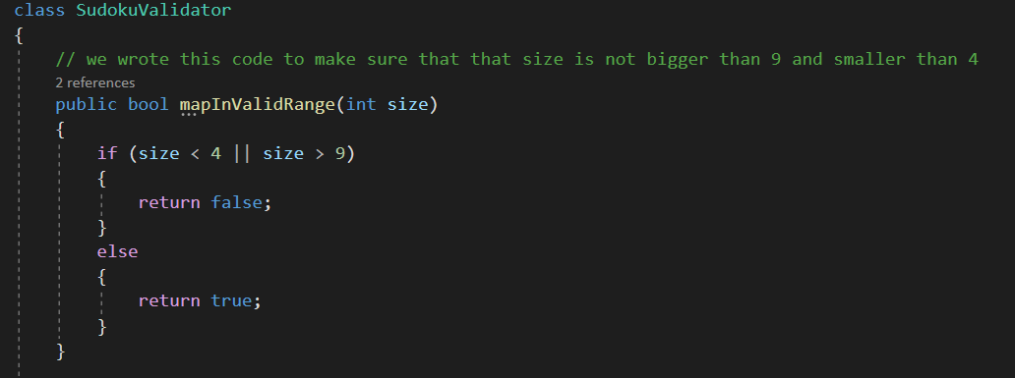
Must be able to Check that the file has at least 4*4 min and at most 9*9
SudokuValidator
Notes:
All the explanation is done by writing as a comment inside the code .

Slide 26
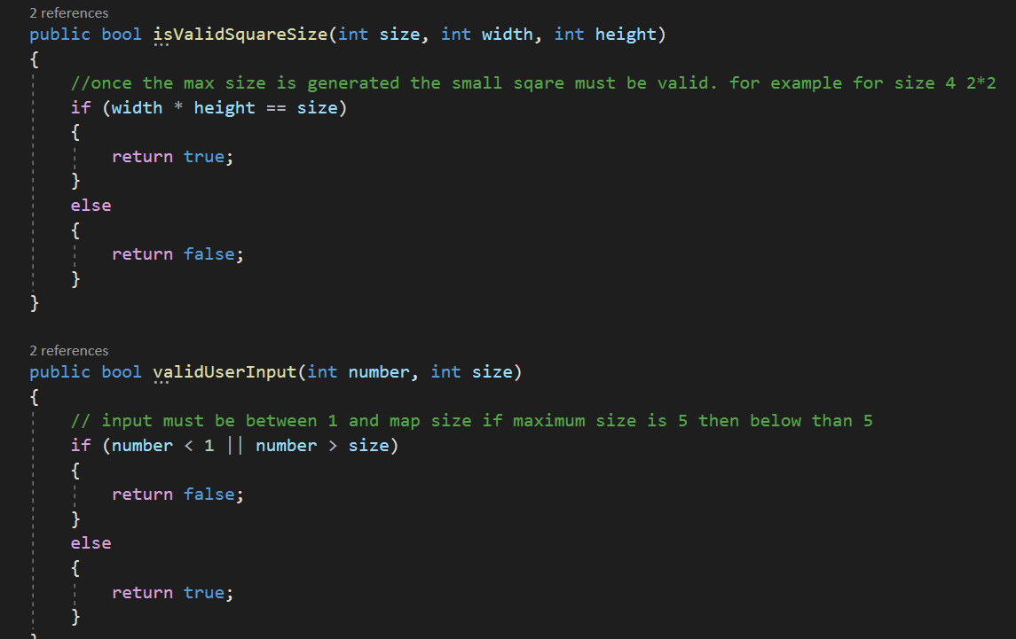
Check if user’s input is valid
SudokuValidator
Notes:
All the explanation is done by writing as a comment inside the code .

Slide 27
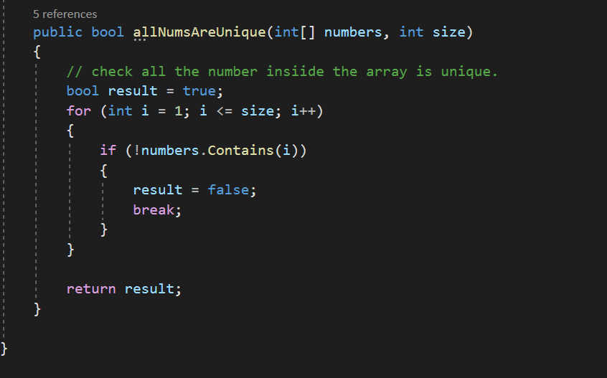
Check if user has won
SudokuValidator
Notes:
All the explanation is done by writing as a comment inside the code .

Slide 28
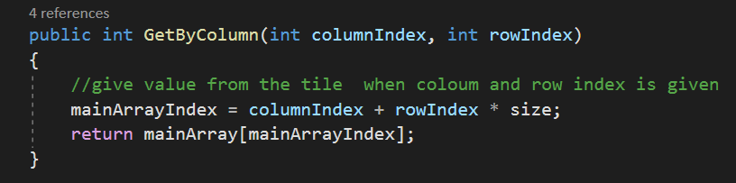
Get value of a given cell by column
SudokuMap
Notes:
All the explanation is done by writing as a comment inside the code .

Slide 29
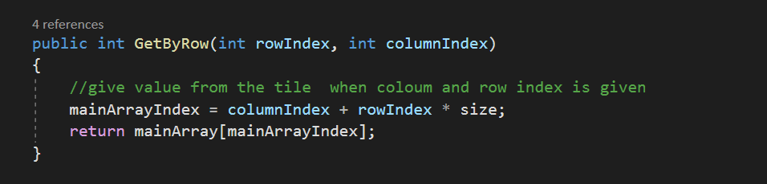
Get value of a given cell by row
SudokuMap
Notes:
All the explanation is done by writing as a comment inside the code .

Slide 30
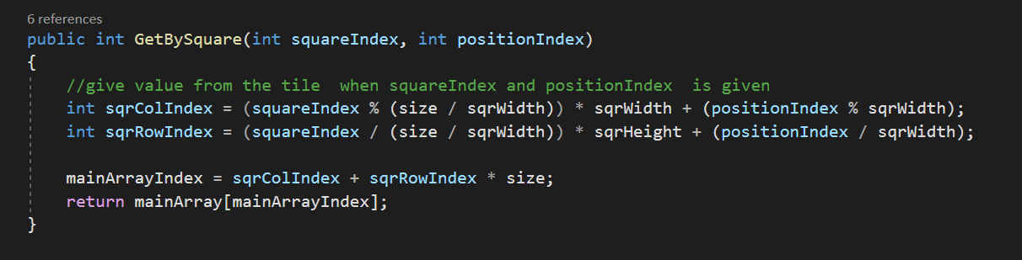
Get value of a given cell by squareIndex and positionIndex
SudokuMap
Notes:
All the explanation is done by writing as a comment inside the code .

Slide 31
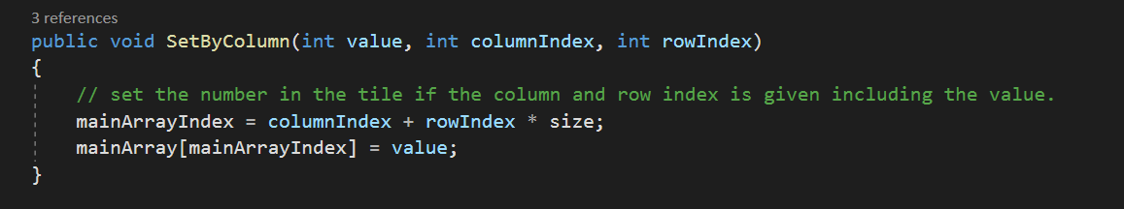
Set value of a given cell by column
SudokuMap
Notes:
All the explanation is done by writing as a comment inside the code .

Slide 32
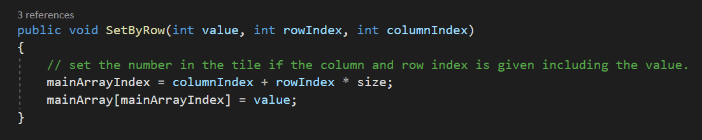
Set value of a given cell by row
SudokuMap
Notes:
All the explanation is done by writing as a comment inside the code .

Slide 33
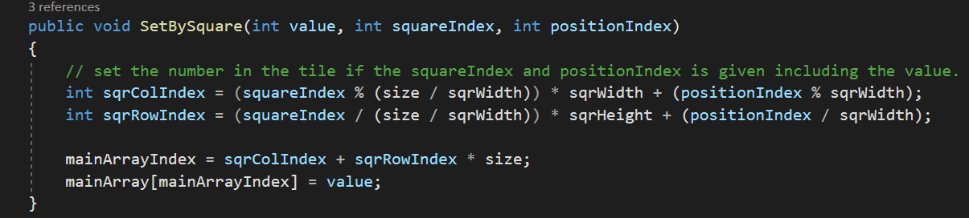
Set value of a given cell by squareIndex and positionIndex
SudokuMap
Notes:
All the explanation is done by writing as a comment inside the code .

Slide 34
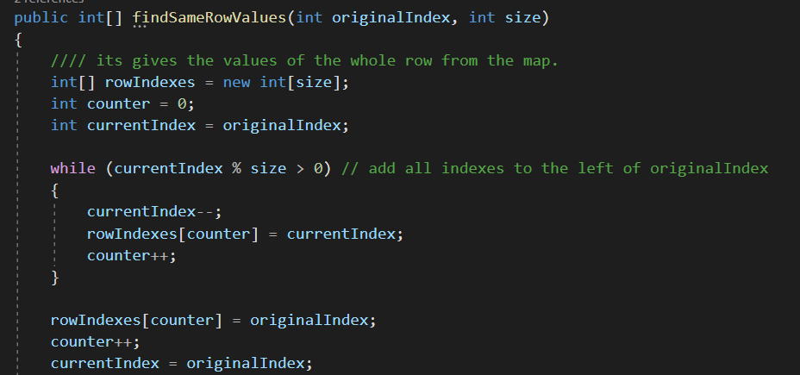
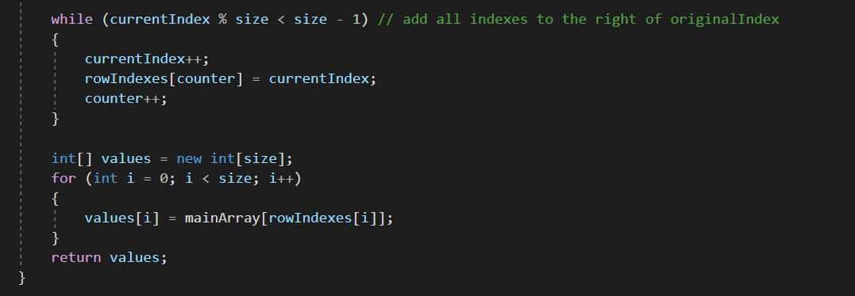
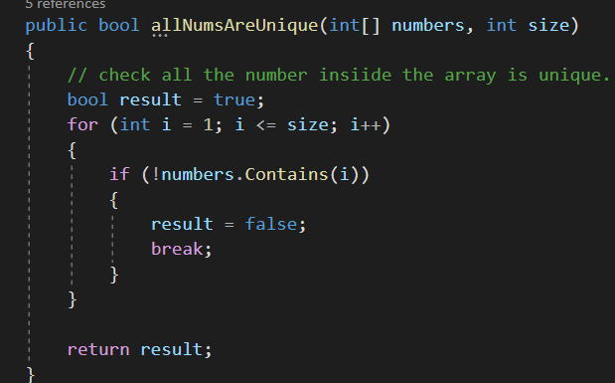
Check if a value of a cell is unique in that row
SudokuMaps
SudokuValidator
Notes:
All the explanation is done by writing as a comment inside the code .

Slide 35
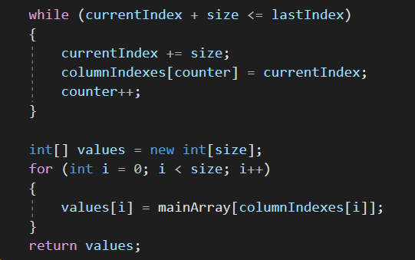
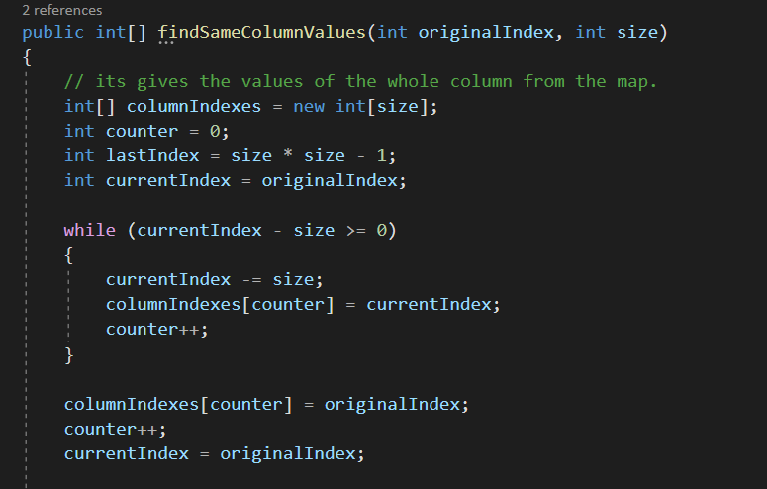
Check if a value of a cell is unique in that column
SudokuMaps
SudokuValidator
Notes:
All the explanation is done by writing as a comment inside the code .

Slide 36
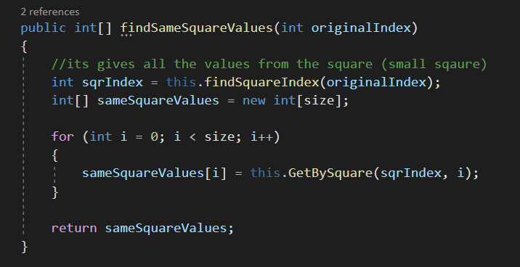
Check if a value of a cell is unique in that square
SudokuMaps
SudokuValidator
Notes:
All the explanation is done by writing as a comment inside the code .

Slide 37
Modifying the values stored in CSV file
SudokuValidator
Notes:
All the explanation is done by writing as a comment inside the code .

