Slide 1

LNMHACKS 4.0

Slide 2
Problem Statement
One of the concerning problem of this technological era is the lack of will to work and take initiative to take up a task/project which mostly results in unskilled workers, stressful work environment ,poor quality of work. This problem can cause an organization a huge loss as poor quality product does not attract customers. So is their any solution for making unwilling people willing to work?

Slide 3
Solution
We observed that people greatly appeal to deals like cashbacks or some added features at the standard price, etc. So a possible solution is an application for workplace which will offer some bonuses for the task taken by the employees on their own, time taken to complete it and the quality of the result . This will cause more work assignments to get completed as there will be more people trying to get rewards and bonuses which can be digital cash prizes or some discount vouchers. This application will be supported by PCs and Mobiles.

Slide 4
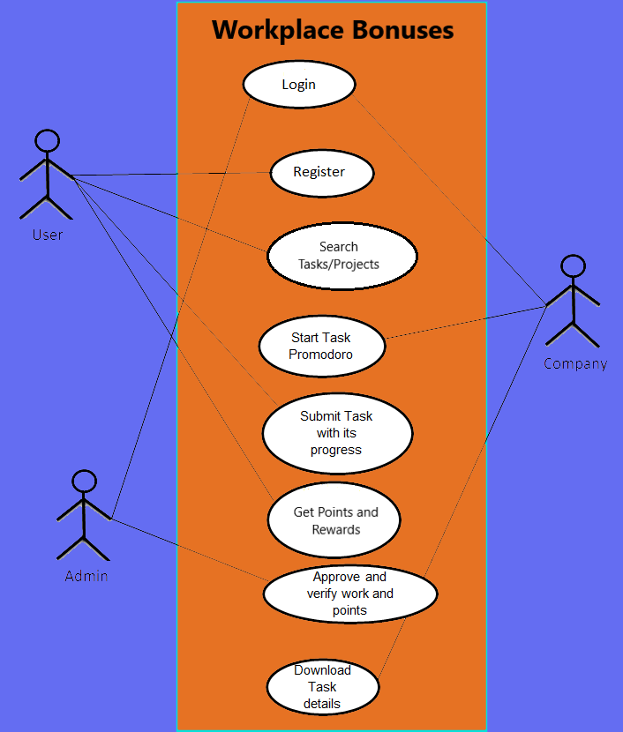
Architecture

Slide 5
Tech Stack
Technology used :
Javascript
HTML5
MongoDB(DBMS)
CSS3

Slide 6
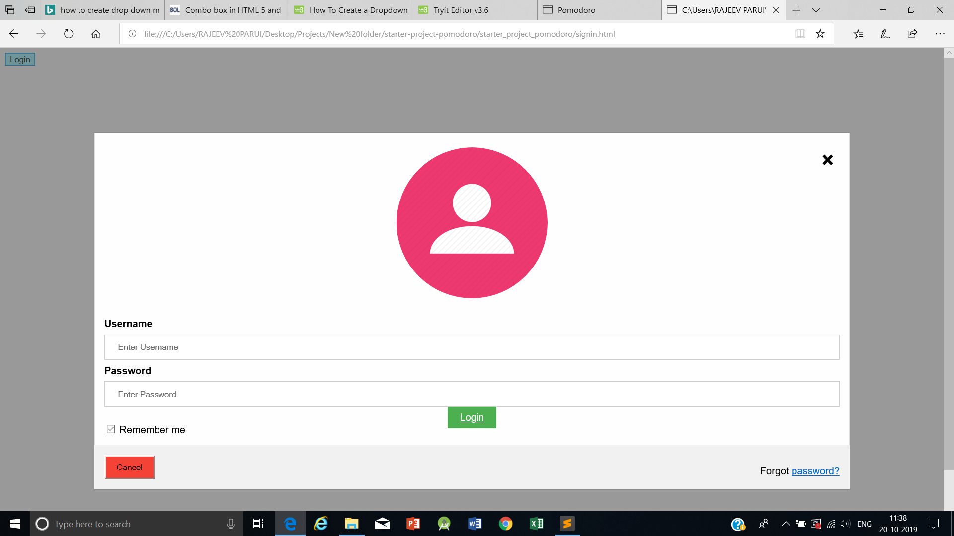
Screenshots

Slide 7
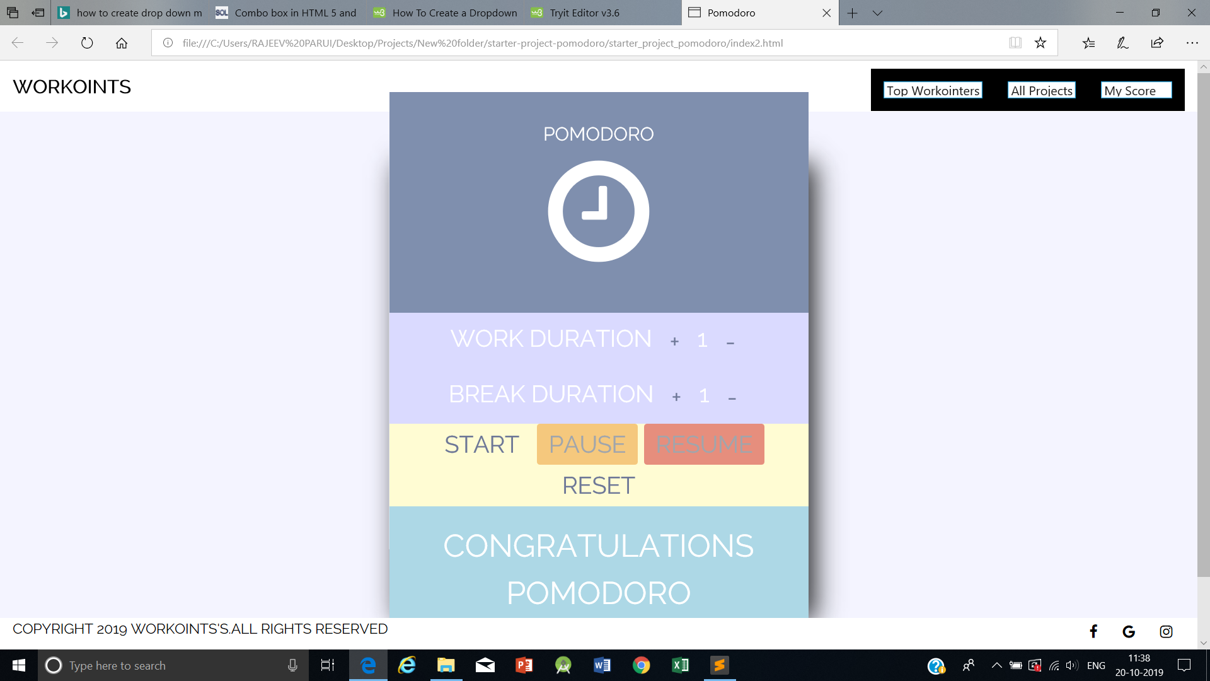
Screenshots

Slide 8
Screenshots

Slide 9
Future Aspects
This approach can be implemented on a global scale as it is every office, city, state and country’s problem to make a work environment with more effective, efficient, productive and more importantly satisfying with good assurance of quality.

Slide 10
THANK YOU FOR YOUR TIME!
By Team HAXPERTS!
Rajeev Parui
Sourabh Kumar Rai
Rajani Sharma
Puneet Garg

Slide 11
Team Skill Set and Achievements
Team : HAXPERTS
Rajeev Parui
https://github.com/Rajeevparui
https://www.linkedin.com/in/rajeev-parui-a6a781166
Sourabh Kumar Rai
https://github.com/Sourabhkr2204
https://www.linkedin.com/in/sourabh-kumar-rai-a711bb113
Rajani Sharma
https://github.com/Rajani169
http://www.linkedin.com/in/rajani-sharma-4a93a6169
Puneet Garg
https://github.com/puneetgarg2601
https://www.linkedin.com/mwlite/me

