Slide 1
Web Services & WCF

Slide 2

Web services
A web service is a collection of protocols and standards used for exchanging data between applications or systems.
WebServices are published, described and located over Internet.

Slide 3
Web services
class MyService
{
public int Addition ( int operand1, int operand2);
public int Subtraction ( int operand1, int operand2);
public int Multiplication( int operand1, int operand2);
}

Slide 4
Characteristics
A Web Service is accessible over the Web.
Web Services communicate using platform-independent and language-neutral Web protocols.
A Web Service shares schemas and contracts/interface that can be called from another program.
A Web Service is registered and can be located through a Web Service Registry.
Web Services support loosely coupled connections between systems.

Slide 5
Demo
Writing a simple WebService in Visual Studio 2005
Consuming WebServices

Slide 6
Technologies
XML (eXtensible Markup Language)
  markup language that underlies most of the specifications used for Web services.
SOAP (Simple Object Access Protocol)
  (Simple Object Access Protocol), is a network, transport, and programming language and platform neutral protocol that allows a client to call a remote service. The message format is XML.
WSDL (Web services description language)
  An XML-based interface and implementation description language. The service provider uses a WSDL document in order to specify the operations a Web service provides.
UDDI (universal description, discovery, and integration)
  Both a client-side API and a SOAP-based server implementation that can be used to store and retrieve information on service providers and Web services.

Slide 7
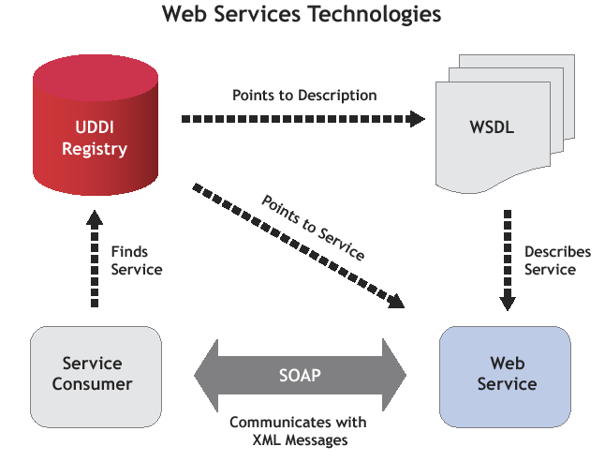

Slide 8
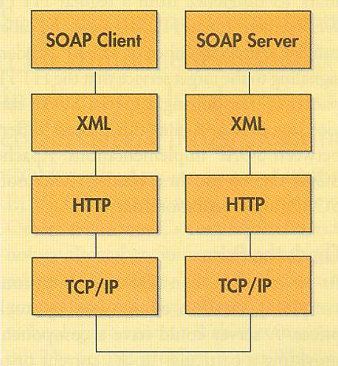
SOAP
Simple Object Access Protocol
SOAP is an open protocol specification defining a uniform way of performing RPCs using HTTP as the underlying communications protocol with XML for the data serialization.
PORT 80 or HTTP

Slide 9
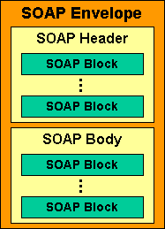
How stuff works?
SOAP-Packet
HTTP Packet
HTTP Header
HTTP Body
TCP communication channel

Slide 10
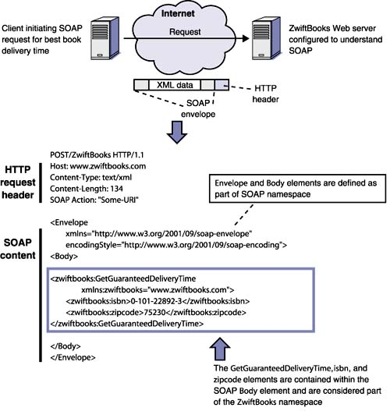
How stuff works?
SOAP-Request

Slide 11
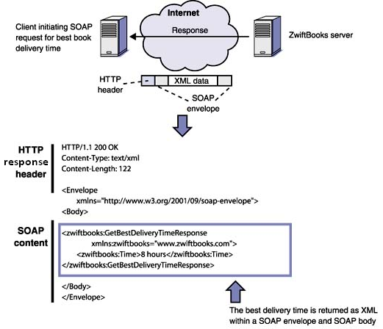
How stuff works?
SOAP-Response

Slide 12
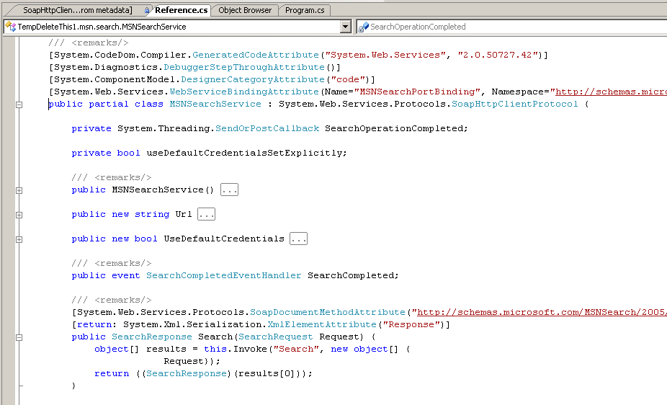
How stuff works?
Within Visual Studio

Slide 13
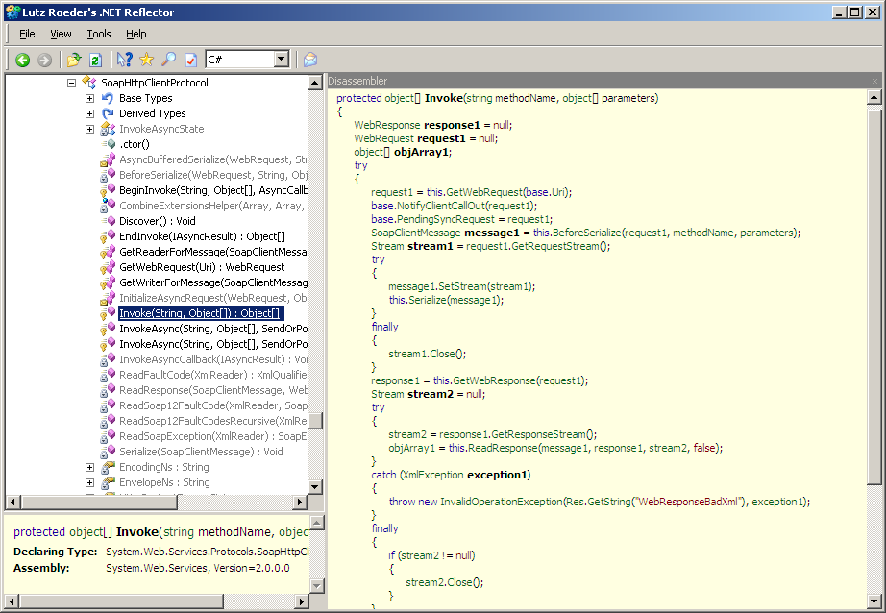
How stuff works?
This method is for setting-up HTML request packet header.
.Net Reflector
Setting-up and creating SOAP envelope

Slide 14
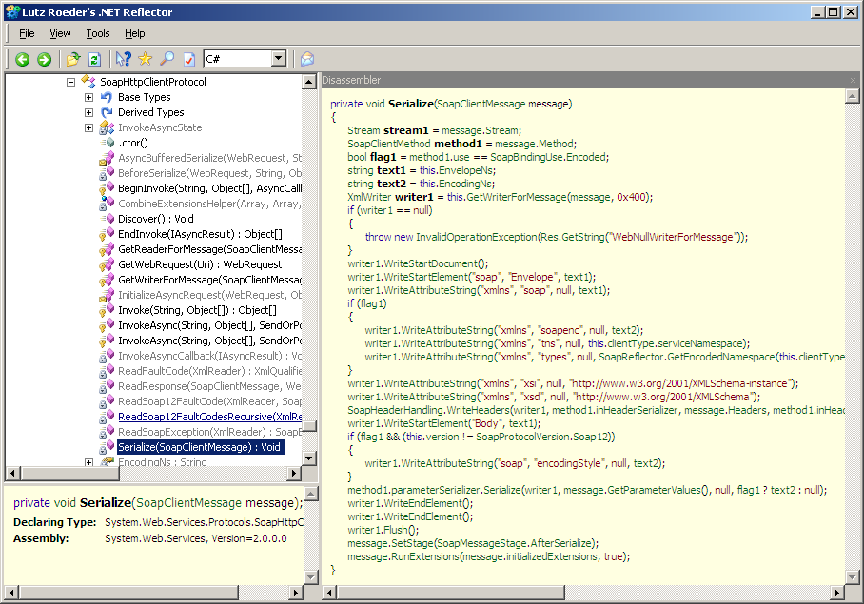
How stuff works?
What all you need to call a WebServices?

Slide 15
Advantages of Web services
WebServices communicate of over http protocol and can easily cross network boundaries.
Web services support only the data types defined in the XSD type system, limiting the number of objects that can be serialized. This makes them interoperable across platforms, and are ideal for heterogeneous environments.
Highly reliable due to the fact that Web services are always hosted in IIS
Provides extensibility by allowing us to intercept the SOAP messages during the serialization and deserialization stages.
Easy-to-create and deploy.

Slide 16
WS-*
WS-Addressing
WS-Routing
WS-Secutiry
WS-AtomicTransaction
WS-Eventing
WS-Transfer
WSE - Microsoft implementation for most of these specifications

Slide 17
SOA
Service
  Small program interacted by well defines message exchanges
  Agile, Reliable, Stable, Interoperable, Secure
Four Tenets
  Boundaries are Explicit
  Services are Autonomous
  Services share schema and contract, not class
  Service compatibility is based upon policy

Slide 18
Thank You

