Slide 1
What’s New In C# 5.0?

Slide 2








Who Am I?
Paulo Morgado
CodePlex
Revista PROGRAMAR

Slide 3
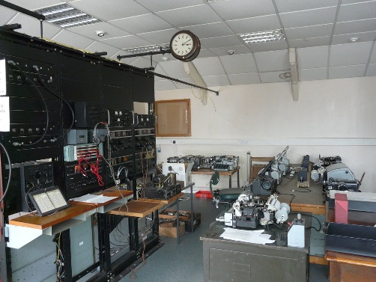
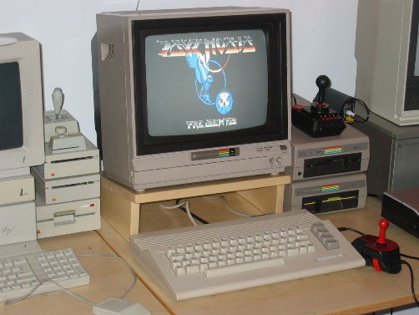
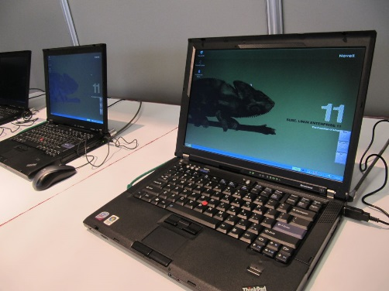
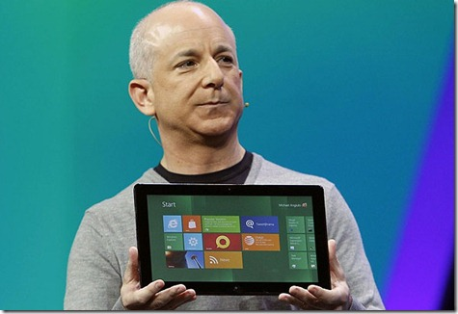

A Language For Each Generation
Fortran, Cobol
1960
Mainframe
1980
Microcomputer
Basic, C, Asm
1990
Desktop
VB, C++, Java, C#
Async
2010
Distributed
Notes:
Language for each generation
* Async is a language feature tailored for the current generation of programs.
* Distributed ones. Devices and servers. Communication. Latency.
* It’s a new control flow primitive. Like GOTO became GOSUB became function calls.
[CLICK]

Slide 4
The Evolution Of C#
C# 1.0
Generics
LINQ
Managed
C# 2.0
C# 3.0
C# 4.0
Dynamic
C# 5.0
Async
Notes:
The Evolution Of C#
[CLICK]
* C# 1.0 – managed code
[CLICK]
* C# 2.0 – Generics – anonymous methods, iterators, method variance
[CLICK]
* C# 3.0 – LINQ – extension methods, anonymous types
[CLICK]
* C# 4.0 – dynamic programming
[CLICK]
* C# 5.0 – asynchronous programming
[CLICK]

Slide 5

The Evolution Of C#
C# 1.0
Generics
LINQ
Managed
C# 2.0
C# 3.0
C# 4.0
Dynamic
C# 5.0
Async
please wait for the next slide
clicking won’t make it come any faster
Notes:
* Oh. That’s not meant to happen.
[CLICK]
* Leslie Lamport, one of the godfathers of computer science, said “A distributed system is one in which the failure of a computer you didn't even know existed can render your own computer unusable”.
* That’s the messy truth about our generation of programs.
[CLICK]
* Okay, it looks like we’re okay.

Slide 6
Demo
Sync UI app

Slide 7
Introducing Async - Yesterday
Click
void Button_Click(...)
{
LoadImage();
UpdateView();
}
Message pump
void LoadImage()
{
// ...
LoadLocalData(...);
// ...
}
Click
Notes:
Introducing async: file
* You need to understand the message-loop.
[CLICK]
* It’s a single thread – the UI thread - in an infinite loop, waiting for messages, and handling them.
* When button-click arrives, this thread calls into the Button_Click handler.
* Oh, I’m giving this talk all in VB, but the feature’s exactly the same in C#.
* In this case reading configuration from a text file, and returning.
[CLICK]
* Then it gets back to the message-loop
[CLICK]
* and can handle further messages, further UI events.

Slide 8
Introducing Async - Today
Click
void Button_Click(...)
{
LoadImage();
UpdateView();
}
Message pump
void LoadImage()
{
// ...
DownloadRemoteData(...);
// ...
}
Click
Notes:
Introducing async: network
* But remember we’re in the distributed generation. Maybe instead of loading config off disk, it gets it off the cloud.
[CLICK]
* What happens then?
[CLICK]
* Well, it takes time. And in the meantime, the UI thread can’t handle any other clicks or events or messages.
* That’s not a bug. It’s not something we can fix. It’s reality. It’s the speed of light!
* (Light might seem fast. But when you add the roundtrips it has to make across the atlantic, and internet backbone router congestion, and TCP algorithm timeouts, well, the milliseconds add up).
[CLICK]
* Eventually it’ll finish and get to the events. But your application looks poor, especially to mass-market audiences who aren’t used to the spinning toilet bowl of death.

Slide 9
Demo
Add the async & await keywords
Notes:
DEMO 1: Add Keywords
in VS11, opening the existing AsyncVB project (in its initial state)
DEMO 1: KEYWORDS
1. Run it
Observe the frozen behavior. Try to e.g. grab it down.
Win8 doesn’t even bother with the spinning toilet bowl because it assumes you know better.
2. Add Async and Await
* IO.Network.DownloadAsync("http://www.wischik.com/lu/postcards.xml")
* Ctrl+Dot to make method async
* Rename it to LoadSettingsAsync:
Async Function LoadSettingsAsync() As Task
3. Change Button1_Click
* Await LoadSettingsAsync()
* Ctrl+Dot to make method async:
Private Async Sub Button1_Click(sender As Object, e As RoutedEventArgs) Handles Button1.Click
4. Run it
Observe that the button clicks immediately. It still takes time of course due to the speed of light. But everything’s responsive.

Slide 10
Introducing Async
Click
async void Button_Click(...)
{
await LoadImageAsync();
UpdateView();
}
void Button_Click(...)
{
LoadImage();
UpdateView();
}
Message pump
async Task LoadImageAsync()
{
// ...
await DownloadRemoteDataAsync(...);
// ...
}
void LoadImage()
{
// ...
DownloadRemoteData(...);
// ...
}
Notes:
Introducing async: recap
* Recap what we just did.
* Changed it from DownloadRemoteData to “await DownloadRemoteDataAsync”
* Change the method prototype: mark it async, change its name, make it return Task
[CLICK]
* In the caller, changed it from LoadImage to “Await LoadImageAsync”
* Changed the function prototype: marked it async

Slide 11
Explaining Async
Click
async void Button_Click(...)
{
await LoadImageAsync();
UpdateView();
}
Task ... LoadImageAsync
LoadImage
Message pump
async Task LoadImageAsync()
{
// ...
await DownloadRemoteDataAsync(...);
// ...
}
Click
Task ... DownloadRemoteDataAsync
Download
Notes:
Introducing async: recap
[CLICK CLICK CLICK – speaker is on his/her own at this point! Too complicated to explain in the notes]
* By now we have a rough idea of the message-loop. And the fact that continuing after an await all happens via the message loop.
* Now let’s see the implications of that.

Slide 12
Demo
Async UI app: re-entrancy and deadlock
Notes:
var image = this.LoadImageAsync(Properties.Settings.Default.ImageUrl).Result;

Slide 13
Demo
Async console app
Notes:
1. Invoke it from Main, and manually add Async
static void Main(string[] args)
{
HelloAsync().Wait();
}
2. Error: can’t do that. So Wait().
static async void Main(string[] args)
{
await HelloAsync();
}
* Observe: it works fine!
* Why? Console apps don't run on a UI message-loop. They run on the thread pool. That has as many message-loops as it wants. It says “hey, that thar thread over there is blocked, so I’ll just spin up another one.”

Slide 14
Demo
Async unit tests
Notes:
using System;
using Microsoft.VisualStudio.TestTools.UnitTesting;
using System.Threading.Tasks;
namespace UnitTests
{
[TestClass]
public class UnitTest1
{
[TestMethod]
public async void TestMethod1()
{
await Task.Delay(1000);
Assert.Fail();
}
}
}

Slide 15
Source Code Caller ID

Slide 16
Source Code Caller ID
CallerFilePathAttribute
Allows you to obtain the full path of the source file that contains the caller. This is the file path at the time of compile.
http://msdn.microsoft.com/library/system.runtime.compilerservices.callerfilepathattribute.aspx
CallerLineNumberAttribute
Allows you to obtain the line number in the source file at which the method is called.
http://msdn.microsoft.com/library/system.runtime.compilerservices.callerlinenumberattribute.aspx
CallerMemberNameAttribute
Allows you to obtain the method or property name of the caller to the method.
http://msdn.microsoft.com/library/system.runtime.compilerservices.callermembernameattribute.aspx

Slide 17
Source Code Caller ID - Examples
static void TraceMessage(
string message,
[CallerMemberName] string memberName = "",
[CallerFilePath] string sourceFilePath = "",
[CallerLineNumber] int sourceLineNumber = 0)
{
Trace.WriteLine(
string.Format(
"{0} at {1} in {2}:line {3}",
message,
memberName,
sourceFilePath,
sourceLineNumber));
}

Slide 18
Source Code Caller ID - Examples
private string field;
public string Property
{
get { return this.field; }
set
{
if (this.field != value)
{
this.field = value;
this.NotifyPropertyChanged();
}
}
}
protected void NotifyPropertyChanged([CallerMemberName] string propertyName = "")
{
// …
}

Slide 19
Breaking Changes

Slide 20
Breaking Changes
You can use the iteration variable of a foreach statement in a lambda expression that’s contained in the body of the loop.
You can use the iteration variable of a foreach statement in a LINQ expression that’s contained in the body of the loop.
Overload resolution has been improved for calls that use named arguments to access methods that contain params parameters.
Overload resolution is improved for calls where the algorithm must choose between a Func<object> parameter and a Func parameter that has a different type parameter (e.g., string or int?) for a Func<dynamic> argument.
Side effects from named and positional arguments in a method call now occur from left to right in the argument list.
http://msdn.microsoft.com/library/hh678682(v=vs.110).aspx
Notes:
Corrected compiler bugs
Changes to prevent expected bugs with async

Slide 21
Resources

Slide 22
Resources
C# Reference
http://msdn.microsoft.com/library/618ayhy6.aspx
Breaking Changes in C# 5.0
http://msdn.microsoft.com/library/hh678682(v=vs.110).aspx
.NET Framework 4.5
http://msdn.microsoft.com/library/vstudio/w0x726c2(v=vs.110).aspx
Task Parallel Library (TPL)
http://msdn.microsoft.com/library/vstudio/dd460717.aspx
Asynchronous Programming with Async and Await (C# and Visual Basic)
http://msdn.microsoft.com/library/hh191443.aspx
Task-based Asynchronous Pattern
http://msdn.microsoft.com/library/hh191443.aspx

Slide 23
Resources
Task.Run vs Task.Factory.StartNew
http://blogs.msdn.com/b/pfxteam/archive/2011/10/24/10229468.aspx
An Async Premier
http://msdn.microsoft.com/vstudio/jj573641.aspx
Eduasync by Jon Skeet
http://msmvps.com/blogs/jon_skeet/archive/tags/Eduasync/default.aspx
Eric Lippert's Blog
http://blogs.msdn.com/b/ericlippert/
Lucian Wischik's Blog
http://blogs.msdn.com/b/lucian/archive/tags/async/
Parallel Programming Team Blog
http://blogs.msdn.com/b/pfxteam/archive/tags/async/

Slide 24
Resourceso
Paulo Morgado
http://PauloMorgado.NET/
http://mvp.support.microsoft.com/profile/Paulo.Morgado
http://msmvps.com/blogs/paulomorgado/
http://weblogs.asp.net/paulomorgado/
http://pontonetpt.org/blogs/paulomorgado/
http://www.codeproject.com/Members/PauloMorgado
http://code.msdn.microsoft.com/site/search?f%5B0%5D.Type=User&f%5B0%5D.Value=Paulo%20Morgado
http://www.codeplex.com/UserAccount/UserProfile.aspx?UserName=PauloMorgado

Slide 25
Q & A

Slide 26
Thank You

