Slide 1
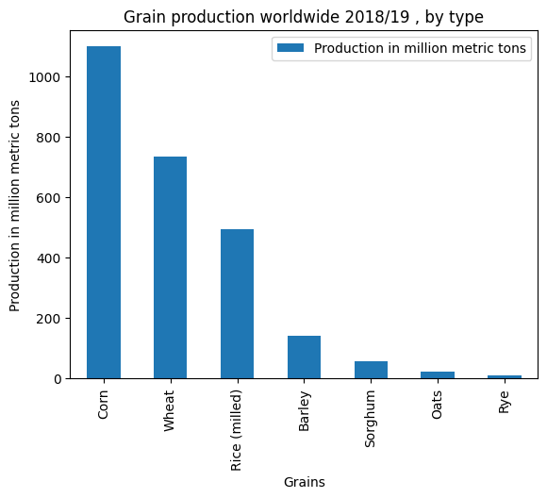
Rdgdfgdfgdfgdf dfg dfg dfg

Slide 2
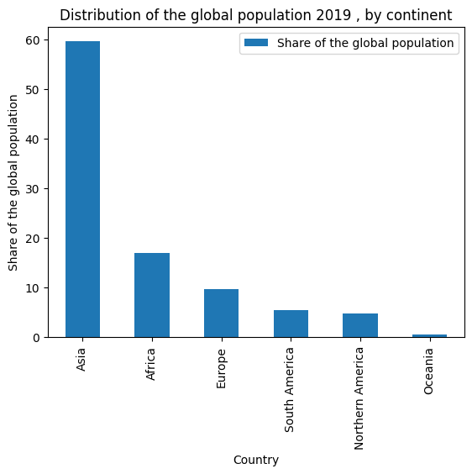
Chart 2

Slide 3
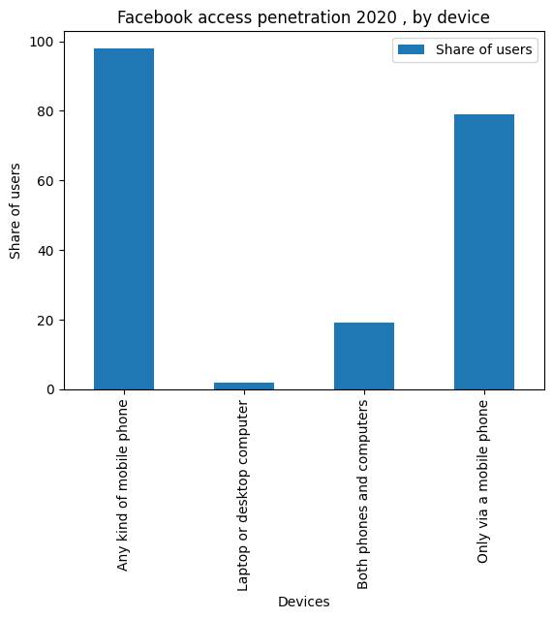
Chart 34

Slide 4
Table
Name | Age | Location | Gender
Alan | 22 | USA | M
asdasd | asd | asd | sd
asda | asd | sdasd | asd

