Slide 1
MCA Final Year Project (Review I) “Drowsy Driver Detection System Using Deep Learning”
Submitted to the Presidency University, Bengaluru in partial fulfillment for the award of the degree of Master of Computer Applications(MCA)
Project Number : 221
Under the supervision of
Mr. Sakthi S Asst. Prof, Department of SCSE School of Computer Science and Engineering
Name | Roll Number
Ankitha G | 20232MCA0012

Slide 2
Content
Problem Statement
Literature Survey
Tools and Technologies to be used
Timeline of the Project
GitHub Link
References

Slide 3
Problem Statement
Design a real-time drowsy driver detection system that monitors signs of fatigue, such as slow blinking, mouth closure, and head movement.
The system should distinguish between normal and drowsy driving behavior, providing immediate auditory alerts to encourage breaks.
It must work in various lighting conditions, adapt to different driver behaviors,
It should be easy to install, reliable, cost-effective, and scalable for diverse vehicles and driving scenarios.

Slide 4
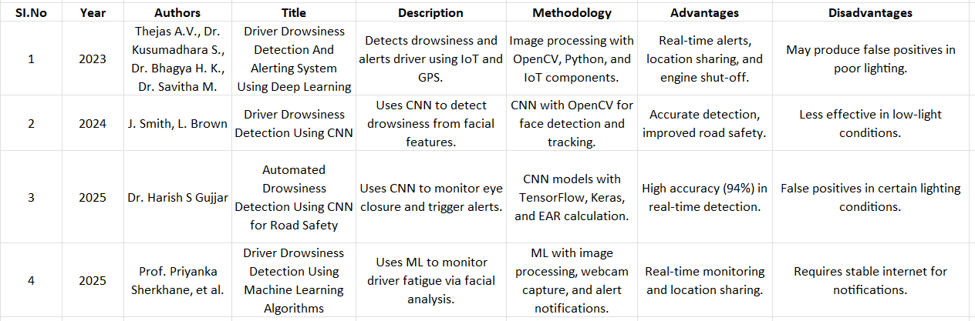
Literature Review

Slide 5
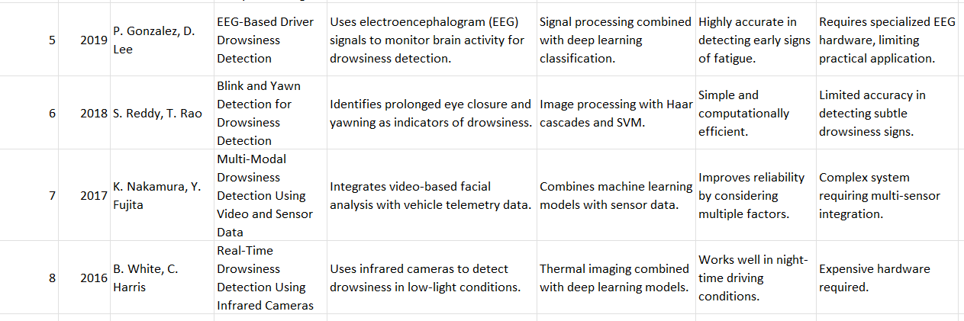

Slide 6
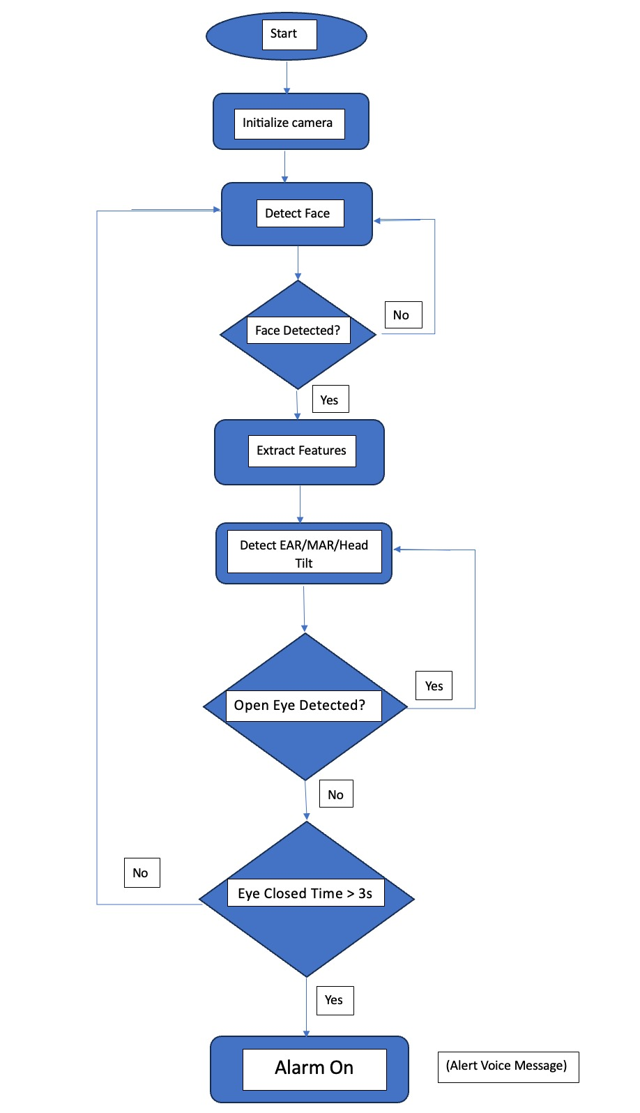
Module Design

Slide 7
Start & Initialize Camera: The system begins by activating the camera to monitor the driver.
Detect Face: It checks for the presence of a face. If no face is detected, it loops back to keep searching.
Extract Features: Once a face is detected, the system extracts facial features.
Detect EAR/MAR/Head Tilt: It analyzes the facial landmarks to calculate parameters like Eye Aspect Ratio (EAR), Mouth Aspect Ratio (MAR), and head tilt.
Open Eye Check: The system checks whether the driver’s eyes are open.
If yes, it continues monitoring.
If no, it checks how long the eyes remain closed.
Eye Closed Time > 3s: If the eyes are closed for more than 3 seconds, the system triggers an alarm.
Alarm Activation: The alarm turns on with a voice message to alert the driver.

Slide 8
Modular Breakdown
Module 1: Data Collection
Captures real-time video feed from the camera to monitor the driver.
Detects the presence of a face to ensure continuous tracking.
Uses OpenCV, Dlib, and Mediapipe for facial feature extraction.
Module 2: Data Processing
Extracts key facial landmarks such as eye aspect ratio (EAR), mouth aspect ratio (MAR), and head tilt.
Applies Deep Learning models (CNN, Dlib facial landmarks) to detect signs of drowsiness.
Implements threshold-based detection (e.g., eye closure for more than 3 seconds) to confirm drowsiness.
Module 3: Analysis & Output
Triggers an alarm system (auditory or visual alert) if drowsiness is detected.
Provides real-time notifications to alert the driver.
Ensures continuous monitoring with adaptability to different lighting conditions.

Slide 9
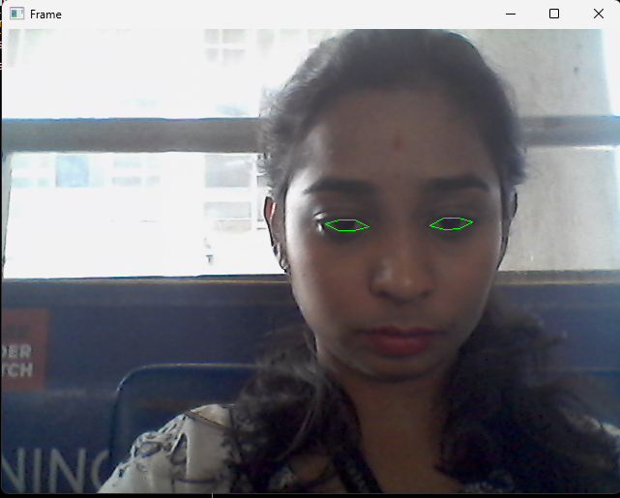
Module 1: Data Collection
Activation of webcam: cv2.VideoCapture(0)
Face detection using dlib: detect = dlib.get_frontal_face_detector()
Use of OpenCV and Dlib for real-time video and face detection.

Slide 10
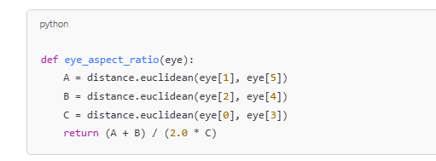
Module 2: Data Processing
The EAR is a mathematical formula that gives a single value representing how “open” or “closed” the eyes are.
The lower the value, the more closed the eye is.
This is used to distinguish normal blinking vs. eye closure due to drowsiness.
Input | Output
Face image | EAR value, drowsiness status

Slide 11
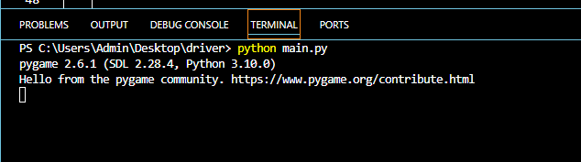
Module 3: Analysis & Output
This module plays an audio alert when the system detects that the driver’s eyes are closed for a risky duration, helping prevent accidents.
If eyes are closed (EAR < 0.22) for 3 or more frames, it plays an audio alert using the Pygame mixer.
The alert stops automatically when the driver opens their eyes again.

Slide 12
Tools And Technologies To Be Used
Software Technologies
Programming Language: Python 3.7+
Libraries and Frameworks:
OpenCV: Image processing and video analysis.
Dlib: Facial landmark detection.
Mediapipe: Face mesh detection.
NumPy & SciPy: Numerical computations.
Imutils: Image processing utilities.

Slide 13
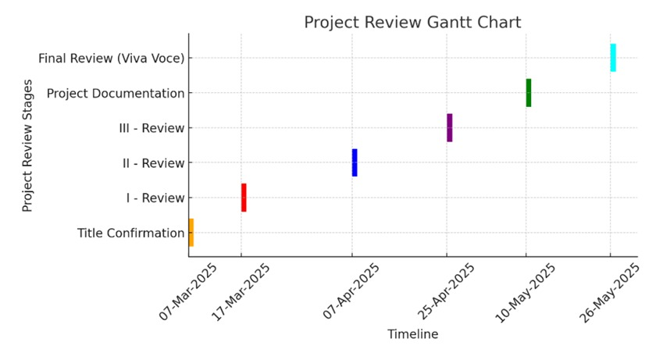
Project Timeline

Slide 14
GitHub Link
https://github.com/Rajankitha/Drowsy-Driver-Detection-Using-Deep-Learning-

Slide 15
References
Thejas A.V., Dr. Kusumadhara S., Dr. Bhagya H. K., and Dr. Savitha M., "Driver Drowsiness Detection And Alerting System Using Deep Learning," International Journal of Creative Research Thoughts (IJCRT), vol. 11, no. 7, pp. 777–784, July 2023. [Online]. Available: IJCRT2307777
J. Smith, L. Brown , "Driver Drowsiness Detection Using CNN," Journal of Emerging Technologies and Innovative Research (JETIR), vol. 11, no. 6, pp. 93–101, June 2024. [Online]. Available: JETIRGG06093
Dr. Harish S. Gujjar, "A Deep Learning Approach to Automated Drowsiness Detection in Drivers Using CNN Models for Enhanced Road Safety," Proceedings of the International Conference on Emerging Trends in Technology and Science, 2025, pp. 1–8.
Prof. Priyanka Sherkhane, Sahane Purvesh Vaibhav, Bibin Yohannan, Shaikh Mohammed Saqib Abdul Shakoor, and Gade Rohan Kailas, "Driver Drowsiness Detection Using Machine Learning Algorithms," The International Journal of Engineering Research (TIJER), vol. 25, no. 1, pp. 13–21, 2025. [Online]. Available: TIJER2501013

Slide 16
H. Garg, "Drowsiness Detection of a Driver using Conventional Computer Vision Application," 2020 International Conference on Power Electronics & IoT Applications in Renewable Energy and Its Control (PARC), Mathura, India, 2020, pp. 236-556, doi: 10.1109/parc49193.2020.236556.
K. H. Lee, W. Kim, H. K. Choi, and B. Tae Jang, "A Study on Feature Extraction Methods Used to Estimate a Driver’s Level of Drowsiness," 2019 21st International Conference on Advanced Communication Technology (ICACT), PyeongChang, South Korea, 2019, pp. 1-5, doi: 10.23919/icact.2019.870192.
B. G. Pratama, I. Ardiyanto, and T. B. Adji, "A review on driver drowsiness based on image, bio-signal, and driver behavior," 2017 3rd International Conference on Science and Technology - Computer (ICST), Yogyakarta, Indonesia, 2017, pp. 1-6, doi: 10.1109/icstc.2017.8011855.

Slide 17


