Slide 1


Kadi Sarva Vishwavidyalaya
S.V. Institute of Computer Studies - BCA
BCA SEMESTER – V
SEC205-3C
“PROJECT WORK - V”
“Car Rental Management System”
STUDENT NAME | EXAM NUMBER | ENROLLMENT NUMBER
Rai Rajan Satyendra |  | 24BCA53182
Patel Harsh Jayshree
Panchal Jaynesh
Thakur Virajsinh Ranjit |  | 24BCA53225

Slide 2
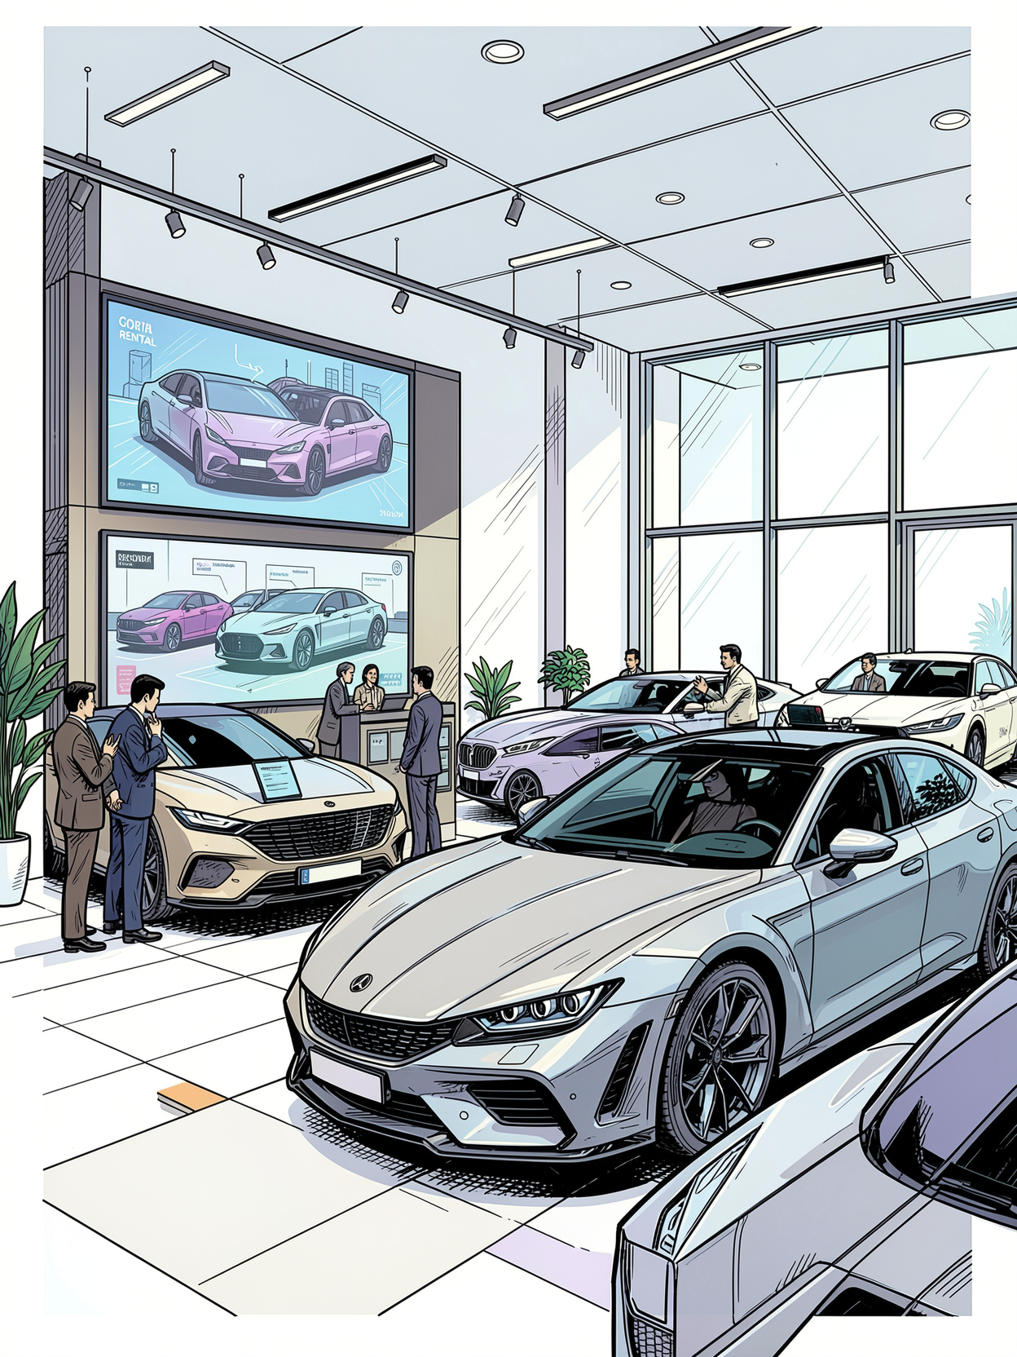
Title:- Car Rental System
Project Definition
The Car Rental System is a web-based application developed using PHP (Laravel Framework) and MySQL to automate the process of renting cars. The system enables customers to register, browse available vehicles, make online bookings, complete secure payments, and manage their rental history. It also provides administrators with tools to manage vehicles, customers, bookings, payments, maintenance records, and reports through a centralized dashboard. The project aims to replace manual rental operations with a secure, efficient, and user-friendly digital solution.

Slide 3
Project Scope / Objectives
Objectives:
To develop a secure and user-friendly online car rental system.
To allow customers to search and book available vehicles online.
To provide real-time vehicle availability and booking management.
To automate payment processing and booking confirmation.
To enable administrators to manage cars, customers, bookings, and payments efficiently.
To maintain vehicle maintenance schedules and service records.
To generate reports for bookings, payments, and vehicle usage.
To improve operational efficiency, reduce paperwork, and minimize human errors.
Scope:
The Car Rental Management System is designed to simplify and automate the vehicle rental process. The system covers customer registration, vehicle management, booking management, payment processing, maintenance tracking, and report generation. It provides role-based access for customers and administrators while ensuring secure authentication and efficient database management.

Slide 4

Study of Existing System
The existing car rental system in many small and medium rental businesses is largely manual. Customers visit the rental office or contact the company by phone to check vehicle availability and make reservations. Rental records, customer information, and payment details are often maintained in paper files or spreadsheets. This process is time-consuming, error-prone, and difficult to manage as the business grows.
Some existing online rental systems provide basic booking features but may lack advanced functionalities such as maintenance scheduling, role-based access, online payments, automated notifications, and comprehensive reporting. As a result, both customers and administrators face delays and operational challenges.
The proposed Car Rental Management System overcomes these limitations by providing an integrated web application with online booking, secure authentication, payment integration, vehicle management, maintenance tracking, and automated report generation.

Slide 5
Limitations of Existing System
Manual booking process is slow and inefficient.
High possibility of human errors in maintaining records.
Difficulty in tracking vehicle availability in real time.
Paper-based records can be lost or damaged.
Limited access to customer booking history.
No automated payment or booking confirmation.
Poor management of vehicle maintenance schedules.
Report generation requires significant manual effort.
Limited accessibility, as customers must visit or contact the rental office.
Lack of centralized data management and security.
These limitations highlight the need for a modern, web-based Car Rental Management System that improves efficiency, accuracy, security, and customer satisfaction.

Slide 6
TASK-2
Existing System vs Proposed System
Feature
Existing System
Proposed System
Booking Process
Manual (phone/office visits)
Online (web-based)
Record Keeping
Paper files, spreadsheets
Centralized database (MySQL)
Vehicle Availability
Difficult to track in real-time
Real-time updates
Payment
Manual cash/card processing
Secure online payment gateway
Maintenance Tracking
Poorly managed/manual
Automated scheduling and records
Reporting
Manual, time-consuming
Automated, comprehensive reports
Accessibility
Limited (office hours/location)
24/7 access from any device
Error Rate
High due to human intervention
Minimized through automation
Security
Vulnerable to data loss/theft
Laravel's built-in security features
Customer Experience
Slow, inconvenient
Fast, user-friendly, efficient

Slide 7
Proposed System & Advantages
The proposed Online Car Rental System is a secure web-based application. It automates the complete vehicle rental process, allowing customers to search, compare, and book vehicles online while enabling administrators to manage vehicles, bookings, payments, maintenance, and reports through a centralized dashboard.
Real-Time Vehicle Availability
Smart Search and Filters
Online Booking and Secure Payments
Role-Based Access Control
Automated Notifications
Customers can instantly view available cars, preventing double bookings.
Users can search cars by brand, location, price, fuel type, and transmission.
Customers can book vehicles and make payments online with instant confirmation.
Separate dashboards for customer, and administrators ensure secure and efficient management.
Email/SMS notifications for booking confirmations, payment status, pickup, and return reminders.
Maintenance Management
Digital Document Verification
Analytics and Reports
Responsive Design
Secure Architecture
Admins can generate reports on bookings, revenue, vehicle usage, and maintenance to support decision-making.
The system works smoothly on desktops, tablets, and smartphones.
Uses Laravel's built-in security features such as password hashing, CSRF protection, input validation, and role-based authorization.
Tracks vehicle service schedules and automatically marks cars unavailable during maintenance.
Customers can upload required documents online for faster approval.

Slide 8
Technology Used
Category
Technology
Programming Language
PHP
Framework
Laravel
Frontend
HTML5, CSS3, Bootstrap 5, JavaScript
Template Engine
Laravel Blade
Database
MySQL
ORM
Laravel Eloquent ORM
Web Server
Apache (XAMPP)
Package Manager
Composer
IDE
Visual Studio Code
Version Control
Git & GitHub

Slide 9
Hardware & Software Requirements
Hardware Requirements
Software Requirements
Developer / Server:
Windows 10/11
XAMPP (Apache)
PHP 8.x
Laravel Framework
MySQL
Composer
Visual Studio Code
Google Chrome / Microsoft Edge / Mozilla Firefox
Intel Core i3/i5 Processor or higher
8 GB RAM (Minimum)
256 GB SSD
Stable Internet Connection
Client / User:
Desktop or Laptop
Android / iOS Smartphone
Internet Connection

Slide 11
Task 3: Database Design
• Entity-Relationship (E-R) Diagram • Data Dictionary (Master & Transaction Tables with 10 Sample Records)

Slide 12
Task 3: Entity-Relationship (E-R) Diagram Overview
Master Entities: Users (Customers & Admins), Cars (Vehicle Fleet).
Transaction Entities: Bookings, Payments, Documents, Maintenance Records, Car Images.
Key Relationships:
• Users (1) ─── (N) Bookings [Places]
• Cars (1) ─── (N) Bookings [Reserved in]
• Bookings (1) ─── (N) Payments [Financial Transactions]
• Users (1) ─── (N) Documents [Identity Verification]
• Cars (1) ─── (N) Maintenance Records [Servicing Logs]
• Cars (1) ─── (N) Car Images [Gallery Showcase]

