Slide 1
Designing Effective PowerPoint Presentations
Prepared by:
Victor Chen
ERAU
Best viewed by PowerPoint 2001 or later
Click whenever you want to continue

Slide 2
Designing Effective PowerPoint Presentation
Big
Progressive
Consistent
Simple
Clear
Summary
Click the words to explore
Press <-- to go back
Press Esc to stop

Slide 3
Make It Big

Slide 4
Make it Big (Text)
This is Arial 12
This is Arial 18
This is Arial 24
This is Arial 32
This is Arial 36
This is Arial 44

Slide 5
Make it Big (Text)
Too Small
This is Arial 12
This is Arial 18
This is Arial 24
This is Arial 32
This is Arial 36
This is Arial 44

Slide 6
Make It Big (How to Estimate)
Look at it from 7 feet away
7 ft

Slide 7
Keep It Simple

Slide 8
Keep It Simple (Text)
Too many colors
Too Many ^{Fonts} and _{Styles}
The 6 x 7 rule
  No more than 6 lines per slide
  No more than 7 words per line

Slide 9
Keep It Simple (Text)
Instructional Technology:
A complex integrated process involving people, procedures, ideas, devices, and organization, for analyzing problems and devising, implementing, evaluating, and managing solutions to those problems in situations in which learning is purposive and controlled
(HMRS 5th ed.)
Too detailed !

Slide 10
Keep It Simple (Text)
Instructional Technology:
A process
involving people, procedures & tools
for solutions
to problems in learning
(HMRS 5th ed.)
Much Simpler

Slide 11
Falling Leaves Observed
 | Christchurch | Dunedin | Wellington
January | 11,532,234 | 14,123,654 | 3,034,564
February | 1,078,456 | 12,345,567 | 16,128,234
March | 17,234,778 | 6,567,123 | 16,034,786
April | 16,098,897 | 10,870,954 | 7,940,096
May | 8,036,897 | 10,345,394 | 14,856,456
June | 16,184,345 | 678,095 | 4,123,656
July | 8,890,345 | 15,347,934 | 18,885,786
August | 8,674,234 | 18,107,110 | 17,230,095
September | 4,032,045 | 18,923,239 | 9,950,498
October | 2,608,096 | 9,945,890 | 5,596,096
November | 5,864,034 | 478,023 | 6,678,125
December | 12,234,123 | 9,532,111 | 3,045,654
Too detailed !

Slide 12
Falling Leaves in Millions
In 10⁶ | Christchurch | Dunedin | Wellington
January | 11 | 14 | 3
February | 1 | 12 | 16
March | 17 | 6 | 16
April | 16 | 10 | 7
May | 8 | 10 | 14
June | 16 | 0 | 4
July | 8 | 15 | 18
August | 8 | 18 | 17
September | 4 | 18 | 9
October | 2 | 9 | 5
November | 5 | 0 | 6
December | 12 | 9 | 3
Much Simpler

Slide 13
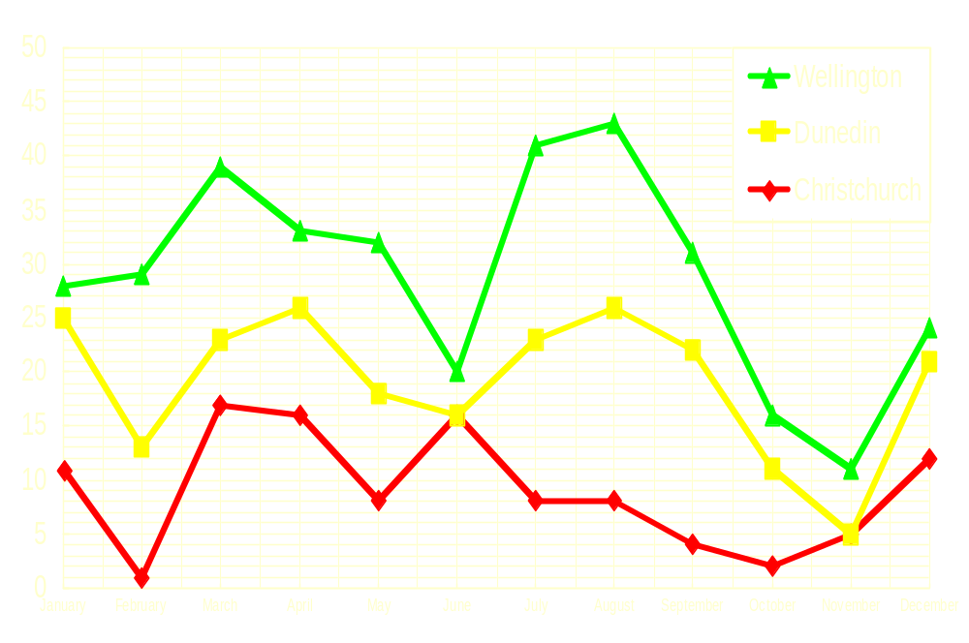
Falling Leaves
Too detailed !

Slide 14
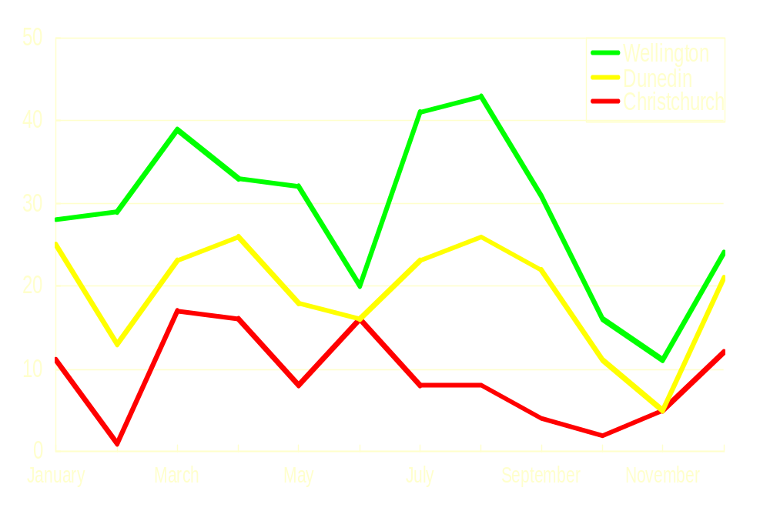
Falling Leaves
Much Simpler

Slide 15






Keep It Simple (Picture)
Art work may distract your audience
Artistry does not substitute for content

Slide 16




Keep It Simple (Sound)
Sound effects may distract too
Use sound only when necessary

Slide 17
Keep It Simple (Transition)
This transition is annoying, not enhancing
"Appear" and "Disappear" are better

Slide 18
Keep It Simple (Animation)
7 ft
Too distracting !

Slide 19
Keep It Simple (Animation)
7 ft
Simple & to the point

Slide 20
Make It Clear

Slide 21
Make It Clear (Capitalisation)
ALL CAPITAL LETTERS ARE DIFFICULT TO READ
Upper and lower case letters are easier

Slide 22
Make It Clear (Fonts)
Sanserif Z
Serif Z
clear
busy

Slide 23
Make It Clear (Fonts)
Serif fonts are difficult to read on screen
Sanserif fonts are clearer
Italics are difficult to read on screen
Normal or bold fonts are clearer
Underlines may signify hyperlinks
Instead, use colors to emphasise

Slide 24
Make It Clear (Numbers)
Use numbers for lists with sequence
For example:
How to put an elephant into a fridge?
1. Open the door of the fridge
2. Put the elephant in
3. Close the door

Slide 25
Make It Clear (Numbers)
How to put a giraffe into a fridge?
1. Open the door of the fridge
2. Take out the elephant
3. Put the giraffe in
4. Close the door

Slide 26
Make It Clear (Bullets)
Use bullets to show a list without
Priority
Sequence
Hierarchy, …..

Slide 27
Make It Clear (Colors)
Use contrasting colors
Light on dark vs dark on light
Use complementary colors

Slide 28
Make It Clear (Contrast)
Use contrasting colors
Light on dark vs dark on light
Use complementary colors
high contrast
low contrast

Slide 29
Make It Clear (Contrast)
Use contrasting colors
Light on dark vs dark on light
Use complementary colors
This is light on dark

Slide 30
Make It Clear (Contrast)
Use contrasting colors
Light on dark vs dark on light
Use complementary colors
This is dark on light

Slide 31
Make It Clear (Complement)
Use contrasting colors
Light on dark vs. dark on light
Use complementary colors
These colors do not complement

Slide 32
Make It Clear (Complement)
Use contrasting colors
Light on dark vs. dark on light
Use complementary colors
These colors complement

Slide 33

Make It Clear (Size)
Size implies importance

Slide 34
Make It Clear (Size)
Size implies importance

Slide 35
Make It Clear (Focal Points)
Focal points direct attention

Slide 36
Make It Clear (Focal Points)
Focal points direct attention

Slide 37
Be Progressive

Slide 38
Types of Instructional Tools
Discovery
Learning
Individual
Constructive
Tools
Social
Constructive
Tools
Too many in one go!
Guided
Inquiry
Informational Tools
Mode of Instruction
Individual
Instructive
Tools
Social
Communicative
Tools
Direct
Instruction
Individual
Pair
Group
Complexity of Interactions

Slide 39
Types of Instructional Tools
Discovery
Learning
Individual
Constructive
Tools
Social
Constructive
Tools
Guided
Inquiry
Informational Tools
Mode of Instruction
Progressive & thus focused
Individual
Instructive
Tools
Social
Communicative
Tools
Direct
Instruction
Individual
Pair
Group
Complexity of Interactions

Slide 40

Understanding Technology
Mouse
I/O Error
Main Storage
CPU
Function key
Too many & not focused
User interface
Software
Debugger
Floppy disk
Backup system

Slide 41
Understanding Technology
Mouse
I/O Error
Main Storage
CPU
Function key
Progressive & thus focused
User interface
Software
Debugger
Floppy disk
Backup system

Slide 42
Be Consistent

Slide 43
Be Consistent
Differences draw attention
Differences may imply importance
Use surprises to attract not distract

Slide 44
Be Consistent
Differences draw attention
Differences may imply importance
Use surprises to attract not distract
This tick draws attention

Slide 45
Be Consistent
Differences draw attention
Differences may imply importance
Use surprises to attract not distract
These differences distract!

Slide 46
Be Consistent
Differences draw attention
Differences may imply importance
Use surprises to attract not distract
_x001d_
This implies importance

Slide 47
Be Consistent
Differences draw attention
Differences may imply importance
Use surprises to attract not distract
Confusing differences!

Slide 48
Be Consistent
Differences draw attention
Differences may imply importance
Use surprises to attract not distract
This surprise attracts

Slide 49
Be Consistent
Differences draw attention
Differences may imply importance
Use surprises to attract not distract
These distract!

Slide 50
In Summary
Big
Simple
Clear
Progressive
Consistent

Slide 51
Tips for Presenting
Limit the number of slides
  3 slides per minute is the maximum
Practice moving between slides.
Be prepared for technical difficulties
Avoid the use of flashy transitions.
This is TOO flashy!

Slide 52
Some Final Words
Communication is the key
Text to support the communication
Pictures to simplify complex concepts
Animations for complex relationships
Visuals to support, not to distract
Sounds only when absolutely necessary

Slide 53
Designing Effective PowerPoint Presentations
Prepared by:
Victor Chen
ERAU

