Slide 1
Digital Portfolio
STUDENT NAME: RAJARAJAN.S
REGISTER NO AND NMID: 966577BDC903612BF4845AB146DB100D
DEPARTMENT: BSC COMPUTER SCIENCE
COLLEGE: COLLEGE/ UNIVERSITY

Slide 2
DIGITAL PORTFOLIO

Slide 3


AGENDA
Problem Statement
Project Overview
End Users
Tools and Technologies
Portfolio design and Layout
Features and Functionality
Results and Screenshots
Conclusion
Github Link
3/21/2024 Annual Review

Slide 4

PROBLEM STATEMENT
“Many individuals lack a personalized and attractive online portfolio to effectively showcase their skills, projects, and achievements. Without a well-designed portfolio, it becomes difficult to create a strong impression for academic, professional, or career opportunities.”

Slide 5

PROJECT OVERVIEW
"My portfolio website is designed to showcase my skills, projects, and achievements in an attractive and interactive way. It highlights my abilities in web development using HTML, CSS, JavaScript, and Java. The goal is to create a professional online presence that reflects my creativity and technical expertise."

Slide 6
WHO ARE THE END USERS?
Recruiters and hiring managers looking for my skills .
Teachers or evaluators for academic/project submission.
Clients who may want to hire me for freelance work.
Peers and colleagues who want to learn or collaborate.

Slide 7

TOOLS AND TECHNIQUES
HTML5 → Structure of the portfolio.
CSS3 → Styling, colour themes, and animations.
JavaScript → Interactive features like smooth scrolling, form validation.
Java → Backend/programming demonstration (optional).
Google Fonts → Cursive attractive font styles.

Slide 8
PORTFOLIO DESIGN AND LAYOUT
Hero section with name, tagline, and profile image in a circular frame Navigation bar with links (About, Skills, Projects, Contact) About section with personal introduction Skills section displayed with styled tags Projects section using cards with descriptions and screenshots Contact section with a functional form
8

Slide 9
FEATURES AND FUNCTIONALITY
Smooth scrolling navigation bar.
Animated hero section with call-to-action button.
Skills and projects displayed in grid layout with hover effects.
Contact form with validation and thank-you message.
Profile section with image, bio, and tagline.

Slide 10

RESULTS AND SCREENSHOTS
(Here, insert screenshots of your portfolio website)Home Page with navigation bar and hero section.
About Me section.
Skills and Projects grid.
Contact form working with validation.
3/21/2024 Annual Review
10

Slide 11
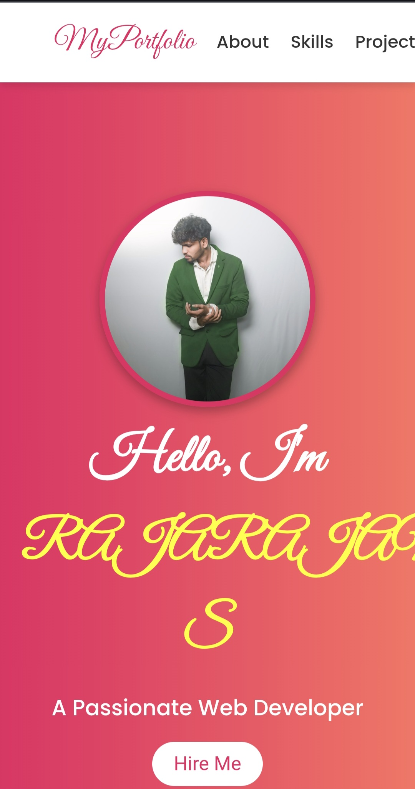
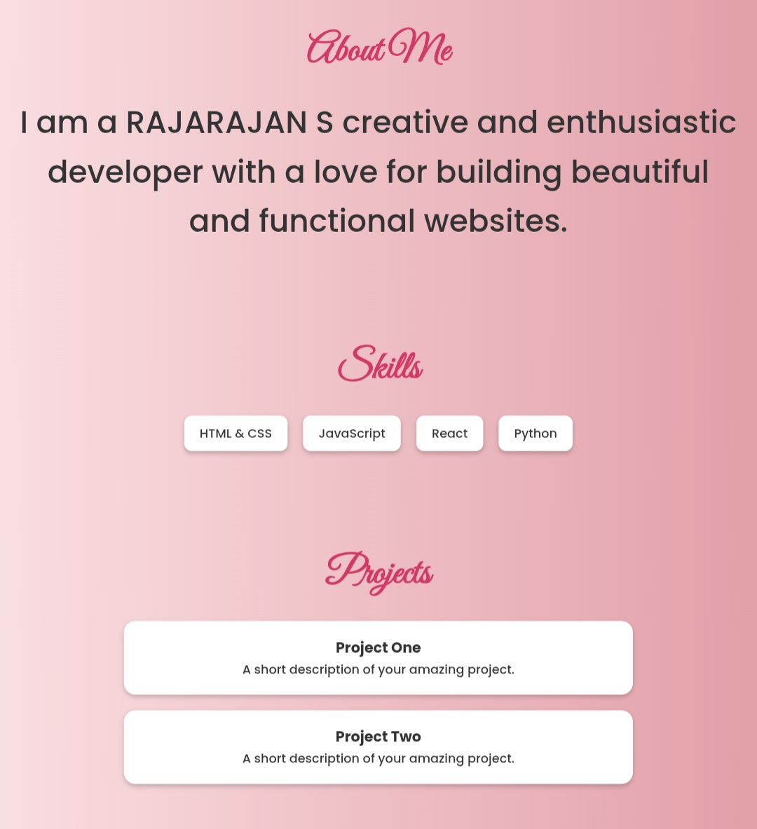
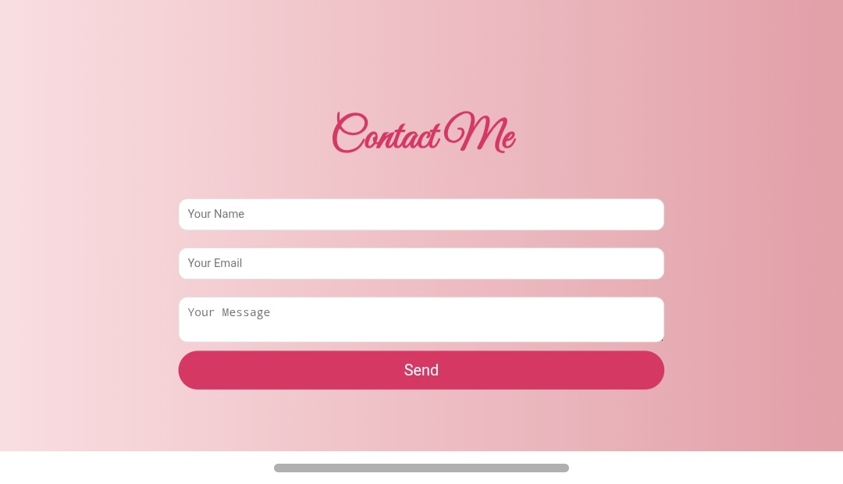

Slide 12
CONCLUSION
The portfolio project successfully demonstrates my ability to design and develop a modern, animated, and responsive personal website. It serves as both a professional resume and a creative platform to showcase my work. Future improvements can include adding more projects, integrating backend features, and enhancing animations.
12

Slide 13
THANK YOU

