Slide 1
Using Parallel Computing to Performing the Cluster Analysis(K-means) CS566 – Parallel Computing
Rajarajan Loganathan Hood College Department of Computer Science Frederick, MD, USA

Slide 2
Index:
Introduction of K Mean Clustering
Introduction of MPI
Functions of MPI
Implementing MPI with K Mean Clustering
Using Java with MPI from MPJExpress
Compile and Running Project
Sample Input and Output

Slide 3
Introduction of K Mean Clustering:-
K-Mean Clustering is a method of vector quantization, Originally from signal processing ,that is popular for cluster analysis in datamining.
It is also simplest unsupervised learning algorithms that solve the well known clustering problem.
The procedure follows a simple and easy way to classify a given data set through a certain number of clusters (assume k clusters) fixed apriori.

Slide 4
Introduction of MPI:-
The Message Passing Interface Standard (MPI) is a message passing library standard based on the consensus of the MPI.

Slide 5
Functions of MPI:-
MPI.Comm_size() - Returns the number of processes
MPI.Comm_rank() - Returns the process identifier for the calling process
MPI.Allreduce(A, B, MPI_SUM) - Sums all the local copies of “A” in all the processes (reduction operation) and places the result in “B” on all of the processes (broadcast operation)
MPI.Wtime() - Returns the number of seconds since some fixed, arbitrary point of time in the past
MPI.Bcast(message, root) - Broadcasts “message” from a process with identifier “root” to all of the processes
MPI.Send() - Sending the values
MPI.Recieve() - Receive the values

Slide 6
Implementing MPI with K Mean Clustering:-
It has the no of processors.
Splitting the task to multiple processors to perform a fast result.
Running multiple threads inside the coding using mpi functions.
Finding the centroid with data sets.
Sending values from the other slave processors and receiving to Master processor.

Slide 7
MPJExpress:
It is a Java library,
It is to used to import the MPI functions to java.
It is easy to import and use.
http://mpj-express.org/download.php

Slide 8
Compile and Running Project:
Using Eclipse IDE
Java 1.6.0-version
Use MPJExpress.jar file to implement mpi Functions to Java.
Add the variables files in java to run it as a mpi program.

Slide 9
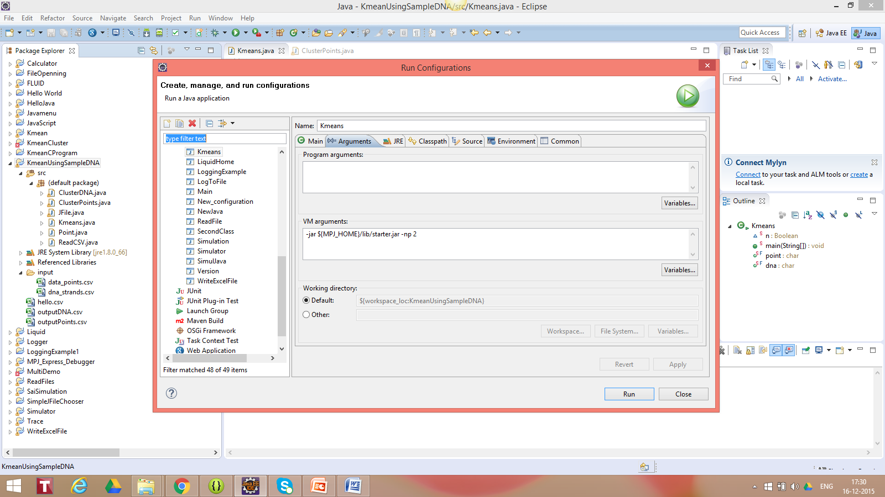

Slide 10
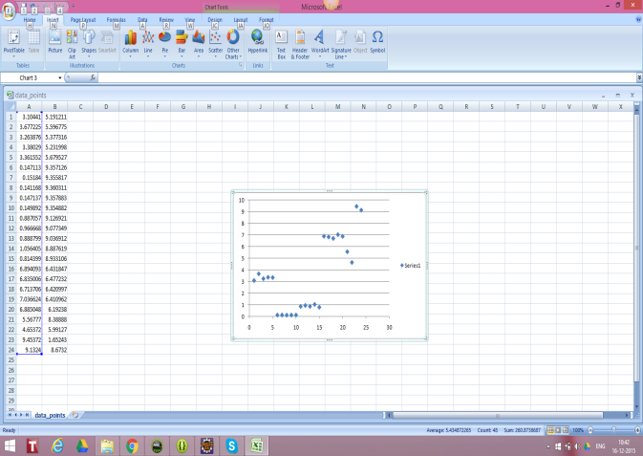
Sample Input and Output:-

Slide 11
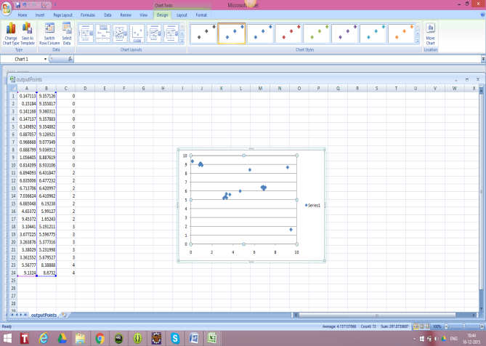
Sample Output:

Slide 12
System have tried:
Intel i7 Processor
16 GB Ram
2.58 GHz
Windows 10

Slide 13
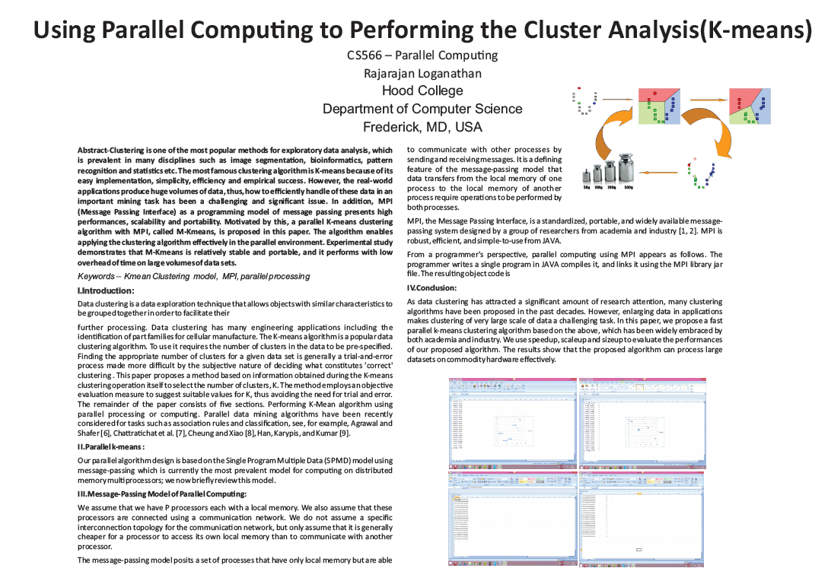

Slide 14
Conclusions:
Finding the K-mean Clustering using a parallel program is more than 60% faster than the sequential program.
So if we try to find the k-mean cluster using with large amount of data set , parallel MPI gives you the faster result.

Slide 15
Thank you

