Slide 1

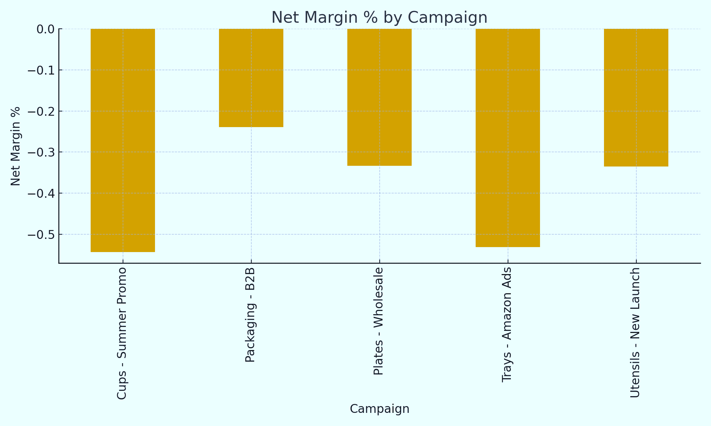



Campaign Performance Summary
Ad Spend vs Sales
Sales grew +10%, but Ad Spend rose +18–25%, lowering margins.
CTR vs Conversion
Several campaigns have high CTR but Conversion Efficiency < 1, causing wasted clicks.
Budget Reallocation
Shift 20–30% ad budget toward campaigns showing positive Net Margins & strong Sales per Click.
Prepared by: Rajarajeswari P

