Slide 1
Temperature Monitoring &
Visualization System
Technical Task Presentation - How I Approached the Task, and the Results
Interview Walkthrough • Embedded Software Architecture • C bare-metal + C++ OOP implementations • GitHub repository
Presented by Rajarajeswari Mani
ZEISS – Software Architect, Embedded Control Systems
Date: 24/08/2026

Slide 2
AGENDA
What I'll Walk You Through
What the task actually asks for, and what I need to deliver
Requirements — System, Hardware, Temperature/LED, Software & Error Handling
My approach — the process I followed, step by step
Architecture decisions and why I made them
The C implementation — what it does, how it's structured
The C++ / OOP implementation — how it differs, and why
Testing — how I verified the requirements, and the results
Requirements coverage recap
GitHub repository

Slide 3
INTRO — WHAT IS THE TASK
Task Description
Architect and design software for a bare-metal embedded system used in a temperature monitoring and visualization device
The device shows the operating condition on 3 LEDs — OK (green), Warning (yellow), Critical (red)
A temperature sensor feeds an ADC; the microcontroller reads it, classifies it, and drives the LEDs via GPIO
An EEPROM (I2C) holds configuration: which hardware revision is fitted, and a serial number placeholder
This is the block diagram given in the task spec — the starting point for everything I designed:
LEDs
Temp
R
ADC
Y
µC
GPIOs
G
I2C
EEPROM

Slide 4
INTRO — DELIVERABLES
What I Need to Do
Sample temperature via ADC every 100µs, very low jitter, and drive 3 GPIO LEDs from fixed thresholds
Support two hardware revisions with different sensor resolution, selected via EEPROM — only one active at a time
Write the software in C for a bare-metal target, demonstrable on a PC with mocked hardware — no real hardware or emulator required
Define ISR function(s) even though they don't need to be functional in the PC demo
Deliver a second implementation in C++ using OOP
Document the architecture as a diagram (.pdf / .png / .svg)
Publish everything (code + diagrams) to a public GitHub repository, link shared ≥ 24h before this interview

Slide 5
Engineering Approach
My development flow was:
Requirements
Why architecture before implementation
↓
Architecture
↓
I designed the architecture before implementing the application logic so that each major requirement had an identifiable software component and verification activity. That ordering is what makes the requirements traceability chain (Section 17) possible — every requirement maps to a named block, and every block maps to a test.
C implementation
↓
C++ re-architecture
↓
Mocks + PC demonstration
↓
Automated tests
↓
Traceability + documentation
5

Slide 6
Requirements — My Starting Point
I converted the task specification into explicit, traceable requirements.
System
Hardware
Software
Temperature monitoring and 3-LED visualization
PC demonstration with mocked hardware
C and C++ implementations
Architecture documentation and public repository
ADC, GPIO, timer and I2C EEPROM
Rev-A = 1°C/digit
Rev-B = 0.1°C/digit
Only the fitted sensor type is active
100µs sampling
Minimal ISR
Conversion, classification and LED control outside the ISR
EEPROM configuration
Hardware abstraction and PC mocks
6

Slide 7
REQUIREMENTS 1/4
System Requirements
ID | Requirement
SYS-1 | Monitor temperature and visualize status via 3 LEDs (OK / Warning / Critical).
SYS-2 | Architecture documented as a diagram in .pdf / .png / .svg.
SYS-3 | Demonstrable on a PC using mocked HW interfaces — no target hardware or emulator required.
SYS-4 | Two implementations: C (procedural/bare-metal) and C++ (OOP).
SYS-5 | Project + diagrams published to a public GitHub repository, link shared ≥24h before the interview.

Slide 8
REQUIREMENTS 2/4
Hardware Requirements
ID | Requirement
HW-1 | Temperature sensor connected to the MCU via an ADC channel.
HW-2 | Three LEDs (Green/Yellow/Red) connected via GPIO pins.
HW-3 | EEPROM provides hardware revision + serial number; mocked for the PC demo.
HW-4 | Two hardware revisions supported: Rev-A = 1 °C/digit, Rev-B = 0.1 °C/digit. Only one active at a time.
HW-5 | Timer peripheral generating a periodic interrupt at 100µs to drive sampling.

Slide 9
REQUIREMENTS 3/4
Temperature Conversion & LED Requirements
ID | Requirement
TEMP-1 / TEMP-2 | Rev-A: raw = °C directly. Rev-B: raw at 0.1°C resolution (raw 100 = 10°C).
TEMP-3 / TEMP-4 | Conversion uses the EEPROM-configured revision; an invalid revision is rejected.
LED-1 / LED-2 / LED-3 | Green: 5°C≤T<85°C. Yellow: 85°C≤T<105°C. Red: T≥105°C or T<5°C.
LED-4 / LED-5 | Exactly one LED lit at a time; all three boundaries handled explicitly.

Slide 10
REQUIREMENTS 4/4
Software & Error Handling Requirements
ID | Requirement
SW-1 / SW-2 | Sample every 100µs, very low jitter; ISR does minimal deterministic work only (read, latch, flag).
SW-3 / SW-4 | Convert raw→°C per hardware revision; read revision + serial from EEPROM at startup.
SW-5 | ISR function(s) defined/implemented, even if not wired to a real interrupt in the PC demo.
SW-6 / SW-7 / SW-8 | C bare-metal + C++ OOP, both with mocked ADC/GPIO/EEPROM interfaces for the PC demo.
ERR-1 / ERR-2 / ERR-3 | Invalid hardware revision and NULL sensor pointer rejected; no silent fallback to a wrong resolution.

Slide 11
PROCESS
My Approach
1
Read the spec closely, extracted requirements
Split into System / Hardware / Software requirements, each given an ID (SYS-x, HW-x, SW-x) — just covered — so every line in the task PDF traces to something concrete.
2
Designed the architecture before writing code
System static view, hardware static view, software static view (class diagram), software dynamic view (sequence diagram) — drawn in Mermaid
3
Built the C implementation first
Plain procedural C: HAL layer (ADC/GPIO/EEPROM), sensor driver, classifier, LED controller, minimal-work ISR, mocked hardware for PC demo.
4
Re-architected the same behavior in C++ (OOP)
Interfaces + dependency injection for hardware abstraction, Strategy pattern for the Rev-A/Rev-B resolution difference, one orchestrator class.
5
Wrote automated tests for both, tied to requirements
Each test case maps to a specific requirement ID — boundary conditions, revision selection, EEPROM round-trip, ISR presence.
6
Documented and packaged for review
This presentation, README with build instructions, requirements & test-plan docs, all pushed to a public GitHub repo.

Slide 12
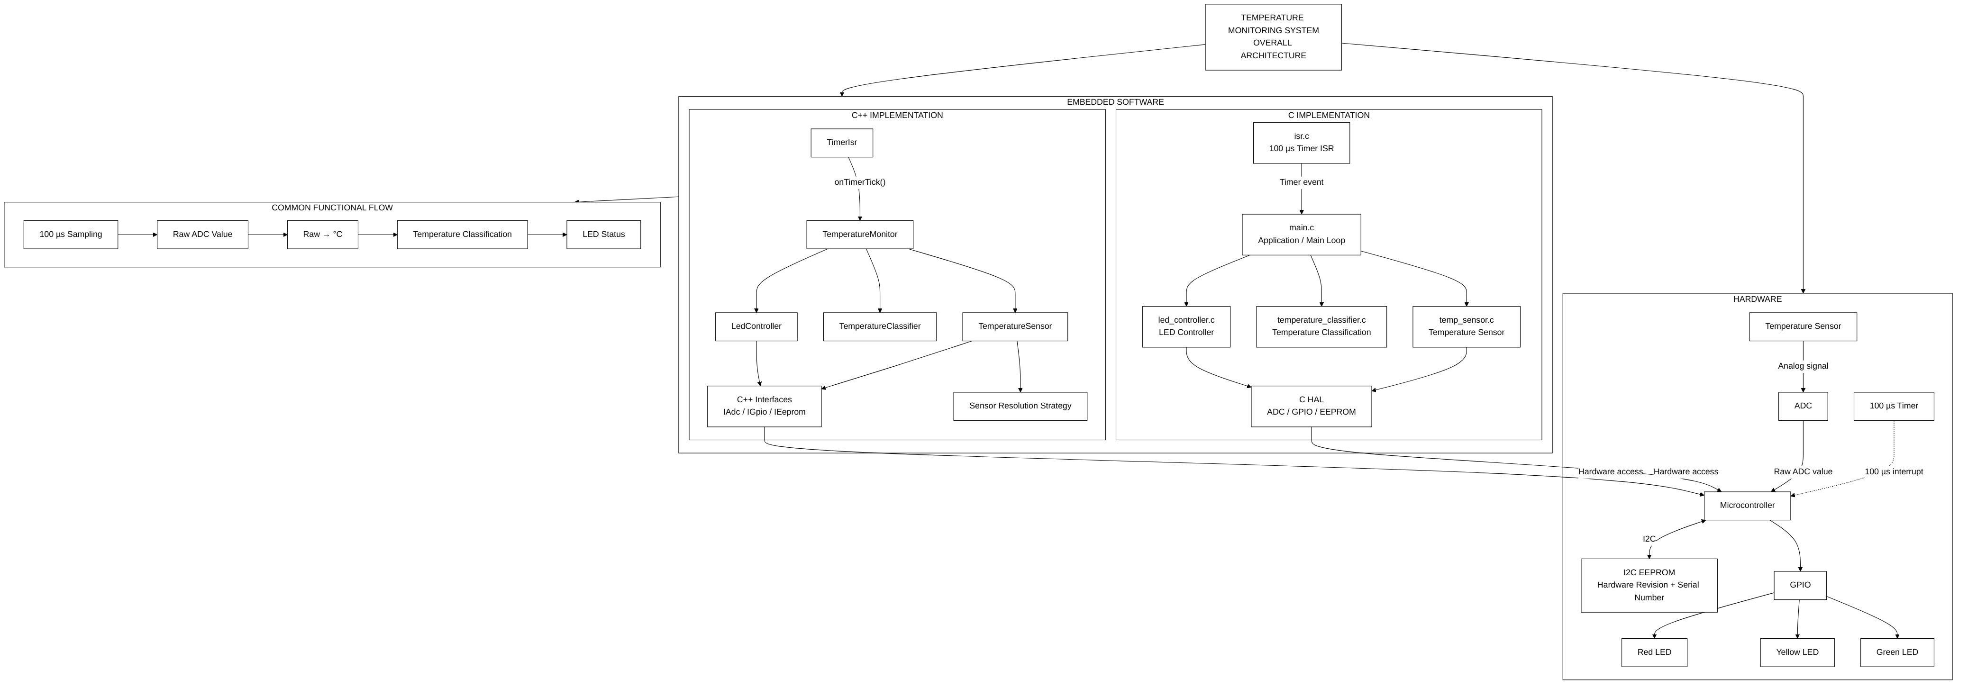
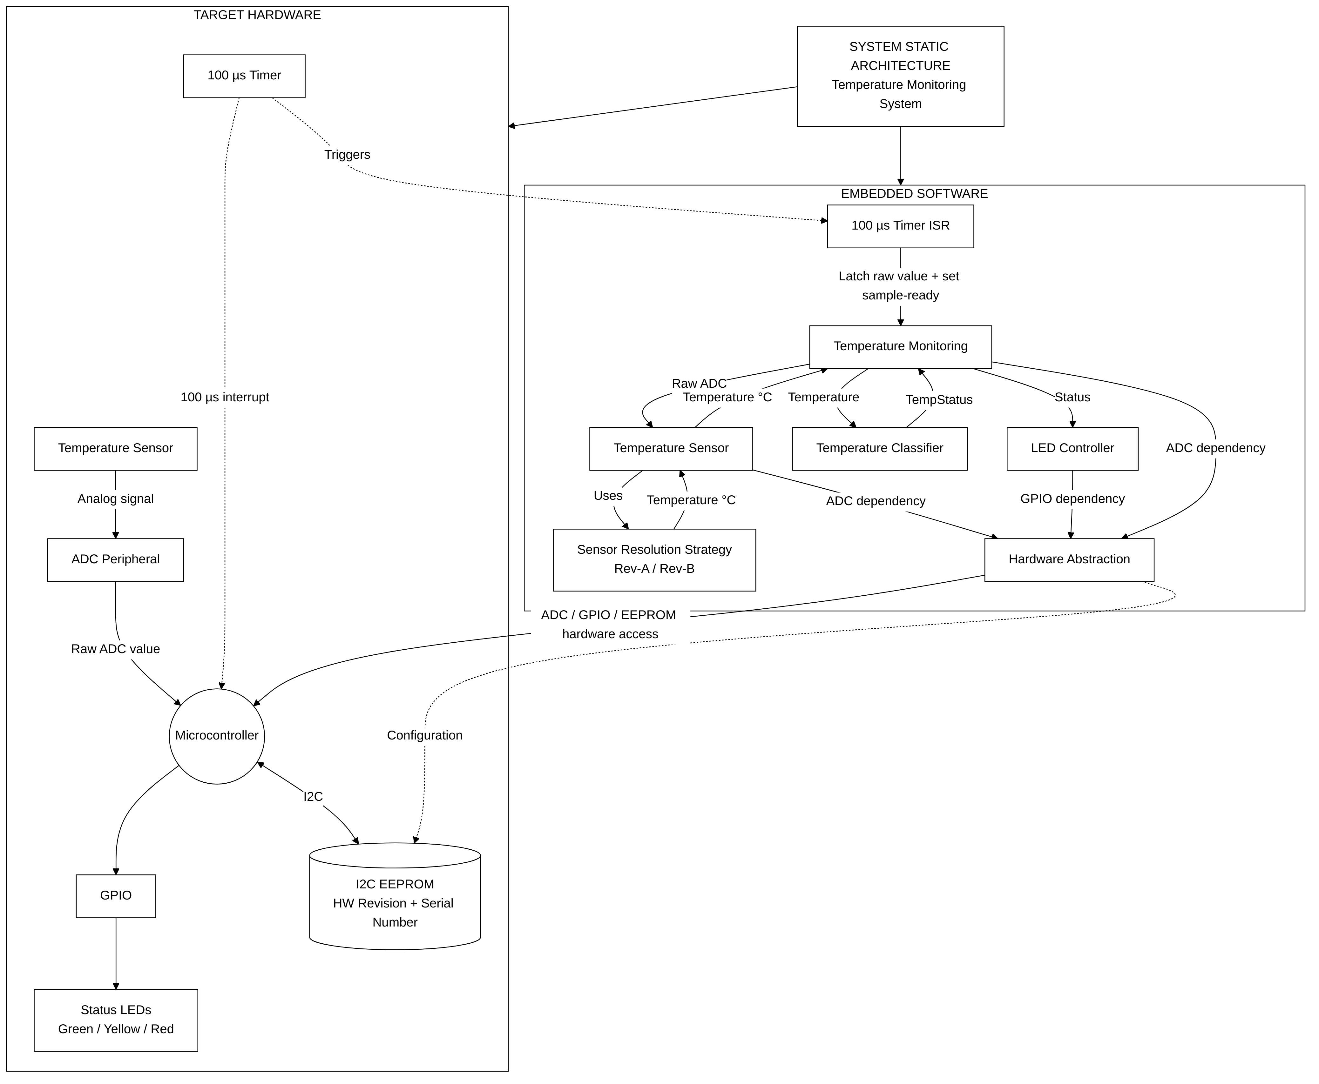
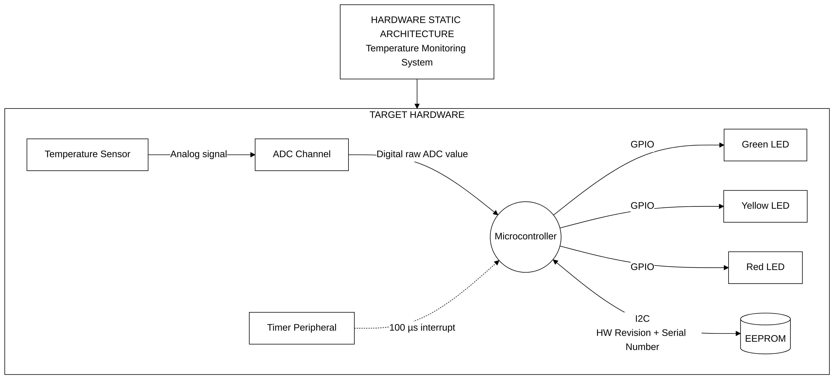
DESIGN 1/2
Architecture, At a Glance — System & Hardware
Overall architecture
System static
Hardware static
All seven diagrams, plus a block-by-block explanation of each, are in docs/diagrams.md in the repo.

Slide 13
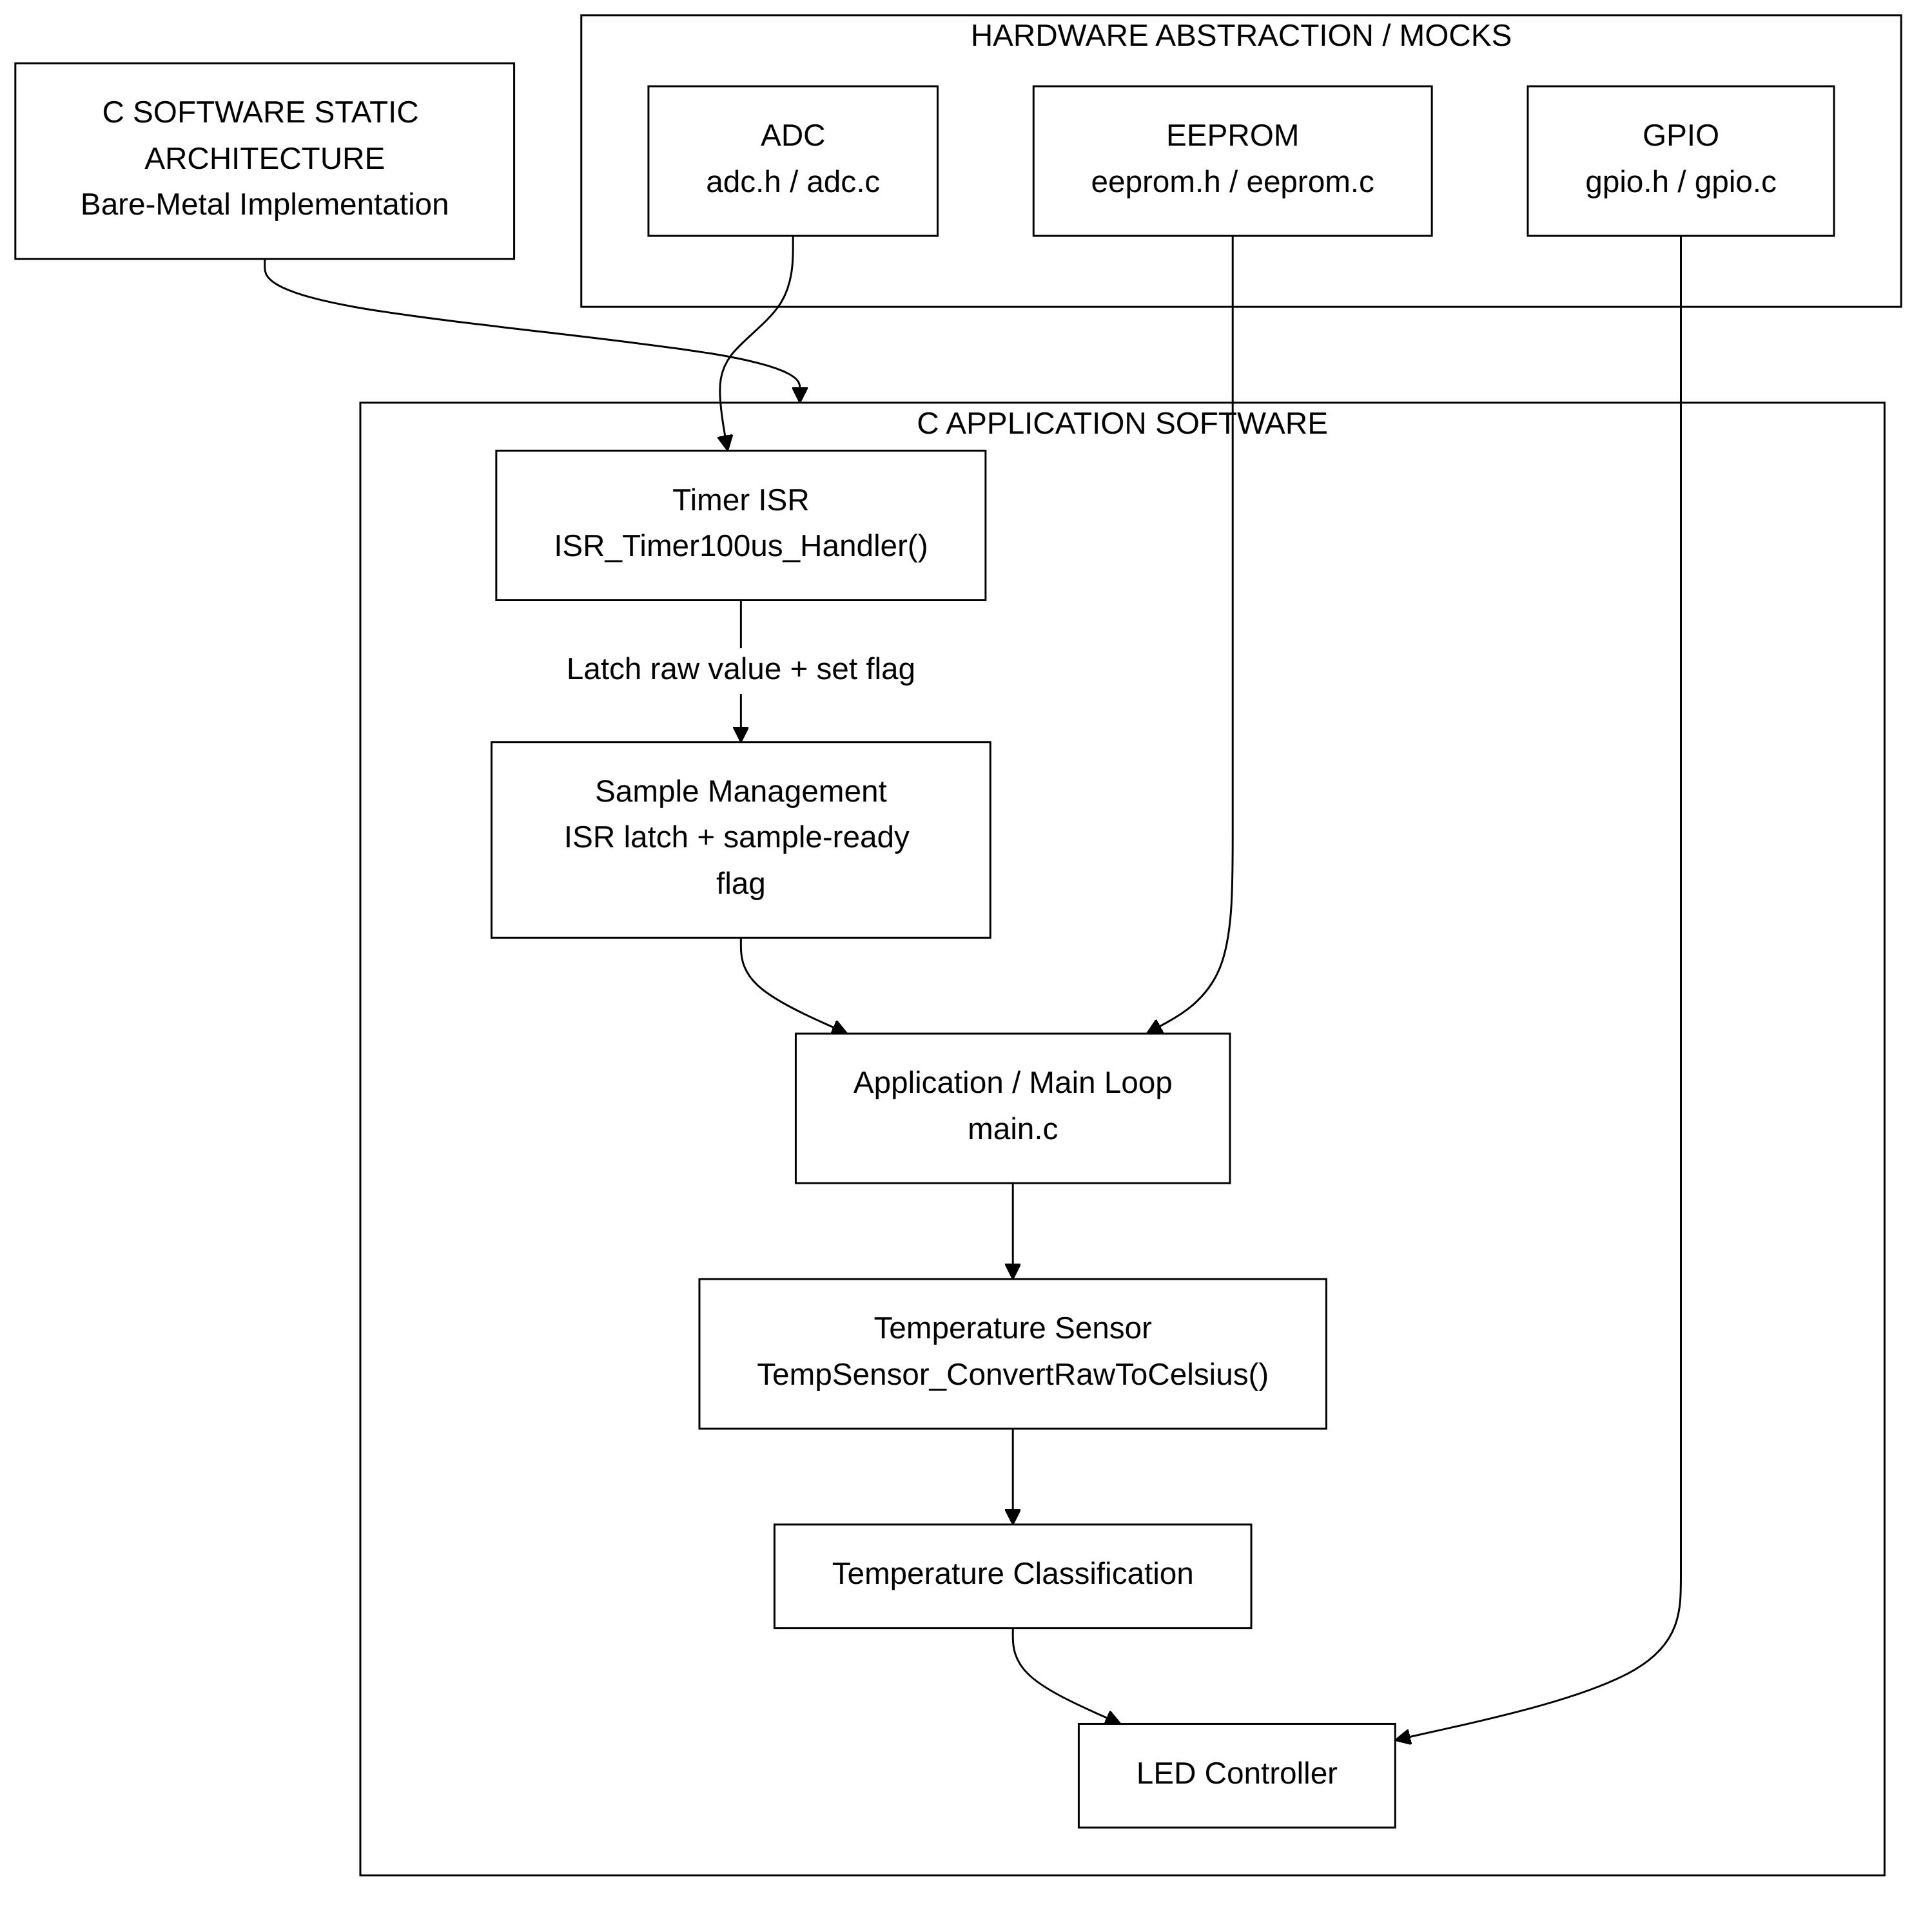
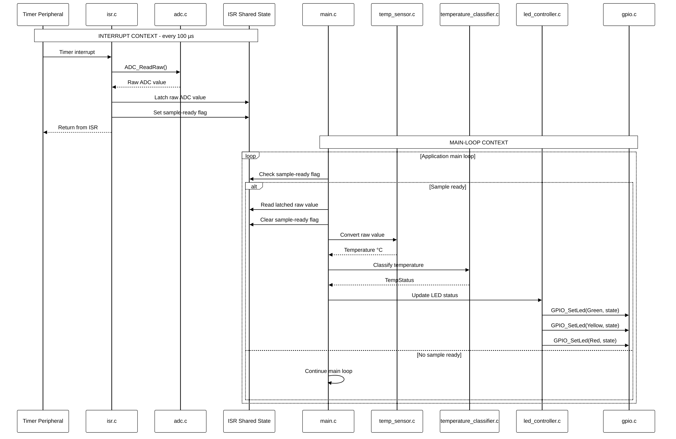
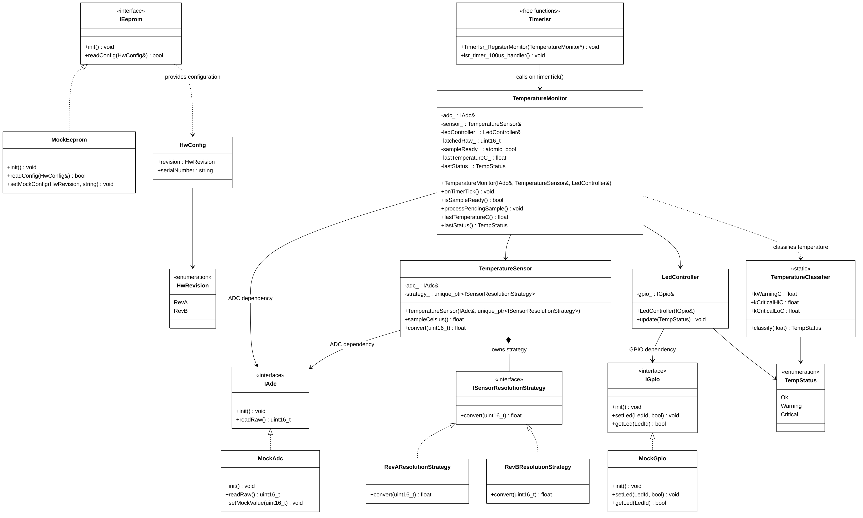
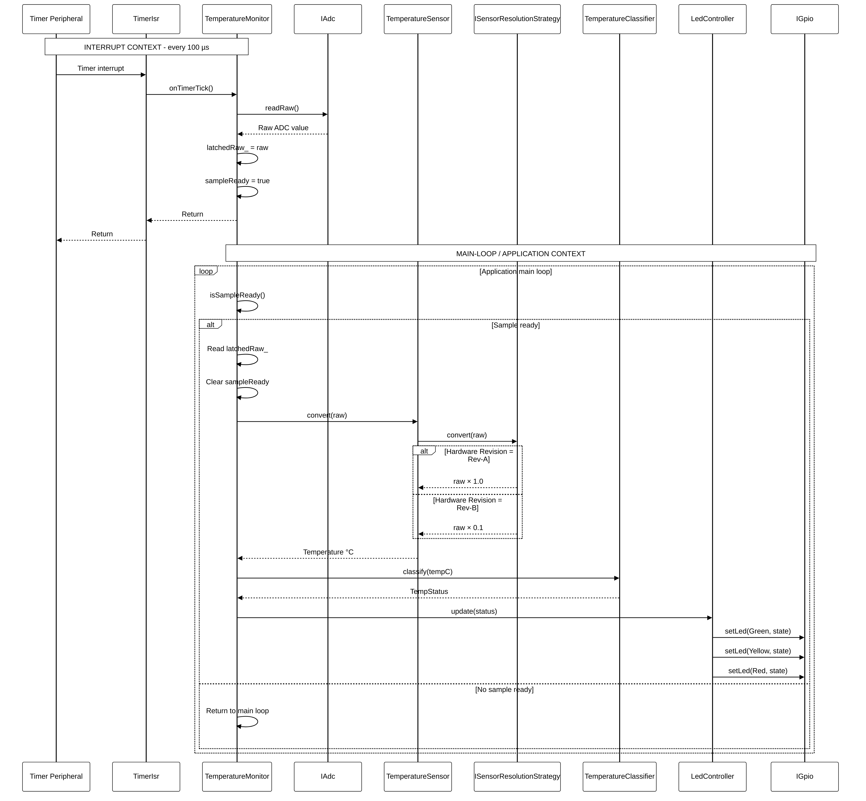
DESIGN 2/2
Architecture, At a Glance — Software (C vs C++)
C static
C dynamic
C++ static (UML)
C++ dynamic (UML)
Same deferred-processing pattern in both languages: a minimal-work ISR latches the raw value; conversion, classification, and LED update happen in the main loop.

Slide 14
DESIGN
Key Design Decisions
Minimal-work ISR: the 100µs interrupt only latches the raw ADC value and sets a flag — no float math, no I/O — so the interrupt has constant, predictable execution time
Deferred processing: conversion, classification, and LED updates happen in the main loop, outside interrupt context, right after the flag is set
Strategy pattern for sensor resolution: Rev-A/Rev-B is a swappable object (C++) or a simple selector (C), chosen once from EEPROM at startup — not an if/else sprinkled through the code
Hardware abstraction + dependency injection: IAdc / IGpio / IEeprom interfaces mean the exact same application logic runs against mocks on a PC or real peripherals on target

Slide 15
DESIGN RATIONALE
Why Keep the ISR Minimal?
100µs period = a 10 kHz sampling event — whatever runs in the ISR runs 10,000 times a second
A short, constant-time ISR reduces interrupt execution time and timing variability
Avoiding long operations (float math, I/O, EEPROM access) in interrupt context protects the real-time sampling path
Deferred processing makes the split between “time-critical” and “application-level” work explicit in the architecture, not just a comment in the code
This also makes the design easier to reason about and verify — the ISR has exactly one job, so it's easy to review and easy to test

Slide 16
RESULTS — C
The C Implementation
Plain, procedural C11 — structs and free functions, no function pointers or opaque handles
adc.h / gpio.h / eeprom.h / temp_sensor.h / led_controller.h / isr.h / config.h, each mocked for the PC demo
main.c drives a synthetic temperature ramp through both hardware revisions (with their own EEPROM serial numbers) and prints the resulting LED state
Builds with gcc -std=c11 -Wall -Wextra -Wpedantic — zero warnings
temp_monitor_demo — actual console output
$ make && ./temp_monitor_demo
=== Hardware Revision: Rev-A (1 degC/digit) | Serial: ABC1234 ===
[GPIO] LED GREEN -> ON
[OK (low-normal)] raw=20 temp= 20.0C status=OK
[GPIO] LED YELLOW -> ON
[WARNING (>=85C)] raw=90 temp= 90.0C status=WARNING
[GPIO] LED RED -> ON
[CRITICAL (>=105C)] raw=110 temp=110.0C status=CRITICAL
[CRITICAL (<5C, cold)] raw=2 temp= 2.0C status=CRITICAL
[back to OK] raw=25 temp= 25.0C status=OK
=== Hardware Revision: Rev-B (0.1 degC/digit) | Serial: XYZ9876 ===
[OK] raw=200 temp=20.0C ... same sequence, x0.1 scale

Slide 17
RESULTS — C++
The C++ / OOP Implementation
C++17, interfaces + dependency injection: IAdc, IGpio, IEeprom, ISensorResolutionStrategy
TemperatureSensor, TemperatureClassifier, LedController, TemperatureMonitor (orchestrator)
RevAResolutionStrategy / RevBResolutionStrategy implement the Strategy pattern for the two hardware revisions
TimerIsr provides a C-linkage trampoline, standing in for a real interrupt vector table entry
Builds with g++ -std=c++17 -Wall -Wextra -Wpedantic — zero warnings, both via Makefile and CMake
temp_monitor_cpp_demo — actual console output
$ make && ./temp_monitor_cpp_demo
=== Hardware Revision: Rev-A (1 degC/digit) | Serial: ABC1234 ===
[GPIO] LED GREEN -> ON
[OK (low-normal)] raw=20 temp= 20.0C status=OK
[GPIO] LED YELLOW -> ON
[WARNING (>=85C)] raw=90 temp= 90.0C status=WARNING
[GPIO] LED RED -> ON
[CRITICAL (>=105C)] raw=110 temp=110.0C status=CRITICAL
[CRITICAL (<5C, cold)] raw=2 temp= 2.0C status=CRITICAL
[back to OK] raw=25 temp= 25.0C status=OK
Identical behavior to the C demo, incl. Rev-B — same
demo points, different implementation paradigm.

Slide 18
TESTING
How I Verified It
Every requirement (SYS/HW/TEMP/LED/SW/ERR-x) has at least one test case tied to it in docs/TEST_PLAN.md
Both C and C++ have a self-contained test suite — no external framework to install, just `make test`
Covers: revision conversion scaling, all three threshold boundaries, exactly-one-LED-lit invariant, EEPROM-driven revision selection, serial round-trip, ISR presence, invalid revision / NULL pointer rejection
Also run automatically on every push via GitHub Actions (.github/workflows/ci.yml)
C — make test (11 checks)
C++ — make test (10 checks)
$ cd c && make test
[TEST 1] TC-01 Rev-A raw->Celsius (x1) ... PASS
[TEST 4] TC-04 WARNING/CRITICAL boundary at 105C ... PASS
[TEST 10] TC-11 invalid hardware revision rejected ... PASS
[TEST 11] TC-12 NULL sensor pointer rejected ... PASS
Passed: 11 Failed: 0 -> ALL TESTS PASSED
$ cd cpp && make test
[TEST 1] TC-01 Rev-A raw->Celsius (x1) ... PASS
[TEST 4] TC-04 WARNING/CRITICAL boundary at 105C ... PASS
[TEST 9] TC-10 ISR entry point (onTimerTick) ... PASS
[TEST 10] TC-11 invalid hardware revision rejected ... PASS
Passed: 10 Failed: 0 -> ALL TESTS PASSED

Slide 19
SCOPE & HONESTY
What the PC Demo Proves — and Doesn't
Proven on the PC demo
Still needs target hardware
Functional behavior of the whole pipeline
C and C++ produce equivalent results
Mocked hardware integration (ADC / GPIO / EEPROM)
Rev-A / Rev-B conversion correctness
Temperature classification and boundaries
LED behavior — exactly one lit at a time
ISR / application separation (the code structure itself)
Actual timer accuracy
True 100µs period on real silicon
Real interrupt jitter
ADC sampling timing
Real ISR execution time
Timing margin under real system load

Slide 20
RESULTS
Results Summary
21 / 21
0
2
7
Automated tests passing
(11 C + 10 C++)
Compiler warnings
(-Wall -Wextra -Wpedantic)
Working implementations
(C procedural, C++ OOP)
Architecture diagrams
(verified)
Both demo programs run end-to-end on a plain PC — no target hardware, no emulator
Both build clean via their documented commands (make, and CMake for C++) — verified from a fresh clone, not just on my machine
Every requirement in the task PDF is traced to a design element and at least one test case — see docs/REQUIREMENTS.md and docs/TEST_PLAN.md
All Architecture Diagrams were re-checked and verified

Slide 21
TRACEABILITY RECAP
Closing the Loop — Every Requirement Accounted For
Category | Status
System (SYS-1..5) | Done — architecture documented, C+C++ delivered, PC-mocked demo; publishing to GitHub is the one remaining step, covered on the next slide
Hardware (HW-1..5) | Done — ADC, GPIO, I2C EEPROM, timer, two revisions all represented in the abstraction layer + diagrams
Temperature & LED (TEMP-1..4, LED-1..5) | Done — Rev-A/Rev-B conversion, all three thresholds (5, 85, 105°C), exactly-one-LED invariant, all boundary-tested
Software (SW-1..8) | Done — 100µs minimal-work ISR, revision-aware conversion, EEPROM config, mocked HW, both language implementations
Error Handling (ERR-1..3) | Done — invalid hardware revision and NULL sensor pointer rejected, no silent fallback
Requirement → Architecture → Implementation → Test
Full ID-by-ID traceability table is in docs/REQUIREMENTS.md in the repo.

Slide 22
GITHUB
Repository
https://github.com/RajarajeswariMani/Temperature-Monitoring-and-Visualization-System
Public repository
Public repository — code (c/, cpp/), diagrams (docs/diagrams/), docs (README, REQUIREMENTS, TEST_PLAN), and this presentation, all in one place
Builds from a clean clone with the documented commands (make in c/ and cpp/, or CMake for C++)
GitHub Actions runs the full build + test suite on every push, so the green checkmark is live proof it still works
Link shared with you ≥ 24h ahead of this interview, per the task's own requirement

Slide 23
CLOSING
Key Engineering Takeaways
1
Keep the 100µs ISR minimal and deterministic
One HAL read, two variable writes — nothing else runs in interrupt context.
2
Separate real-time acquisition from application processing
The sample-ready flag is the explicit hand-off point between the two.
3
Abstract hardware so the application can run on a PC
IAdc / IGpio / IEeprom (and their C equivalents) mean no target hardware is required to demonstrate or test the logic.
4
Keep revision-specific conversion isolated
Strategy pattern (C++) / single conversion function (C) instead of Rev-A/Rev-B conditionals spread through the code.
5
Implement the functional baseline in C first, then re-architect in C++
Same behavior, two paradigms — makes the OOP benefits concrete rather than theoretical.
6
Verify behavior through explicit requirements and tests
Every requirement ID traces to a design element and at least one automated or reviewed test case.

Slide 24
Thank You
Happy to walk through any part of the code, diagrams, or test results in detail.

