Slide 1
CS661 Project
Global YouTube Stats Dashboard
Dr. Soumya Dutta
Dept. of CSE, IIT Kanpur
Armeet Luthra 200185
Rajarshi Dutta 200762
Sourit Saha 200998
Ritam Jana 200798
Ojsi Goel 200653
Project Members:
Sushmita 201027
Yash Goel 201142
Jatin Chauhan 200469
Ishaan Maheshwari 200454

Slide 2
Contents
Introduction
Dataset Description
Libraries Used
Experiments
Country & channel-based overview
Category-based plots
Distribution analysis
Correlation analysis
Annual channel-based trend analysis
Region-based statistics
Dashboard Overview
Conclusion

Slide 3
introduction
Project Focus: Analyze YouTube's trending video data to understand video popularity and viewer engagement.
Techniques Applied: Data preprocessing, statistical analysis, and graphs and charts plotting, using Python and its libraries.
Output: Development of an interactive dashboard with Dash and Plotly, providing insights into factors driving video success.
Objective:
Identify patterns and trends in viewer engagement with trending YouTube videos.
Explore how video category, publish time, and content type influence popularity.
Ensure data integrity through rigorous data processing techniques for meaningful analysis.
Significance: Offers valuable insights for content creators, marketers, sociologists, and platform developers about the dynamics of online video content and aids in strategic decision-making.

Slide 4
Dataset description
Dataset Source: Kaggle
About: Global YouTube Statistics 2023
Collection Method: compiled from various reputable sources, ensuring accuracy and reliability of the information
Features Included: subscribers, uploads, views, country of origin, published date, earnings, channel type etc.
Coverage: Includes data from 50 countries
Link to Dataset: Dataset Link

Slide 5
Libraries used
Plotly Express
High-level data visualization tool within the Plotly ecosystem.
Used for: Creating interactive and static charts such as trend lines, bar charts, and scatter plots.
Benefits: Simplifies complex data visualization, offers dynamic updating, and integrates seamlessly with Dash.
Dash-Bootstrap Components
Library providing Bootstrap components for Dash.
Used for: Styling and laying out the dashboard effectively, making it responsive and visually appealing.
Benefits: Eases dashboard styling, enhances UI without extensive CSS/HTML knowledge, ensures modern look and feel.
Dash
Web application framework designed for data analysis apps in Python.
Used for: Building the interactive web-based dashboard that displays visualizations.
Benefits: Allows for real-time data updates without deep web development skills; enhances interactivity and user engagement.
Key Contributions
Integration of advanced visualization and web technologies to create an accessible, interactive online tool.
Facilitates the deployment of complex analytics into user-friendly interfaces, broadening accessibility to non-technical audiences.

Slide 6
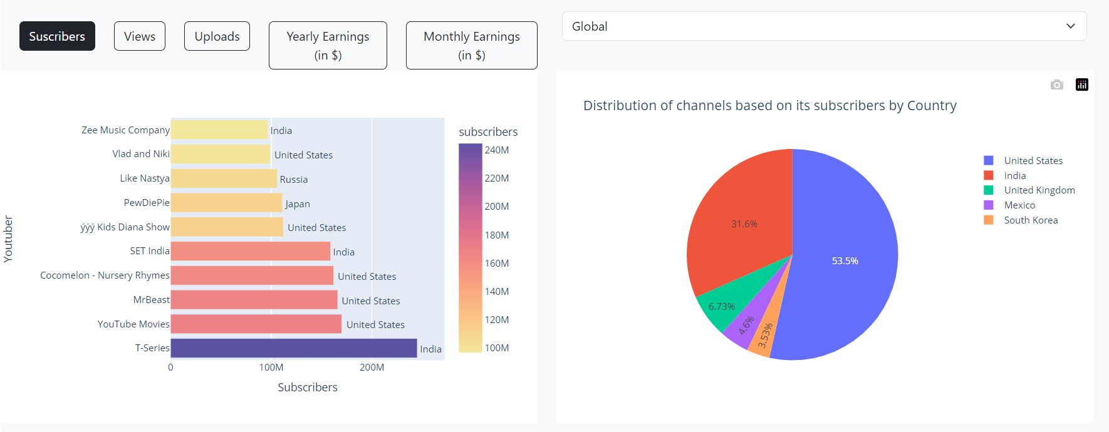
experiments
Channel & Country-based overview
Nature of Plots used: Bar Chart and Pie Chart

Slide 7
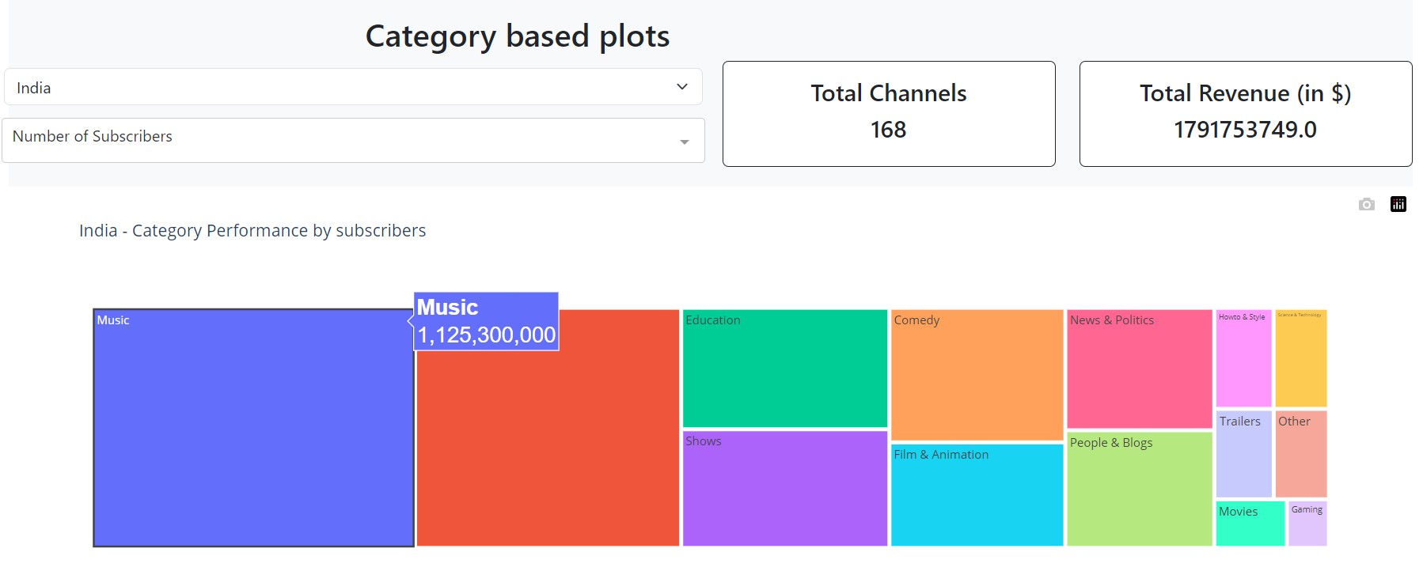
experiments
Category-based plots
Nature of Plots used: TreeMap Plot

Slide 8
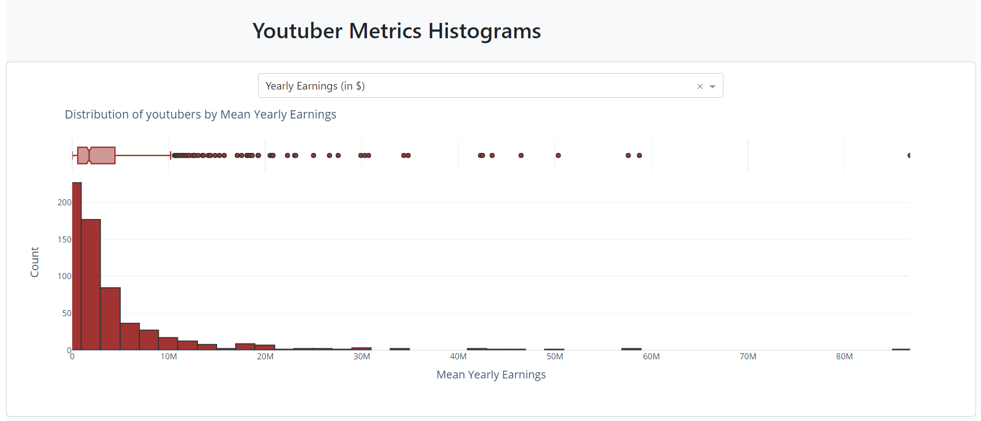
experiments
Distribution analysis
Nature of Plots used: Histogram

Slide 9
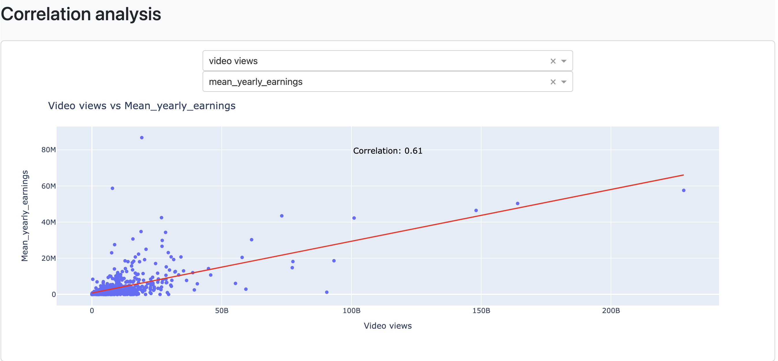
experiments
Correlation analysis
Nature of Plots used: Scatter Plot

Slide 10
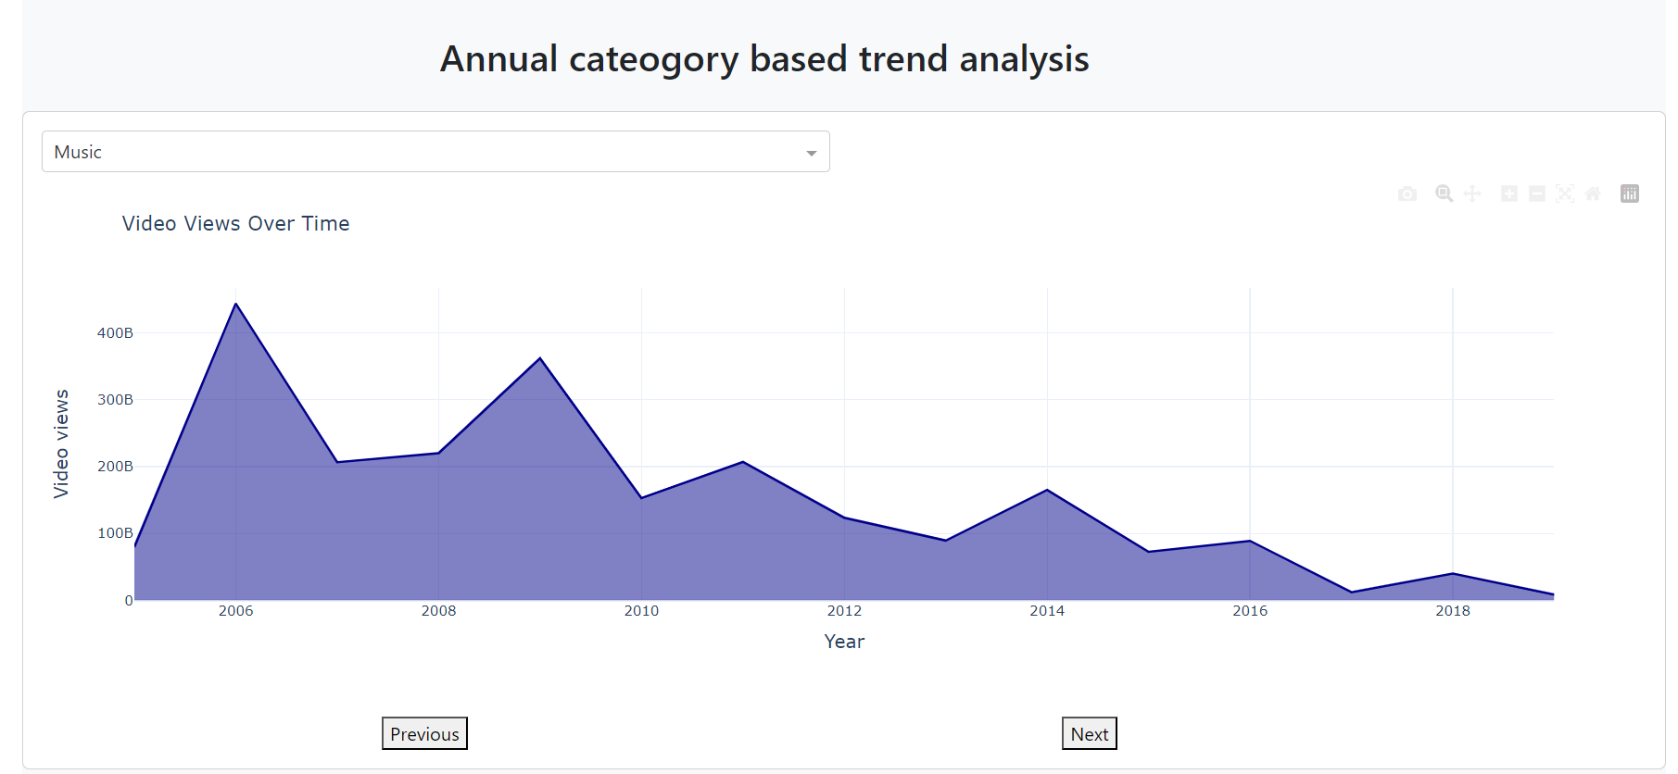
experiments
Annual trend analysis
Nature of Plots used: Line Chart

Slide 11
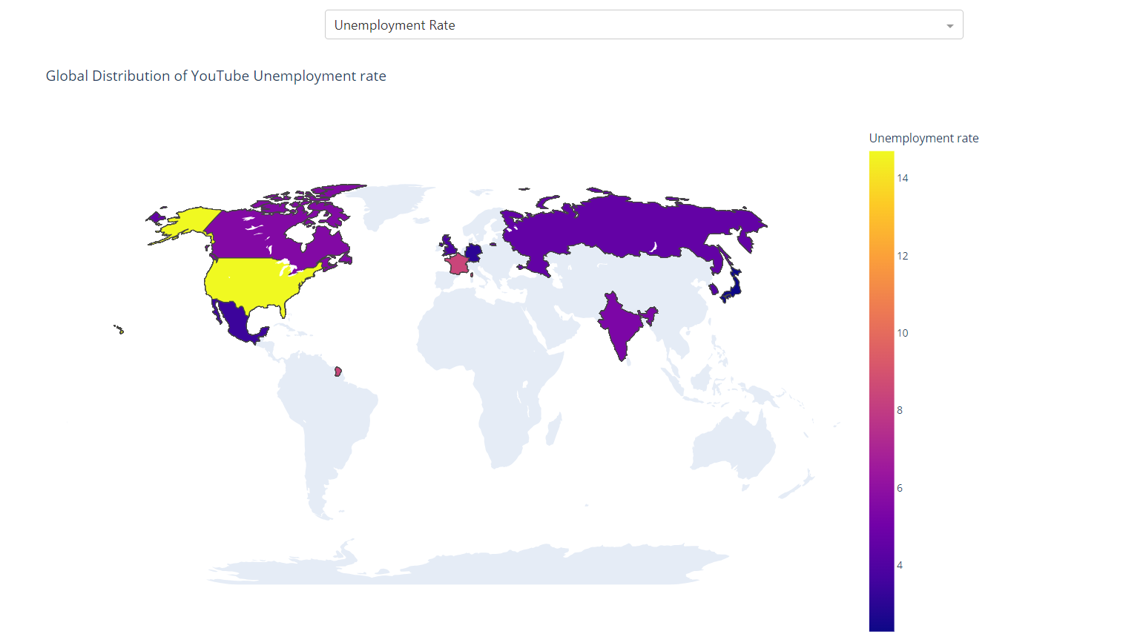
experiments
Region-based statistics
Global Distribution of Unemployment Rate
Nature of Plots used: Global Visualisation

Slide 12
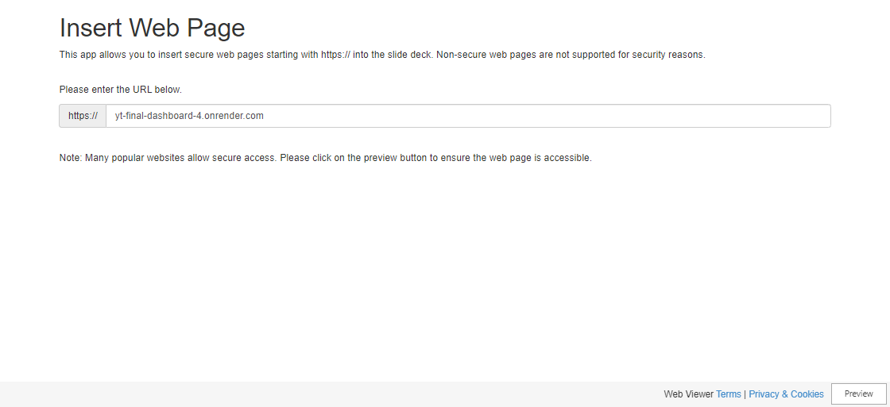
Dashboard overview​
Link to the Dashboard: https://yt-final-dashboard-4.onrender.com

Slide 13
conclusion
Successful Analysis: The project effectively utilized statistical analysis to explore YouTube’s trending video data, revealing key patterns in viewer engagement and video popularity.
Interactive Dashboard: Developed an interactive dashboard using Dash and plotly, which serves as a powerful tool for visualizing the dynamics behind video success on YouTube.
Insightful Findings:
Identified significant trends and patterns in trending YouTube videos across different regions and channel types.
Demonstrated the impact of factors such as video category, publish time, and content type on a video’s popularity.
Value to Stakeholders:
Provided valuable insights for content creators and marketers to strategize effectively.
Offered a useful resource for sociologists and platform developers interested in digital culture and user behavior.

Slide 14
Work distribution
Task | Member(s)
Project Ideation | Everyone
Data Preprocessing | Rajarshi, Armeet, Ojsi
Channel & country based analysis plots | Sourit, Ishaan
Category-based plots | Rajarshi
Distribution analysis and related plots | Armeet
Annual channel-based trend analysis and plots | Yash, Jatin
Correlation analysis and related plots | Armeet, Sourit
Region-based statistics and related plots | Ojsi, Sushmita
Front end: Dashboard UI | Ritam
Web deployment | Rajarshi

Slide 15
THANK YOU
GitHub Repository: Rajarshi1001/CS661_Project

