Slide 1



Sir M. Visvesvaraya Institute of Technology
Department of ICBT
Agentic AI Integration for Process Automation in MSMEs
Team Members
Khalipe Chinmay Mahesh 1MV23IC024
Rajarshi Karforma 1MV23IC044
Team Mentors
Dr. Savita Choudhary
Dept. of ICBT

Slide 2
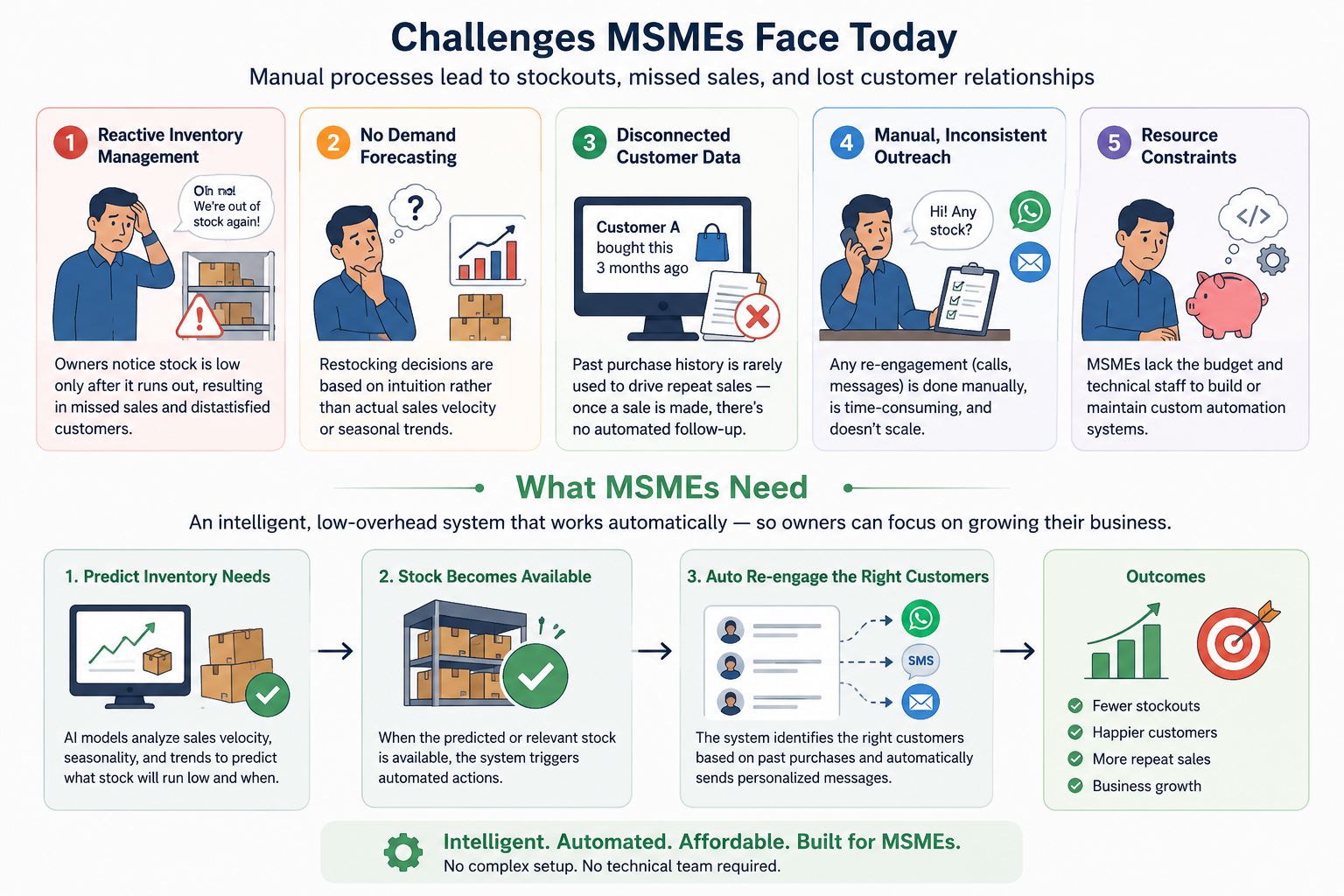
Problem Statement

Slide 3
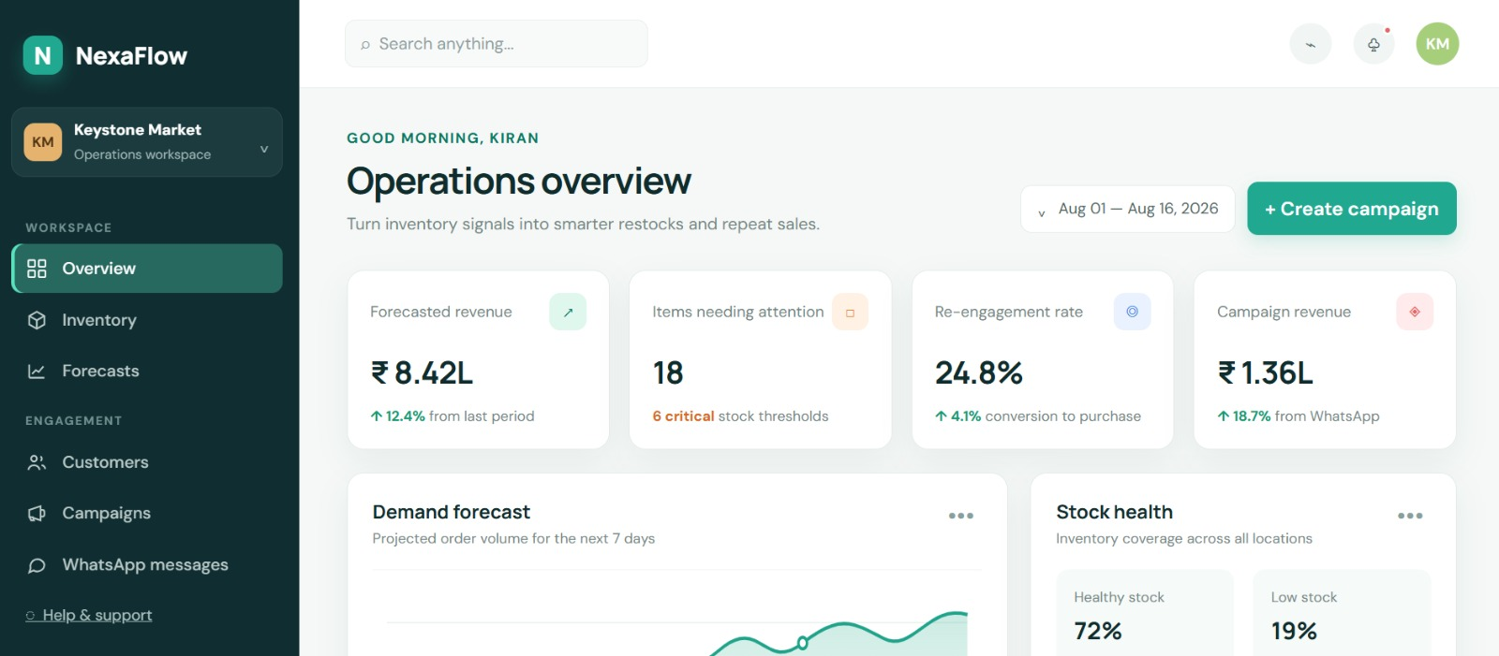
Frontend Illustration-Overview
Sir MVIT, MSME Idea Hackathon 6.0

Slide 4
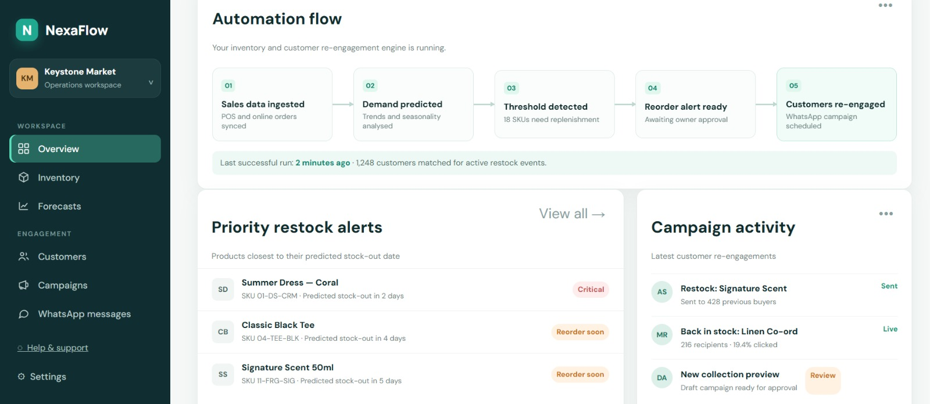
Frontend Illustration-Automation Flow
Sir MVIT, MSME Idea Hackathon 6.0

Slide 5
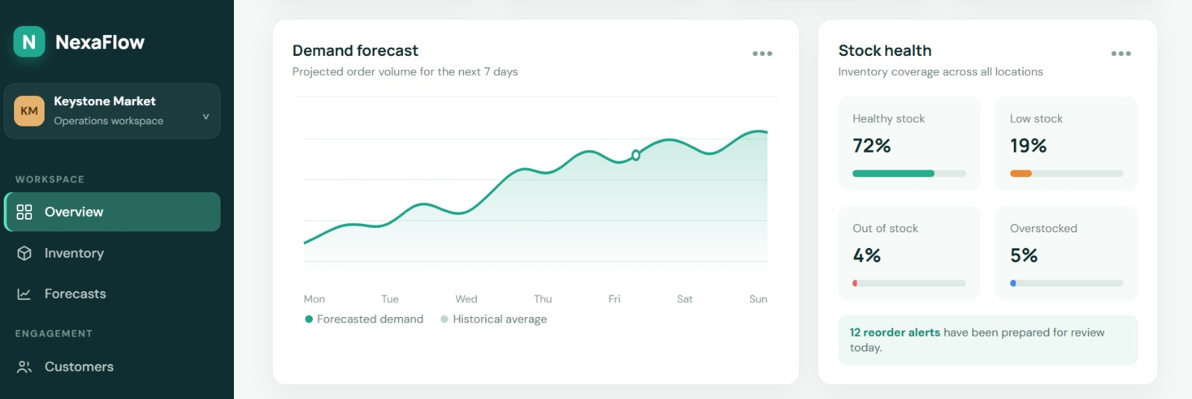
Frontend Illustration-Demand Forecast
Sir MVIT, MSME Idea Hackathon 6.0

Slide 6
Aim and Objectives
Design an Agentic AI core capable of processing sales, POS, and seasonal data for demand forecasting.
Develop a predictive inventory module that forecasts stock depletion per SKU and alerts the owner before stockouts occur.
Develop a customer re-engagement module that matches restocked/newly launched products to relevant past buyers.
Automate personalized customer outreach via WhatsApp notifications triggered by restock events.
Integrate both modules under a shared data engine so inventory intelligence directly drives customer retention actions.
Reduce manual workload in stock monitoring and customer follow-up by a measurable margin (target: 50–70%, consistent with literature benchmarks).

Slide 7
Proposed Solution/Innovation
Build the Sales & Customer Data Engine to centralize transaction and customer data as the single source of truth for both modules.
Implement the Demand Forecasting Engine using historical sales velocity and seasonal patterns to compute per-SKU depletion predictions.
Implement threshold-based alerting logic that notifies the business owner ahead of stockouts rather than after.
Build the Customer–Product Matching logic to link restocked SKUs back to customers who previously purchased the same or related products.
Integrate a WhatsApp Notification Engine to auto-generate and send personalized re-engagement messages triggered by restock/new-launch events.
Connect both modules so that inventory events (restocks) automatically cascade into customer engagement actions without manual triggering.

Slide 8
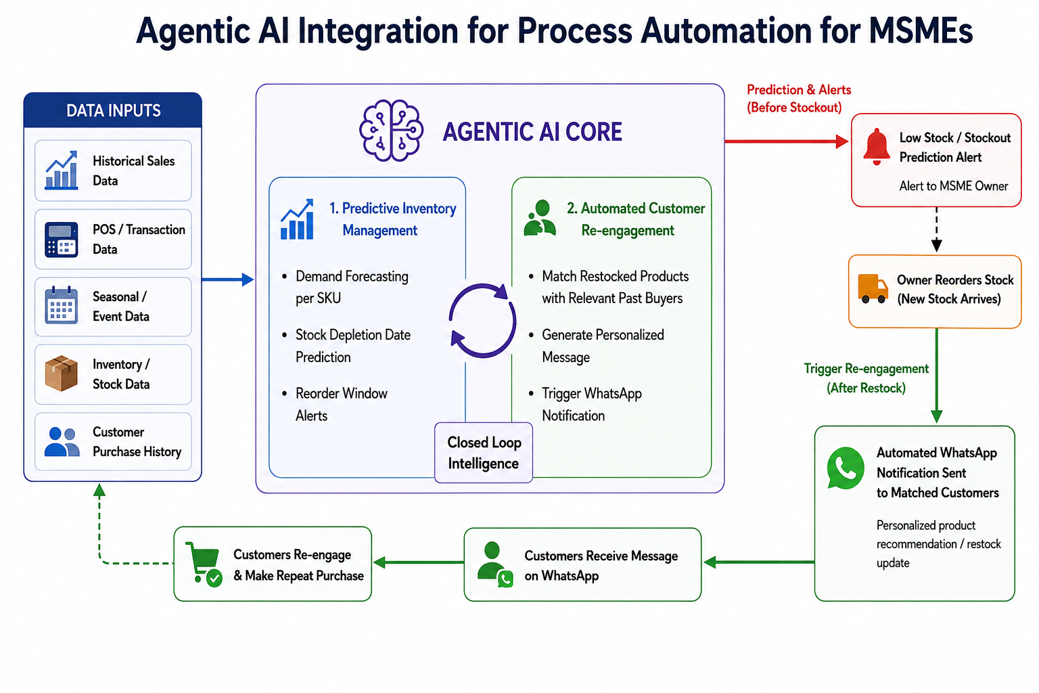
Working Methodology/Diagram

Slide 9
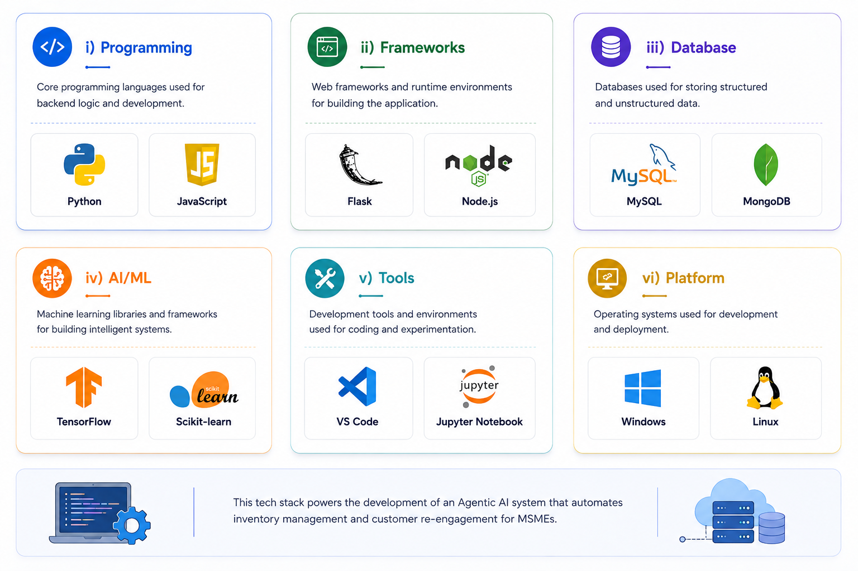
Technical Details
Sir MVIT, MSME Idea Hackathon 6.0

Slide 10
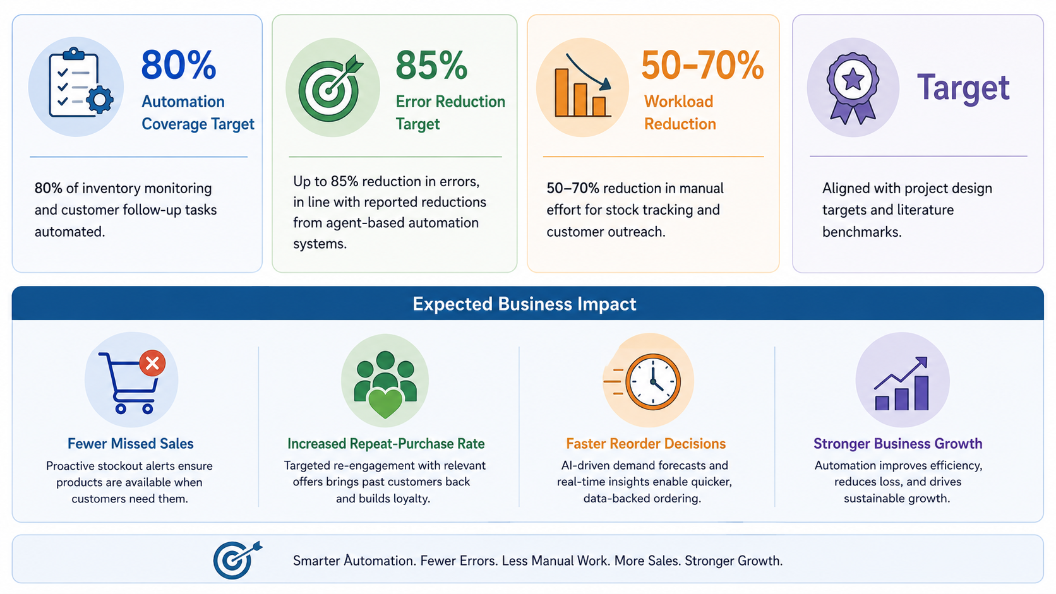
Expected Outcomes and Impact

Slide 11
Estimated Budget/Cost
# | Budget Head | Description | Estimated Cost (Rs.)
1 | Manpower & Development Team | Stipend for 2 developers across the 6-month build phase (backend, Agentic AI core, frontend) | Rs. 5,00,000
2 | Cloud Infrastructure & Hosting | AWS/GCP servers, database (PostgreSQL/MySQL), storage & backups | Rs. 1,50,000
3 | AI / LLM API Costs | Agentic AI core inference for demand forecasting & decision logic | Rs. 2,00,000
4 | WhatsApp Business API Integration | Messaging credits, API setup & automated notification engine | Rs. 1,20,000
5 | Software Tools & Licenses | Dev/testing tools, monitoring, version control, cloud dashboards | Rs. 80,000
6 | Pilot Deployment with MSME Partners | Onboarding 3-5 MSMEs, real-world data collection & field testing | Rs. 1,50,000
7 | Hardware & Equipment | Testing devices, connectivity & peripherals | Rs. 60,000
8 | Marketing, Onboarding & Documentation | User manuals, demo videos & outreach material | Rs. 70,000
9 | Contingency (10%) | Buffer for unforeseen expenses | Rs. 1,20,000
 | Total Estimated Cost | Within the Rs. 15,00,000 sanctioned MSME grant | Rs. 14,50,000

Slide 12
Future Scope and Scalability
The current prototype targets a single MSME vertical for demand forecasting and customer re-engagement. Its modular, cloud-native architecture is built to extend well beyond this first use case:
Multi-Industry Expansion: Extend the Agentic AI core to other MSME sectors - apparel, electronics, pharmacy and home services - by retraining forecasting models on sector-specific data.
Multi-Channel Outreach: Add SMS, email and voice-call automation alongside WhatsApp so customer engagement adapts to each business's preferred channel.
ERP / POS Integrations: Build native connectors for popular platforms such as Tally, Zoho and Vyapar for plug-and-play onboarding of existing MSMEs.
Dynamic Pricing & Supplier Automation: Extend the agentic core to recommend demand-based pricing and auto-trigger supplier reorders, closing the loop from forecast to fulfilment.
Regional Language Support: Localise the WhatsApp messaging and owner dashboard into regional languages to widen accessibility across India.
SaaS Monetization & Scale-up: Package the platform as a tiered subscription (by SKU volume/customer base) and partner with MSME associations for large-scale, cluster-wide rollout.
Sir MVIT, MSME Idea Hackathon 6.0

Slide 13


