Slide 1
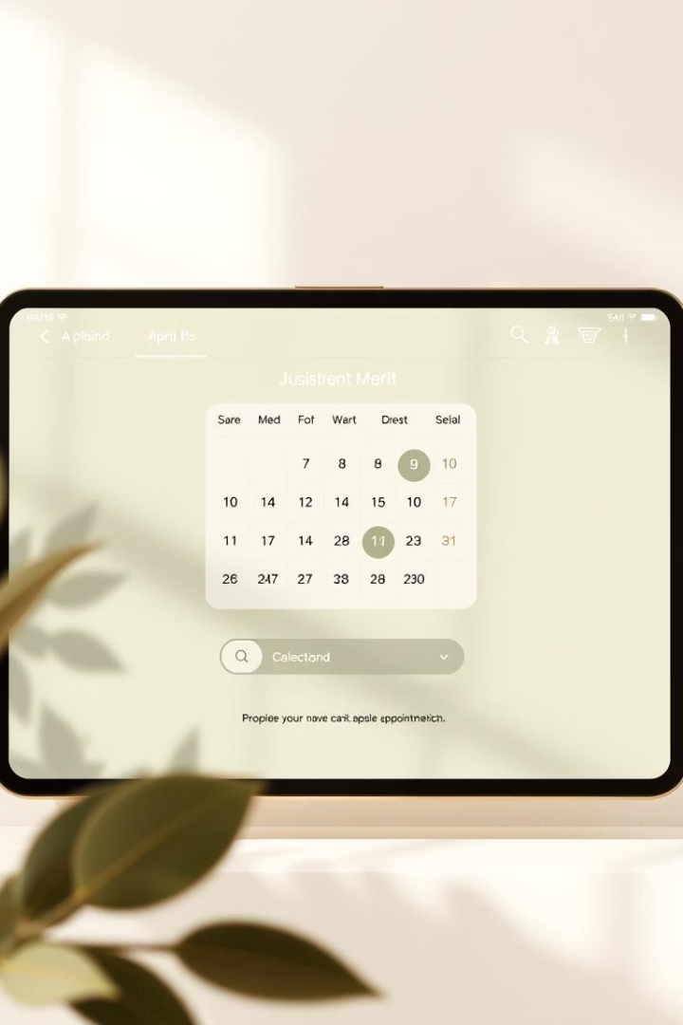
Medical Appointment Booking System
This Java-based console application streamlines the medical appointment process by enabling patients to book appointments and admins to manage doctors. Leveraging advanced Java features such as object-oriented programming (OOP), annotations, reflection, and custom exception handling, the system focuses on core Java principles without involving file handling. It highlights how Java’s powerful abstractions and mechanisms can be used to build secure, robust applications with clear separation of roles and responsibilities.

Slide 2

Core Features of the System
User Roles
Appointment Management
A structured design with an abstract User class supporting Patient, Doctor, and Admin subclasses enables role-specific behavior while promoting code reuse and extensibility.
Patients can book from available doctors, and appointments are tracked until marked as completed, after which the doctor’s availability is restored.
Security and Error Handling
Admin functions are protected by custom annotations accessed via reflection, and robust error detection uses a custom InvalidAppointmentException to handle edge cases gracefully.

Slide 3
Detailed Project Structure
User Hierarchy
Appointment and Validation
Abstract User with ID and name fields and abstract showProfile method
Appointment class pairs Patient and Doctor, manages status changes, and controls doctor availability
Doctor subclass tracks availability with overridden profile display
Custom InvalidAppointmentException ensures booking errors, such as unavailability or invalid indices, are caught
Patient subclass provides personalized profile implementation
Security annotation @Security enforces admin-only methods using reflection at runtime
Admin subclass secured by @Security annotation for privileged actions
Appointment System orchestrates overall logic including registration, booking, completion, and display

Slide 4

System Utilities and Supporting Components
Custom Annotations
Reflection API Usage
The @Security annotation is defined with runtime retention, enabling dynamic access control based on user role during execution.
Reflection inspects class annotations at runtime, allowing Admin functions to verify permissions dynamically, enhancing security without static checks.
Exception Handling
InvalidAppointmentException captures scenarios like absent doctors or invalid appointment states, improving user experience with specific feedback.

Slide 5
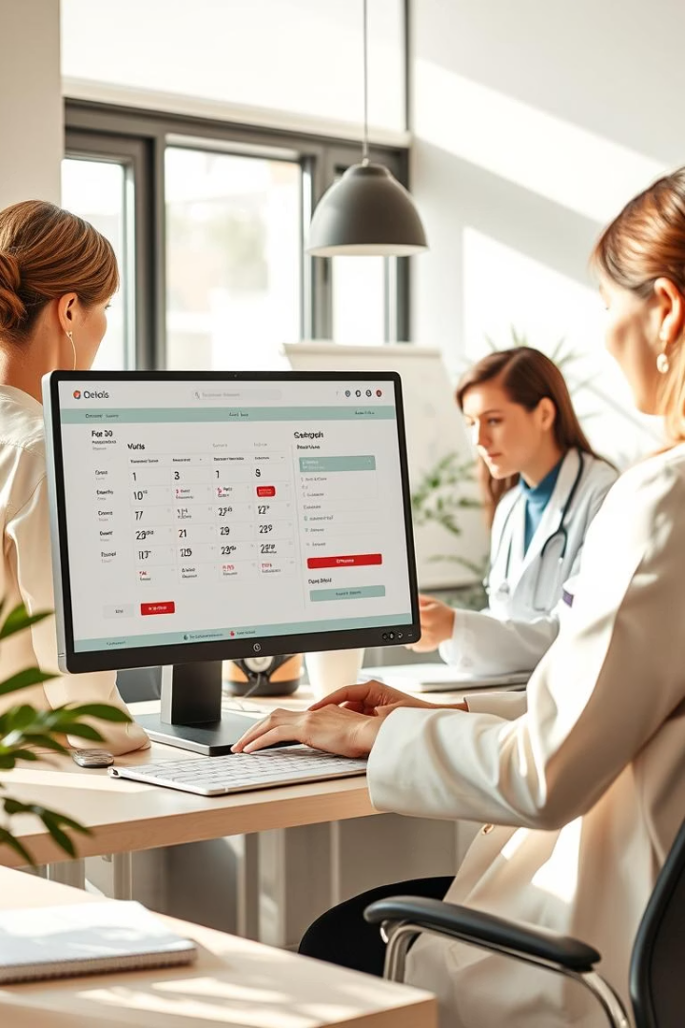




Real-World Use Cases
Patient Registration
New patients sign up and create profiles, enabling personalized appointment booking and management.
Appointment Scheduling
Patients select available doctors and book appointments securely, with the system managing real-time doctor availability.
Admin Doctor Management
Admins use privileged functions to add or remove doctors, enforcing role-based permissions via security annotations and reflection.
Appointment Completion and Tracking
Completed appointments release doctors for new bookings, and the system maintains comprehensive tracking for transparency and auditability.

Slide 6
Future Plans and Enhancements
Implement GUI
Database Integration
Extended Roles and Permissions
Notification System
Develop a graphical user interface to improve usability beyond the console, facilitating easier navigation and interaction.
Add persistent storage to handle data beyond runtime, enabling data recovery, scalability, and multi-user environments.
Integrate automated notifications via email or SMS to remind patients of appointments or alert admins to key system events.
Introduce more granular user roles, enhanced security policies, and possibly multi-factor authentication for increased protection.

