Slide 1
Pariksha
Group - 12

Slide 2
Introduction
Pariksha is a web application which can run on the browser be it desktop or a smartphone.
This web application is made using Angular in the frontend and the server is made using the light weight Java Framework, Spring Boot. To interact with the database we have used Hibernate, and in database we have used MySQL.
Pariksha is capable of taking huge traffic at once, as the architecture is a Three – Tire Architecture.
Flow Diagram of Pariksha

Slide 3
Overview
Basically, Pariksha is a Web Application for taking an online quiz in an efficient manner and no time wasting checking the paper.
The main objective of Pariksha is to efficiently evaluate the candidate thoroughly through a fully automated system which not only saves lot of time but also gives fast results.
Students can attend Quiz according to their convenience and time and there is no need of using extra thing like paper, pen etc.

Slide 4
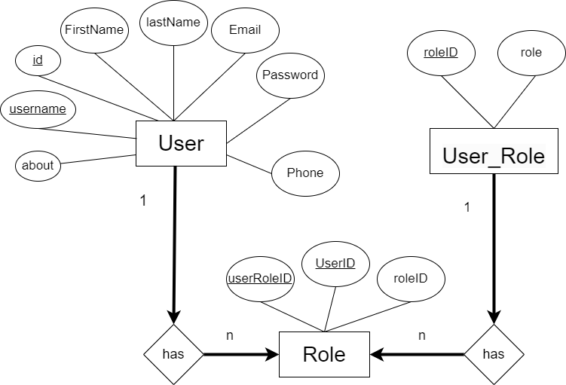
Flow Diagram of Pariksha

Slide 5
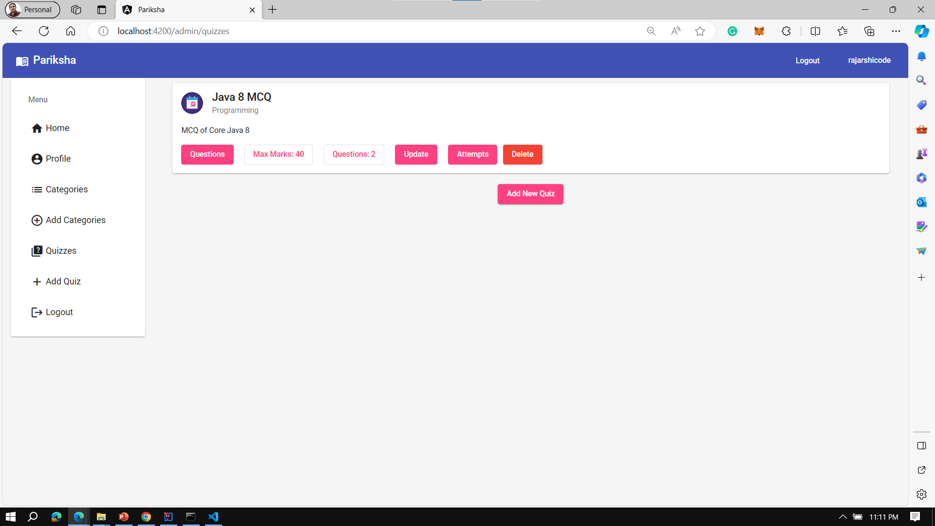
Some Snaps from Admin Panel

Slide 6
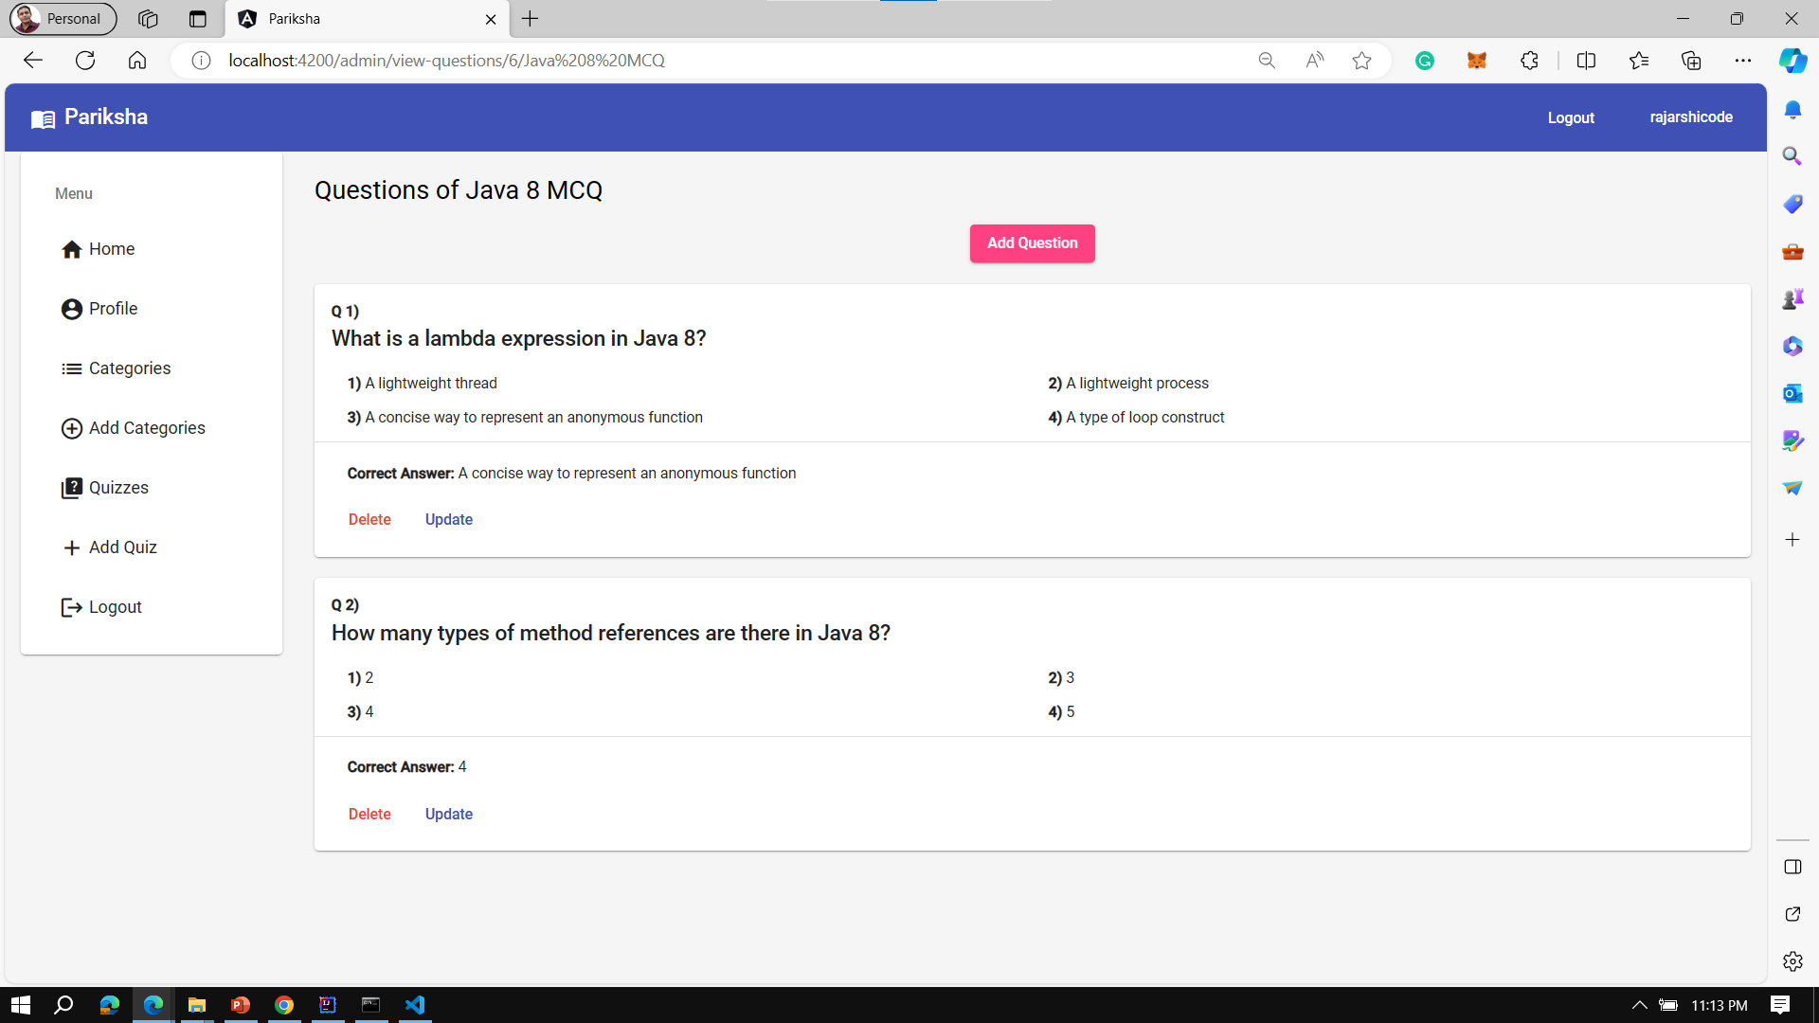
Some Snaps from Admin Panel

Slide 7
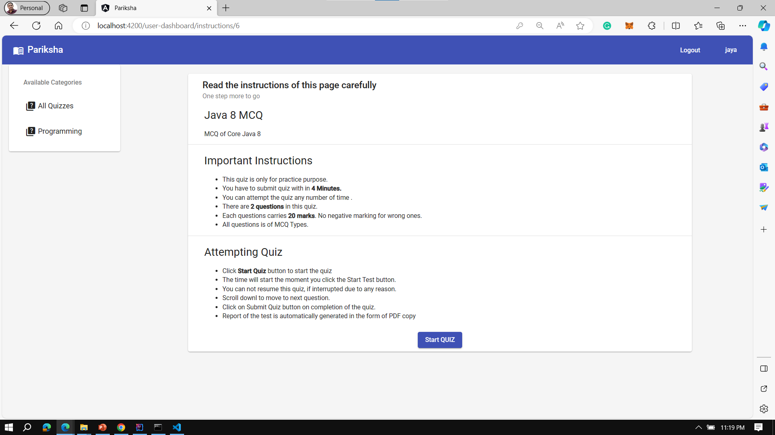
Some Snaps User Panel

Slide 8
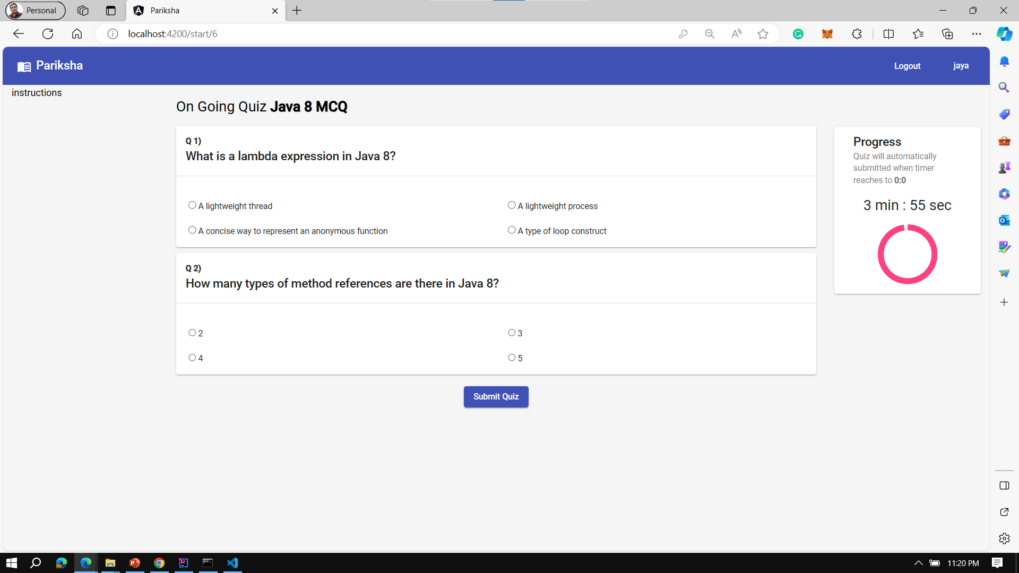
Some Snaps User Panel

Slide 9
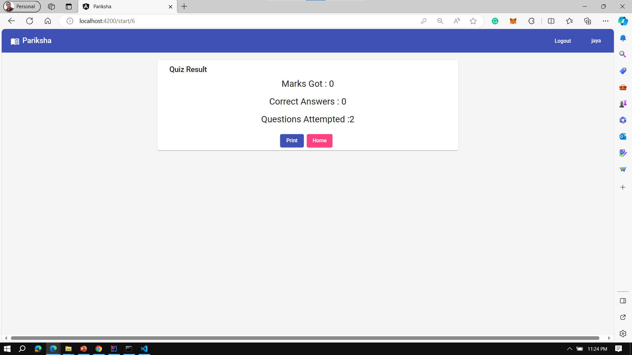
Some Snaps User Panel

Slide 10
Conclusion
Pariksha will help the teachers as well as the Students. This application serves a key role in Educational Institute to upgrade skills and foster a unique way to take assessment.

Slide 11
Thank You

