Slide 1

Uber Fare Prediction

Slide 2
About me
Background ? (B-tech or M-tech)
B.Sc IT
Why you want to learn Data Science ?
To upskill for career growth
Any work experience ?
IT Recruiter

Slide 3

Objective
Predict fare based on distance travelled

Slide 4
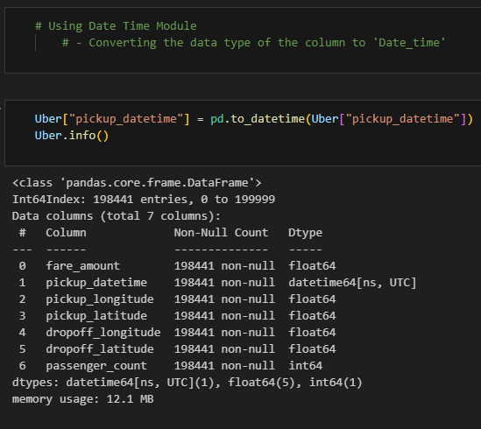
Data Cleaning & Manipulation
Type Conversion
Converting the ‘pickup_datetime’ feature from float to
Date and Time format for better analysis using
‘pd.to_datetime’ module
Subsetting
Removed all the records where passenger count is more than 6 persons
2. Base fare amount is set to a minimum of $3

Slide 5
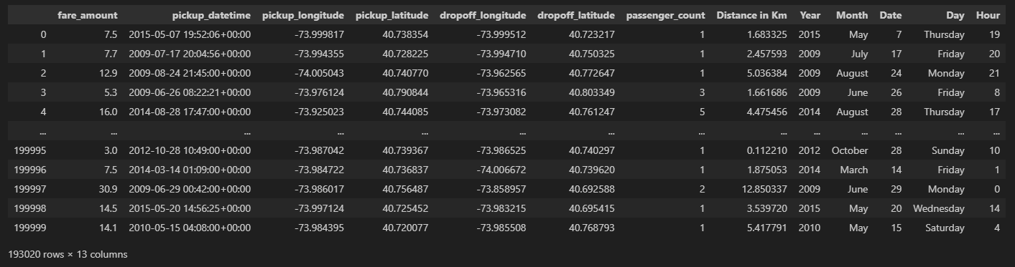
Feature Engineering
1. Calculated distance using Haversine formula
from pick up and drop off latitude and longitudes.
2. Added new features i.e, Distance, Date, Day, Month and Year from existing features.

Slide 6
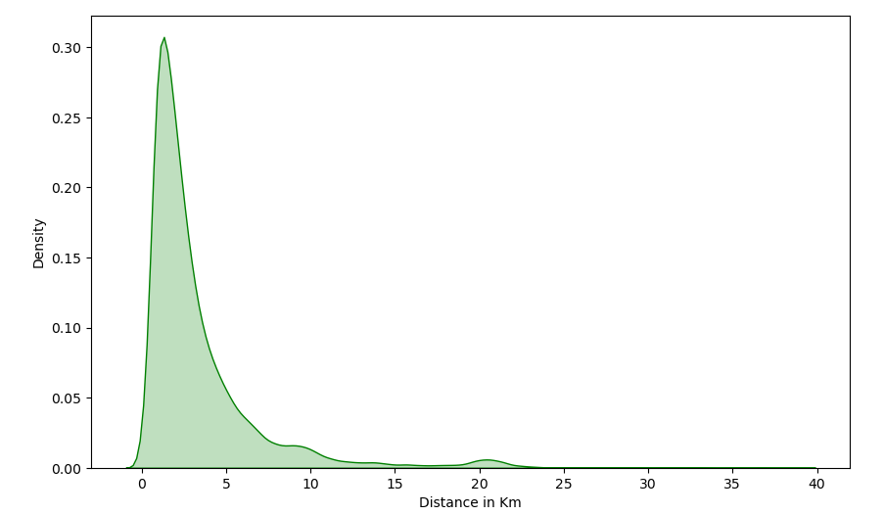
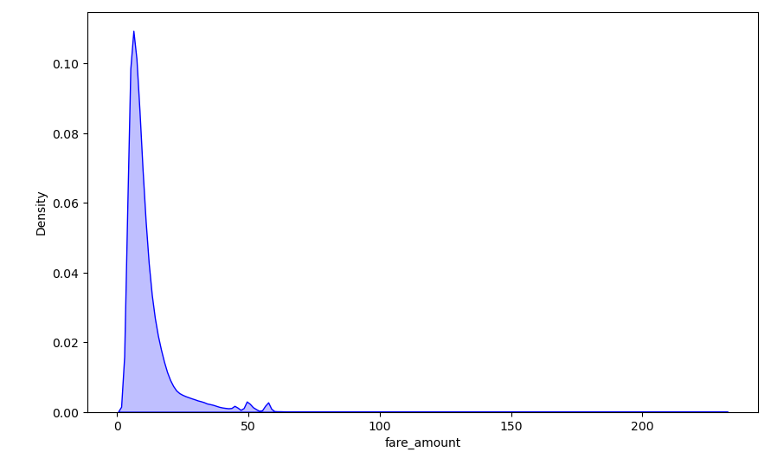
Travel Information
Average travelled distance is below 10 Kms
Average fare is between $25 to $50

Slide 7
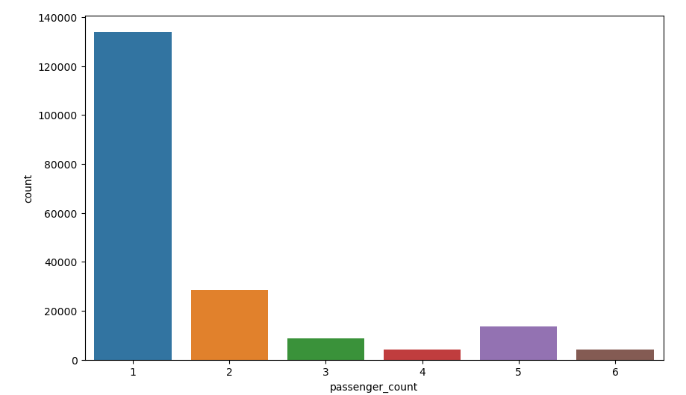
Most passengers are travelling alone

Slide 8
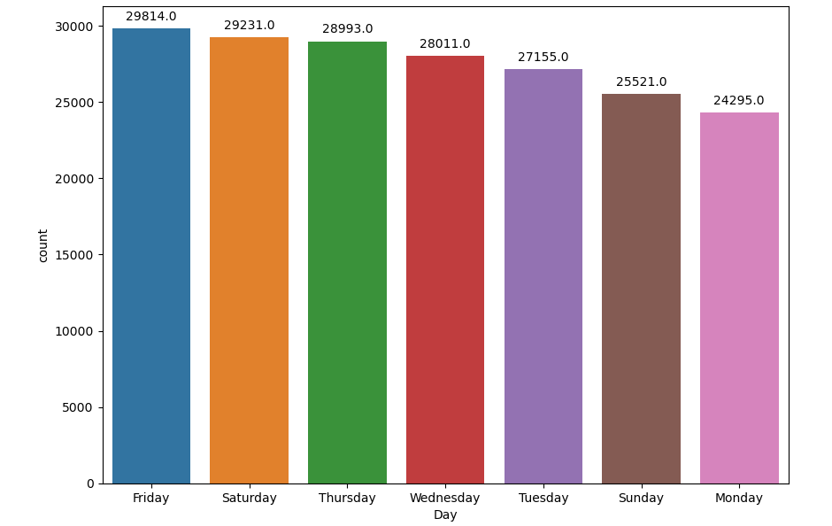
Most bookings are done on Fridays followed by Saturday and Thursday

Slide 9
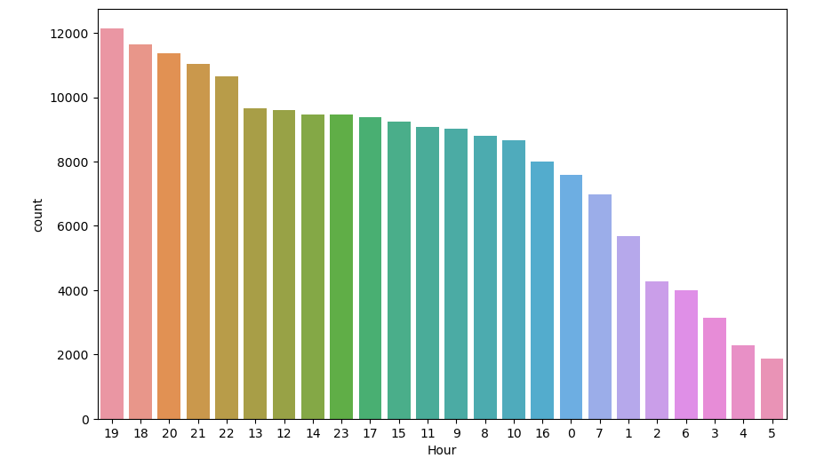

Peak hours are between 06:00 PM to 08:00 PM

Slide 10
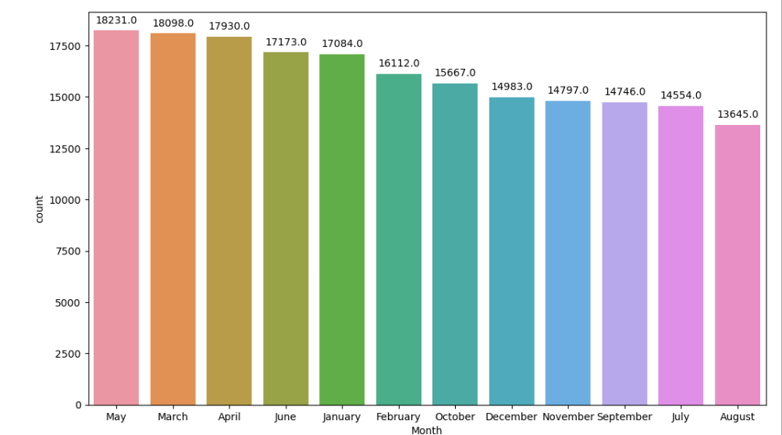
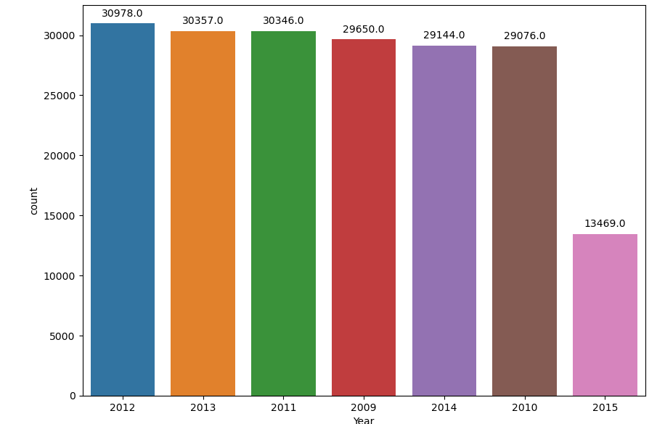
Most bookings are made in May, March and April
2012 has the highest user rate

Slide 11


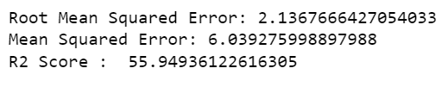


Model Building
KNN For Regression
Linear Regression
Lasso Regression
Elastic Net
Ridge Regression

Slide 12

THANK YOU

