Slide 1
Articture
Data
Together for Analysis
Data Sets
Collections of Data
Numpy & Pandas
High-Performance Data Manipulation
Web Design
Displayed on the internet
Host
Server Offering Resources

Slide 2
Tools of the Project :
Numpy - It is library for the python programing and it supports for the multpile dimension arrays and matrices along with large collection of mathematical functions to operate on these arrays.
Pandas – It aims to the fundemantal high level bulding block for doing pratical, real world data analysis in python.
Matplotlib – It is a collection of functions that make matplotlib work like MATLAB. Each pyplot function makes some change to a figure.
Sklearn – It is the most useful and robust library for machine learning in python.
Seaborn – It is an open source python library built on top of matplotlib. It is used for data visualization and exploratory data analysis.

Slide 3
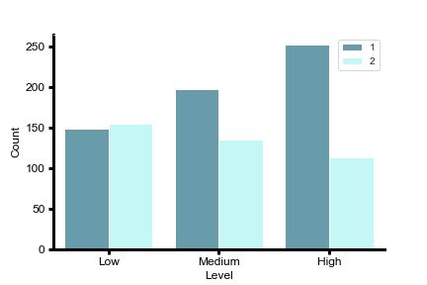
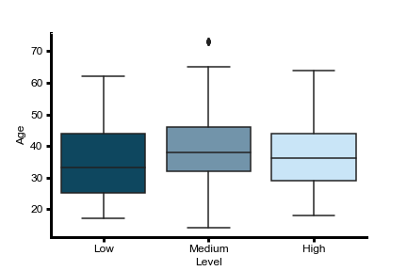
CBC test for Male and Female
Risk factors by Age

Slide 4
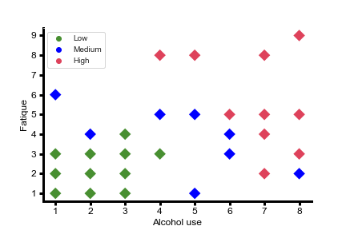
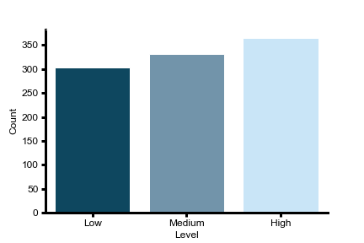
Effected by Alcohol
Ratio of Risk

Slide 5
EDA
Plotter Function
Feature Selection
Its an type survey of the cancer effected members in the specified zones. This type of survey procedure many help to effected and non-effected persons to be medicalized and to educate for precautions.

